Slide 1

Infegy Atlas

Slide 2
Get Login Info in Lab
Link to Cheerios and Kashi Go runs
  Must be logged in for link to work: Click Here
  One login shared across each lab sections
  Please log in and log out when done using

Slide 3
CHEERIOS 2025

Slide 4
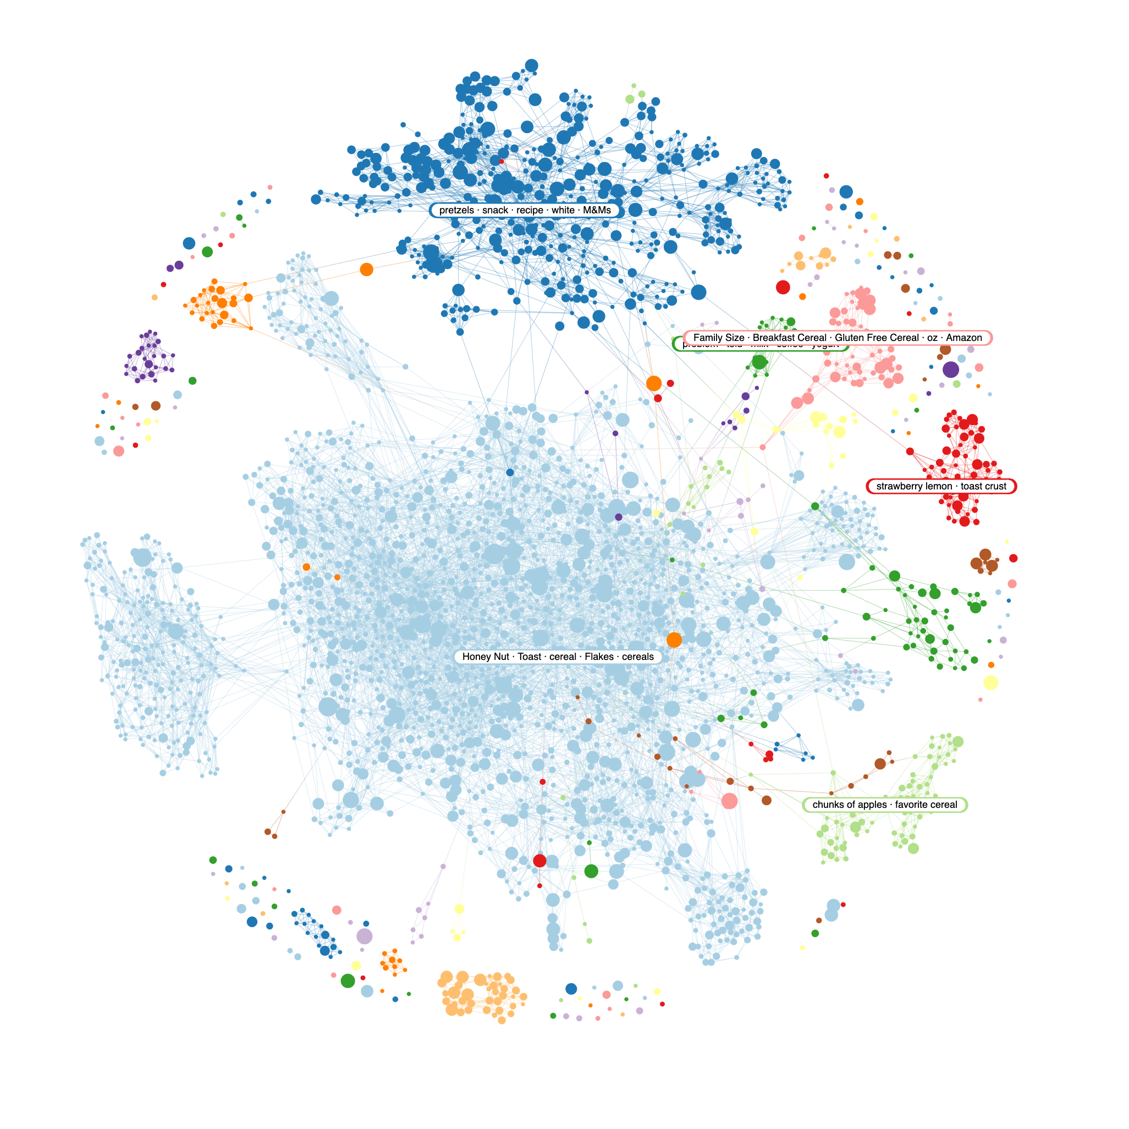

Slide 5
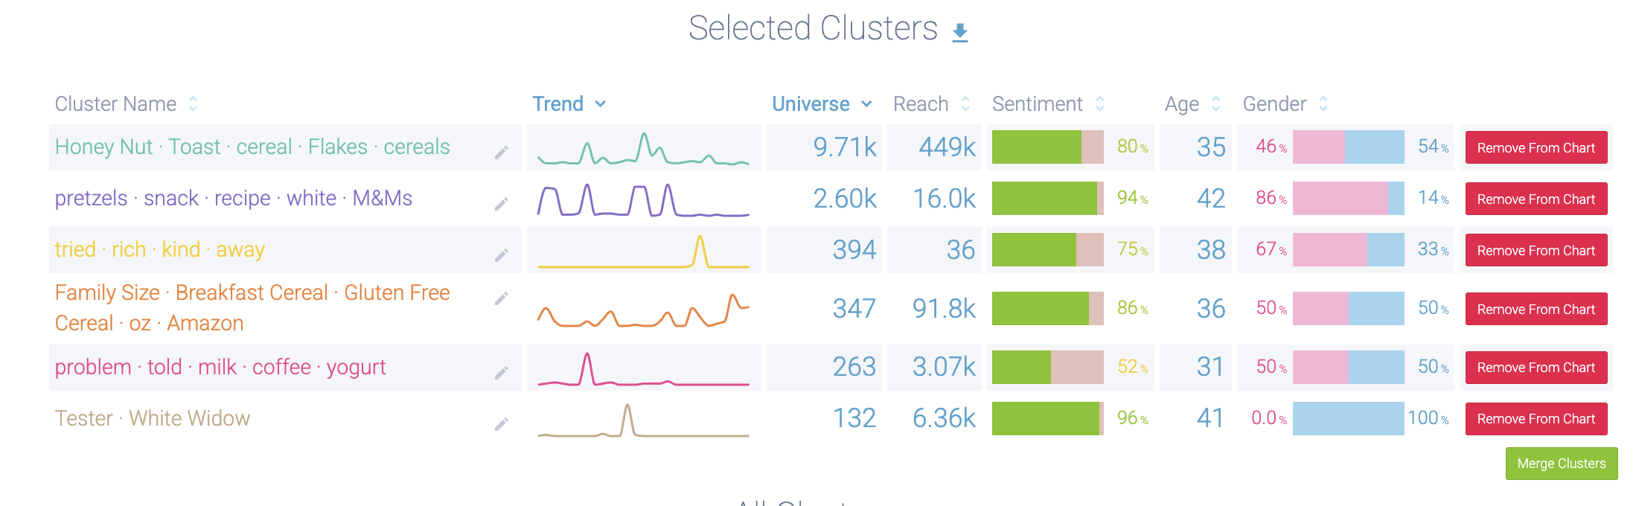
Topics/Narratives

Slide 6
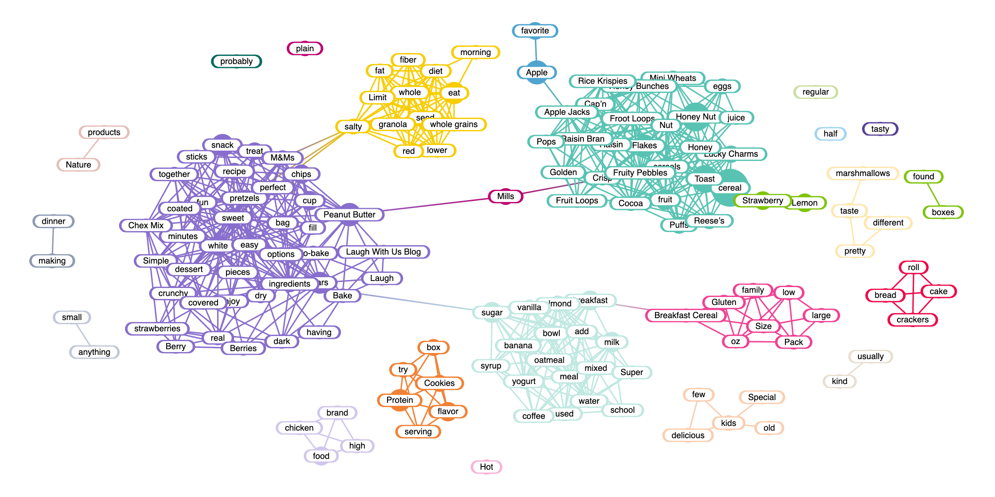
Positive Keywords

Slide 7
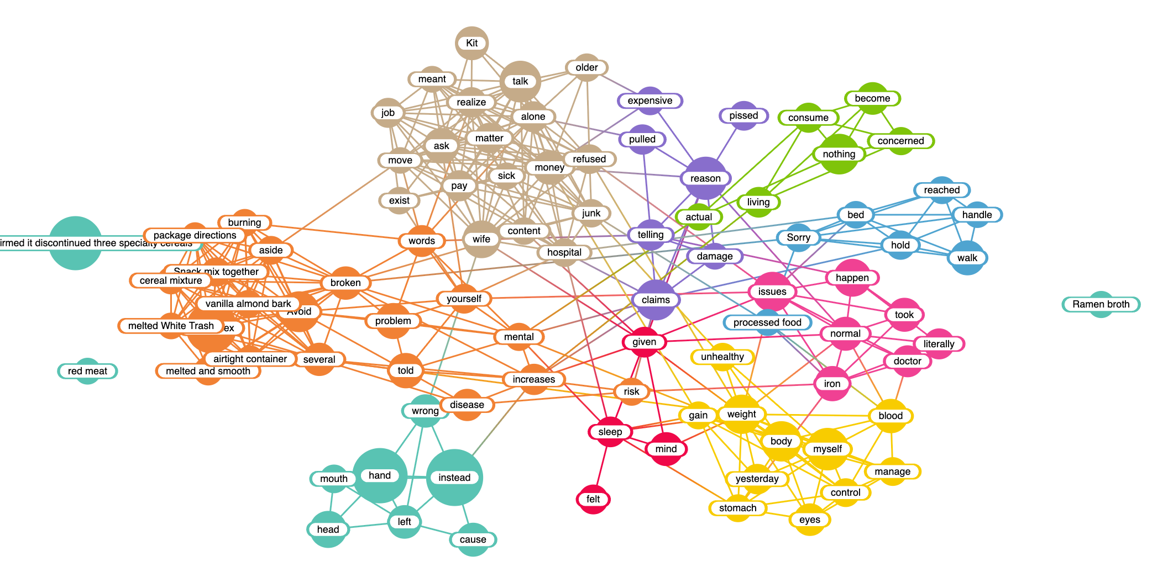
Negative Keywords

Slide 8
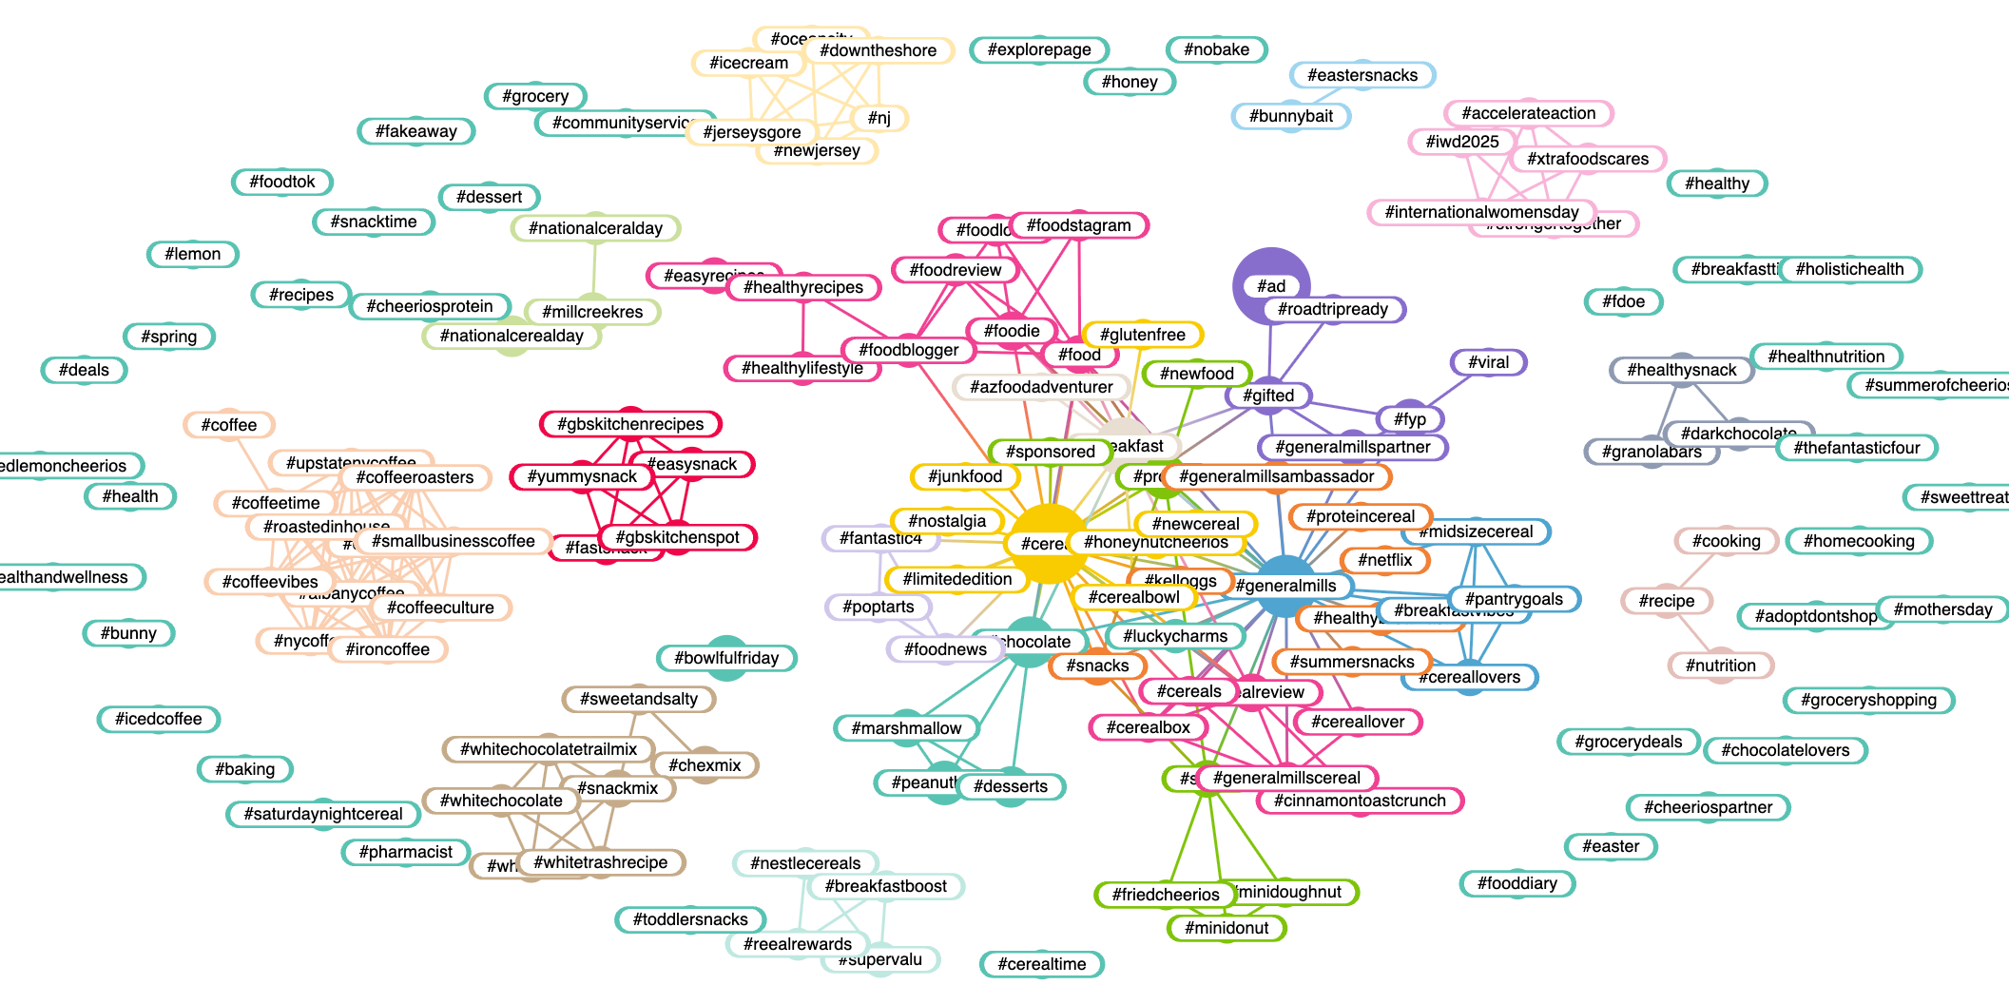
Hashtags

Slide 9
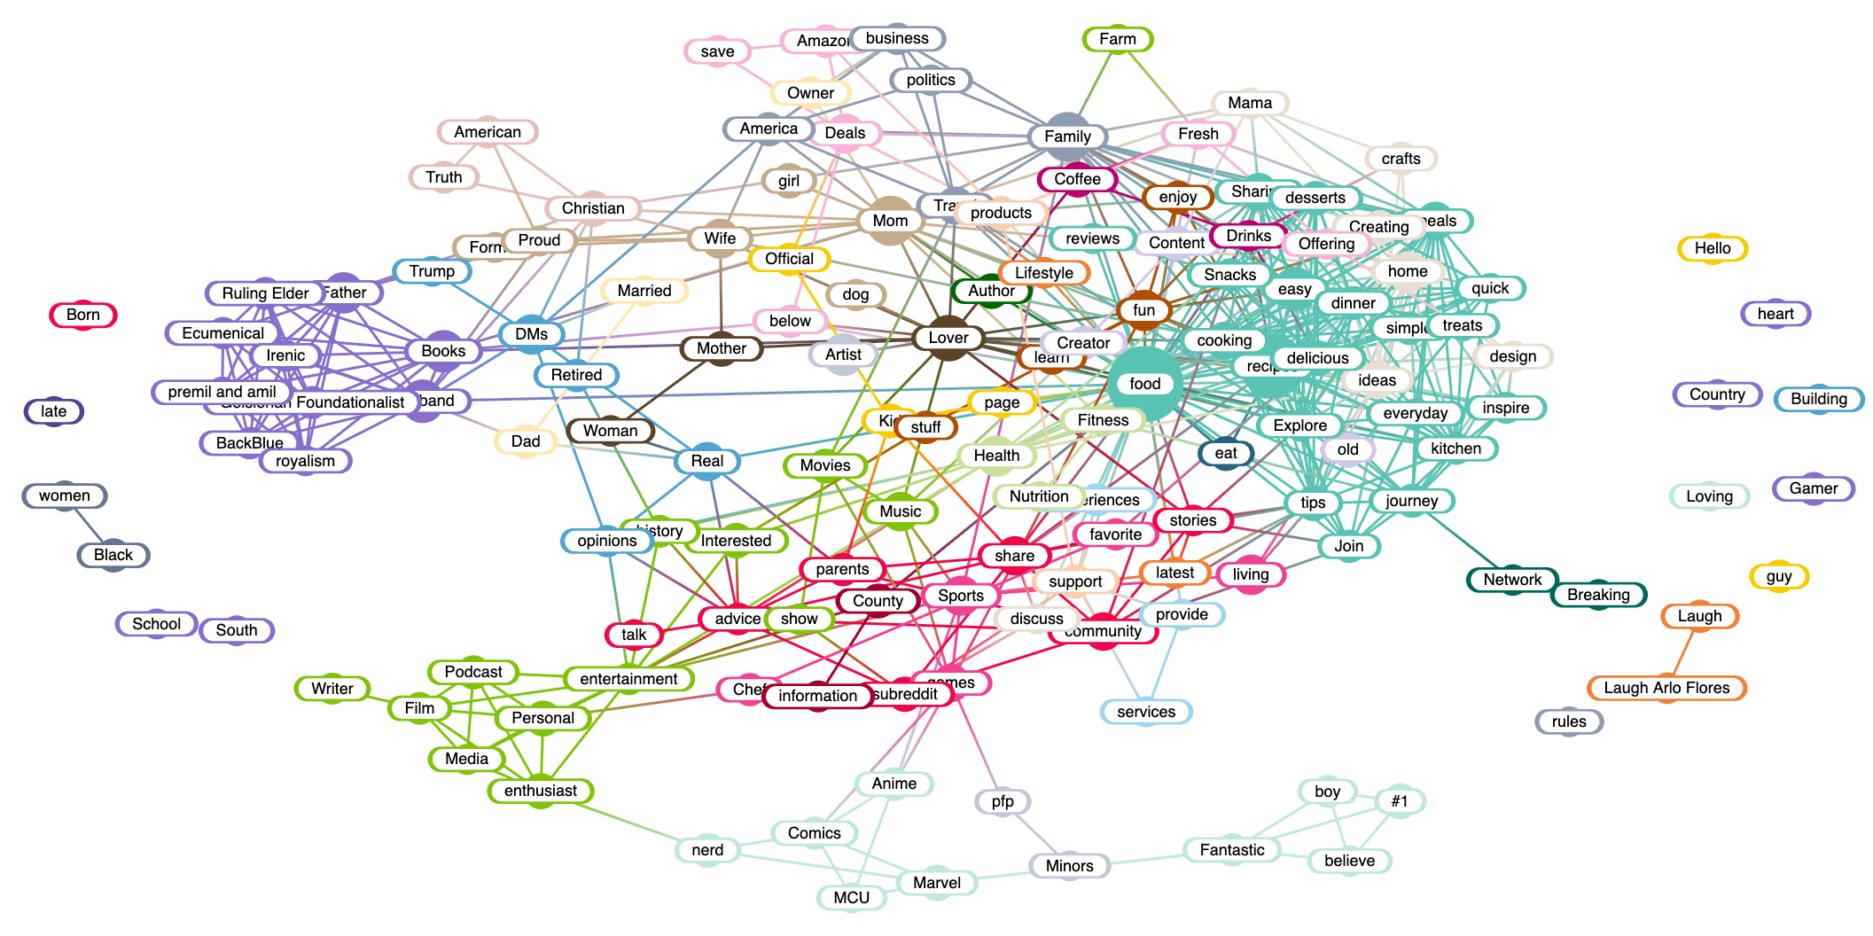
Bios/Target

Slide 10
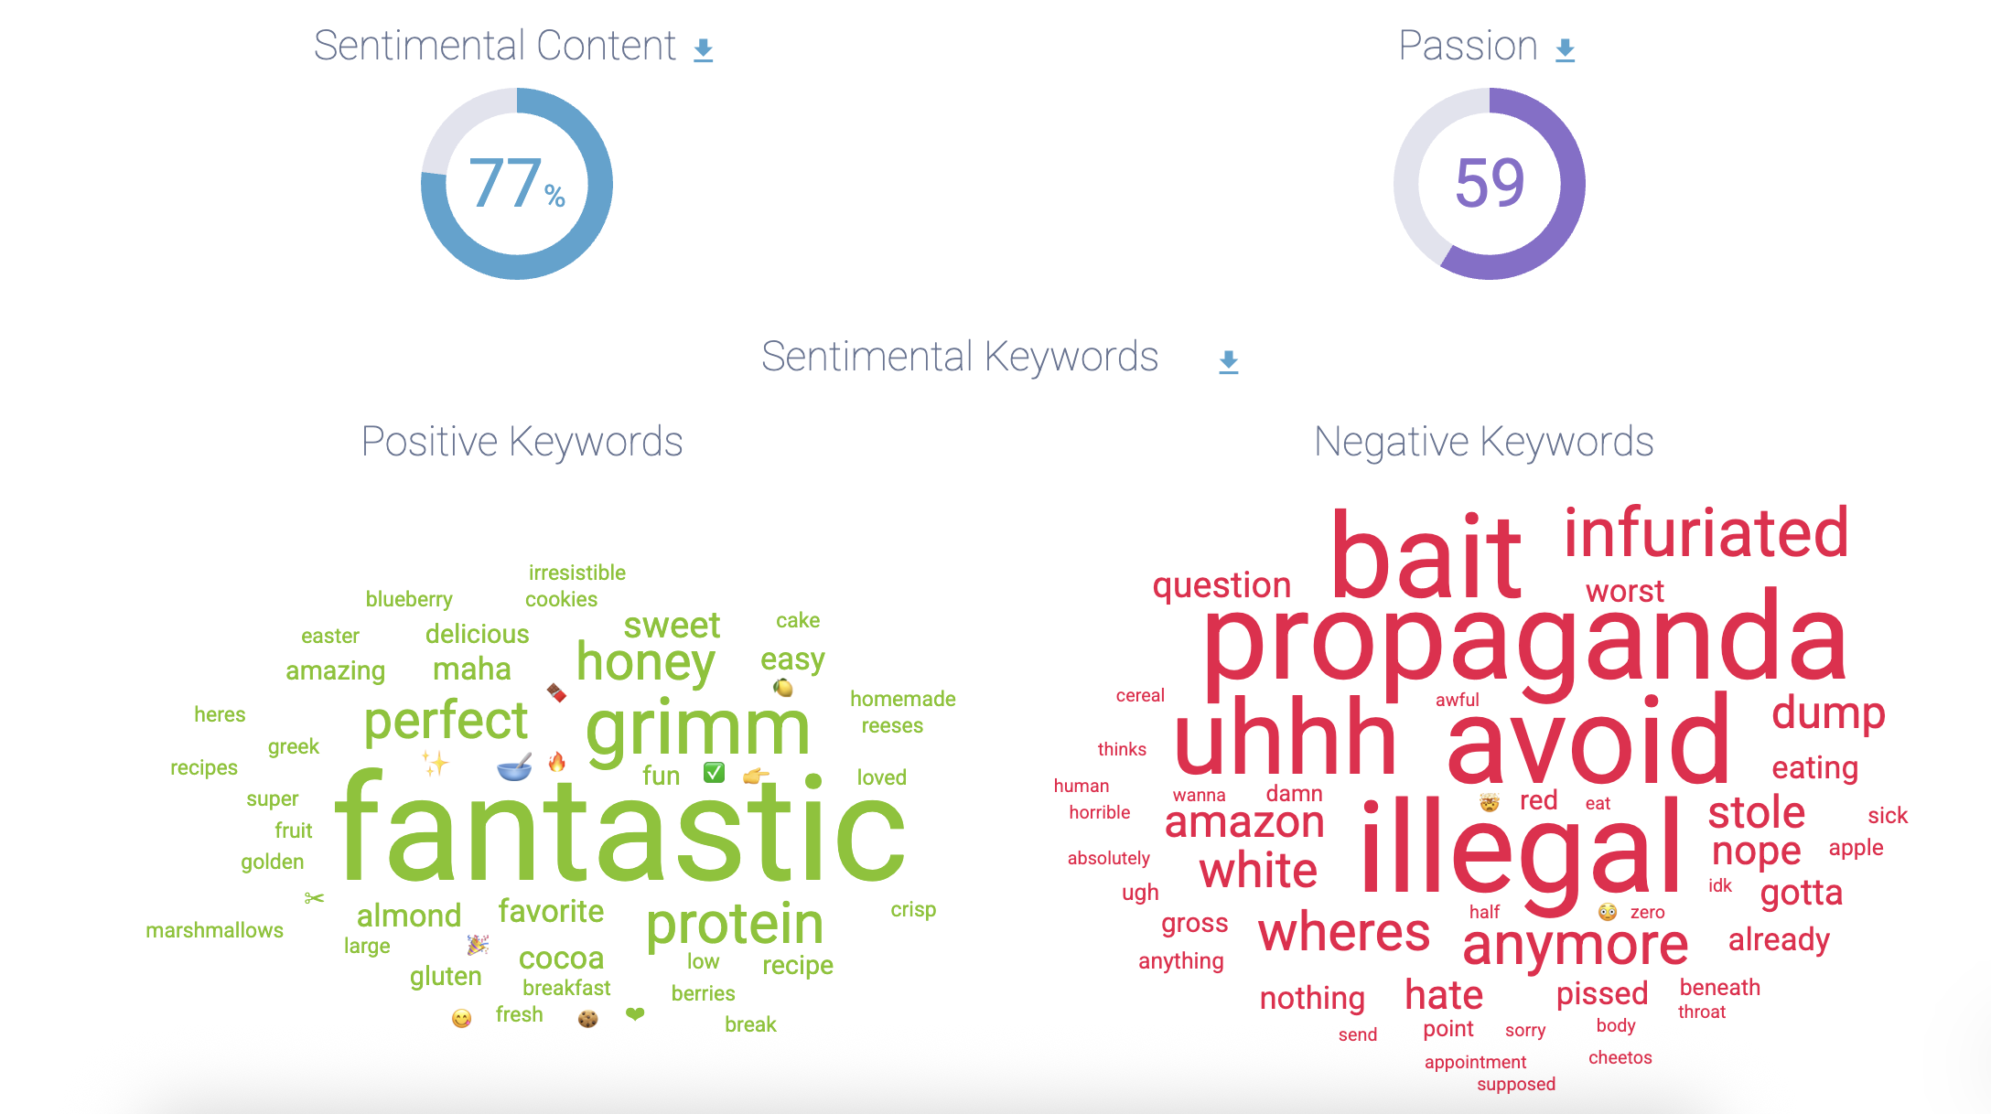
Sentiment

Slide 11
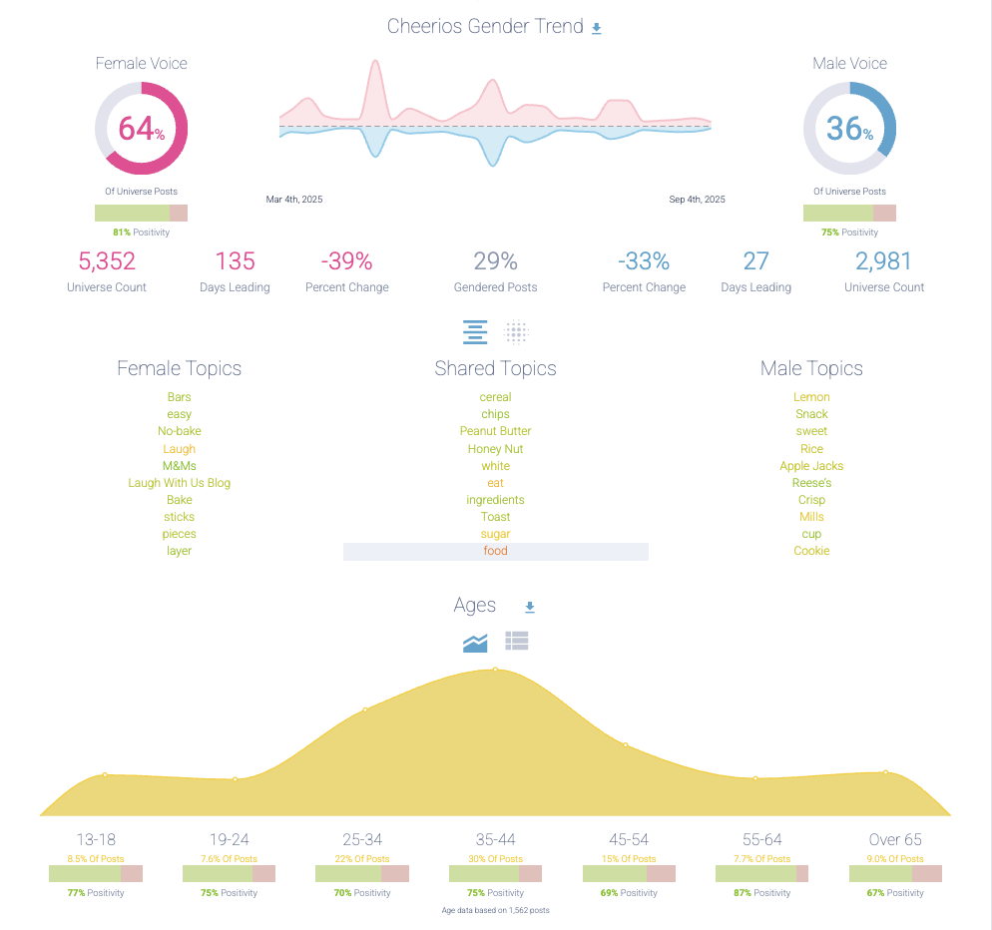
Gender/Age Profile

Slide 12
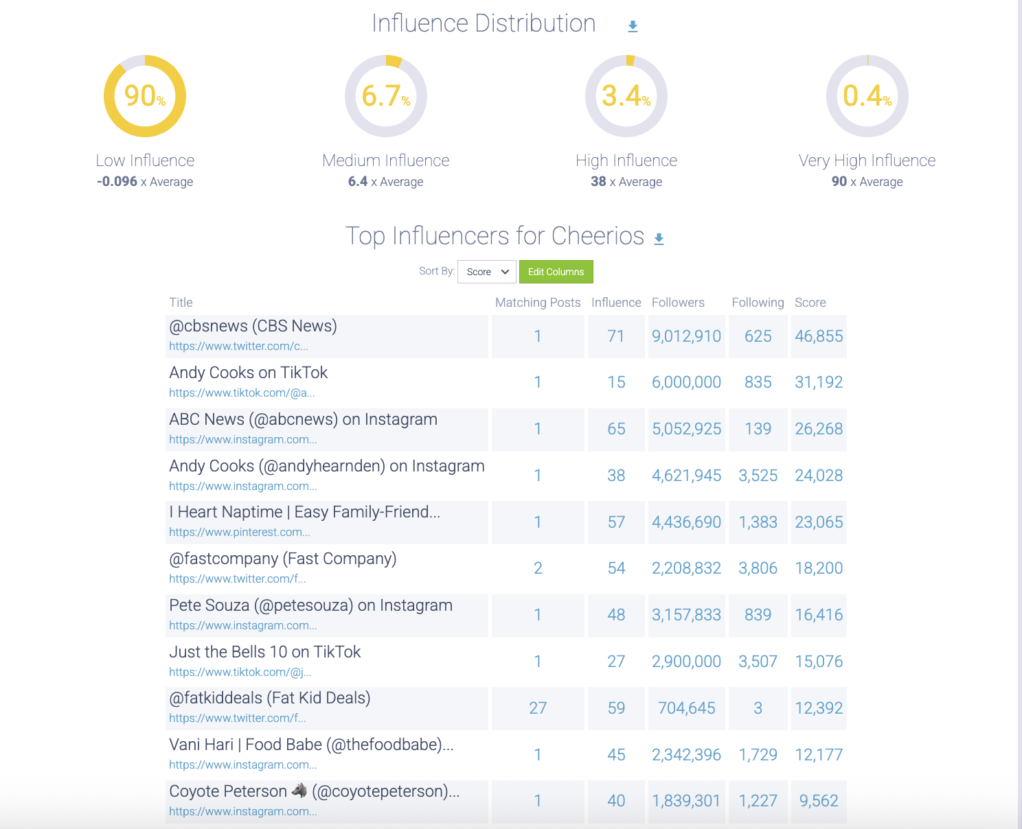
Influencer Distribution

Slide 13
KASHI GO 2025

Slide 14
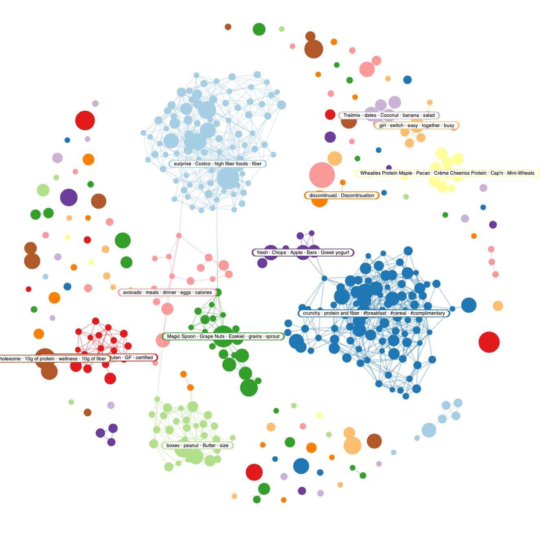

Slide 15
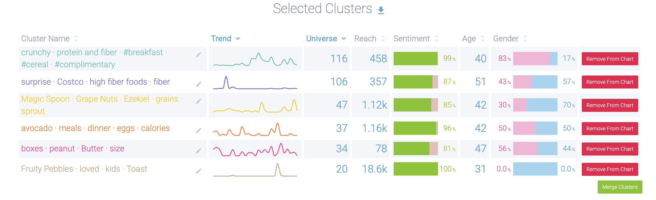
Topics/Narratives

Slide 16
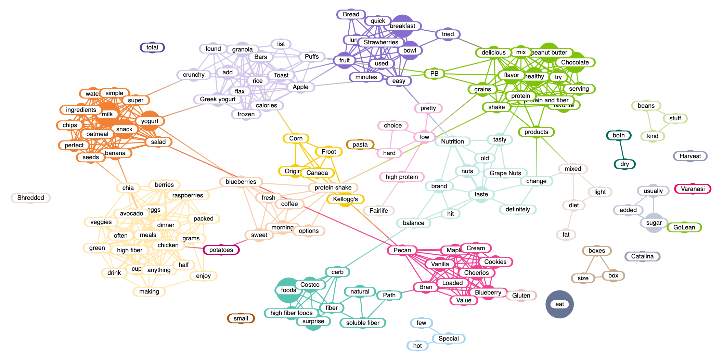
Positive Keywords

Slide 17
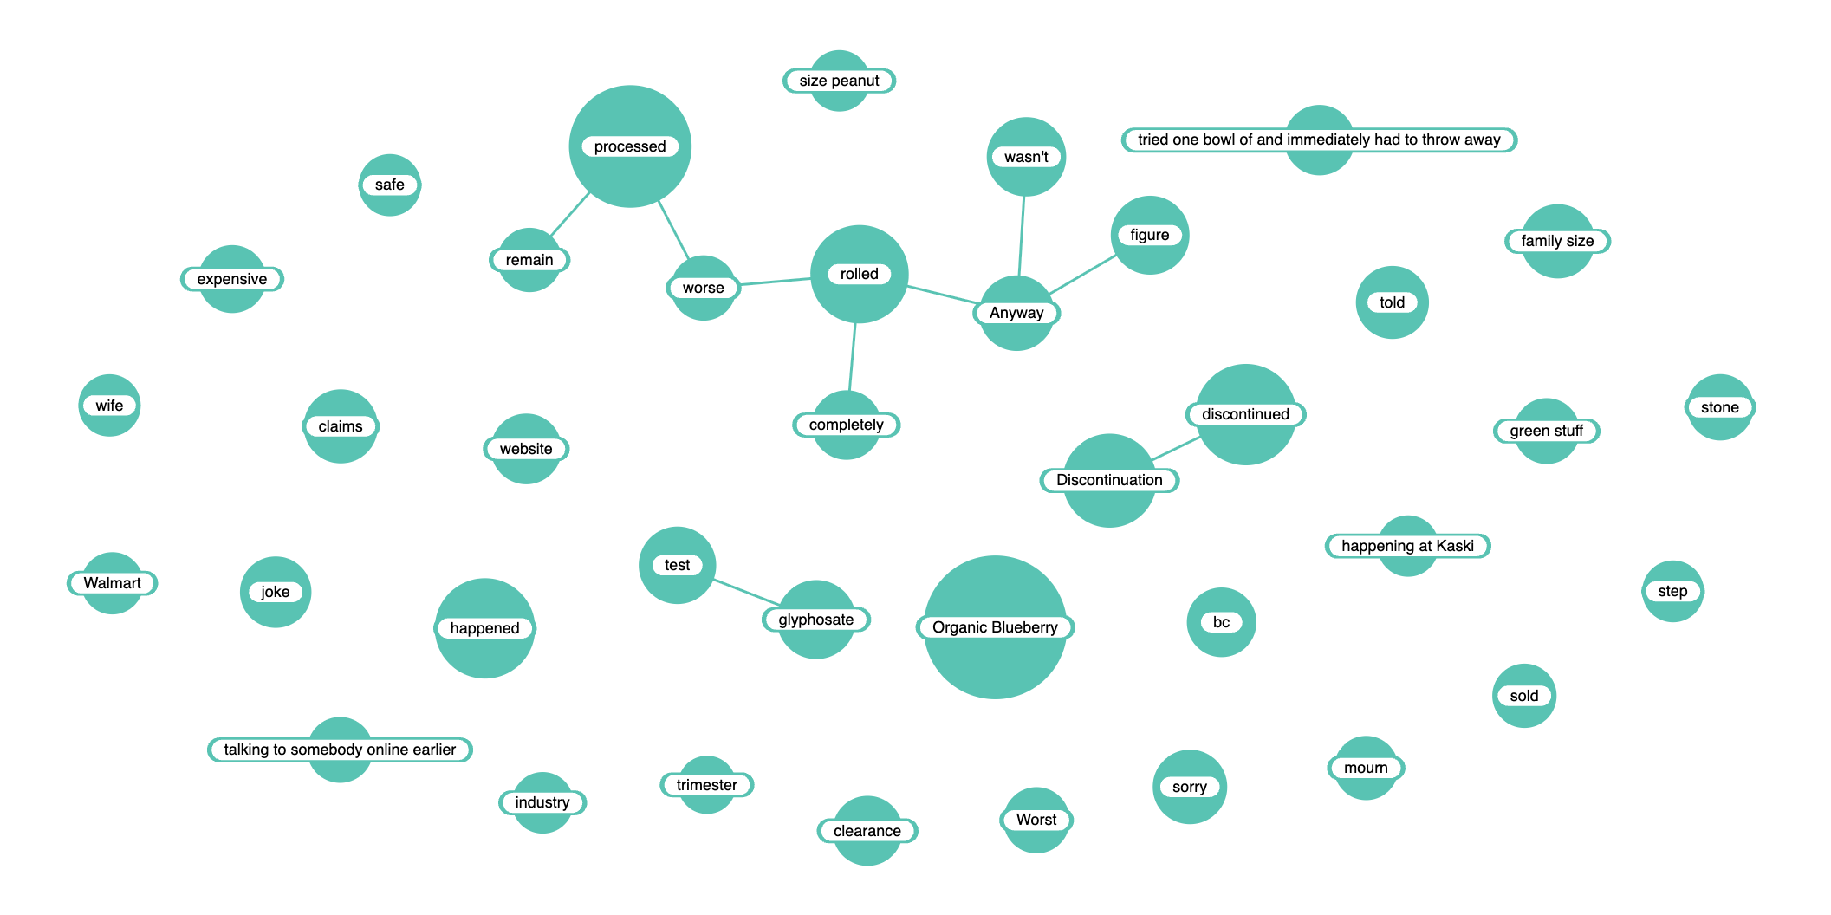
Negative Keywords

Slide 18
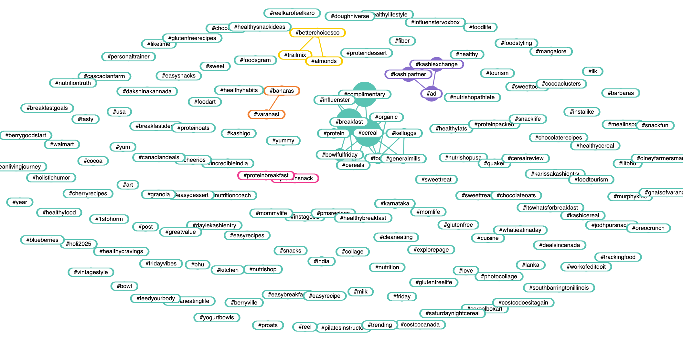
Hashtags

Slide 19
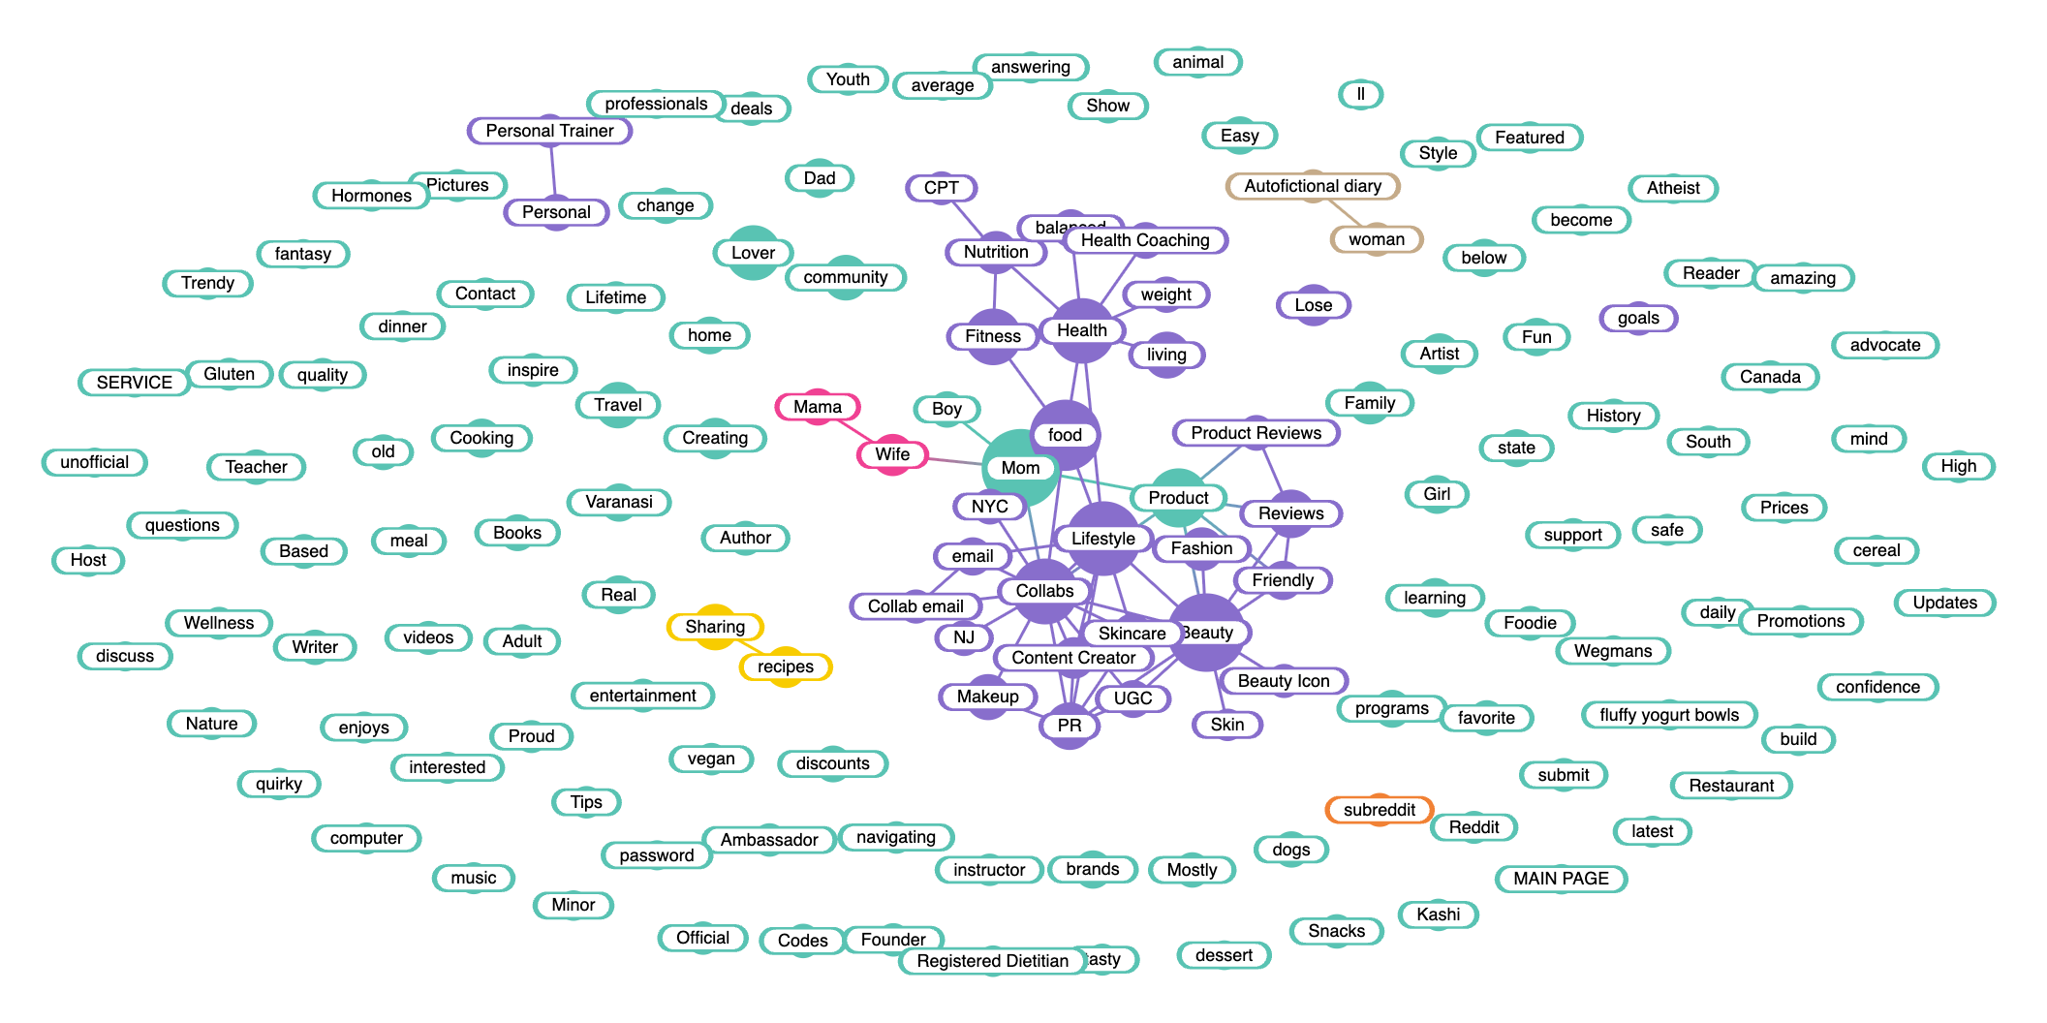
Bios/Target

Slide 20
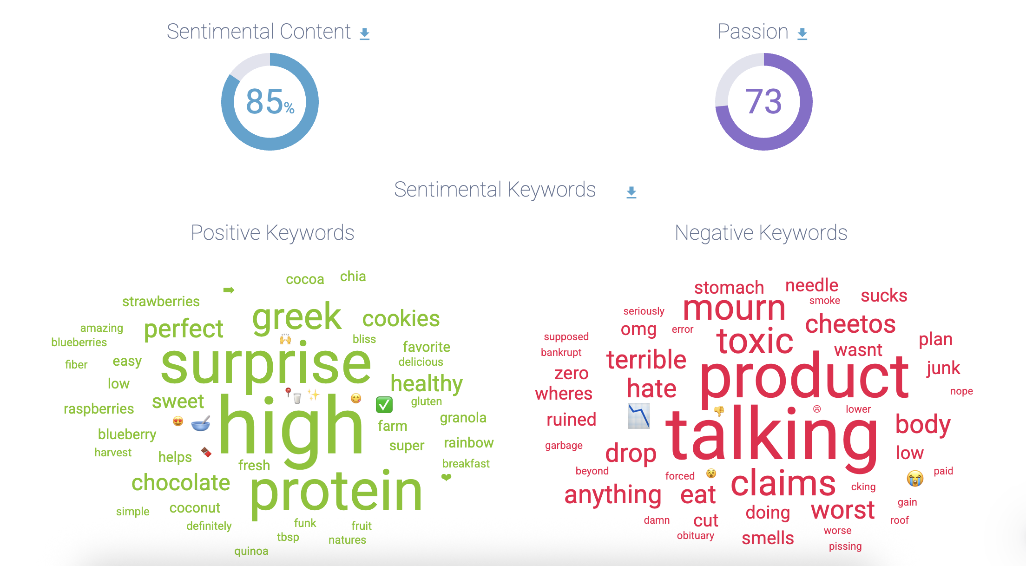
Sentiment

Slide 21
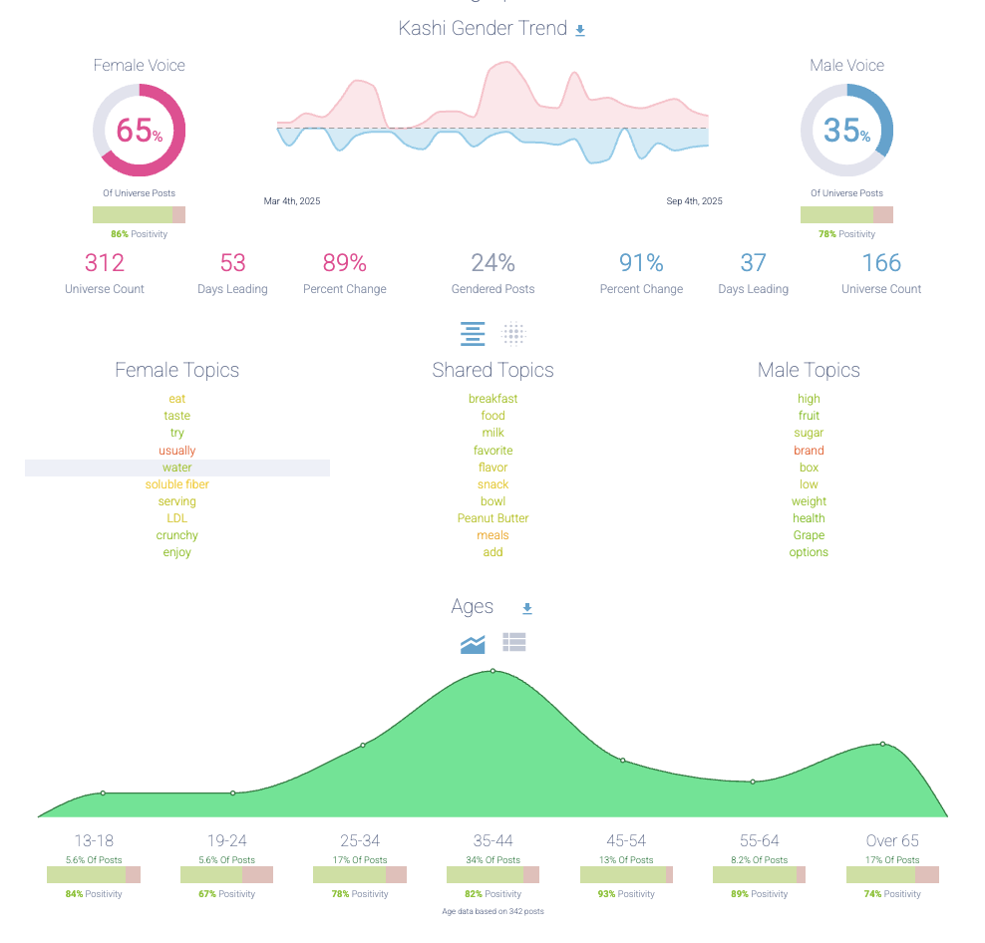
Gender/Age Profile

Slide 22
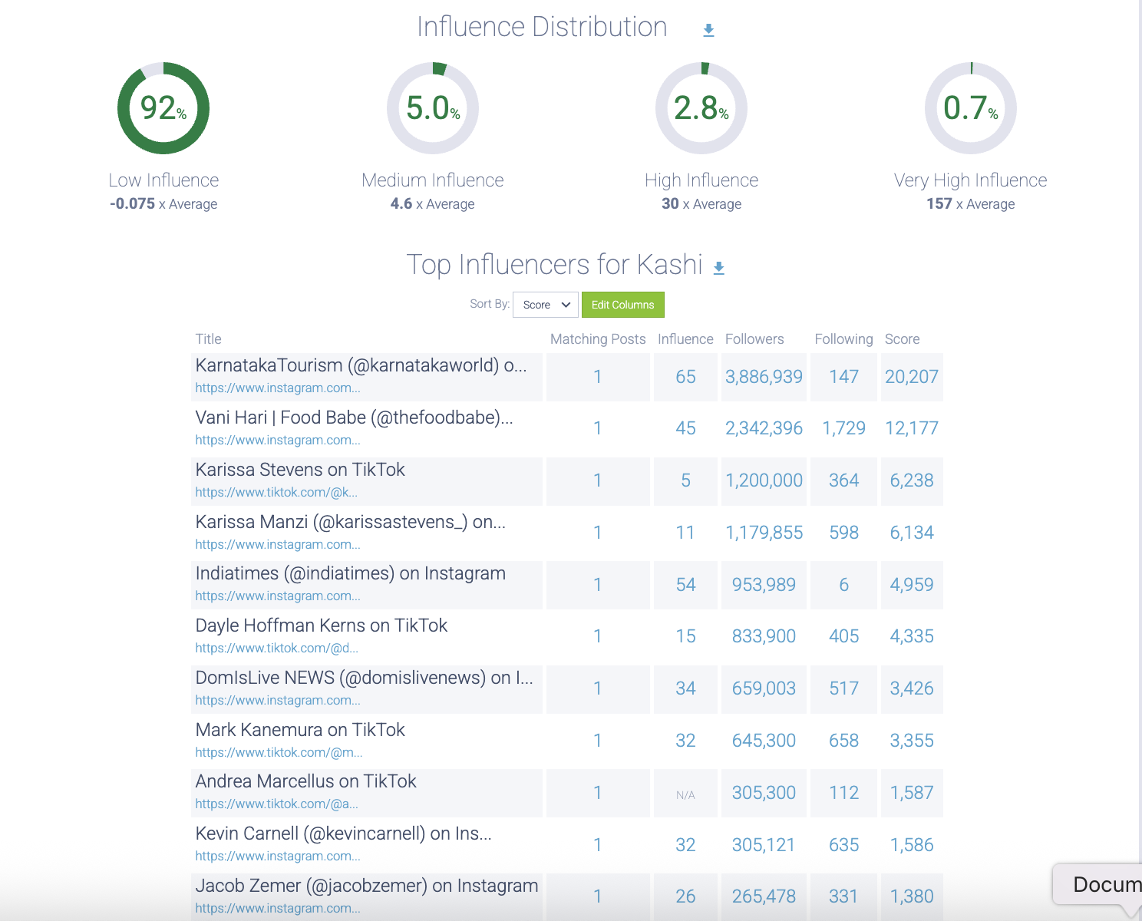
Influencer Distribution

Slide 23
CHEERIOS 2024

Slide 24
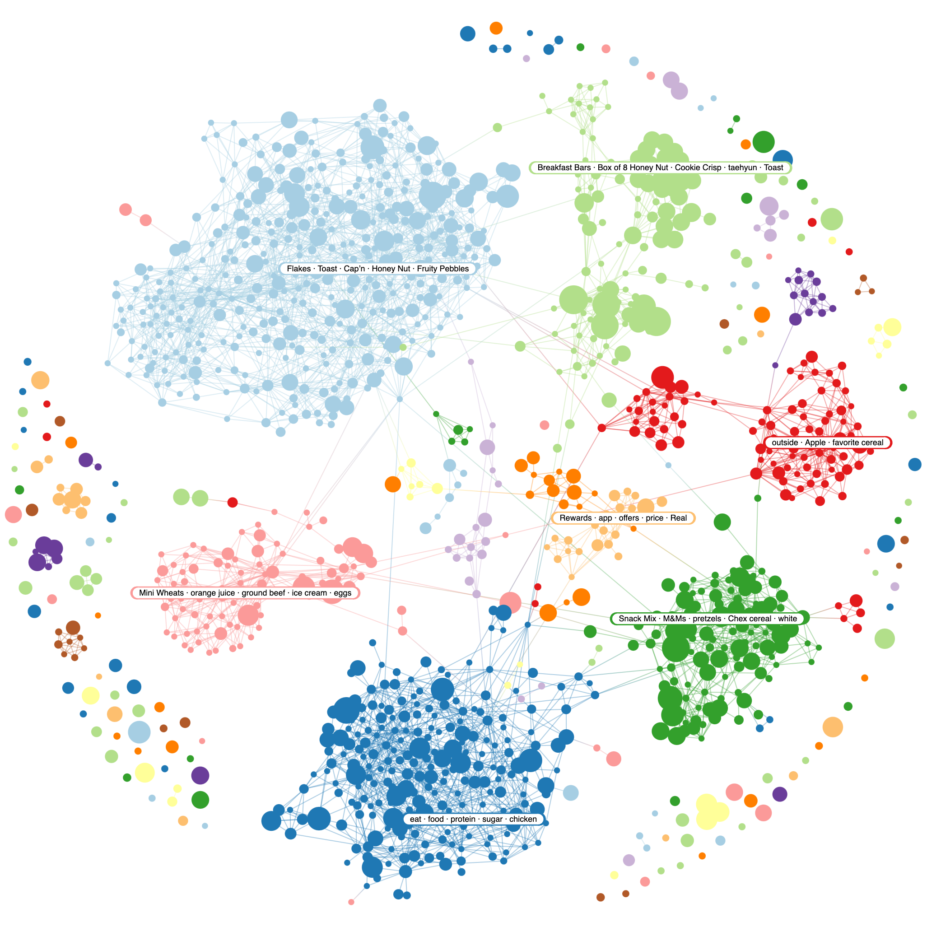

Slide 25
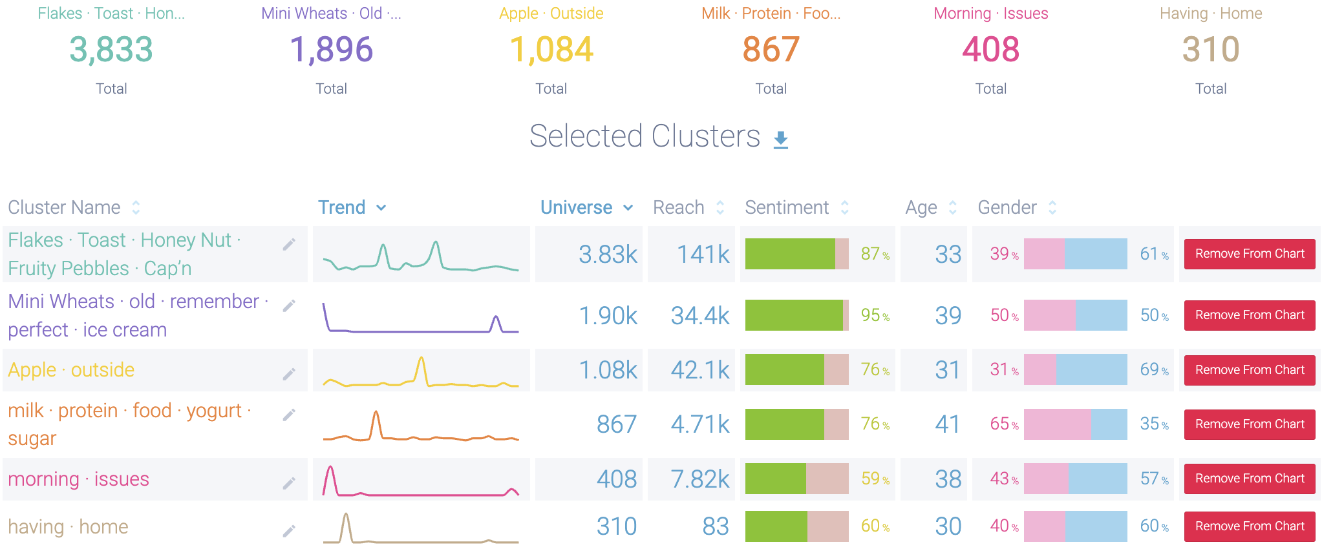
Topics/Narratives

Slide 26
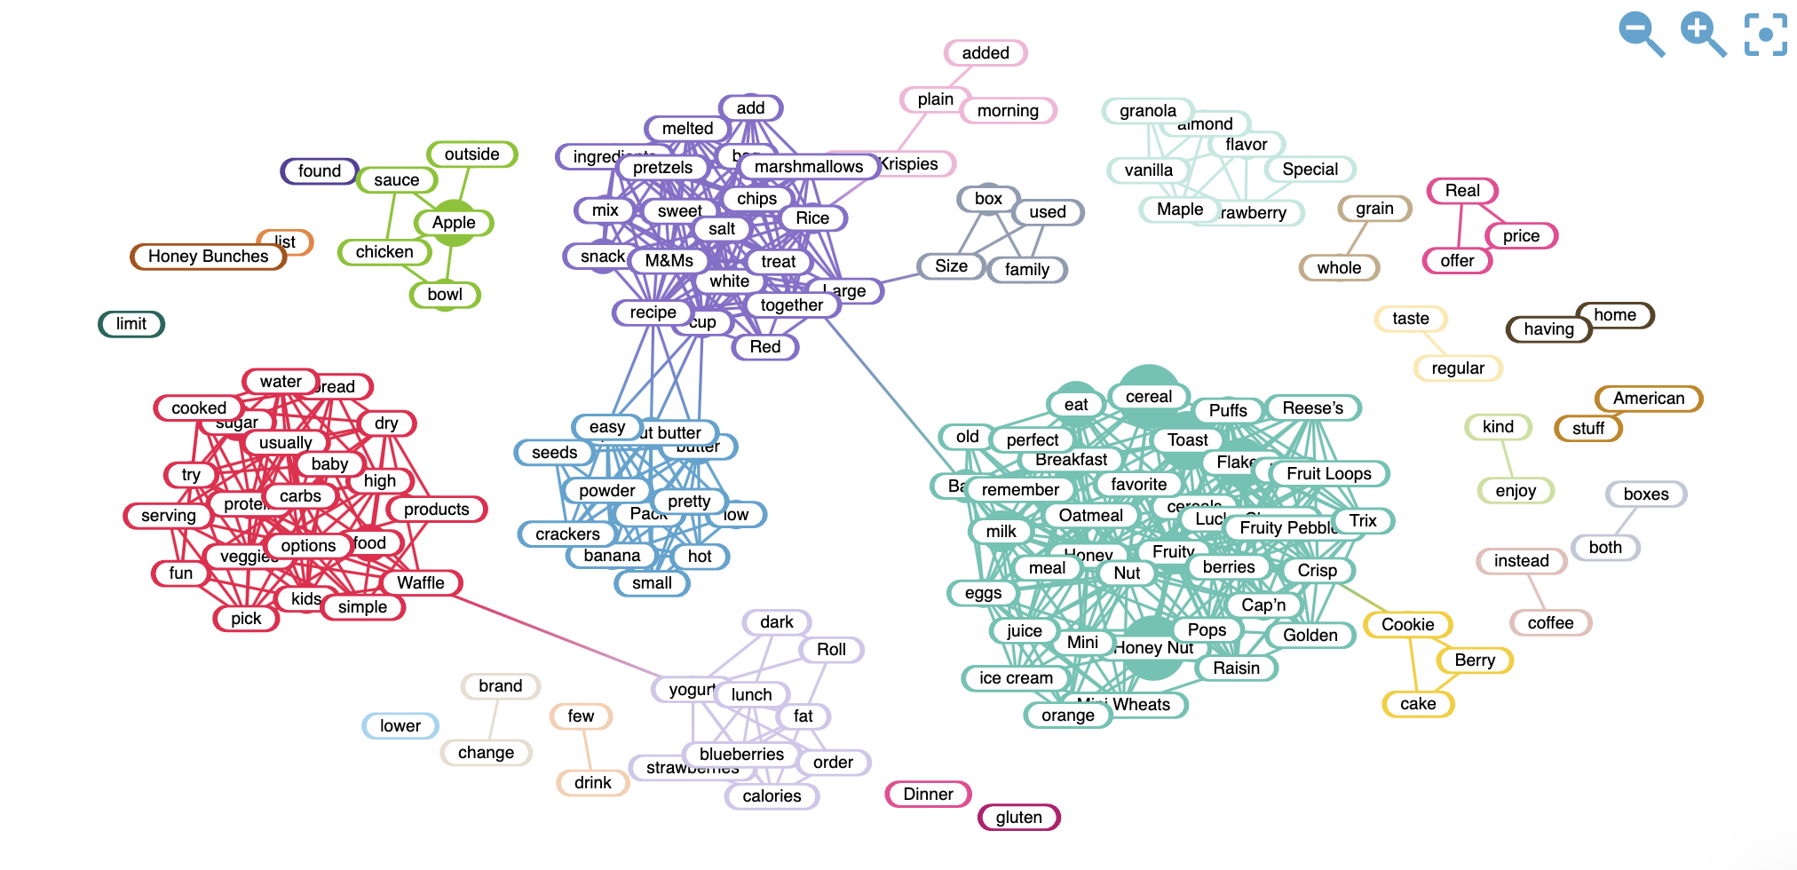
Positive Keywords

Slide 27
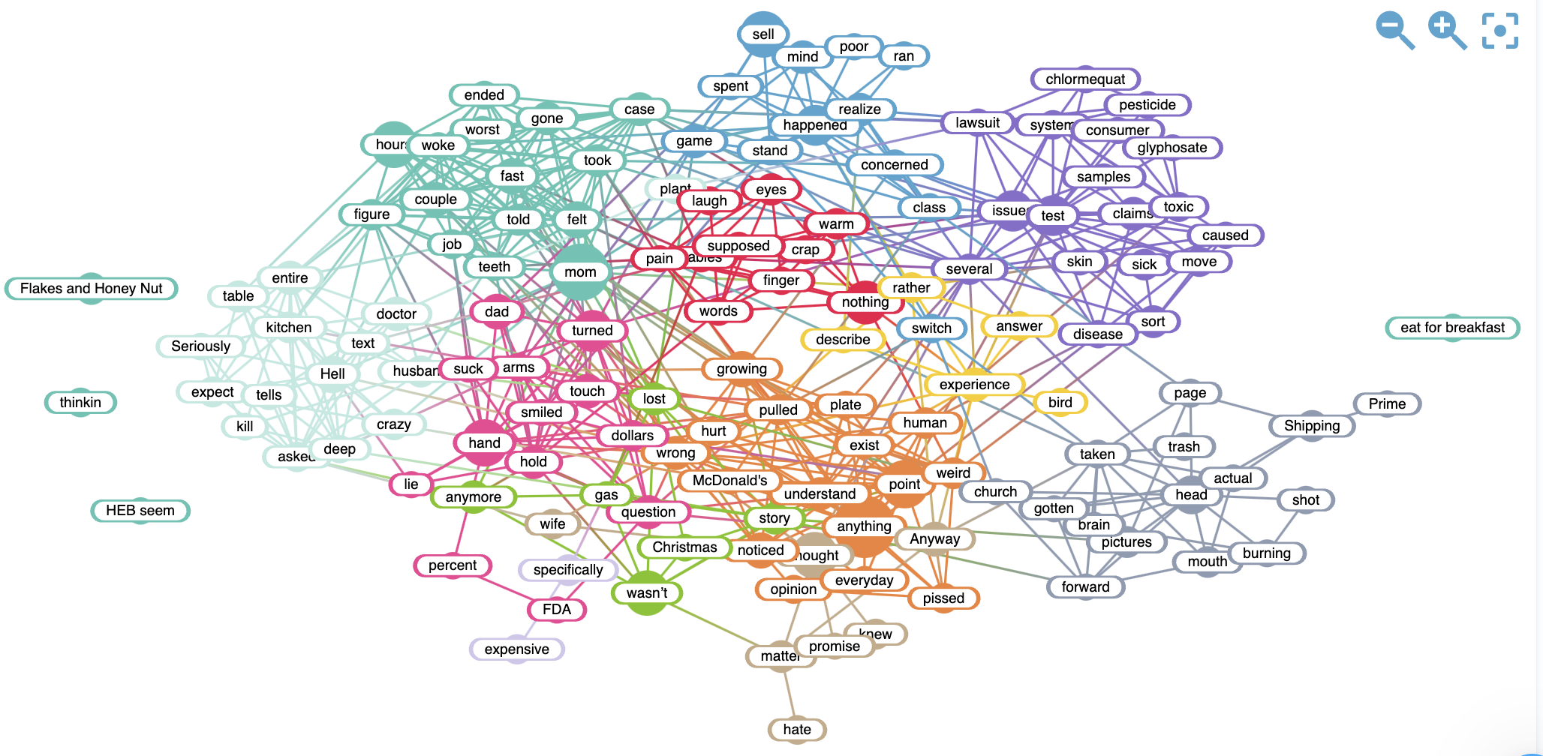
Negative Keywords

Slide 28
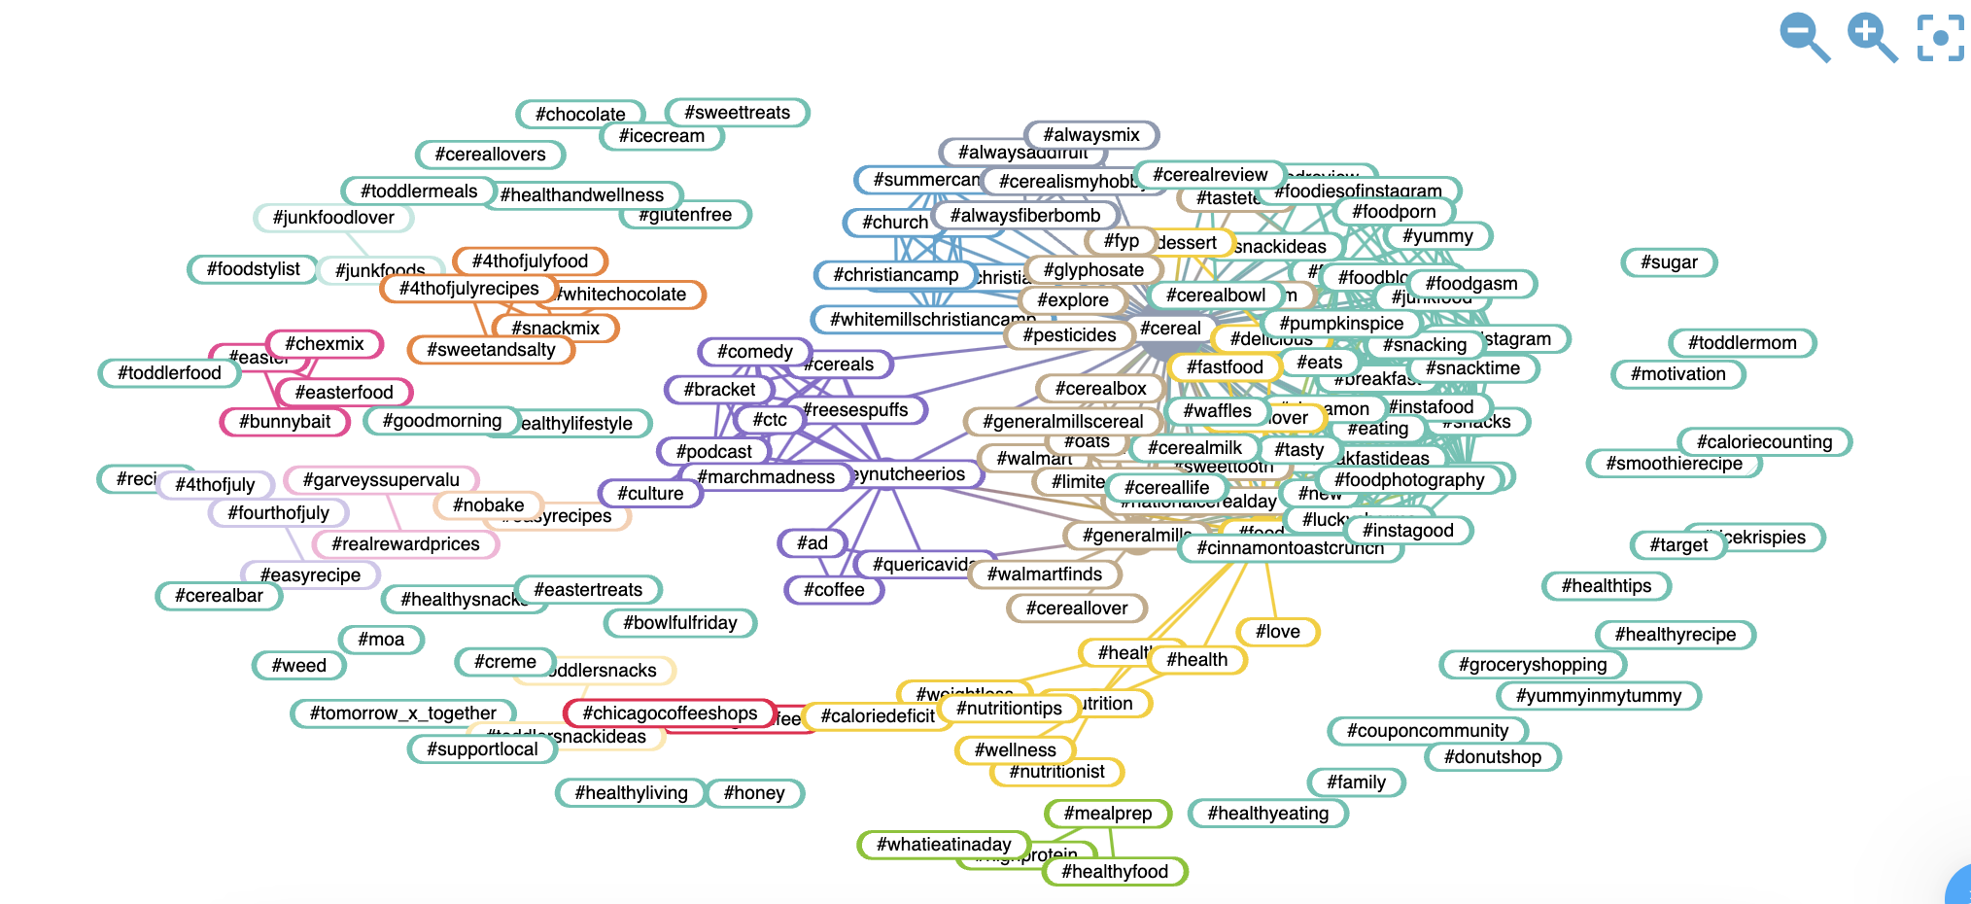
Hashtags

Slide 29
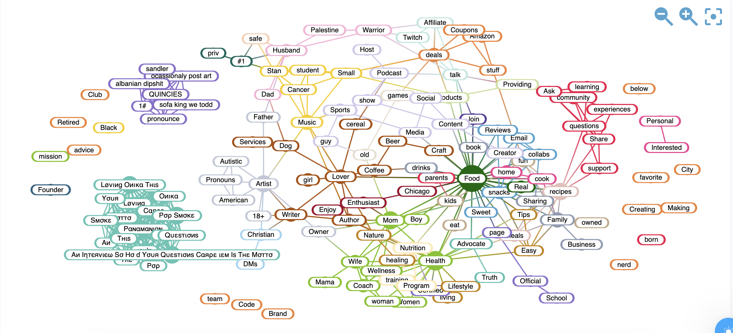
Bios/Target

Slide 30
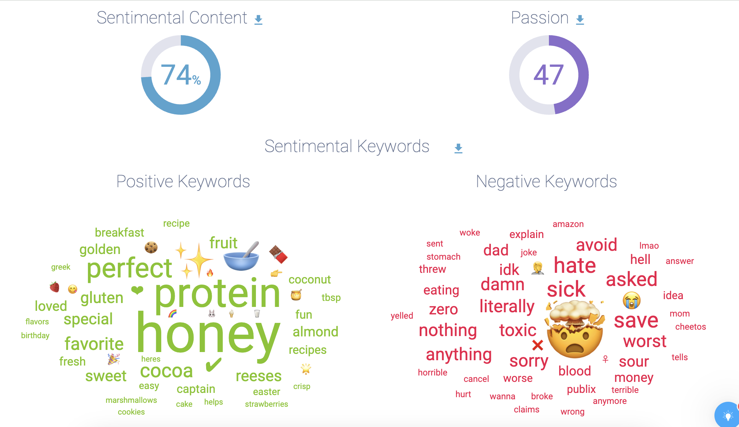
Sentiment

Slide 31
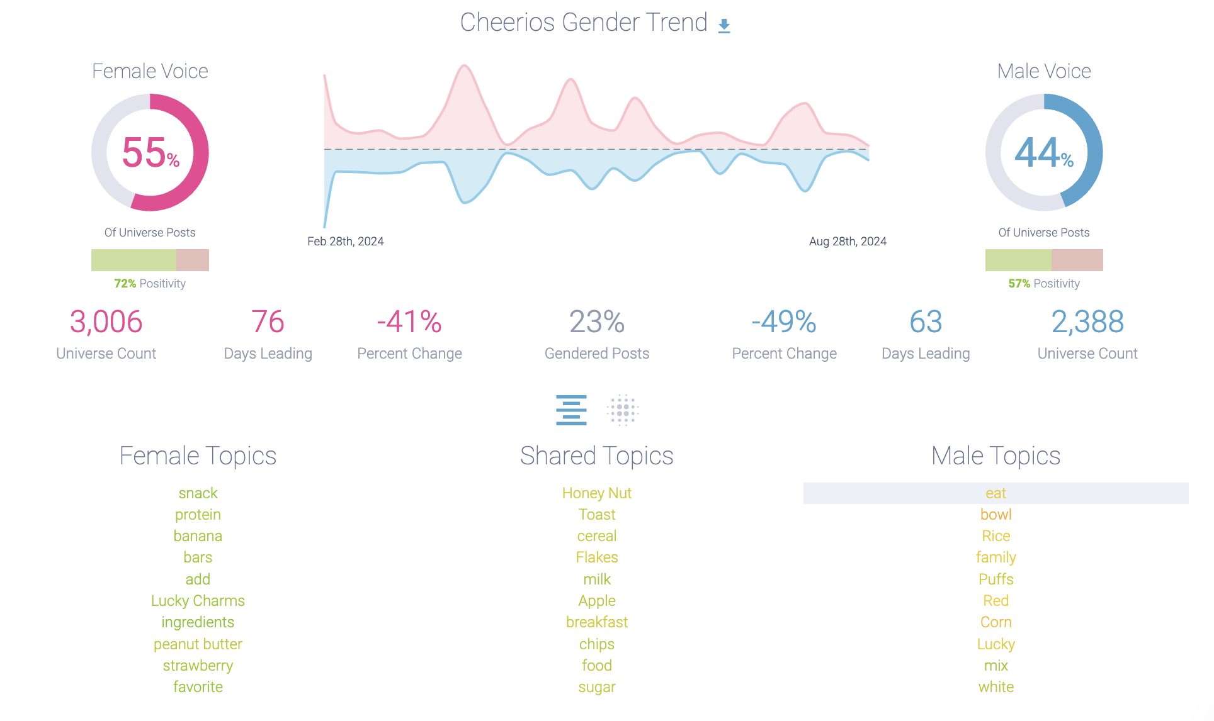
Gender Trend

Slide 32
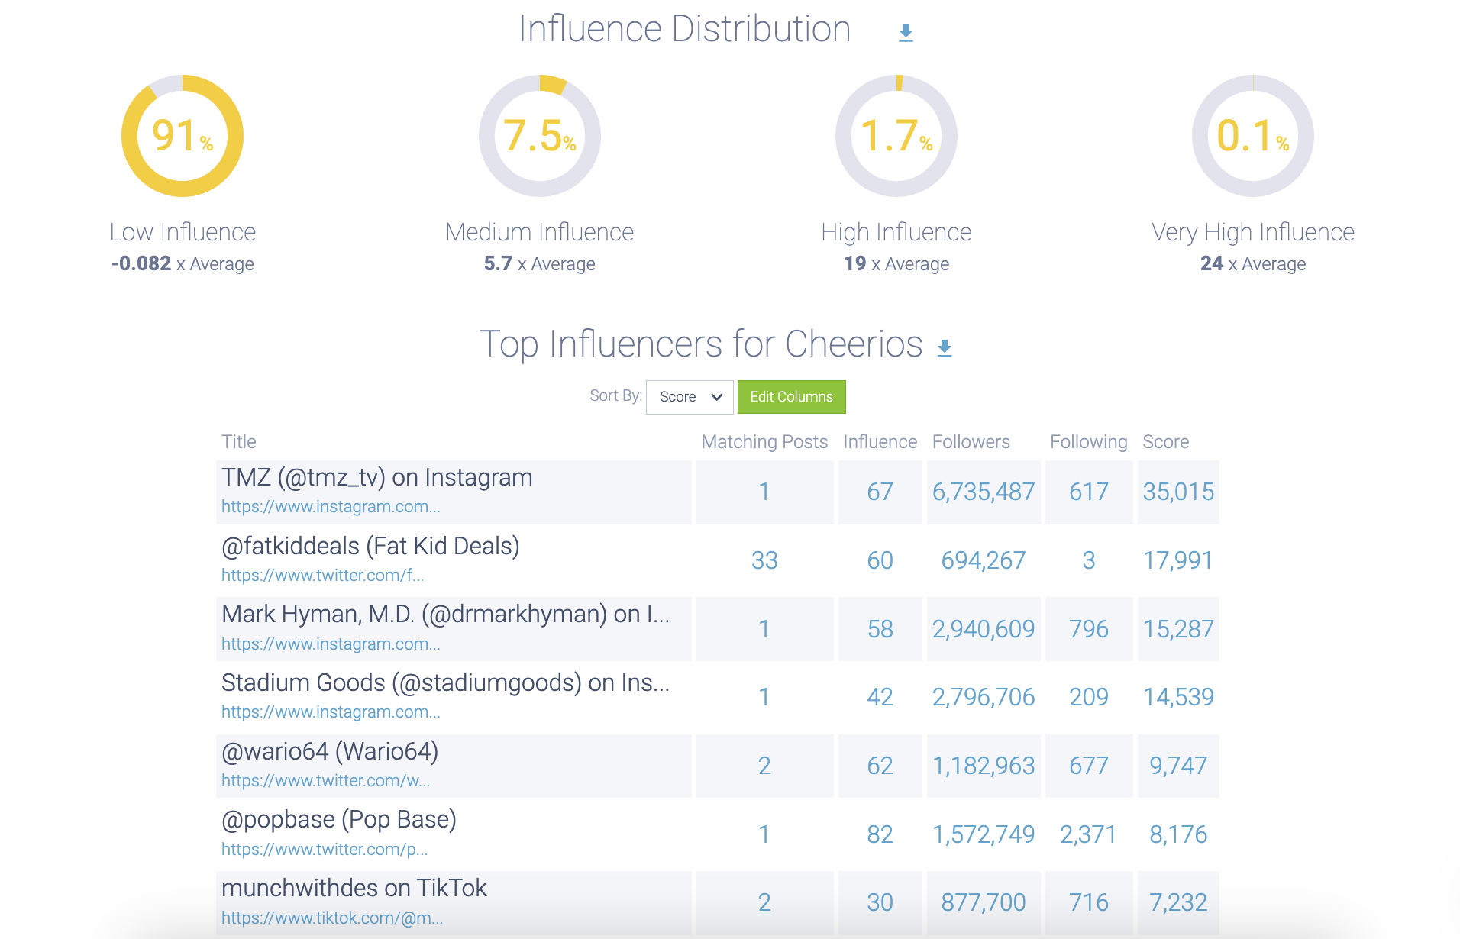
Influencer Distribution

Slide 33
KASHI GO 2024

Slide 34
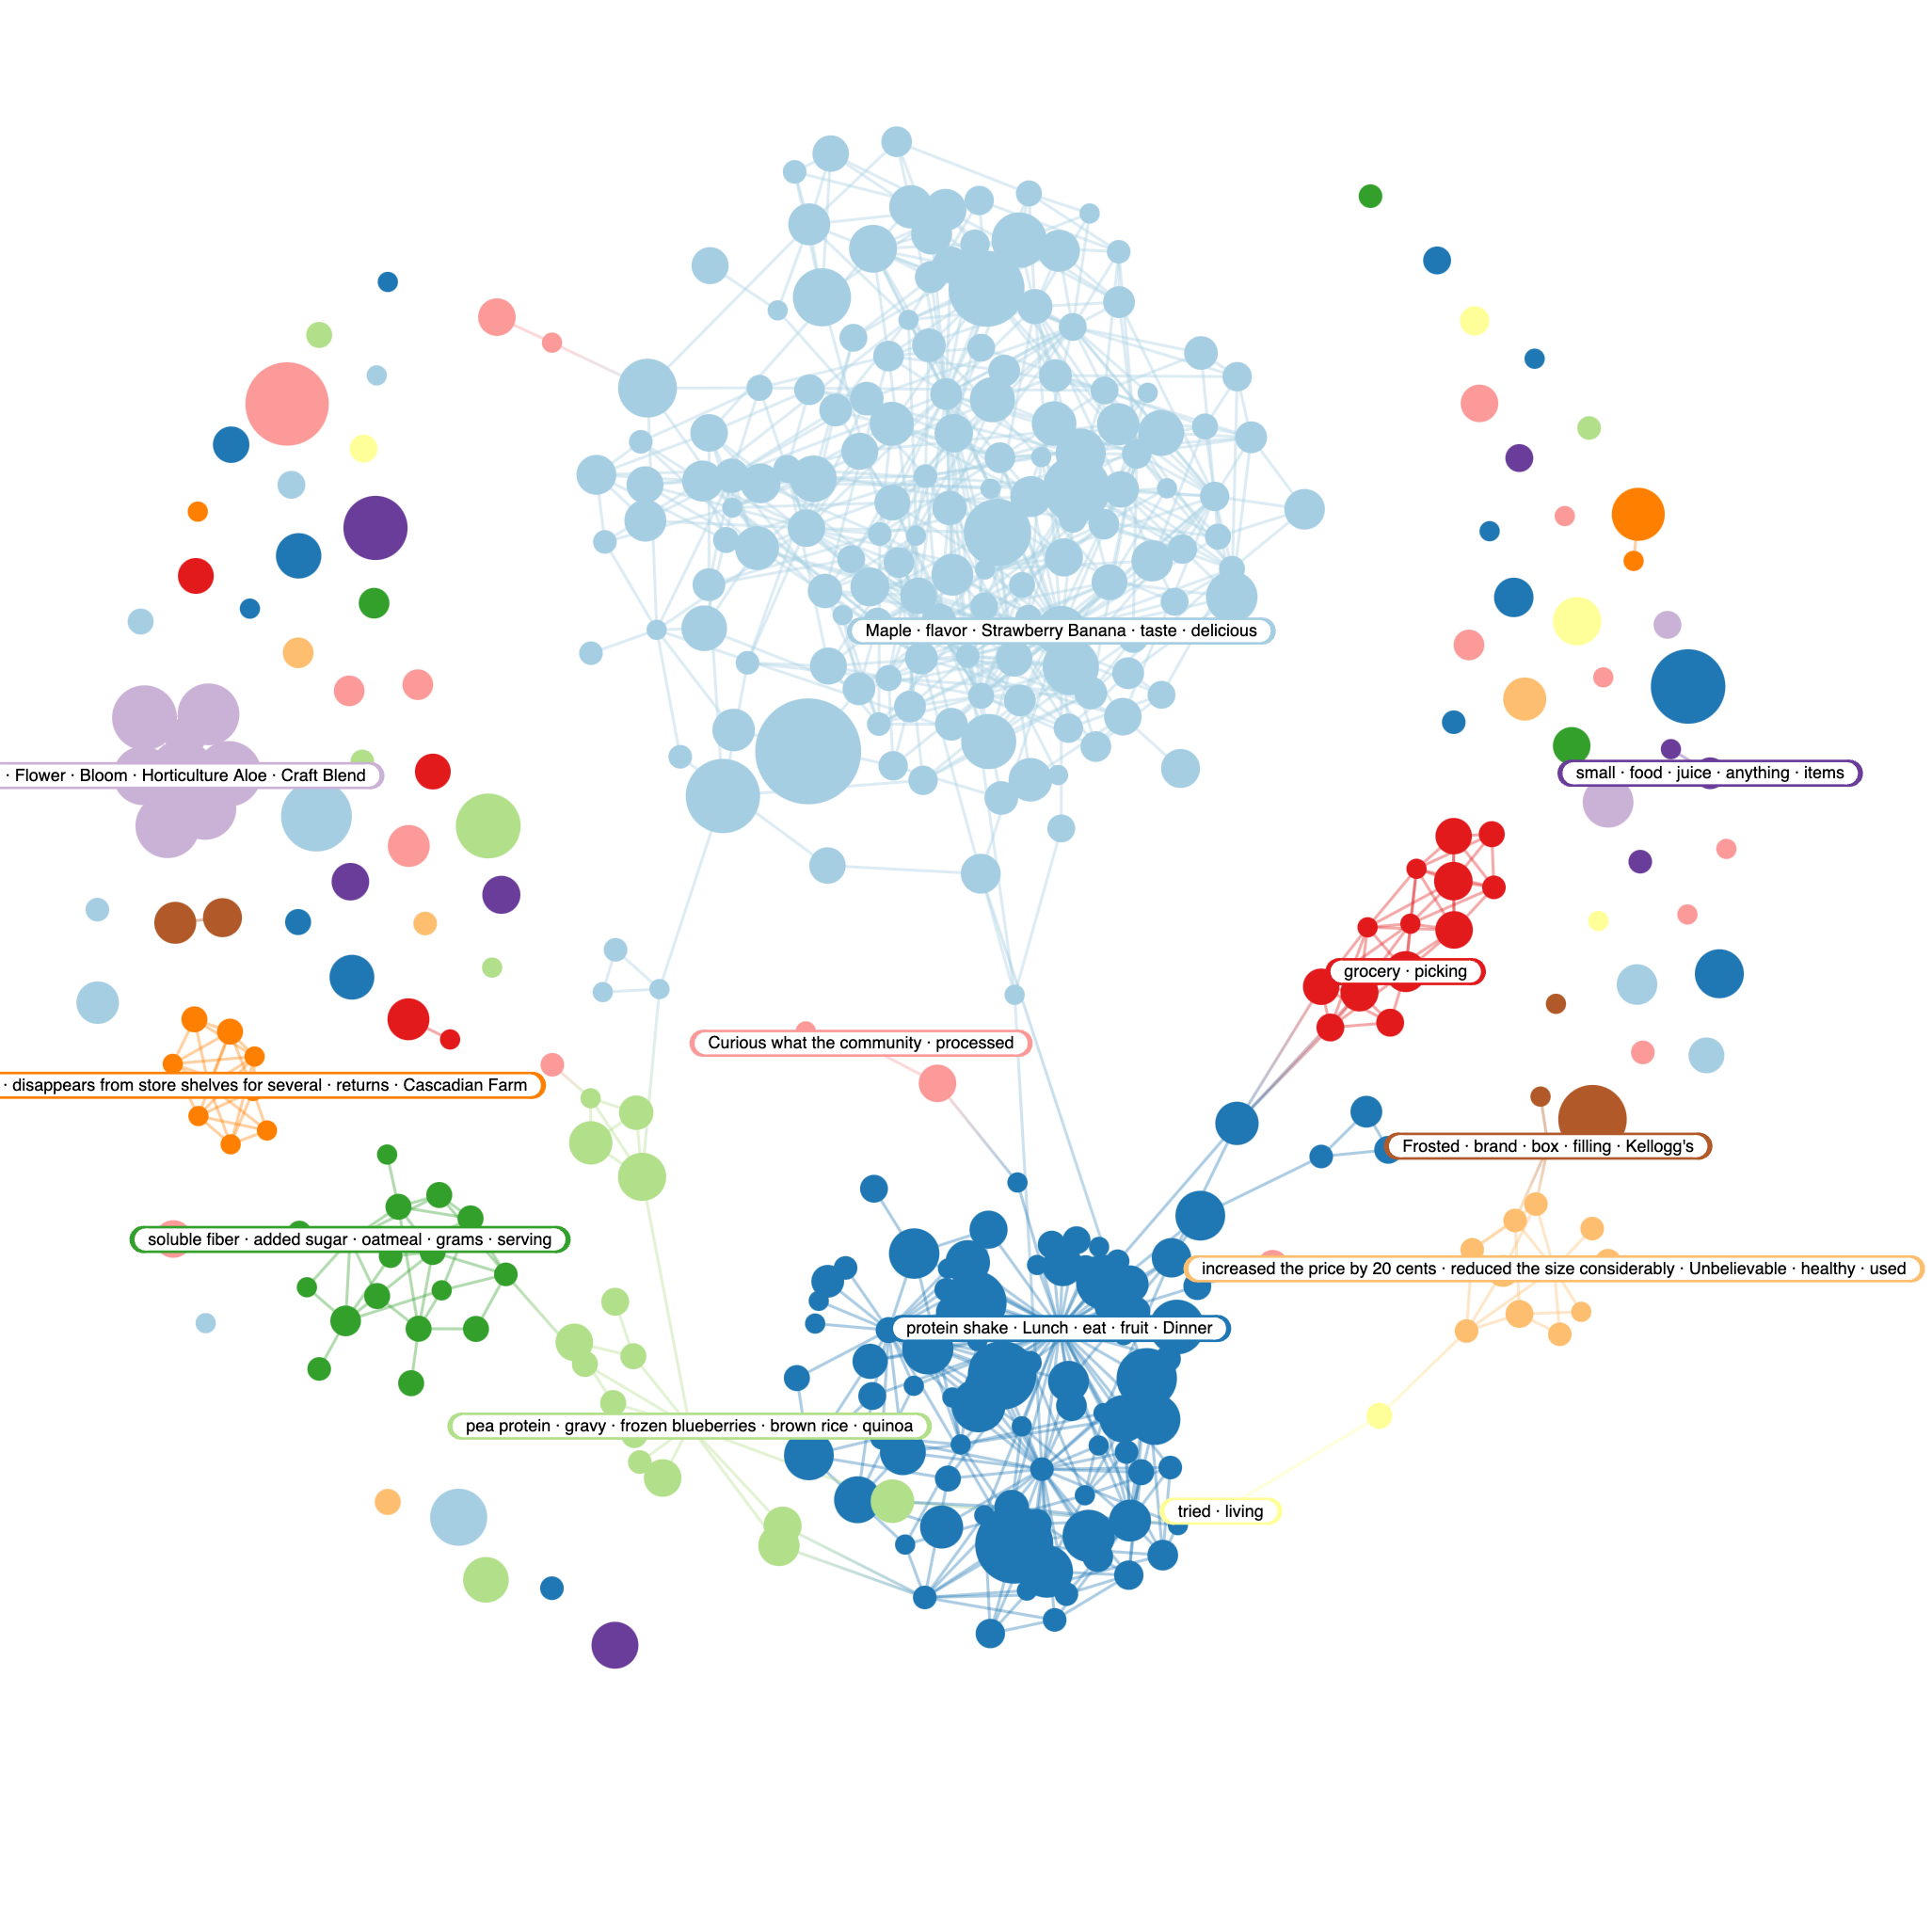

Slide 35
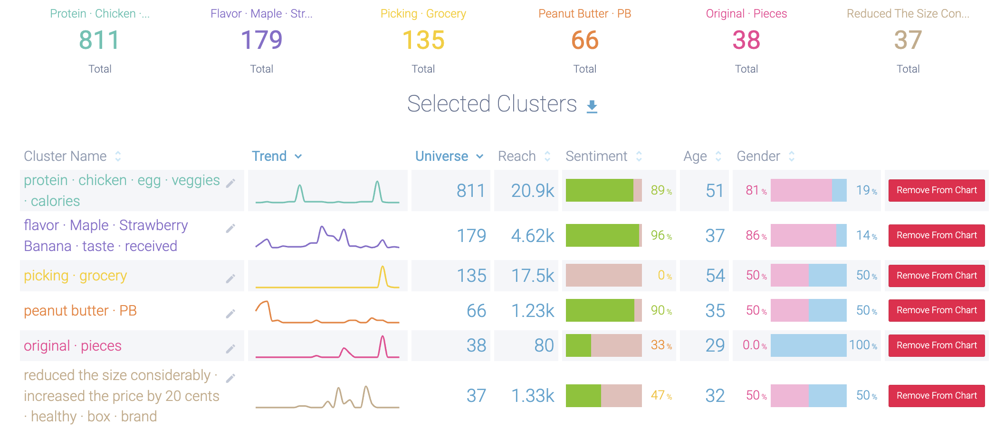
Topics/Narratives

Slide 36
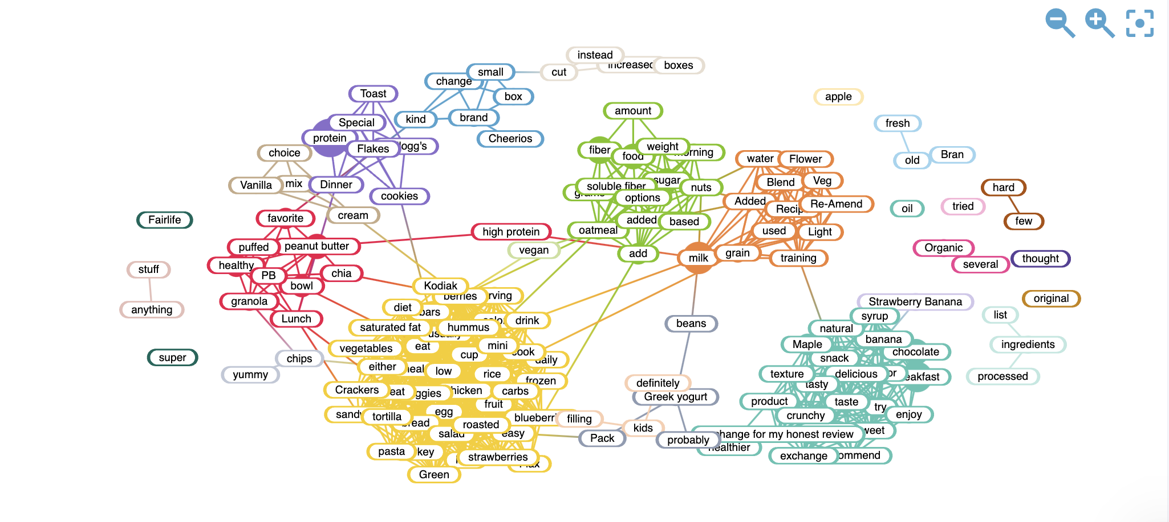
Positive Keywords

Slide 37
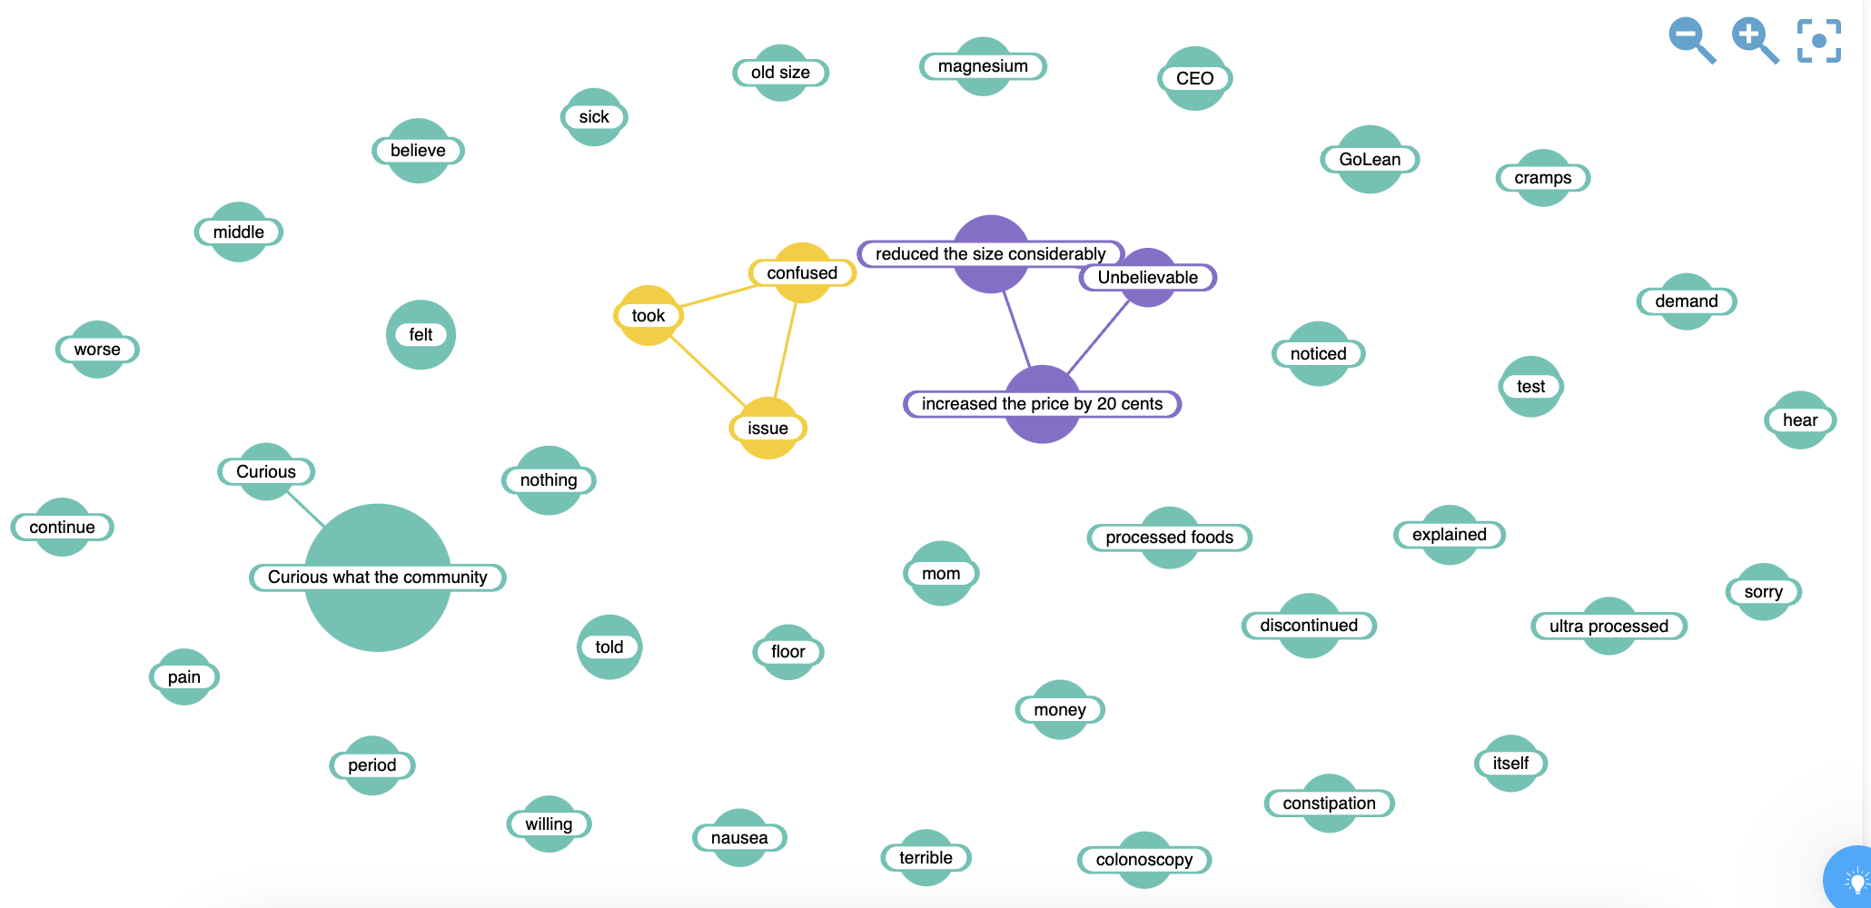
Negative Keywords

Slide 38
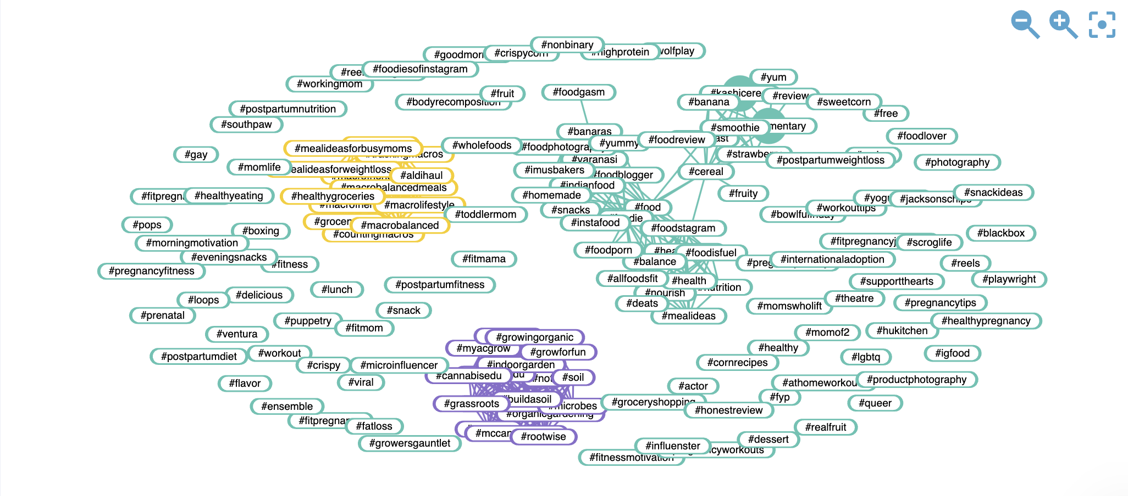
Hashtags

Slide 39
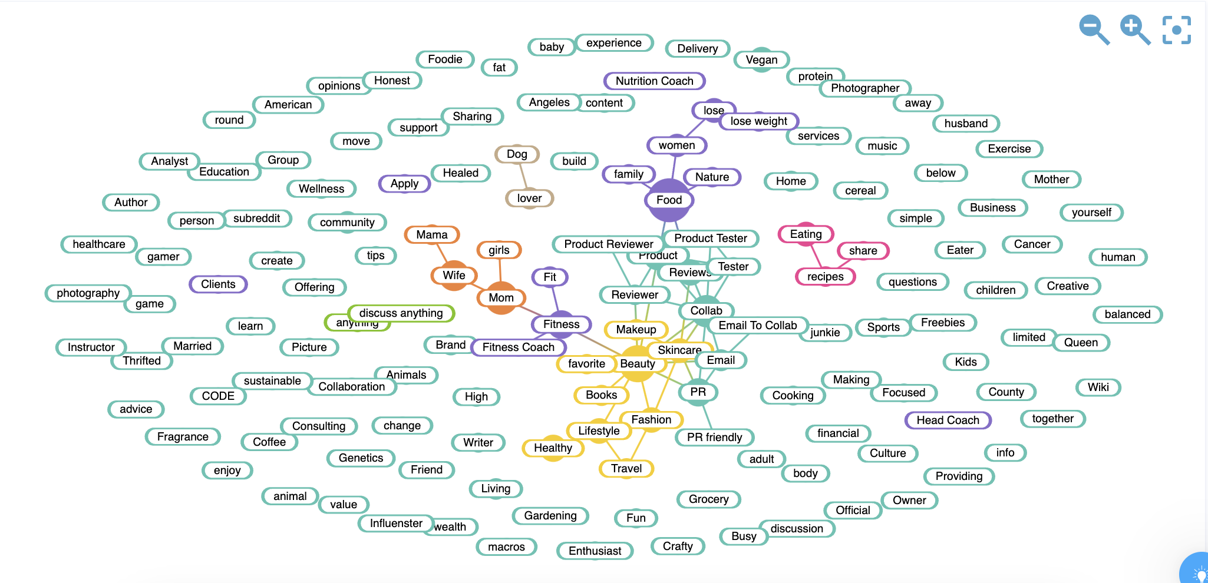
Bios/Target

Slide 40
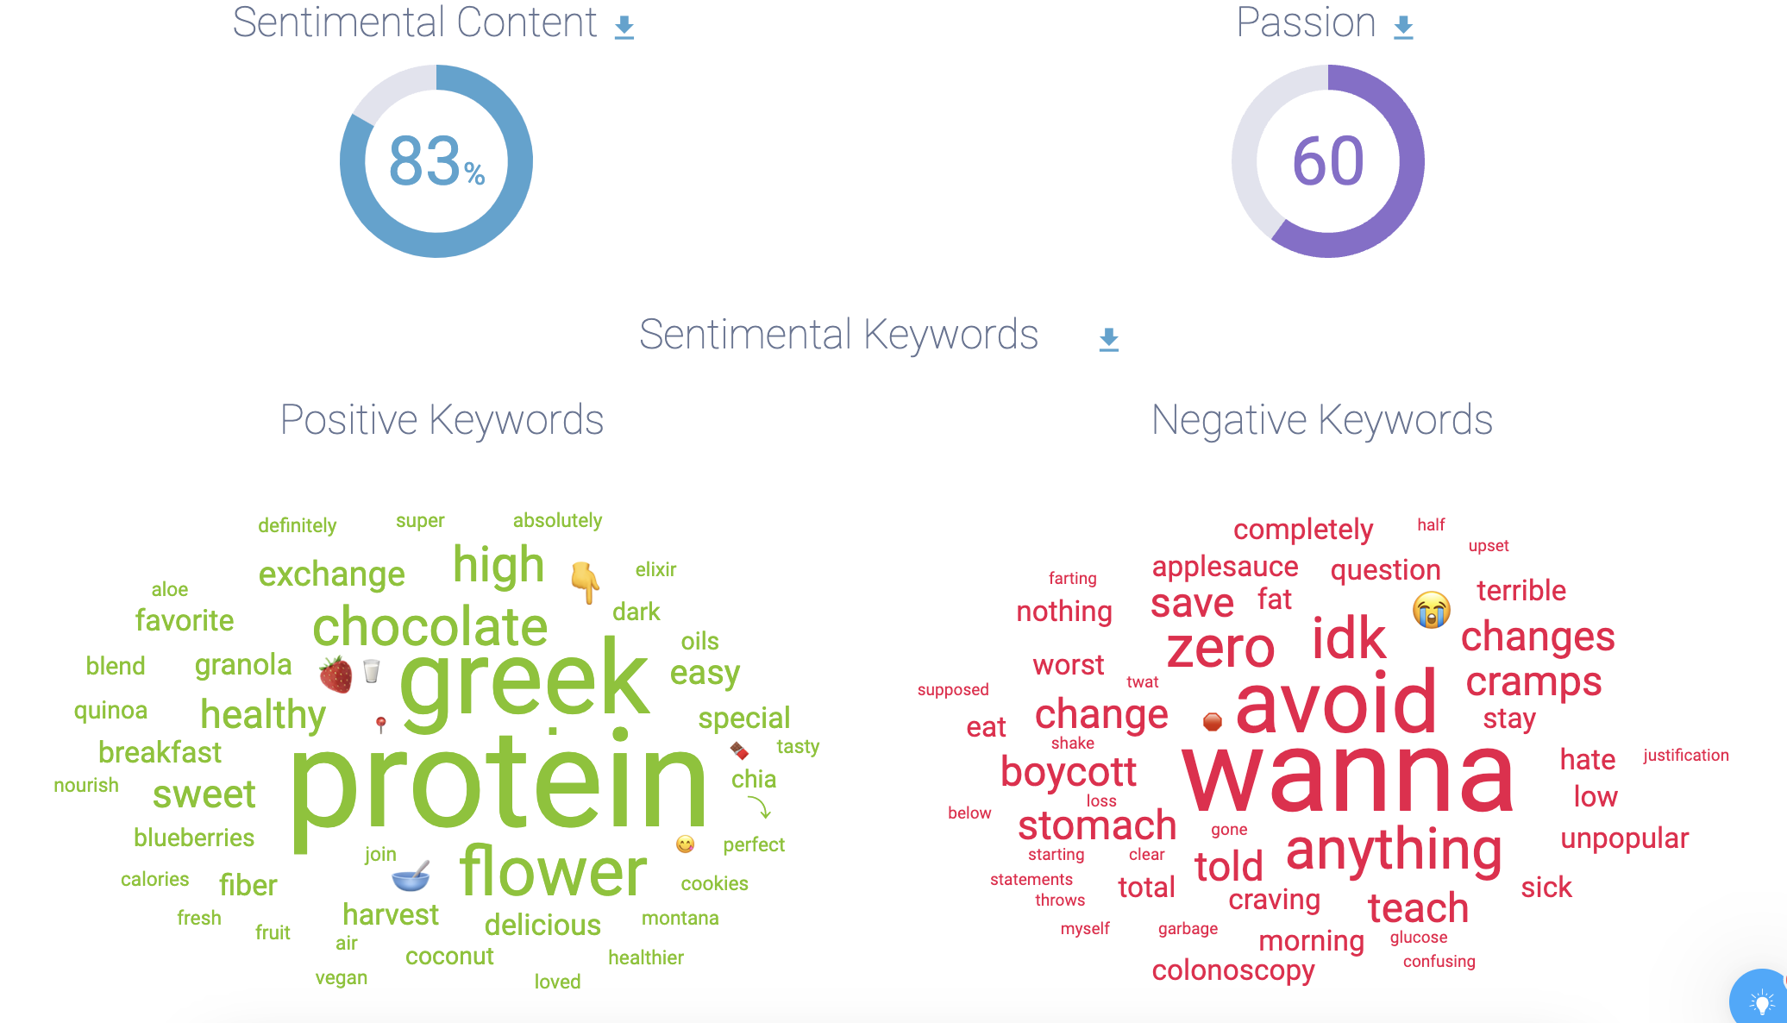
Sentiment

Slide 41
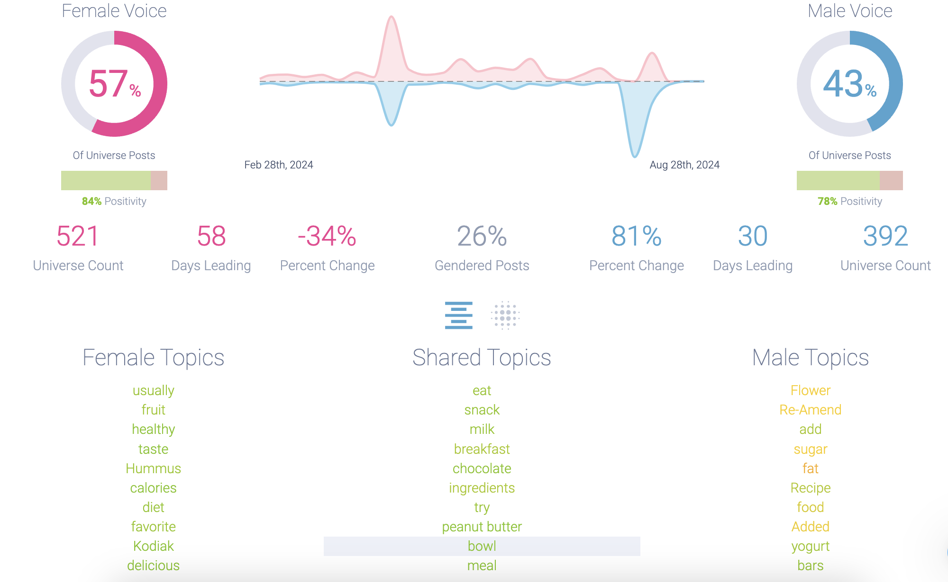
Gender Trend

Slide 42
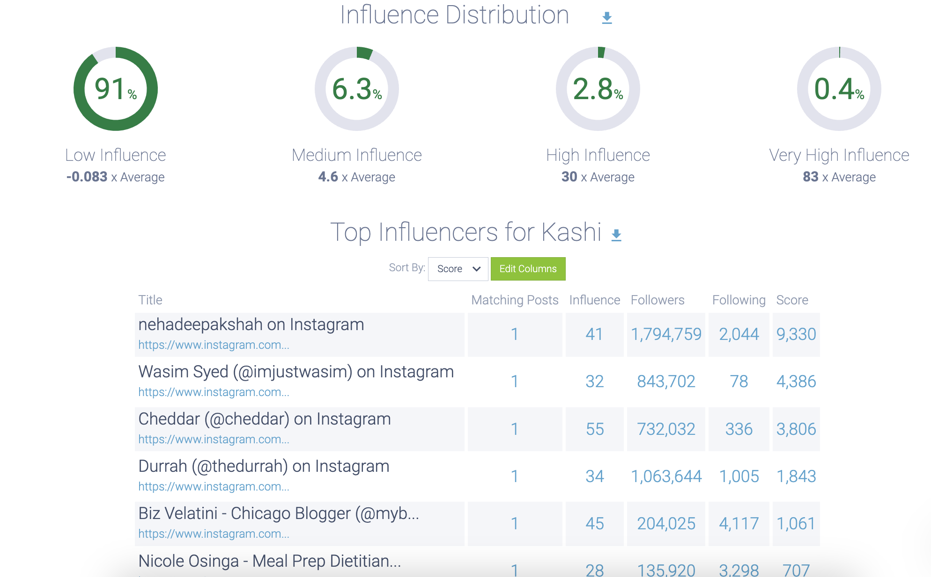
Influencer Distribution

