Slide 1
The Social Psychology of Strategy

Slide 2
How Does Marketing Communication Work?
The Mass Communication Approach
  Interactive Messaging Model
  Expression Effects/Self Effects
The Psychology Behind Message Effects
  Information Processing
  Mental Associations
  Message Style
  Framing and Values
  Persuasion and Attitude Change

Slide 3
Message Reception and Comprehension
Simple sender-receiver model
  Sender
  Message
  Noise
  Receiver
  Feedback

Slide 4
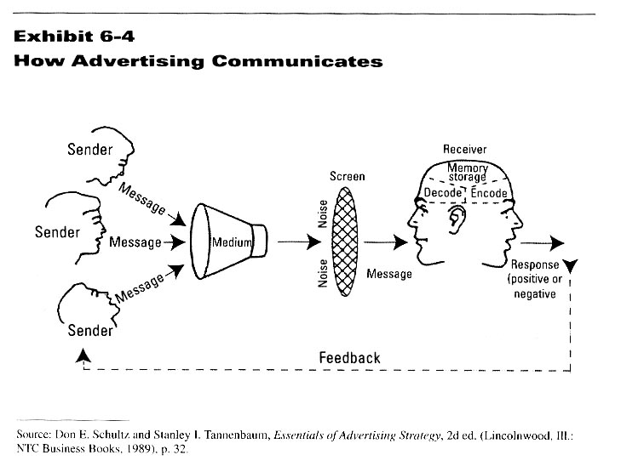
Mass Communication Model

Slide 5
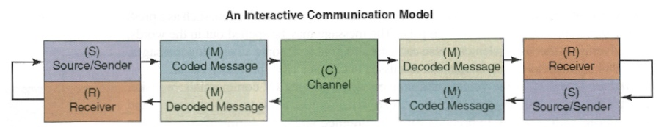
Interactive Messaging Model
Both marketers and consumers are now message producers and receivers
Powerful effects of message expression, more so that message reception

Slide 6
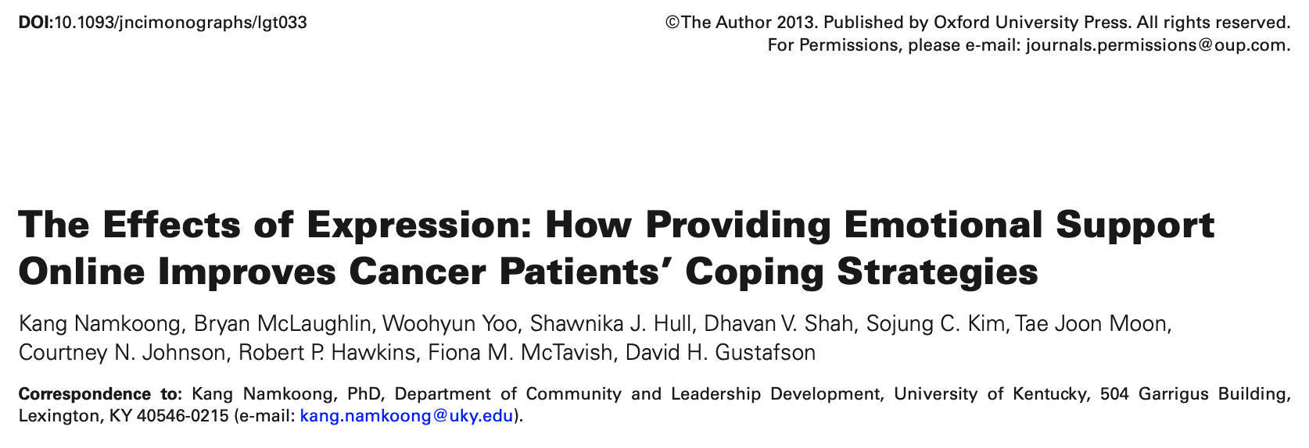
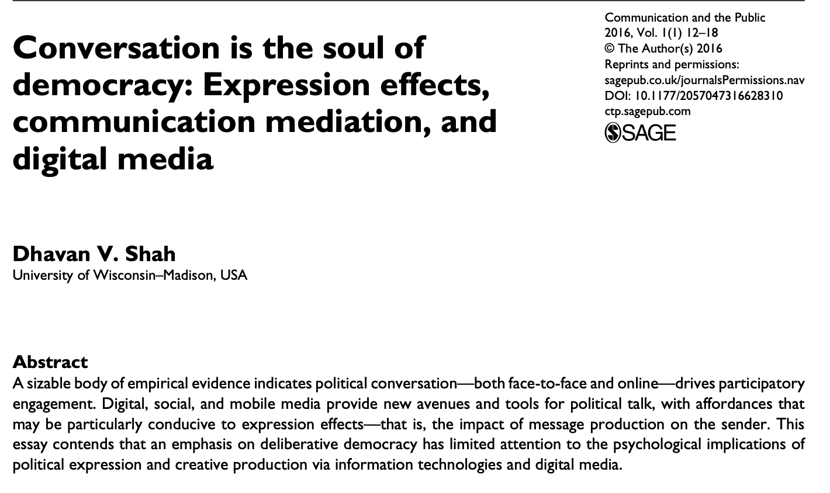

Slide 7
Expression/Self Effects
The crystallization and production of messages, the consideration of audiences, the act of expression, and the publicness of the display have consequences
  Reflection
  Reasoning
  Mentalization
  Self-perception

Slide 8
The Psychology Behind Message Effects

Slide 9
Information Processing and Consumer Behavior
Information processing:
  How people take-in, manage, and use information and respond to it
  Must understand thought process to create effective communication campaigns
  Informed by psychological research on mental processing and decision-making

Slide 10
Message Processing
Multiple senders through multiple media
Noise produced by multiple messages
Consumers put up perceptual screens
  Allows them to control flow of information
  Allows them to sort through information
Decoding-encoding the message
  Failure to decode, processing stops

Slide 11

Focused Attention

Slide 12
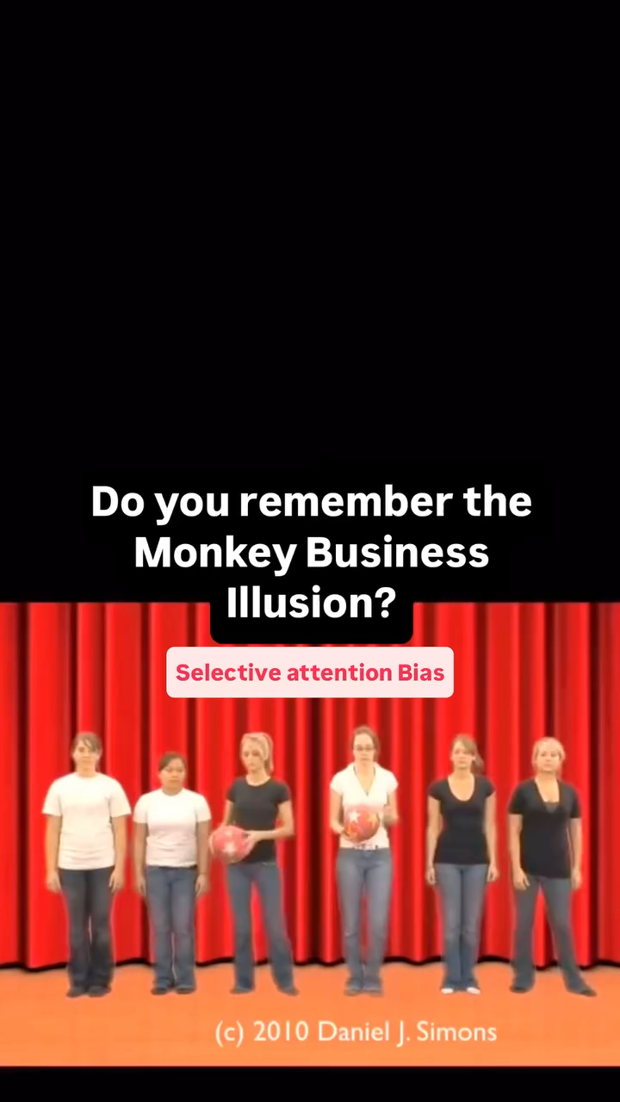
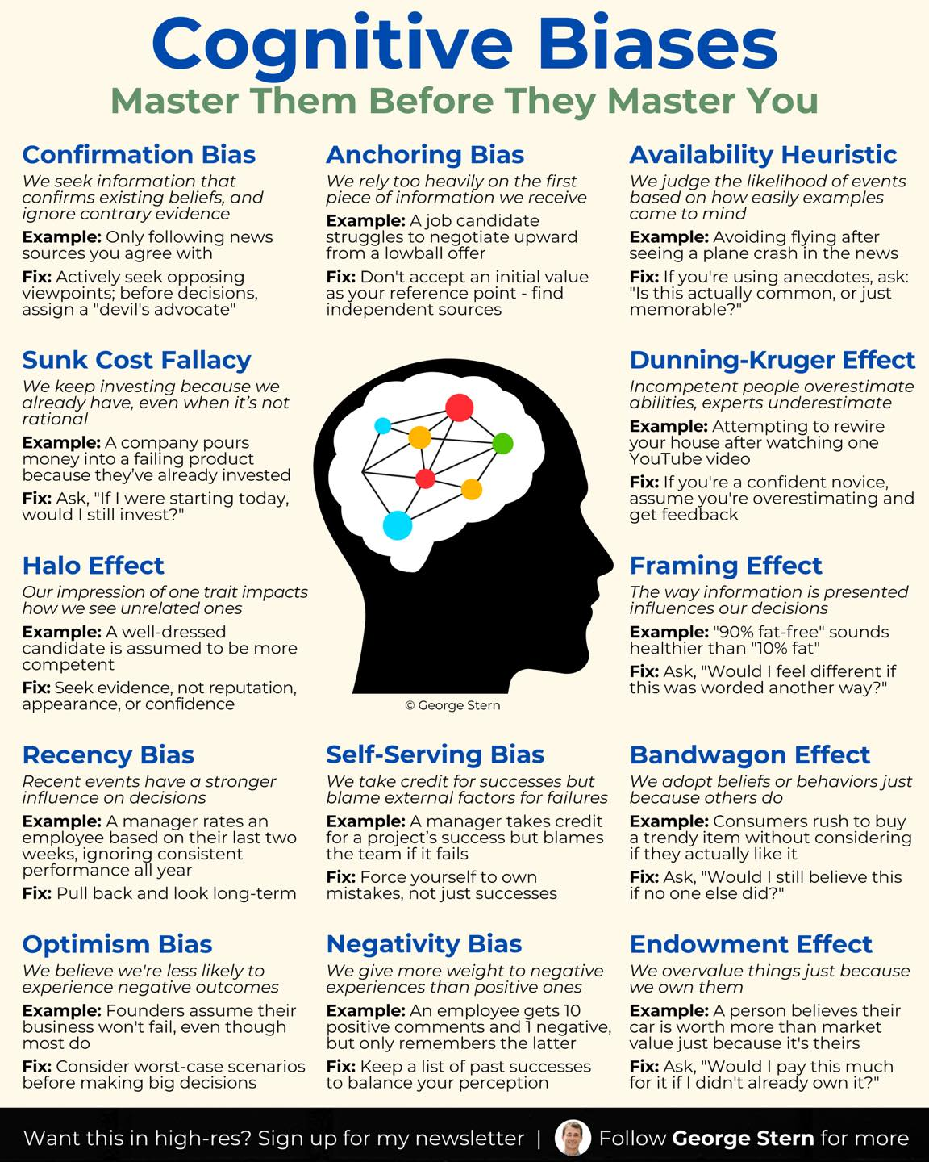
Cognitive Biases

Slide 13
Storing and Retrieving
Incoming information subject to scanning
Two-types of memory
  Short-term - temporary holding area
    5 bits, +/- 2 (telephone number)
  Long-term - complex and detailed information
    Life history in nodes and networks
    Node contains basic elements of an object
    Node is connected to other nodes in the mind

Slide 14
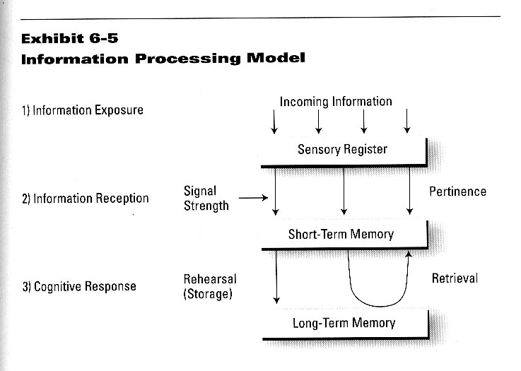
Processing and Memory

Slide 15
Perception Process
Physiological
Screens
(sensory)
Psychological
Screens
(emotional)
Physical Data
(stimuli)
Cognitive
(awareness)
Perception files
(memory)
• Ad/
commercial
• Promotion
• News item
• Product/store
• Price tag
• Conversation
Sight
Hearing
Taste
Smell
Touch
Personality
Self-concept
Attitudes
Beliefs
Habits
Information
Needs
Wants
Awareness
Non-awareness
Feedback

Slide 16
Information Storage
Objects are related to their attributes
Objects are related to other objects
Information is stored over-time
  Contribute to brand knowledge
    Brand awareness
    Brand image

Slide 17
Increasing Memorability
Repetition – multiple message placements
Jingles – verse or tune designed for memory
Slogans – short, striking or memorable phrase tailored to a particular message or campaign
Taglines – distillation of your corporate values and identity into a pithy, longstanding phrase

Slide 18
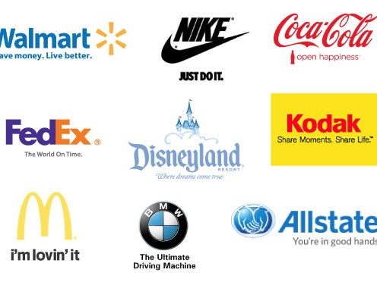

Slide 19
Brand Knowledge
Brand Awareness
  Recognize, recall, and associate
    Name, symbol, color, package, and messages
Brand Image
  Created through brand associations
    Favorable and unfavorable linkages
    “Schema” about a brand

Slide 20
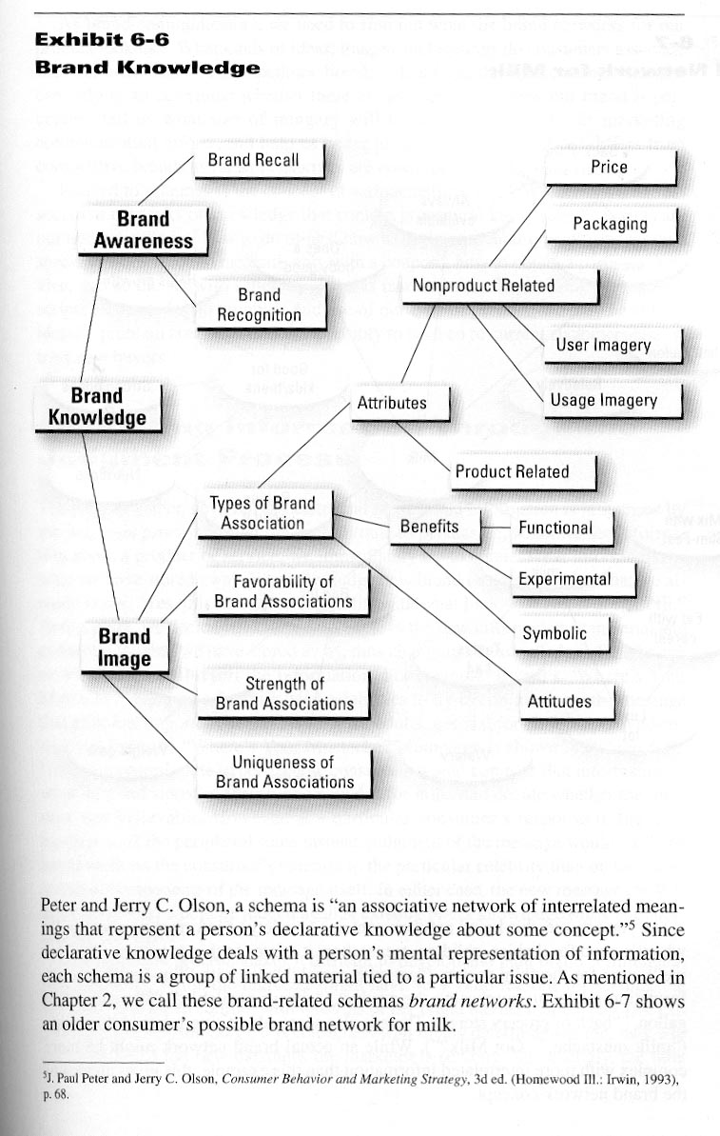

Slide 21
Mental Mapping
Must understand what networks looks like
  Ideas, images, feelings that link to object
Mapping the most common linkages helps us determine problems and opportunities
  How brand is perceived
  What imagery/ideas will be most effective in strategic communication efforts

Slide 22
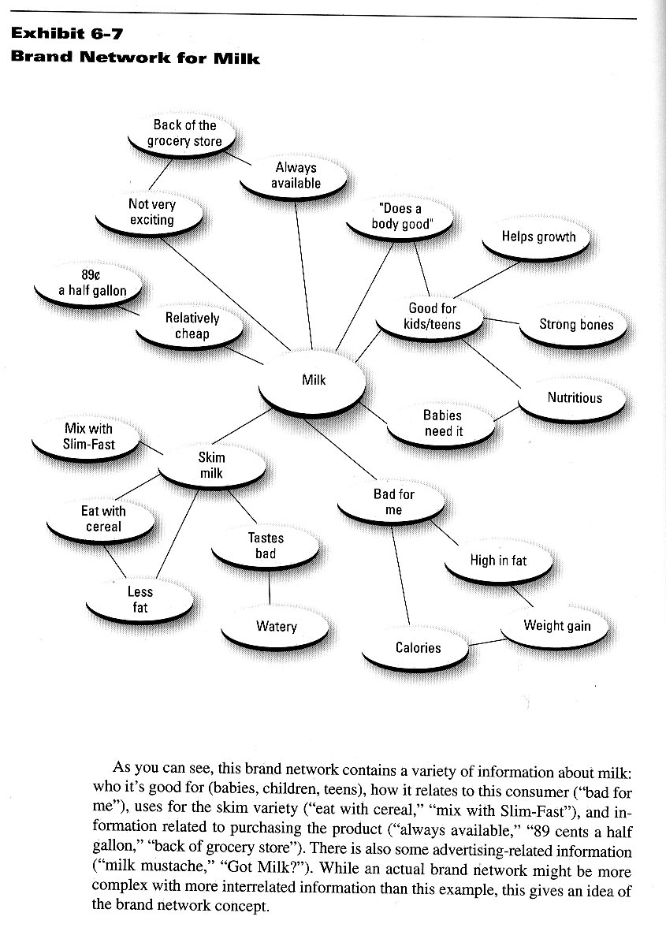

Slide 23
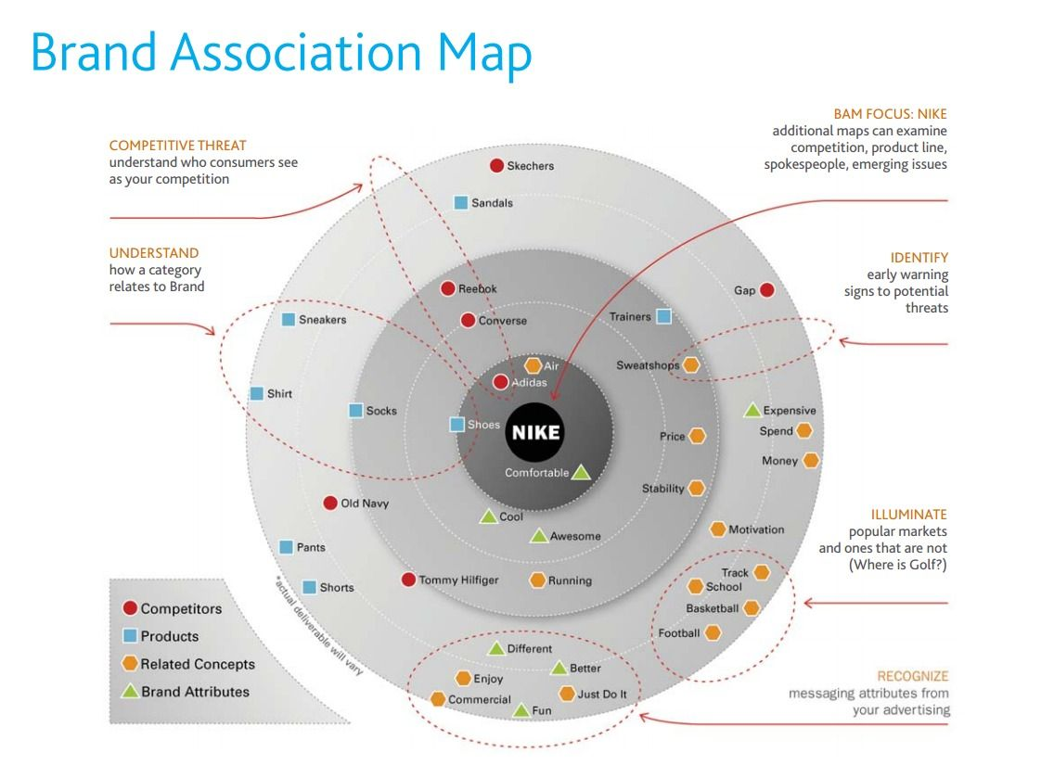
Brand Associations

Slide 24
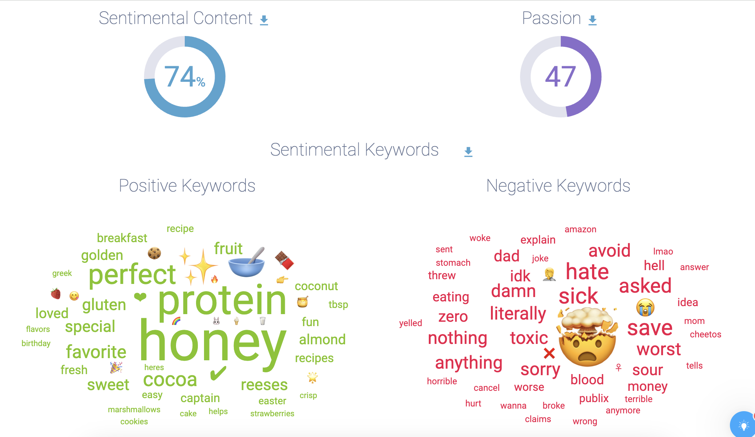
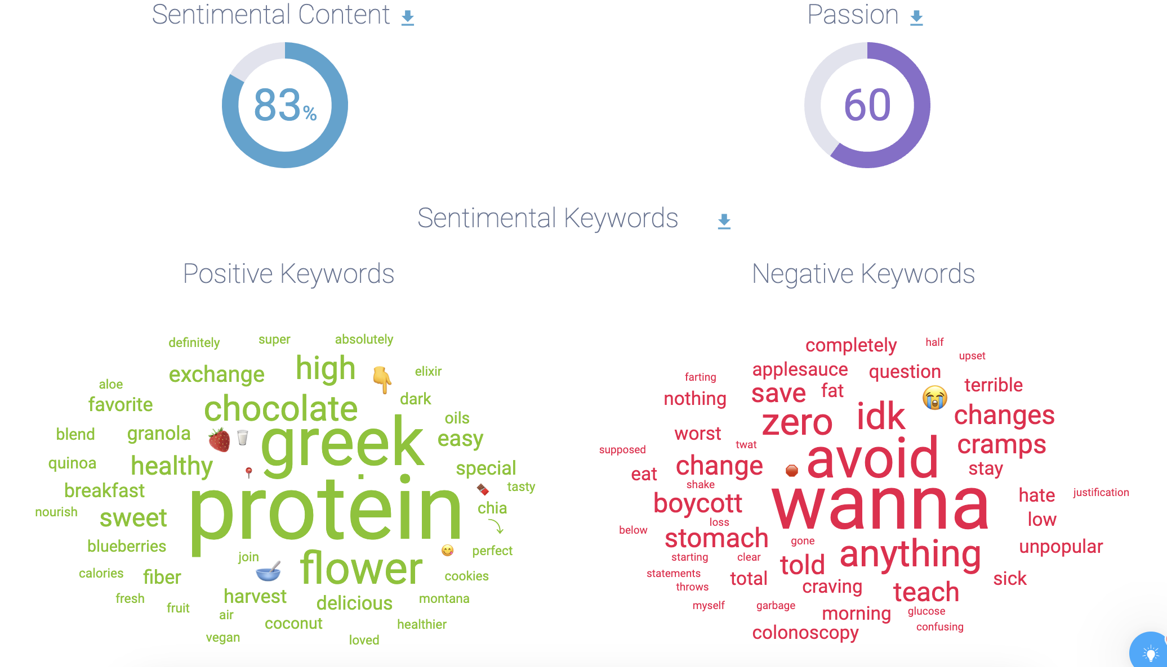
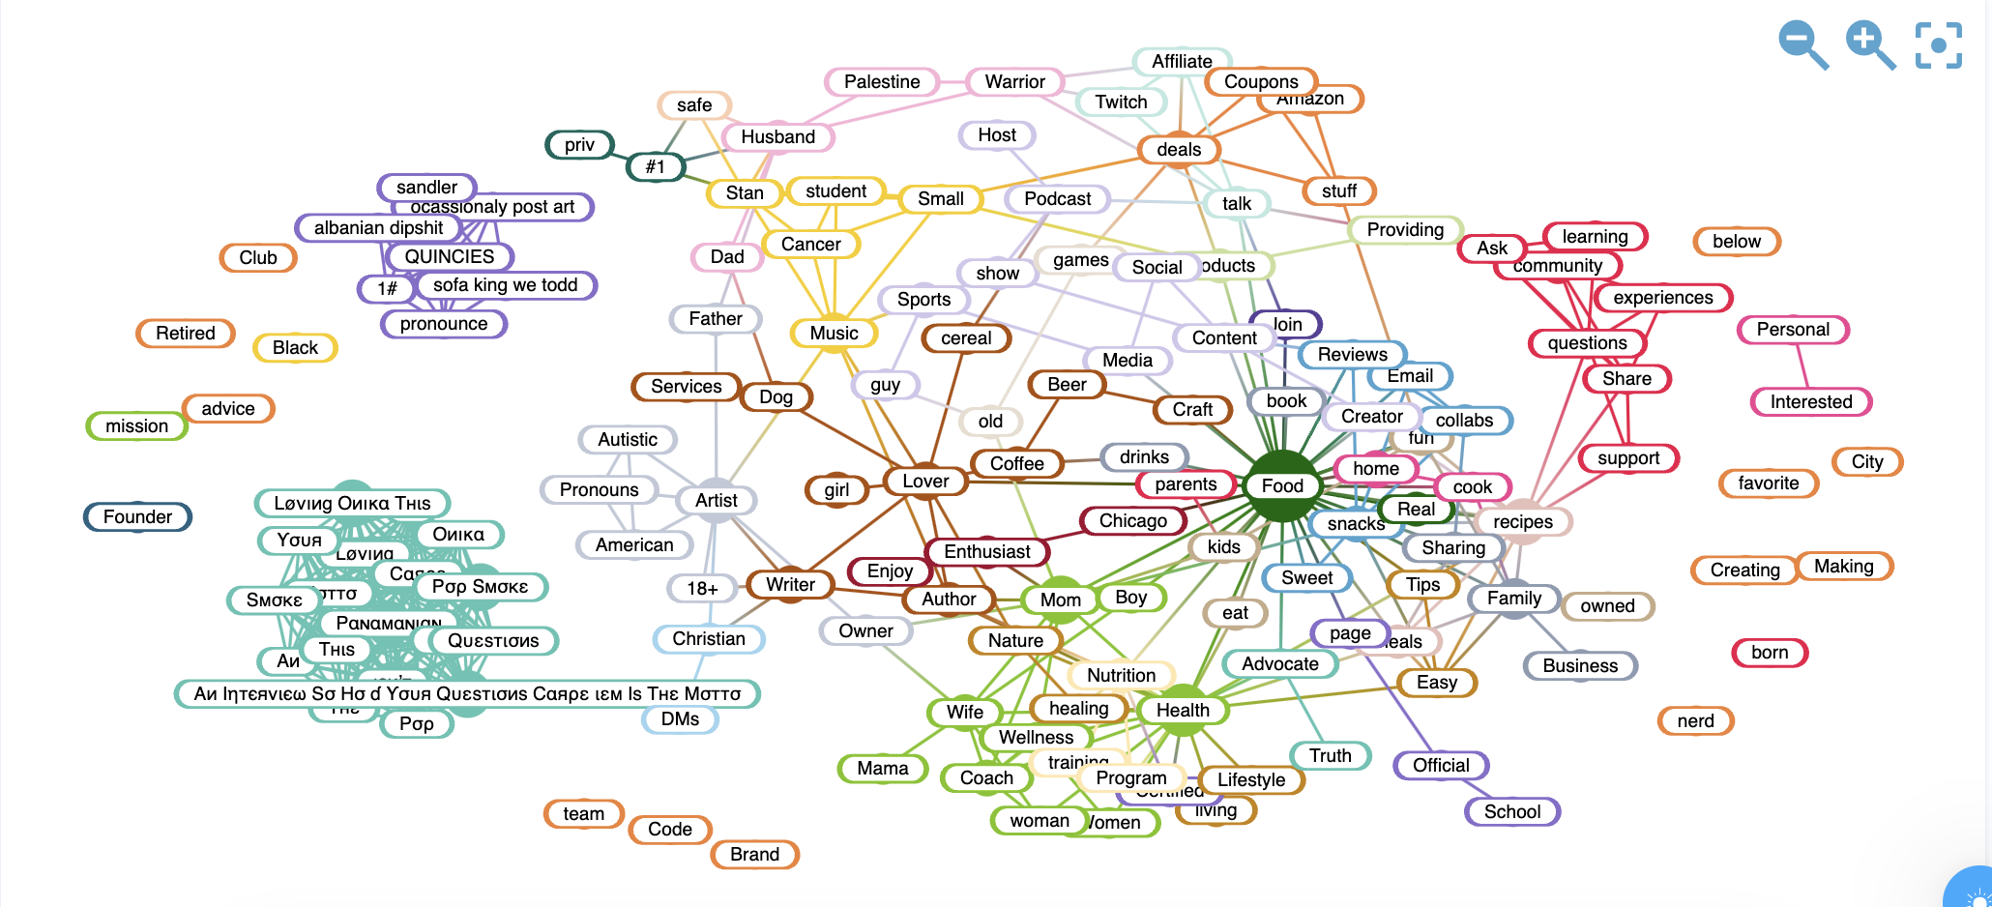
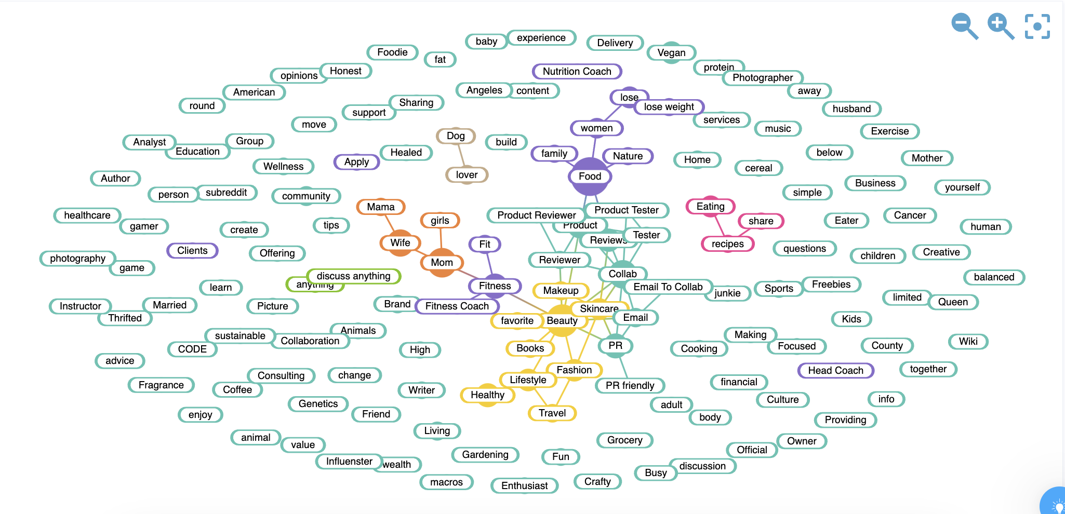
Linguistic Patterns – Word Mapping
Cheerios
Kashi Go

Slide 25


Slide 26
Message Styles
Hard sell vs. Soft sell
  Facts vs. Emotions
Informational vs. Transformational
  Given attributes vs. Expand attributes
Utilitarian vs. Value-Oriented
  Pragmatic vs. Self-expressive

Slide 27
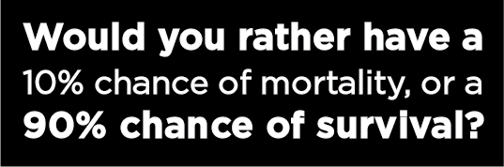
Message Framing
Emphasize certain elements while excluding others – shift perspective
Build message concept around a value
  Easily understood and shared
  Easily processed and integrated into memory
  Easily recalled for later use

Slide 28
Core
Values
A comfortable life
An exciting life
A sense of accomplishment
A world at peace
A world of beauty
Equality
Family security
Freedom
Happiness
Inner harmony
Mature love
National security
Pleasure
Salvation
Self-respect
Social recognition
True friendship
Wisdom

Slide 29
Understanding
Making sense of the ad
Clarity
Literary tools
  Definition
  Explanation
  Demonstration
  Comparison
  Contrast
Association
  Image-building

Slide 30
Persuasion
Getting people to believe or do
Goals of persuasion:
  Establishing attitudes
  Reinforcing attitudes
  Changing attitudes
  Building an argument
  Touching an emotion
  Anchoring conviction/belief

Slide 31
Elaboration Likelihood Model
Central and peripheral route attitude change
Persuasive communication has lasting effect on attitudes when…
  Motivated to process the information
  Ability to process the information
  Cognitive responses are valenced
Otherwise, we rely on peripheral cues
  Attitude change is temporary and unstable

Slide 32
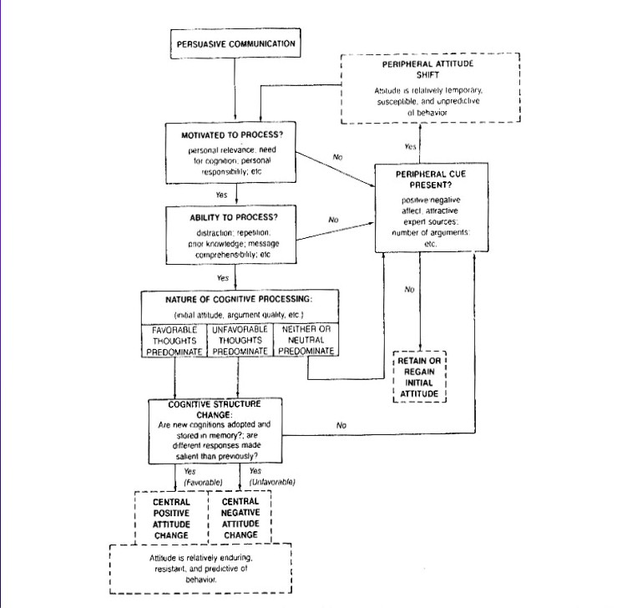

Slide 33
Social Influences
Consumer as a social being
  Culture – the ways of life, the social legacy
    Invisible to those immersed in it
    Yet it defines responses and behaviors
  Values – Expressions of priorities
    Values are enduring and shape action
    Cultural capital – economic or social
  Rituals – formalized symbolic behaviors
    Holidays and celebrations

Slide 34
Social Position
Social Class
  Upper Class
  Upper Middle Class
  Middle Class
Class mobility
Reference Groups
Aspirational Groups
Race and Gender
Family
  Family structure
  Kids in household
  Marital Status
  Parental Education
Intergenerational Influences
  Indoctrination
  Trickle-up
Community

Slide 35
Brand Analysis: Audience Perceptions
1) What are your offerings?
What is your market reach and your range of products? Consider your most popular items, your newest additions, your extensions, and your newest market offers. What are the strengths and weaknesses among these features?
2) What is the competitive landscape?
Who are your major competitors (established and upstart brands)? Who are your core competitors (highly similar brands, including new entrants)? Have competitors shifted their brand strategy in ways that threaten yours?
3) How is your brand perceived?
What’s your brand’s personality? What ideas do users associate with it? How is your brand positioned relative to competitors? What differentiates your brand? What makes ii unique in the market? What are its key attributes?

