Slide 1
Using Marketing Data

Slide 2
First Agency Meeting with Client
Look for a Doodle Poll on the class email list requesting teams to sign up for a one-on-one meeting with the client (me)
Meetings will last 30 minutes
Pick a time when all team members can attend
Once a slot is taken, it cannot be double-booked
All meetings must be scheduled on Friday, Monday, or Tuesday, so you have time before the draft of the situation analysis is due next Thursday

Slide 3
Digging Deeper
Articles from magazines, trade & scholarly journals:
Business Source Complete (business-periodicals)
Communication & Mass Media (has Advertising Age)
MasterFile Premier (has Consumer Reports)
Newspaper Source Plus (has newspapers)
ABI/Inform – academic articles
Factiva - news coverage
Lexis/Nexis – news coverage

Slide 4
Profiling Consumers
Simmons Catalyst
Use Most Recent 12 Month Study
Lags two years behind, so use 2023 data
Generate Quick Report and Cross Tabs
Consumer demographics – age, educ. race, gender etc.
Lifestyle statements – views on fashion, environment, etc.
Consumer behavior – products and brands they buy
Media profile – magazines, TV shows, websites, etc.

Slide 5
Consumer Profile Data
basic demographics
gender, age, education, income, race, ethnicity, marital status, occupational category, sexual orientation
basic orientations
Attitudes and opinions, lifestyles and values
basic media use
(social media used and activities, internet behaviors, magazine readership, newspaper reading, radio formats, streaming services)
BY (c) consumer behavior
Product category or brand consumption and volume

Slide 6
Working with Simmons Data
Identifying potential consumers
Segment prospect markets
Narrow consumer targets
Characteristics
Media use patterns
Identifying efficient media options

Slide 7
Simmons/MRI
Multi-media audience estimates combined with extensive product/service use based on massive survey collection
Simmons Market Research Bureau (SMRB)
Mediamark Research Inc. (MRI) data
2019: Merged into MRI-Simmons
National syndicated studies
Random sample surveys conducted year round
Coterminous 48 states - One respondent per HH
Media measurement methodologies vary

Slide 8
Product Data
MRI-Simmons provide extensive product/service use data
By broad product category - ex. Salted Snacks to Luxury Hotels
Within categories, by type & brand to understand differences
Similar results for overall product use
Also measure volume of product use
Some categories have more detailed volume data

Slide 9
Use vs. Volume
Use: Number of people using a product
Ex. Number of airline travelers
Volume: Number of units or amount of the product used over a specified time period
Ex. Number of trips taken
Must consider use and volume
Offers better understanding of brand user

Slide 10
Volumetrics
MRI provided more volume data
Estimates based on respondent giving actual use figure for each item
MRI-Simmons provides less volume data
Estimates based on respondent checking a “use range” for entire category or kind

Slide 11
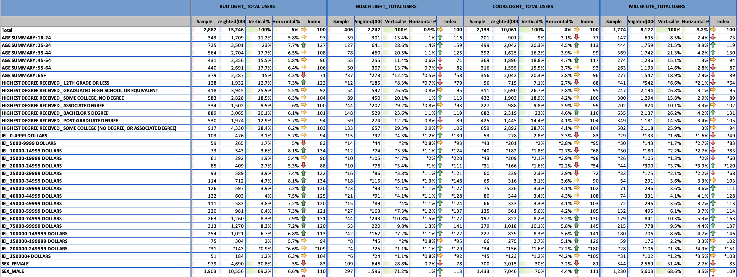
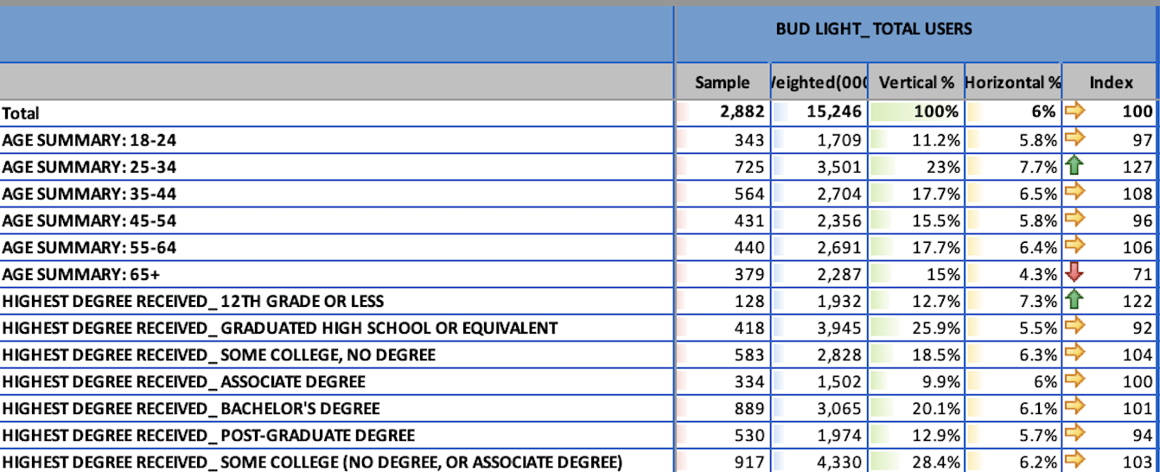
Generate a Crosstab View Report in Simmons

Slide 12
Sample of of US Adults who drink Bud Light
Estimated number of US Adults who drink Bud Light
Percent of US Adults who drink Bud Light
49,187 – Total Sample of US Adults
252,819,000 – Estimated # of US Adults
Percent of US Adults Age 24-34 who drink Bud Light
Index of Adults 25-34 who drink Bud Light (7.7/6.0)
Percent of US Adult Bud Light Drinkers who are 25-34

Slide 13
Vertical percentages
Base = the population that drinks
Bud Light most often
Of them, what % are 25-34?
23.0% of people who drink
Bud Light most often are age 25-34
Coverage of Users
Percent of Bud Light Drinkers who are 25-34

Slide 14
Horizontal percentages
Base = the population of 25-
34 years olds
Of them, what % drink
Bud Light most often?
7.7% of 25-34 years olds
choose Bud Light most often
Composition of Users
Percent of 25-34 who drink Bud Light most often

Slide 15
The Index
Index compares the coverage among the user group to overall coverage in total population
7.7% compared with 6.0%
7.68 / 6.03 = 1.27 = 127 Index
Means 25-34 years olds are 27% more likely to drink Bud Light “most often” than U.S. adults.
Percent of 25-34 who drink Bud Light most often

Slide 16
Must look at all
Vertical Percentage indicates coverage of that demographic group or media user group
is it a large group? Too large to ignore even is index is not high? It is too small to provide a market?
Horizontal Percentage indicates composition of product users in terms of demo or media
Do high percent of demo or media users consume the product? Is it higher than the population in general?
Index Number indicates the selectivity
Compares the composition of the selected group to the population in general. But don’t just look at this!

Slide 17
Two Sets of Data, Do Additional Runs
If you are marketing light beer, who are your possible markets?
If you are marketing light beer, who are your most heavy users?
If you are marketing Bud Light, who should be your target market?
Cheerios Groups
If you are marketing Miller Lite, who should be your target market?
Kashi Go Groups
If there are multiple possible markets, which are the best primary
and secondary target markets for light beer?

Slide 18
Who are the consumer profiles
Generate a demographic, lifestyle, and media portrait of each prospect group?
How many different prospects are there?
How would you prioritize among them?
How would you “name” each target?
“Brock” vs “Bud” vs “Brad”
“College Bro” vs “Craftsman” vs “Golf Dad”

Slide 19
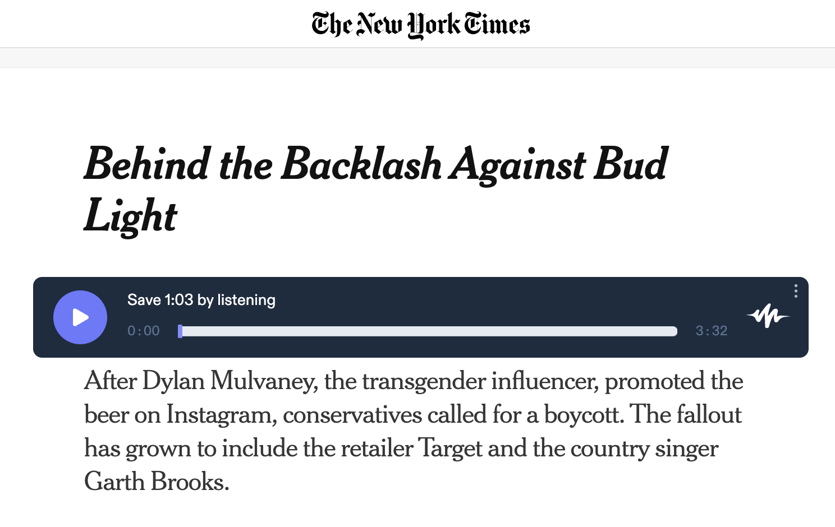
Dylan Mulvaney & 2023 Boycott of Bud Light

Slide 20
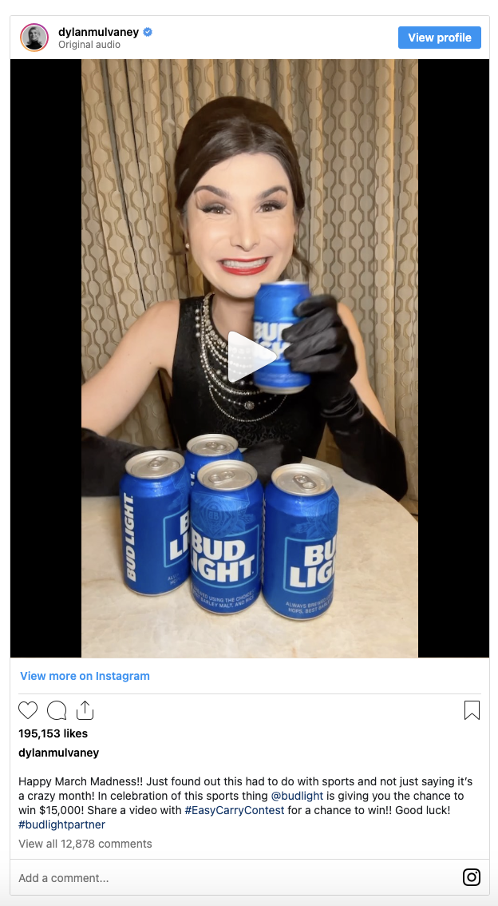
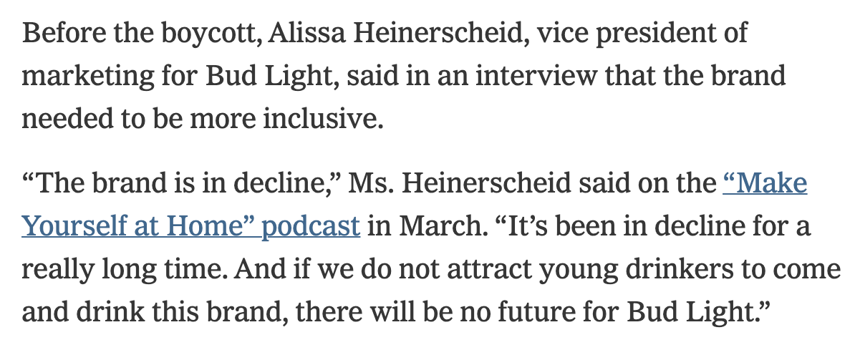
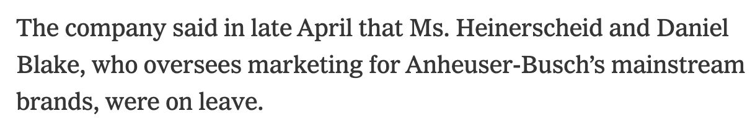
“Bud Light controversy cost parent company about $395 million in lost US sales. The world's largest brewer is counting the costs of being swept into a controversy over Bud Light in the United States. AB InBev said Thursday that US revenue fell 10% in the second quarter as sales of its top brand slumped” - CNN

Slide 21
Real World Ethical Case Study
Should brands endorse social causes / select spokespeople to advance societal concerns?
Should brands stand behind their ad teams when socially conscious marketing goes poorly?
Should brands only support social causes that align with the views of their broad target market?
Should brands be more inclusive to reach younger — “future” — consumers, even it that alienates some current customers?

Slide 22
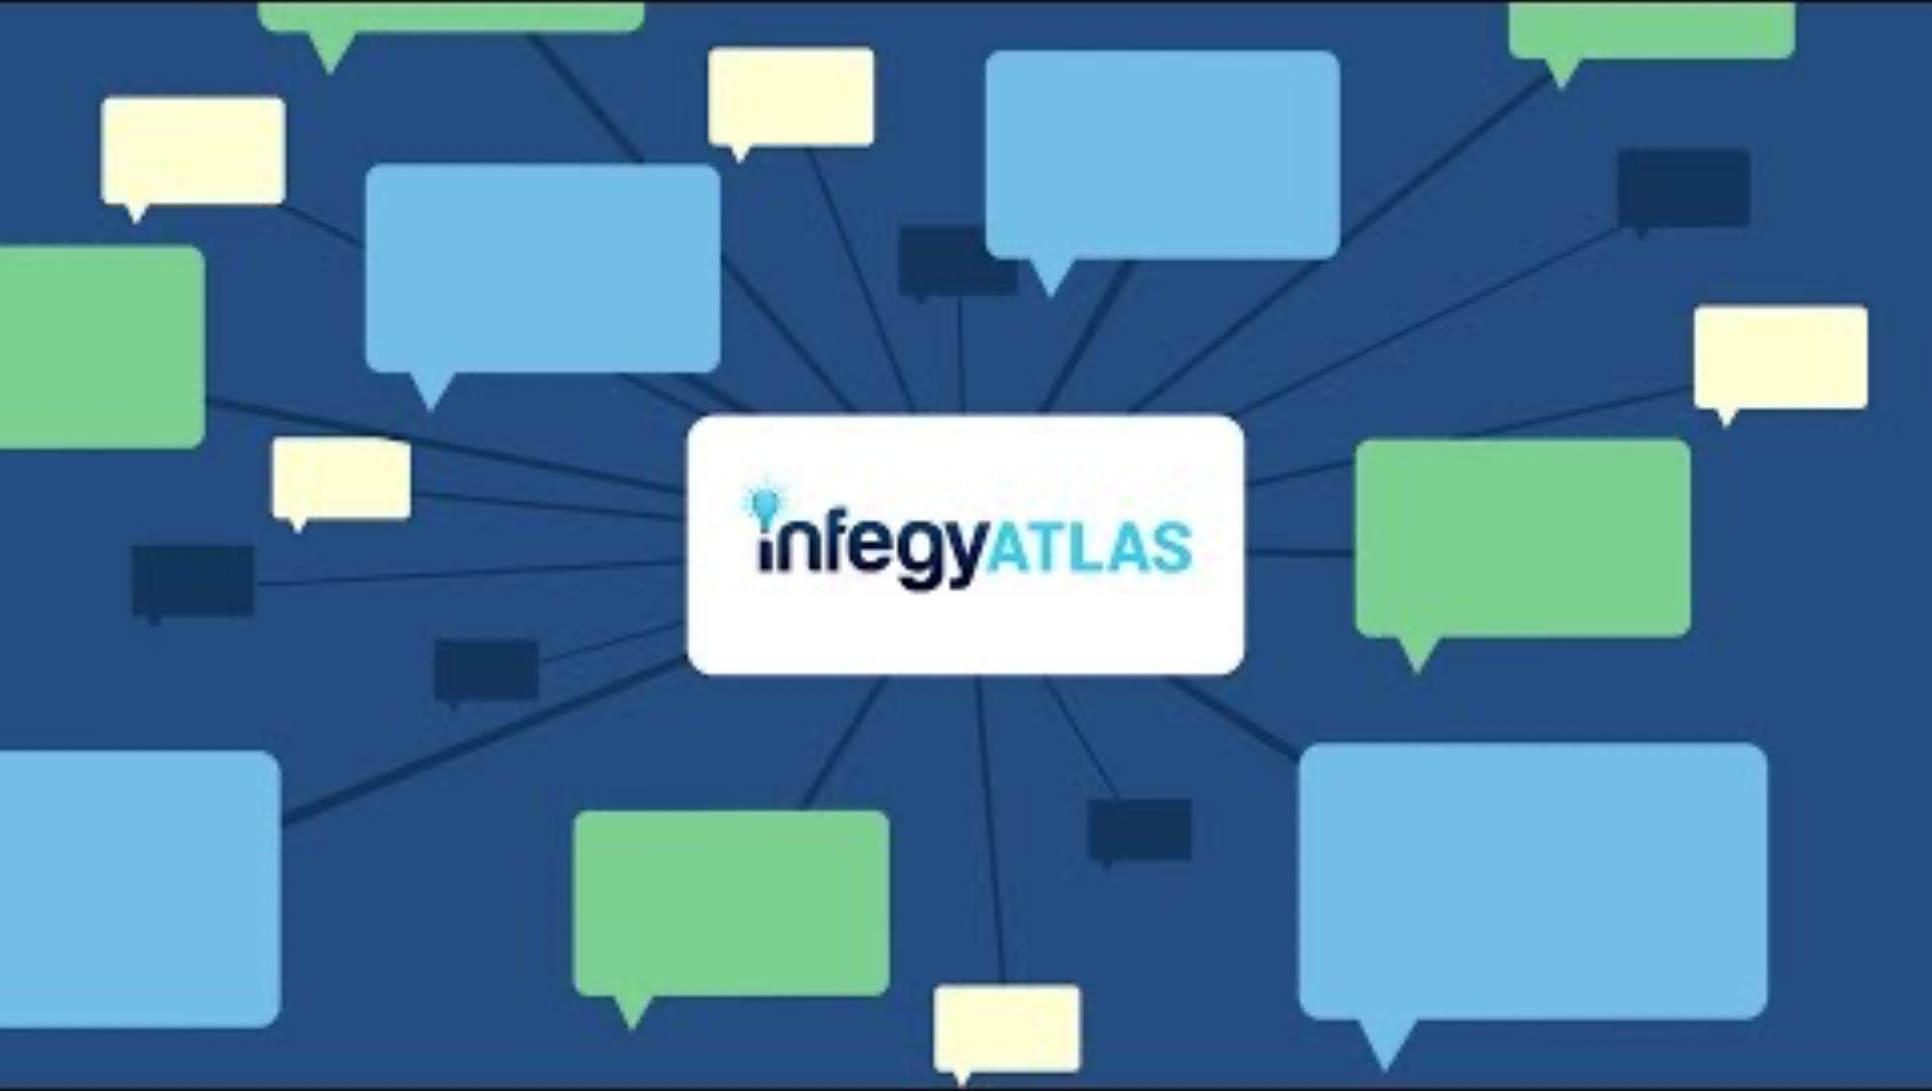
Infegy Atlas

Slide 23
Get Login Info in Lab
Link to Cheerios and Kashi Go runs
Must be logged in for link to work: Click Here
One log in shared across two lab sections
Please log in and log out when done using

Slide 24
CHEERIOS 2025

Slide 25
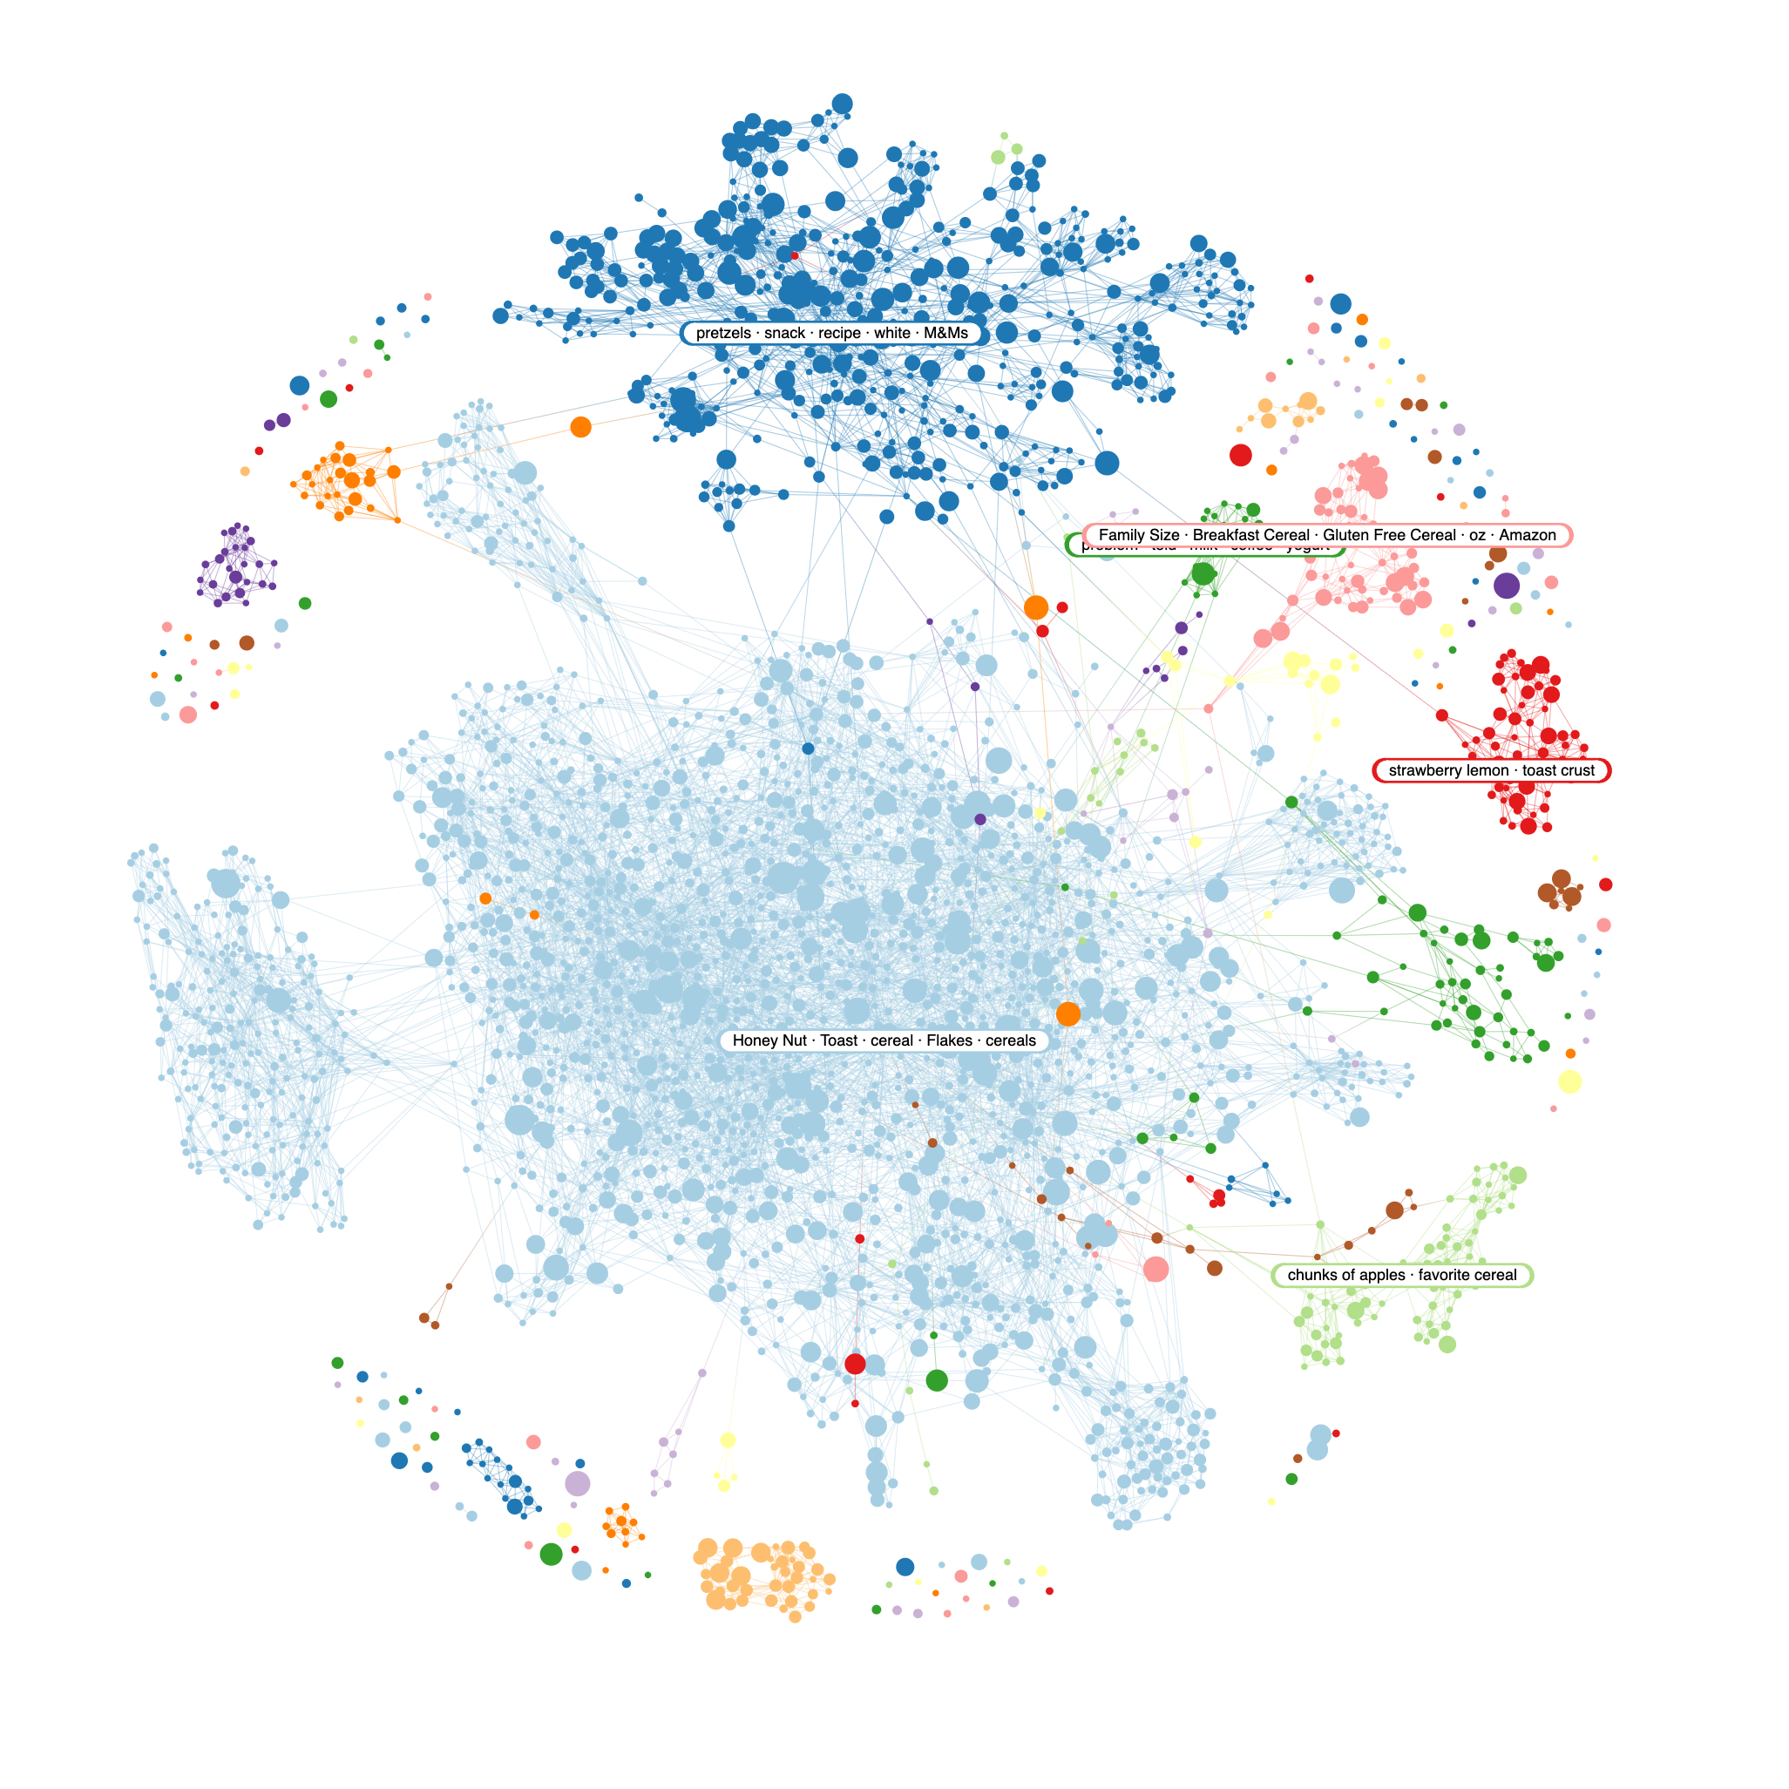

Slide 26
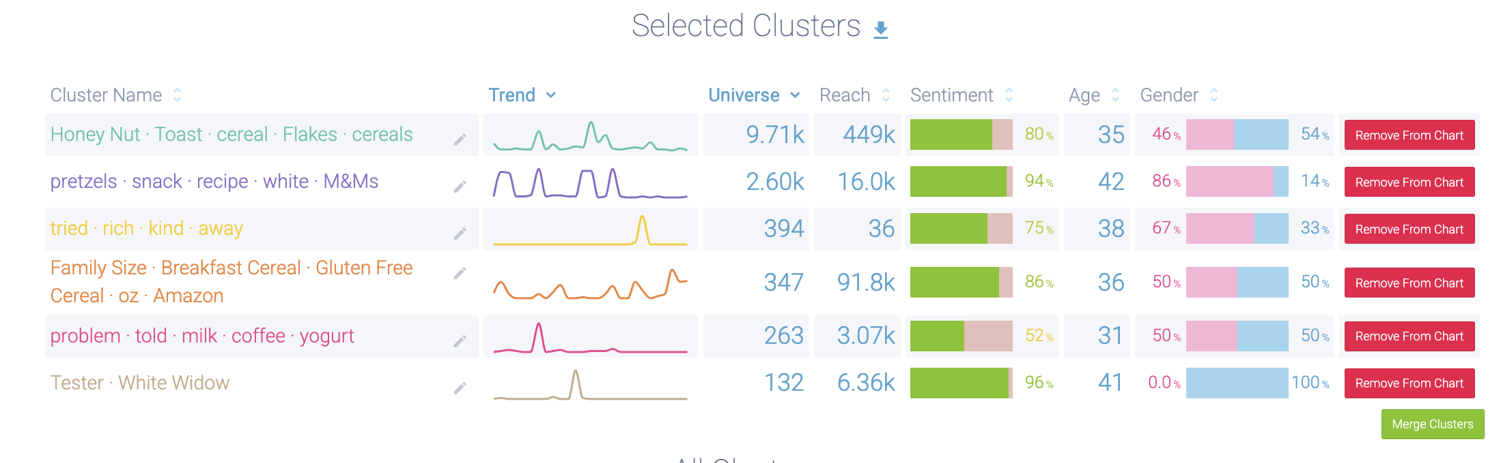
Topics/Narratives

Slide 27
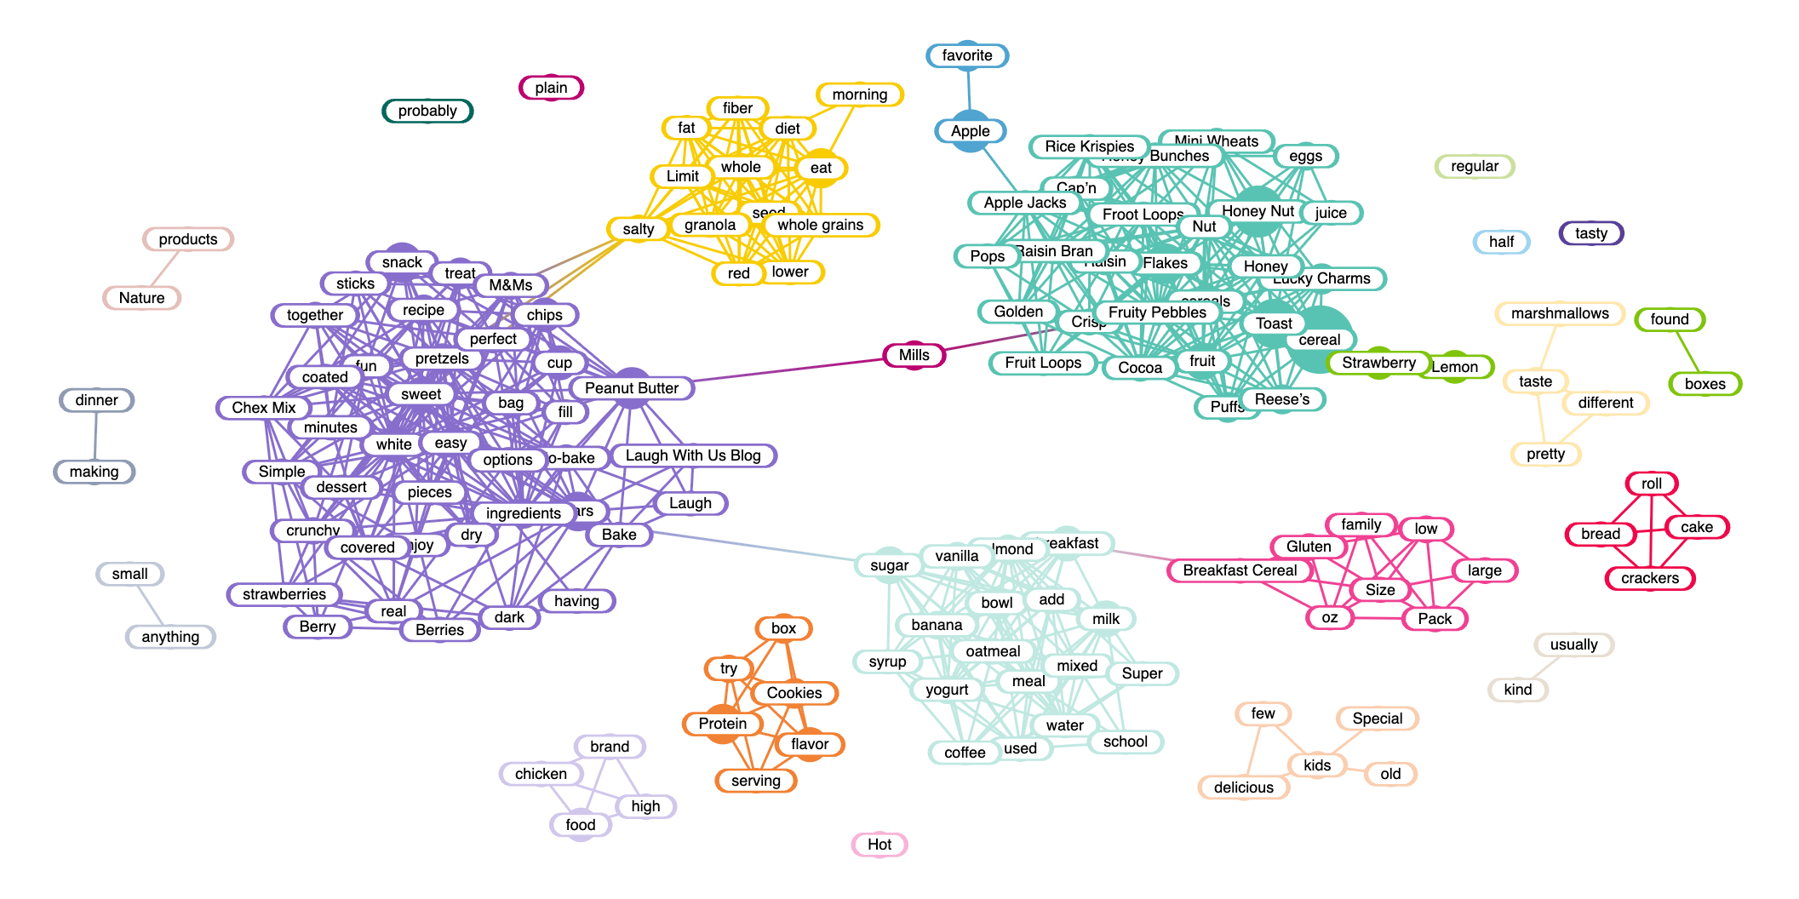
Positive Keywords

Slide 28
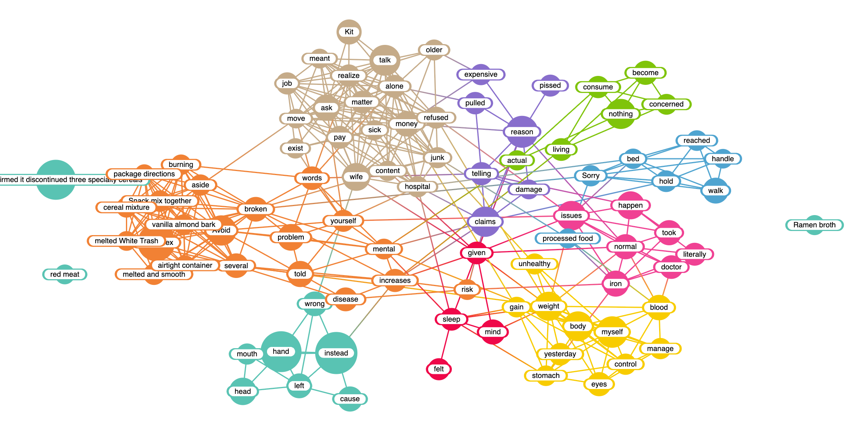
Negative Keywords

Slide 29
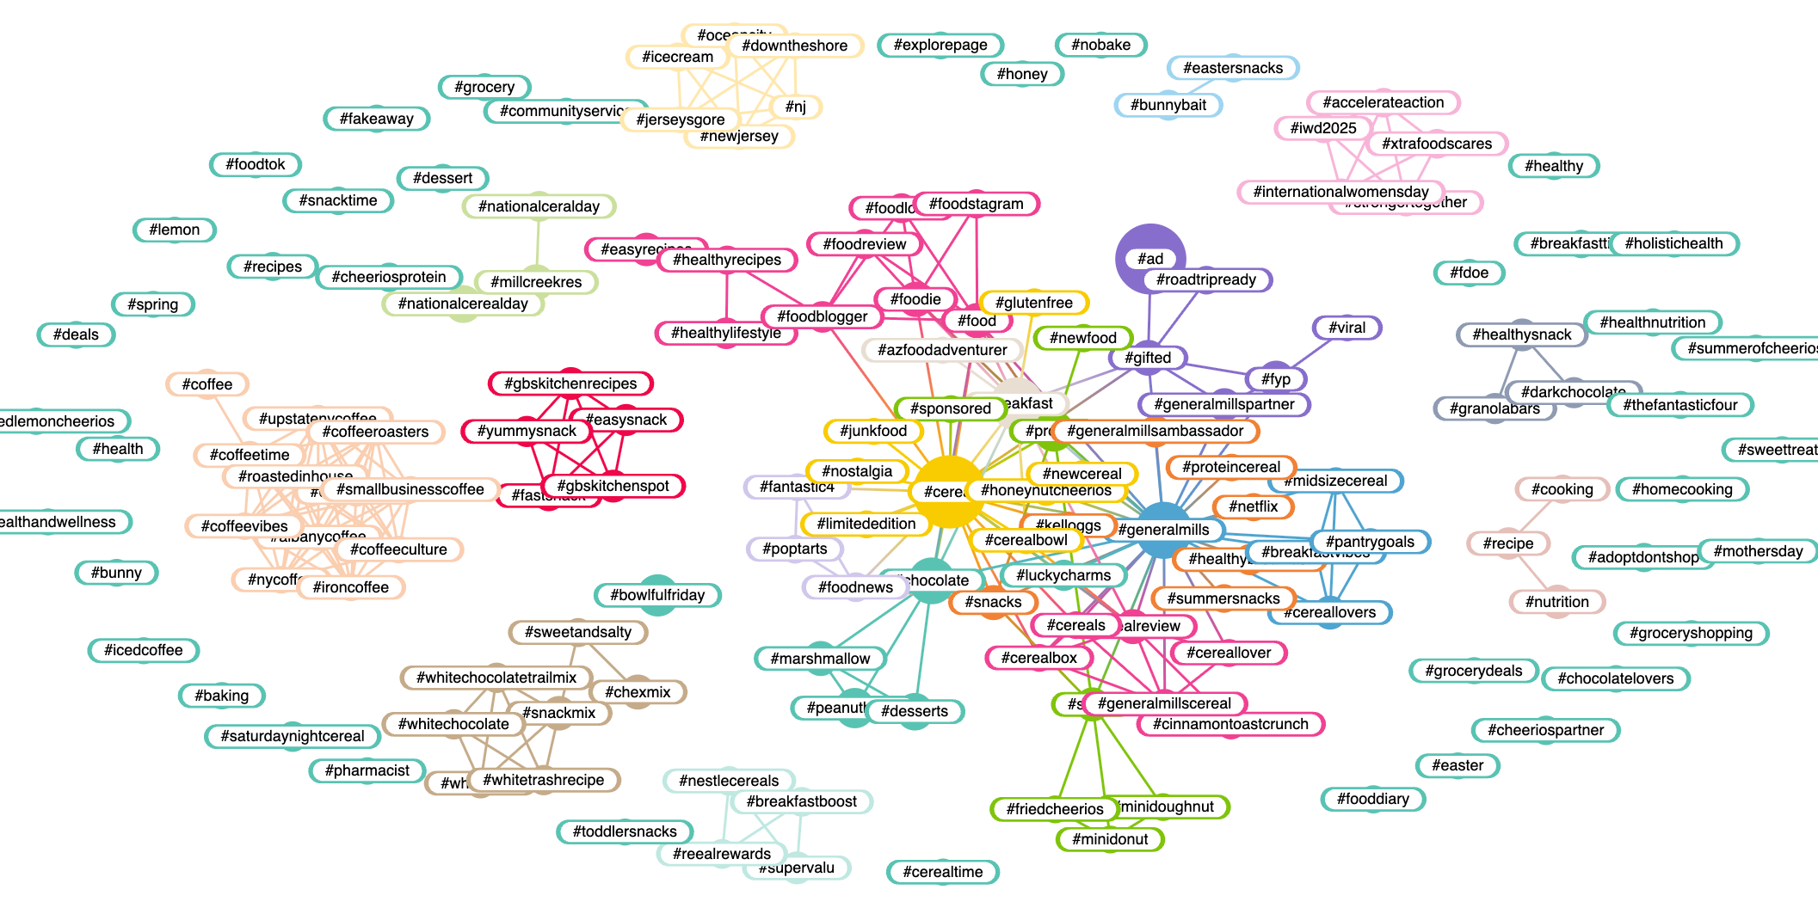
Hashtags

Slide 30
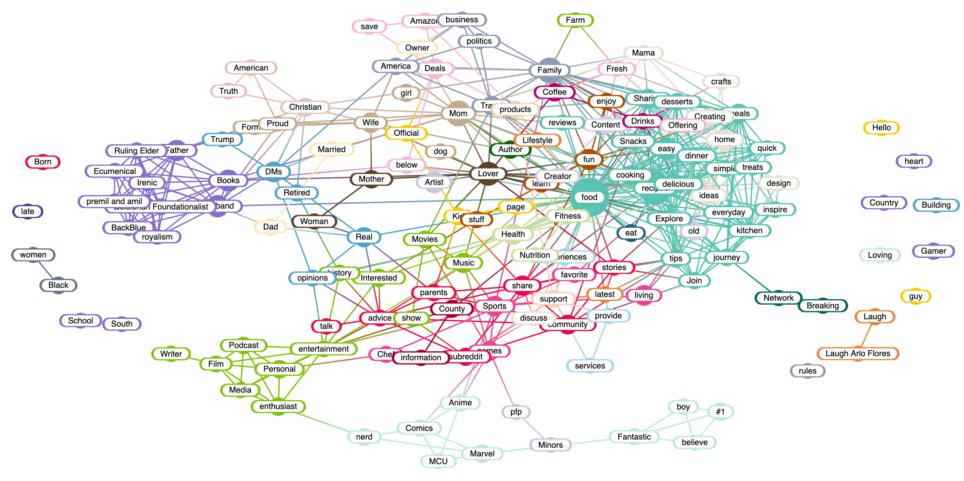
Bios/Target

Slide 31
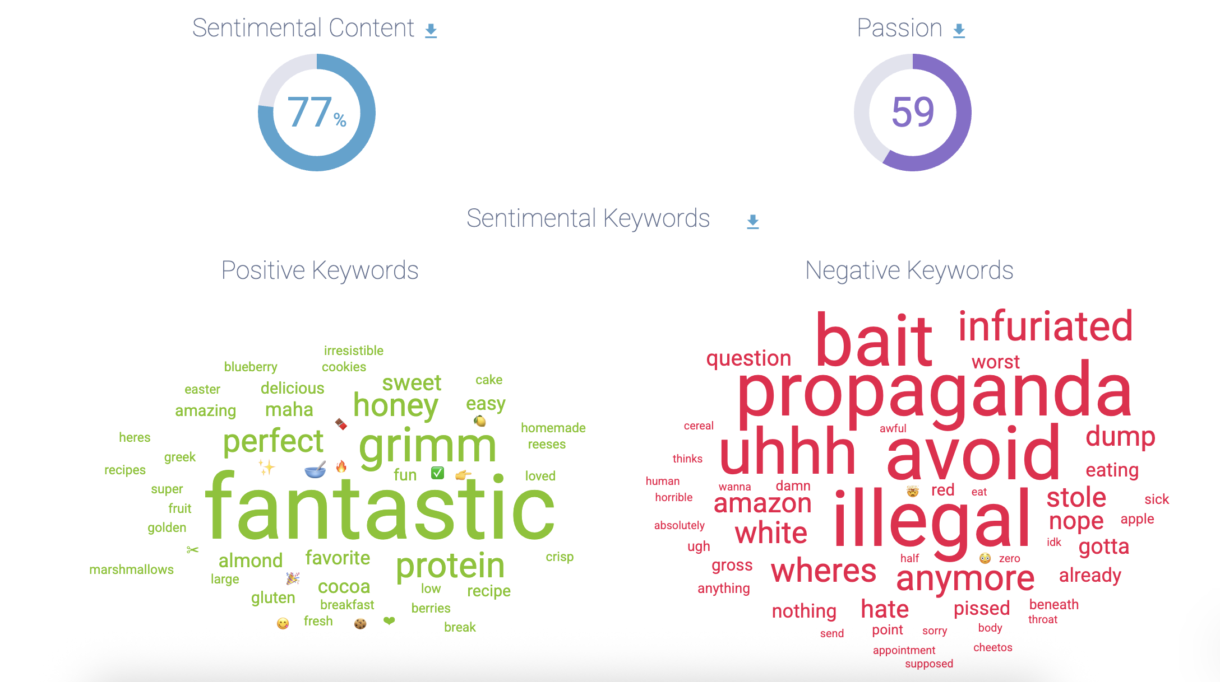
Sentiment

Slide 32
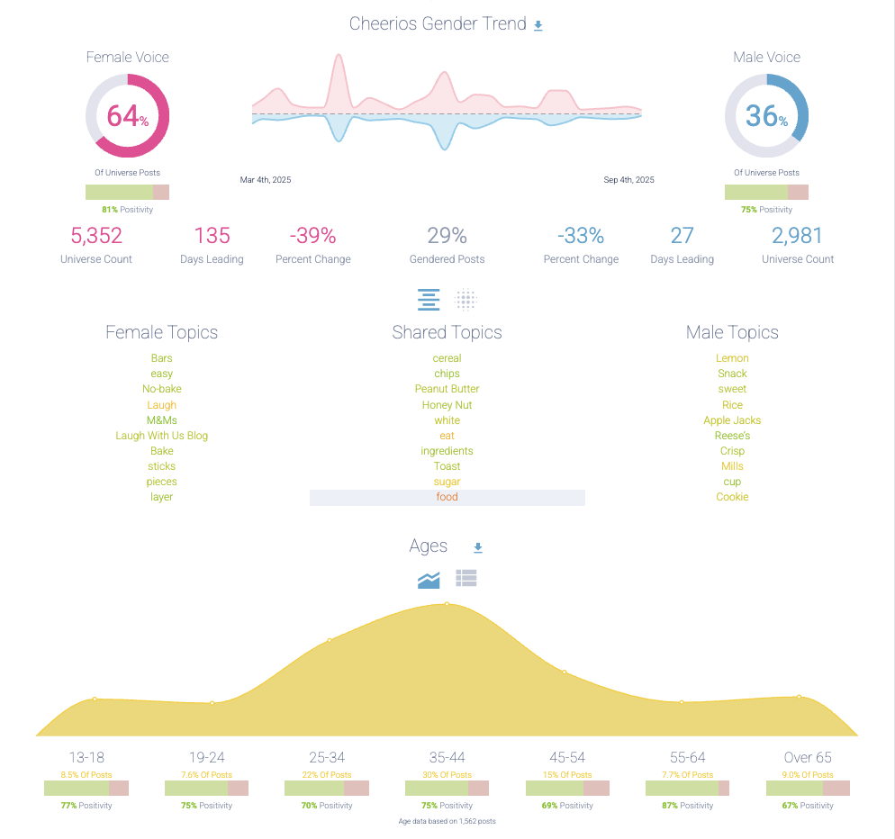
Gender/Age Profile

Slide 33
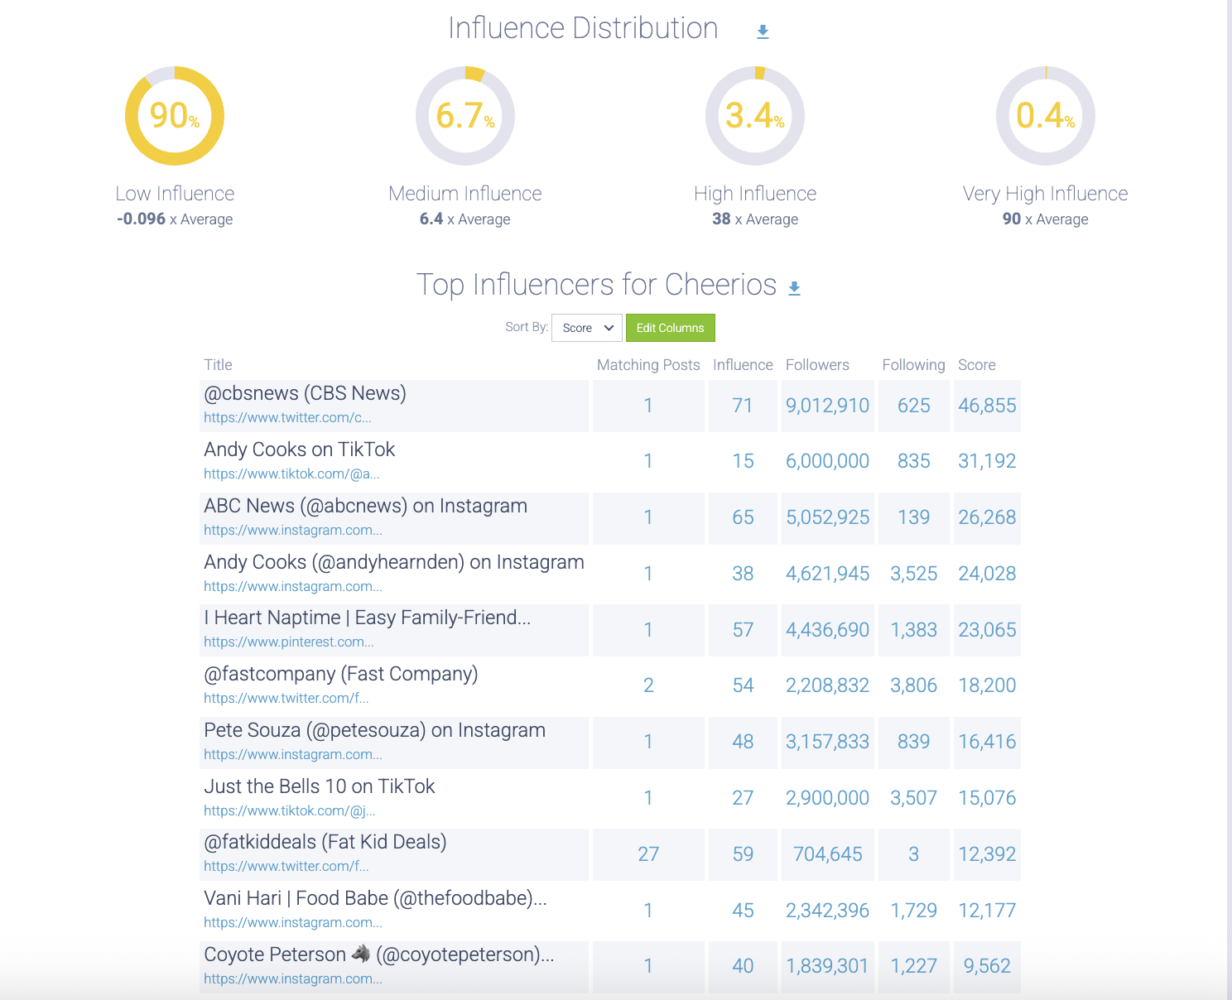
Influencer Distribution

Slide 34
KASHI GO 2025

Slide 35
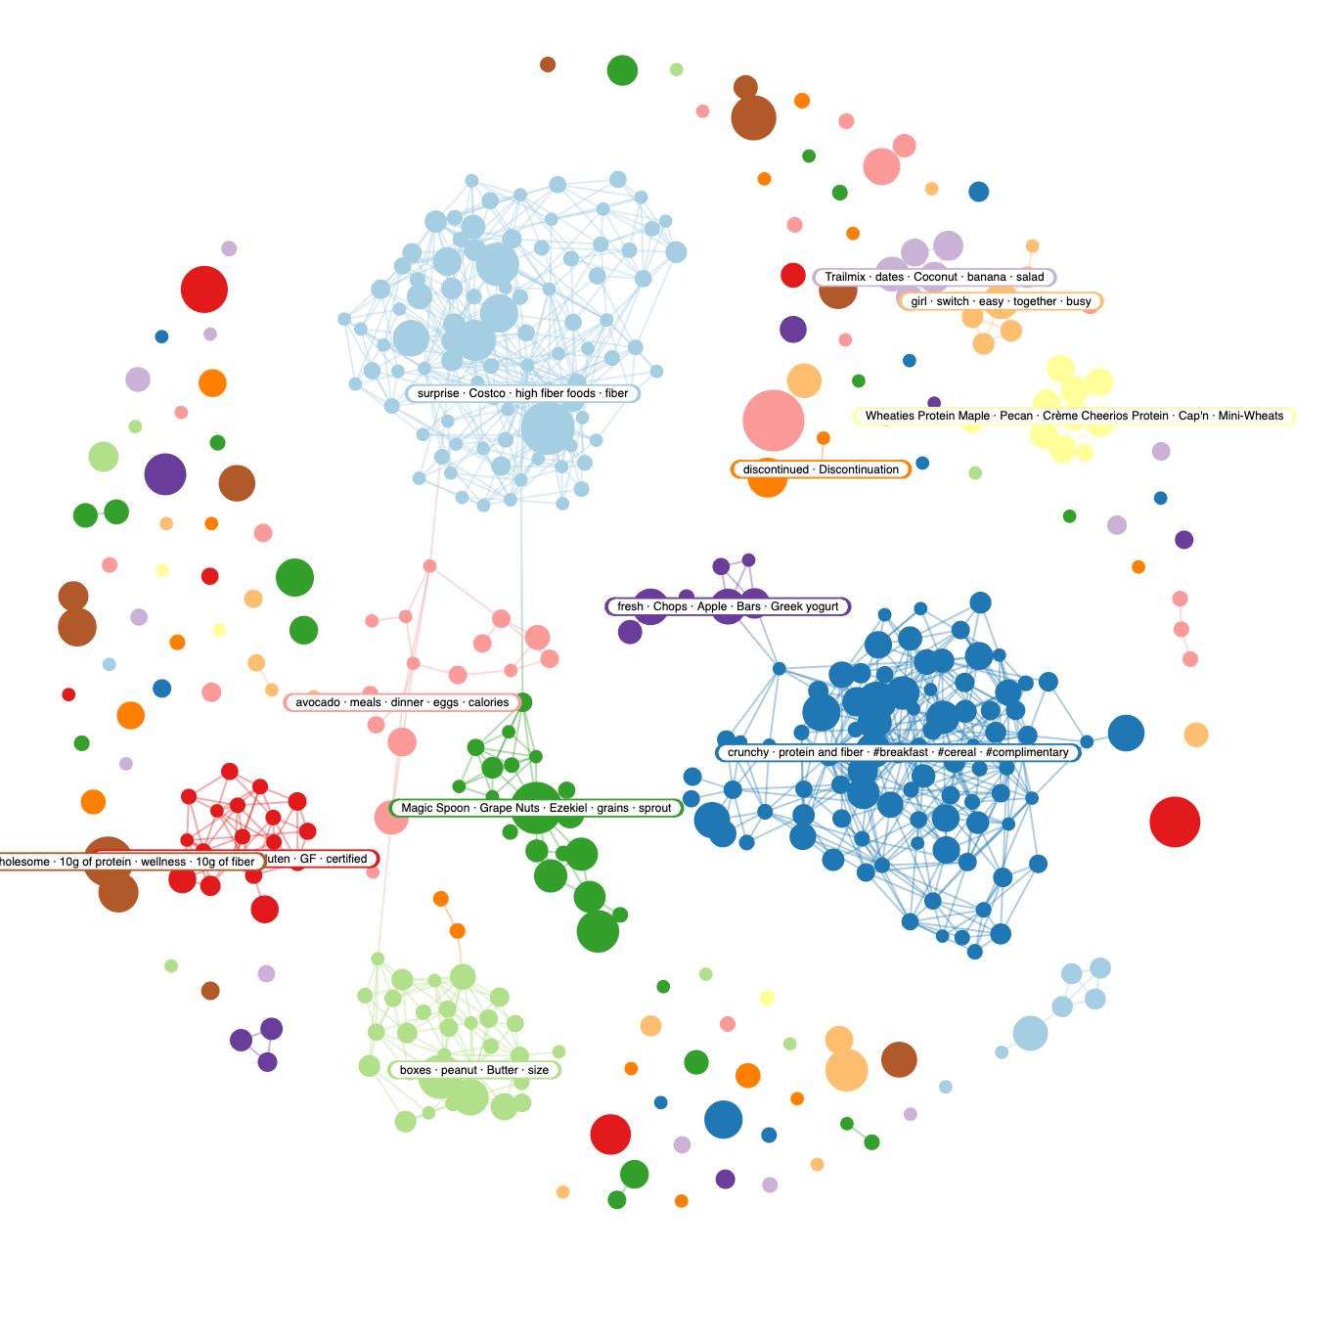

Slide 36
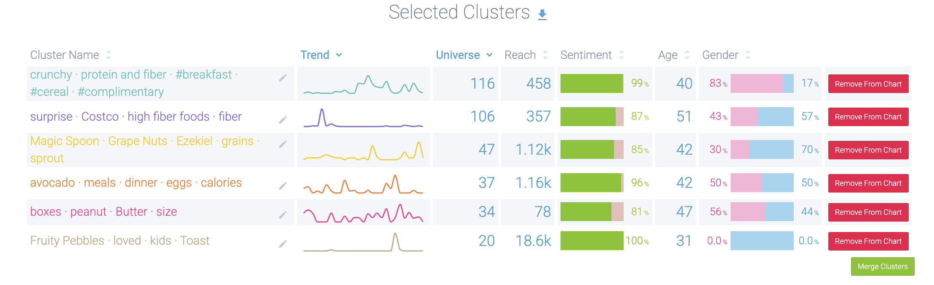
Topics/Narratives

Slide 37
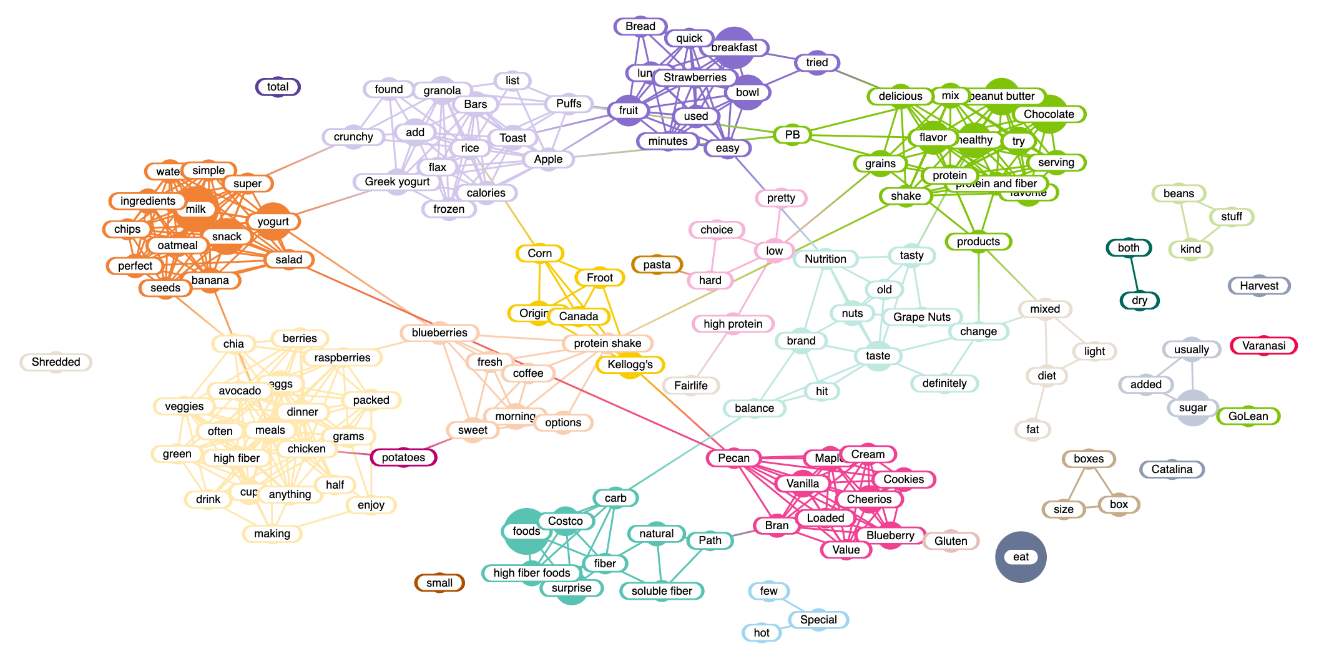
Positive Keywords

Slide 38
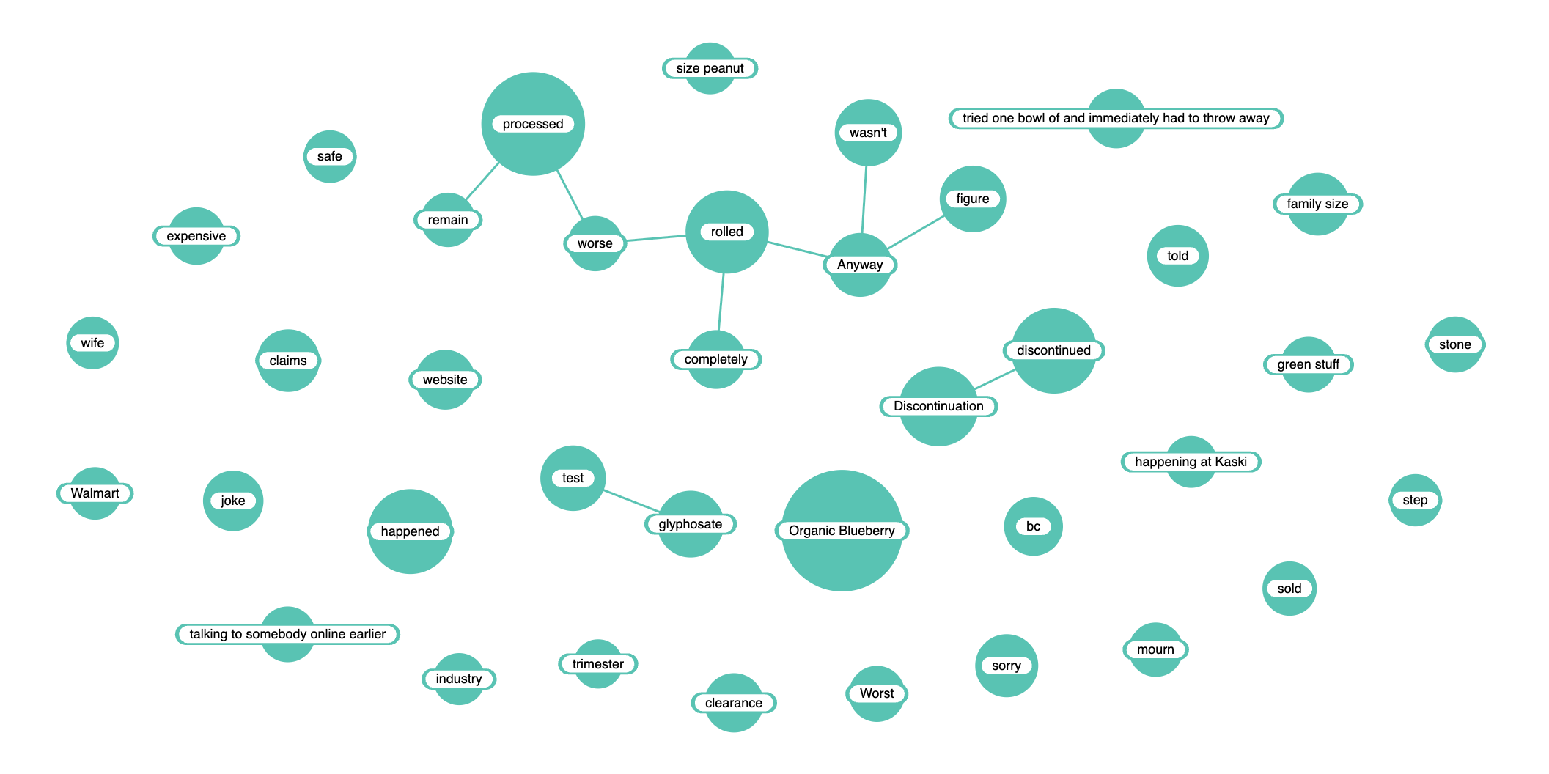
Negative Keywords

Slide 39
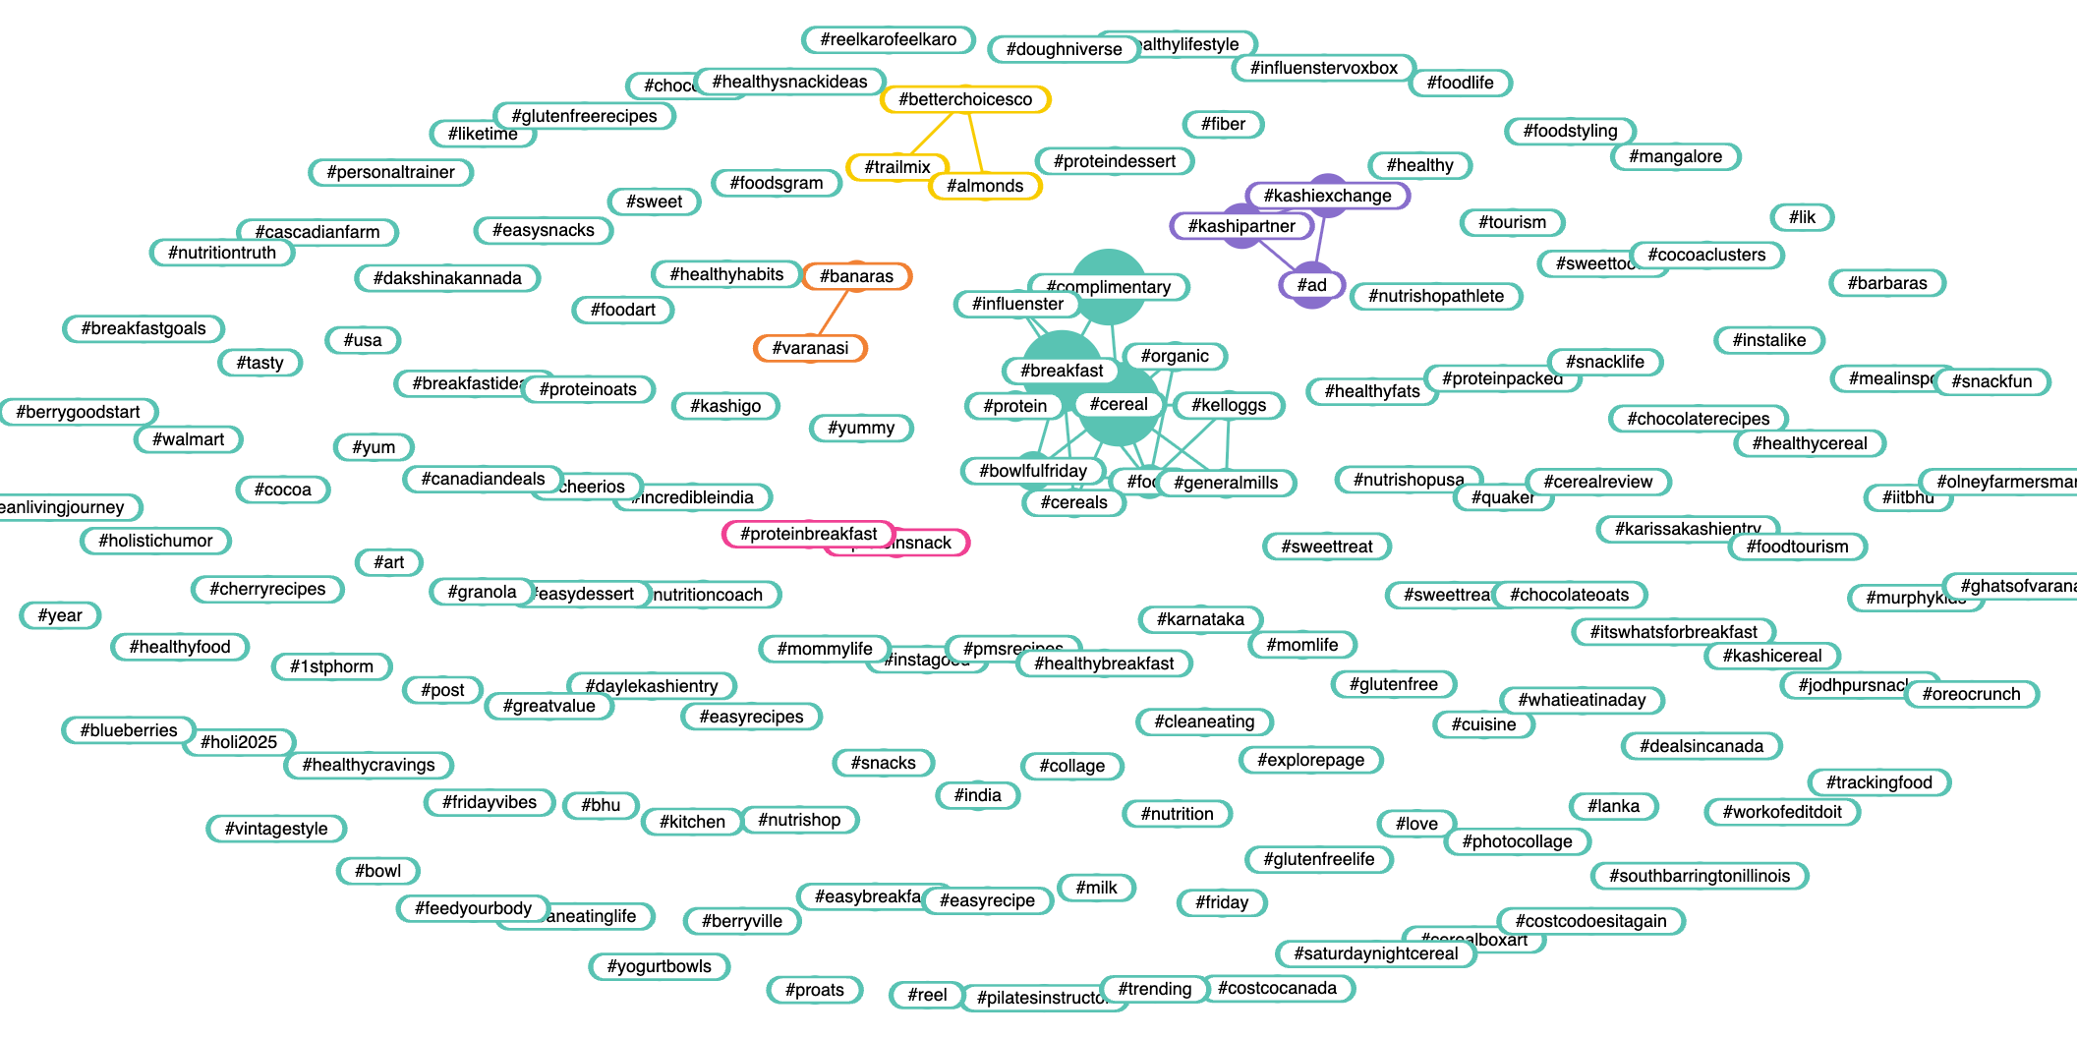
Hashtags

Slide 40
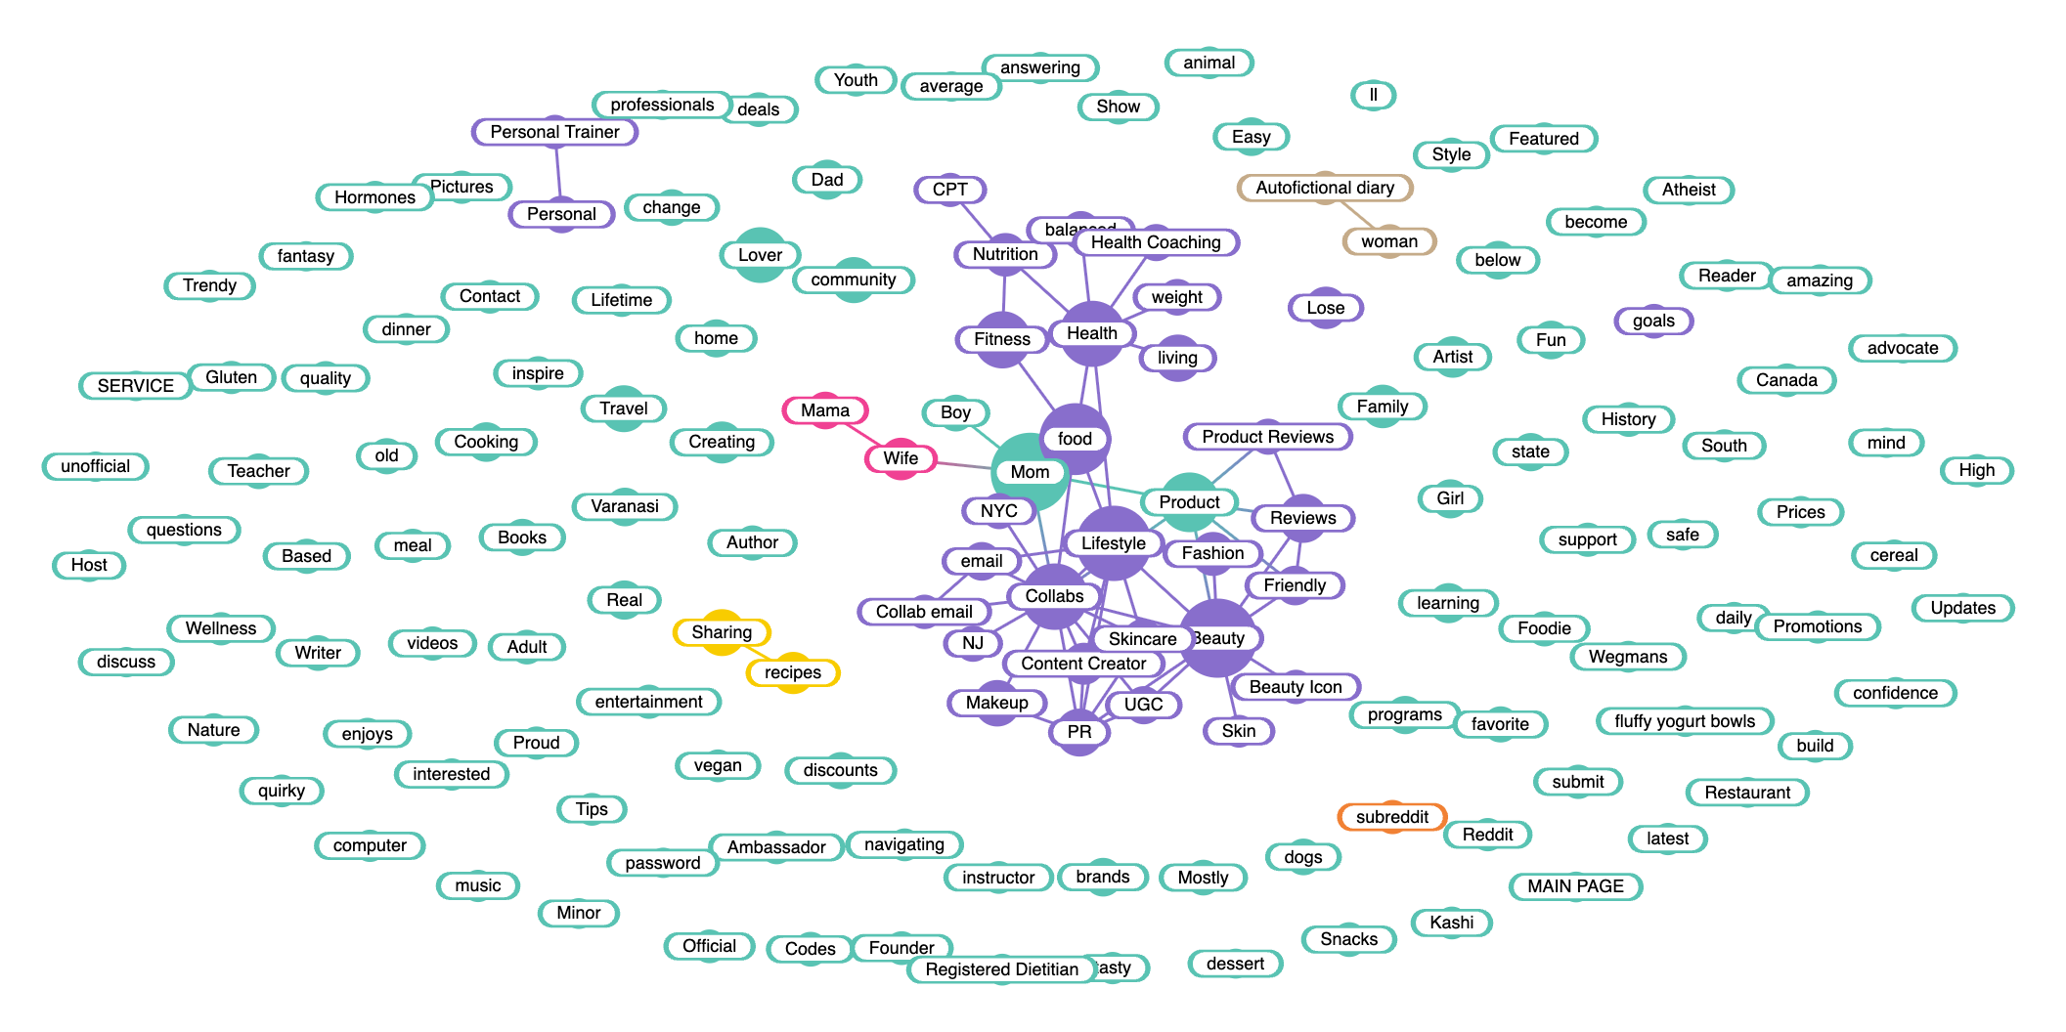
Bios/Target

Slide 41
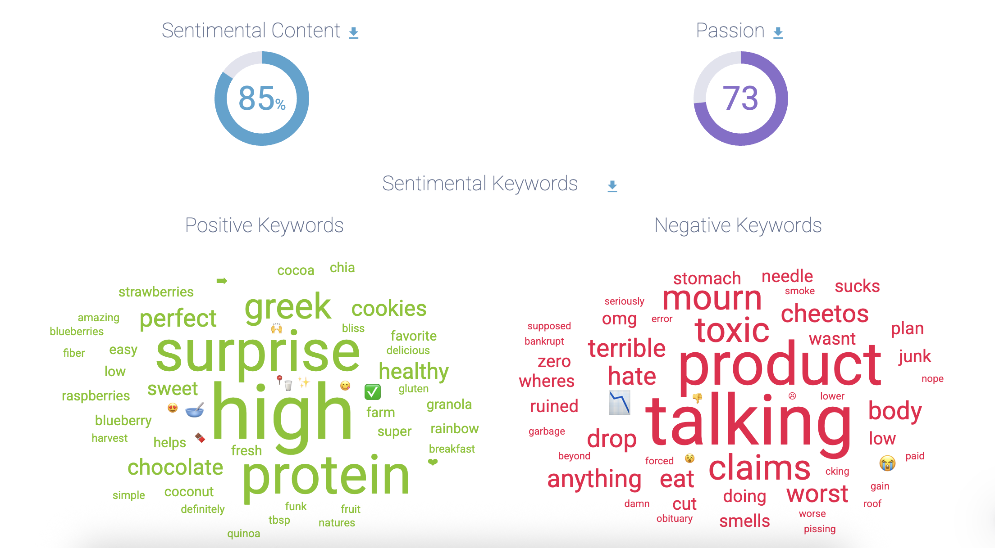
Sentiment

Slide 42
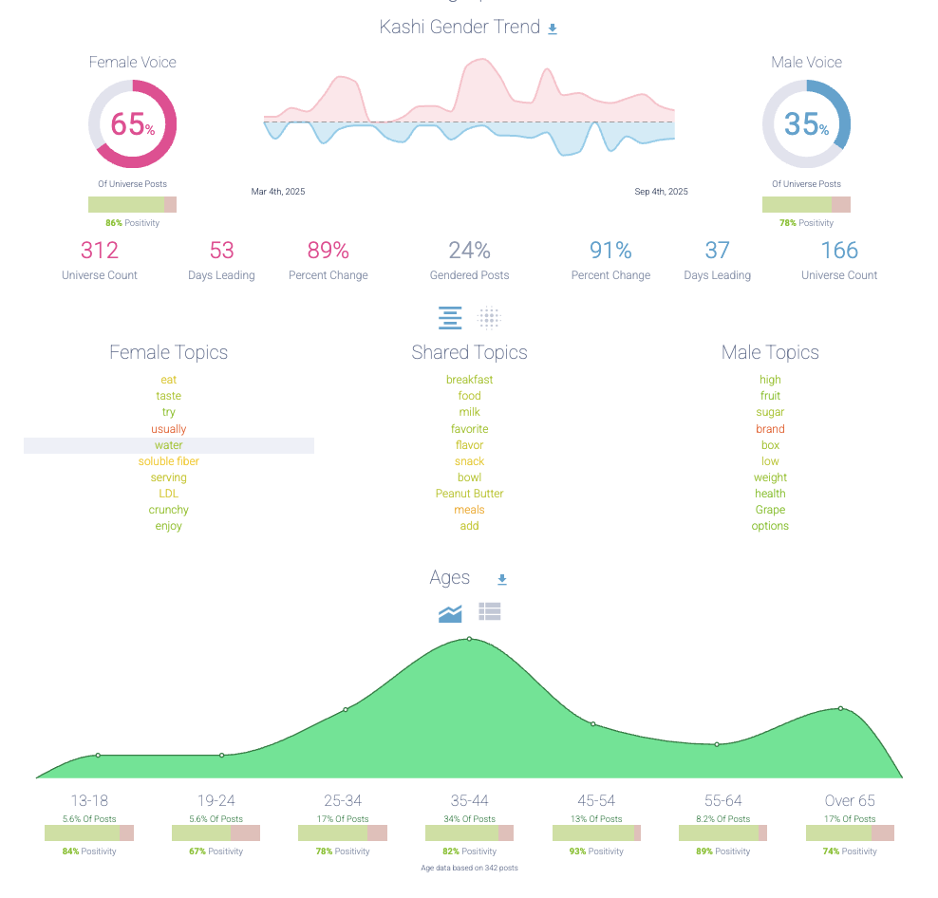
Gender/Age Profile

Slide 43
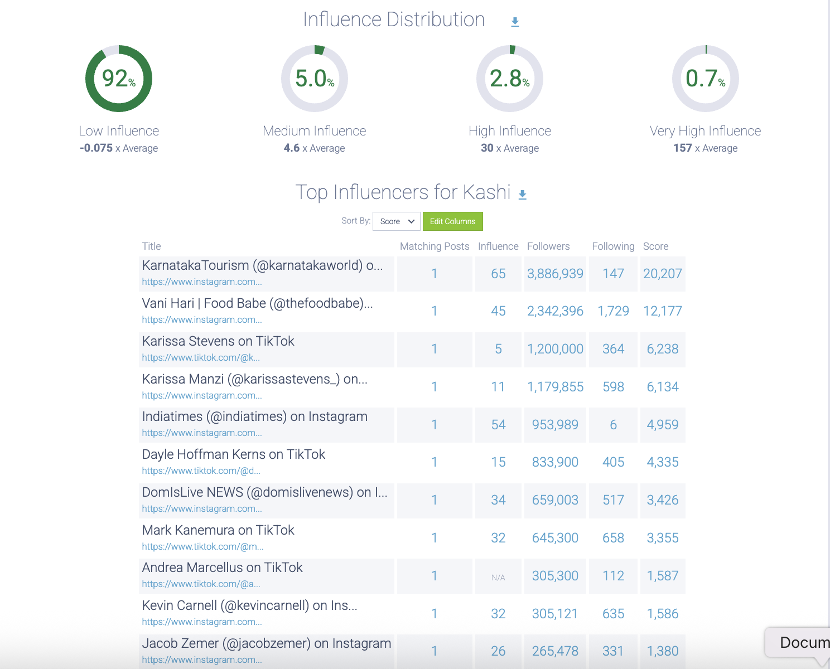
Influencer Distribution

Slide 44
CHEERIOS 2024

Slide 45
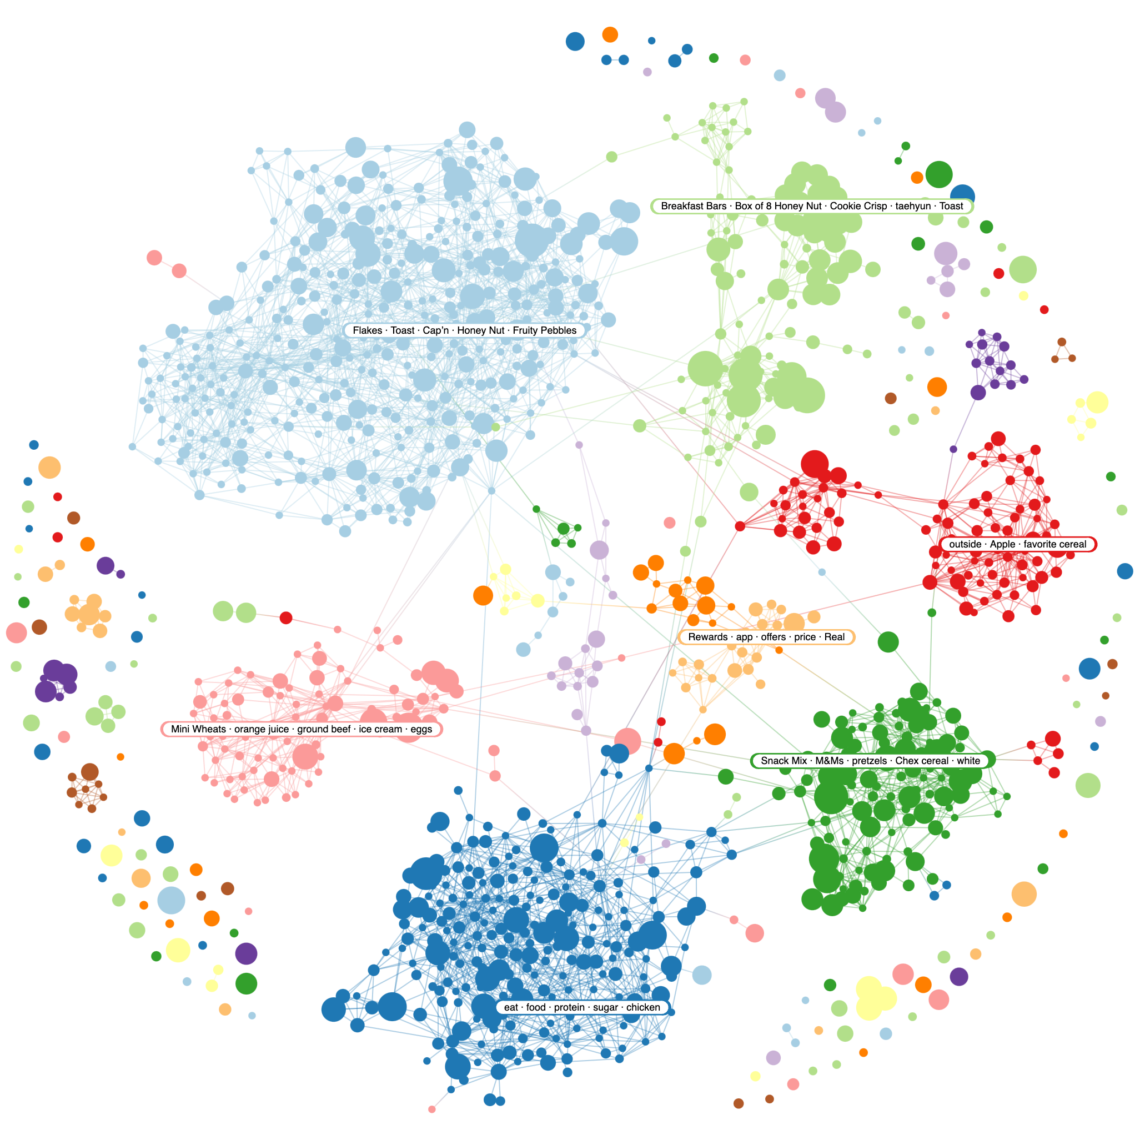

Slide 46
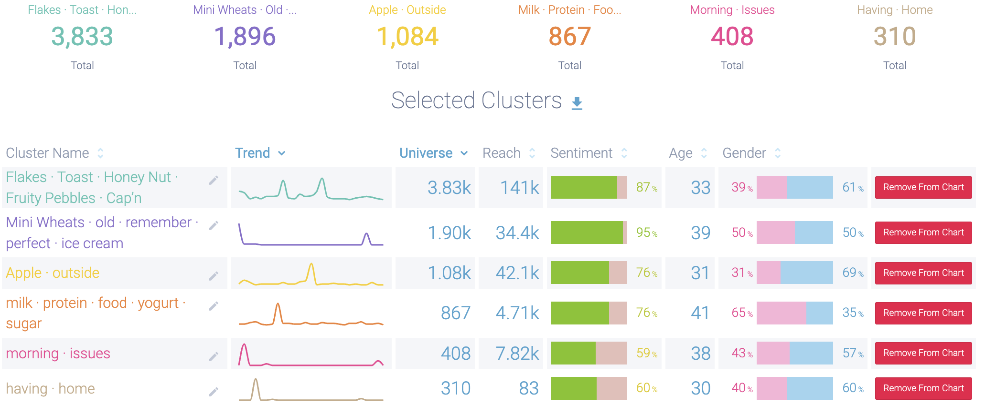
Topics/Narratives

Slide 47
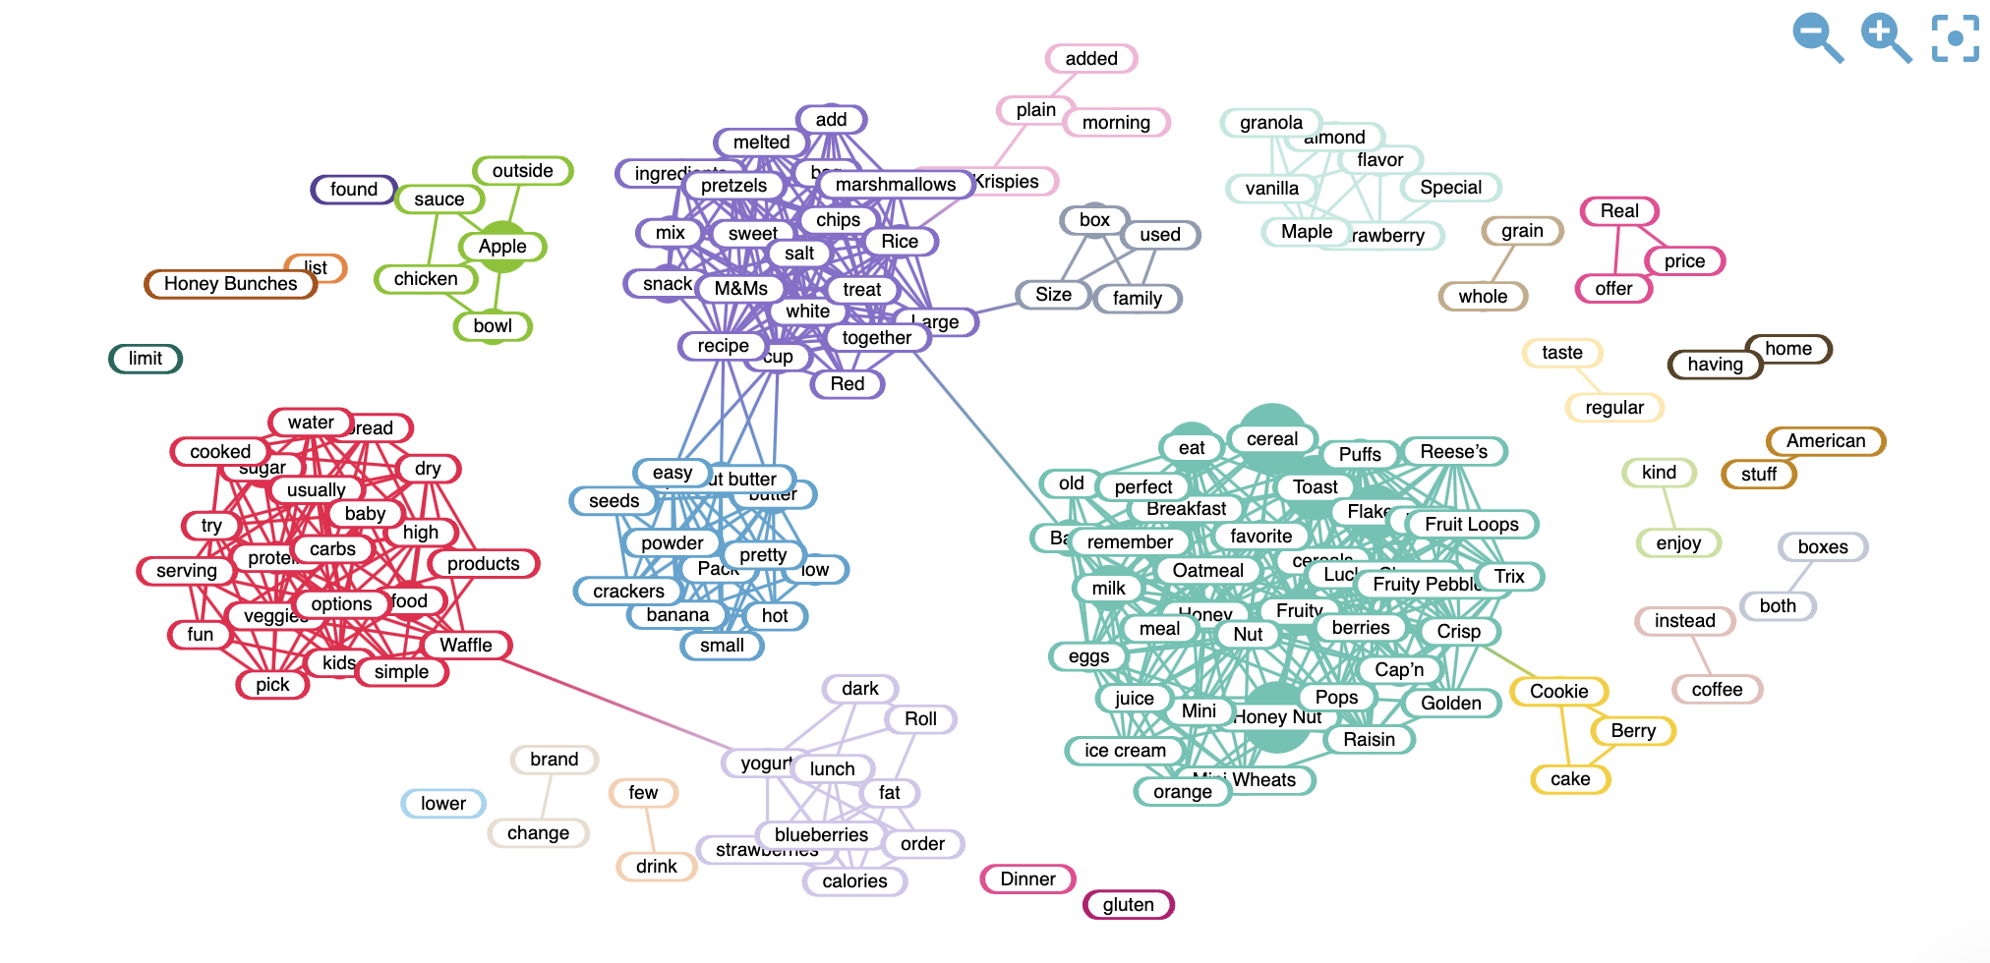
Positive Keywords

Slide 48
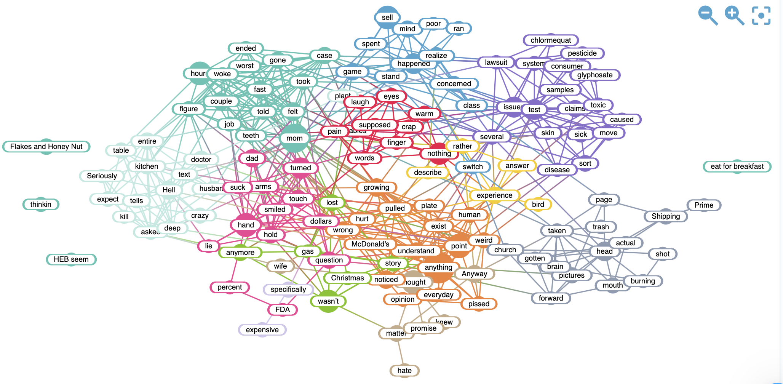
Negative Keywords

Slide 49
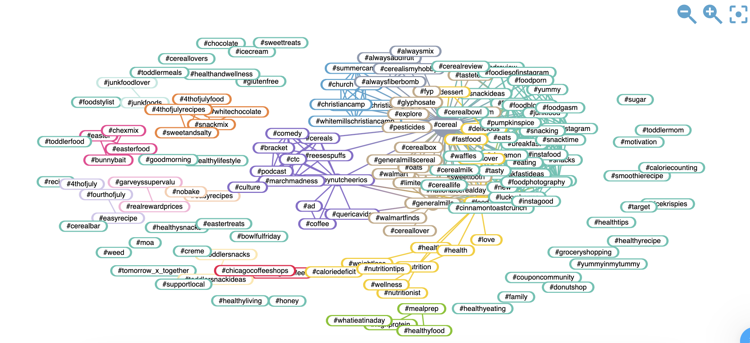
Hashtags

Slide 50
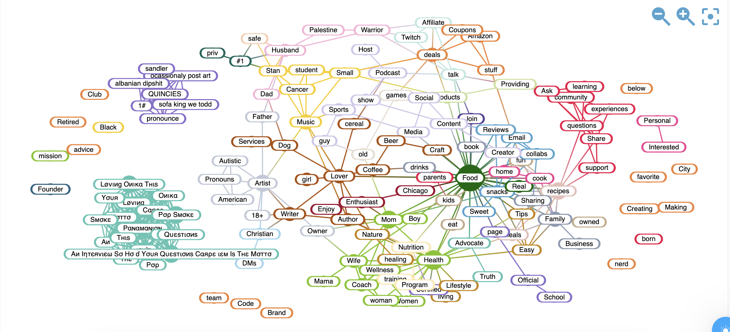
Bios/Target

Slide 51
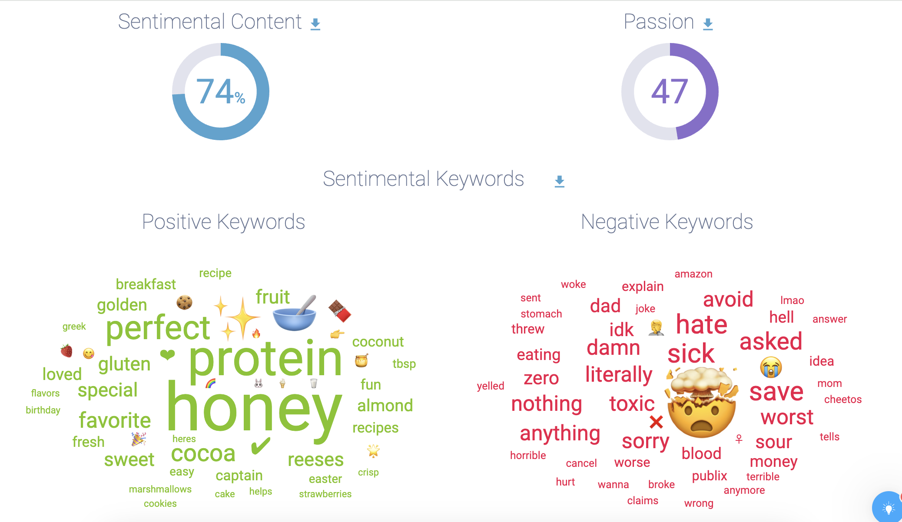
Sentiment

Slide 52
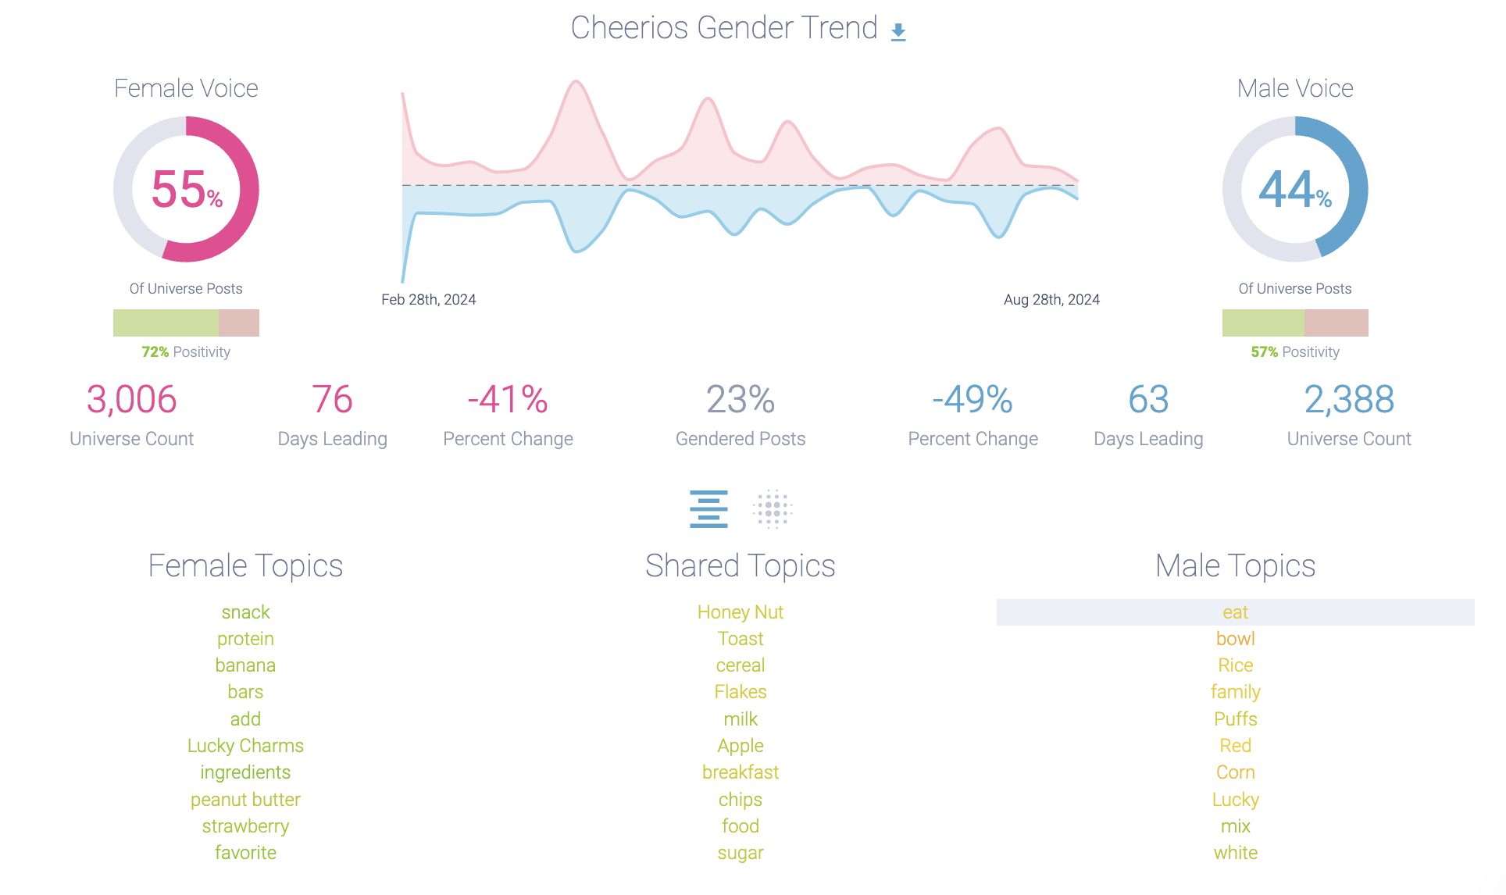
Gender Trend

Slide 53
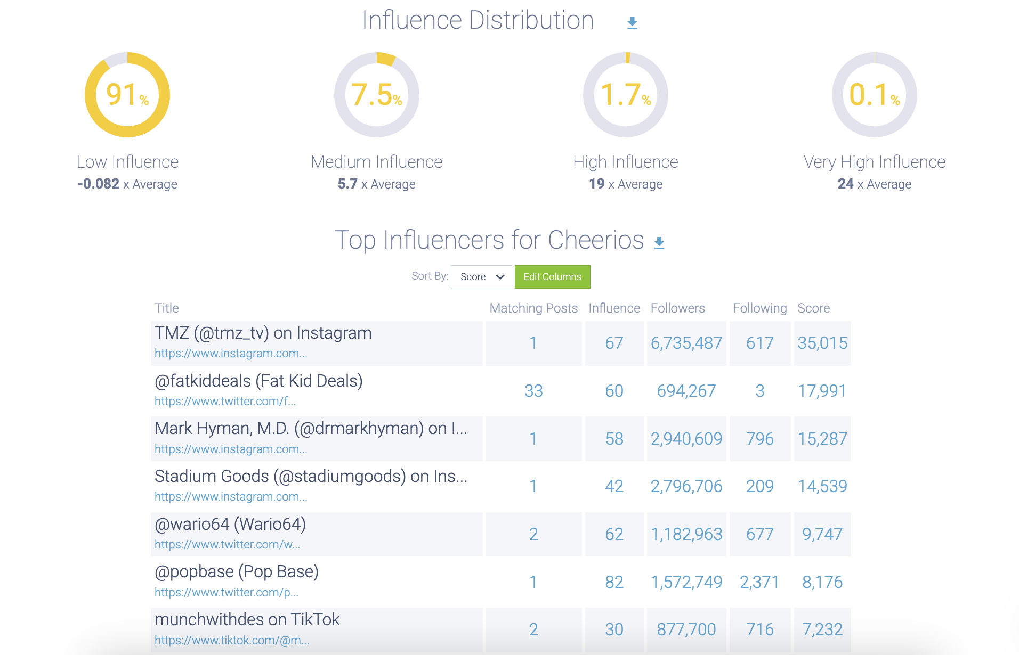
Influencer Distribution

Slide 54
KASHI GO 2024

Slide 55
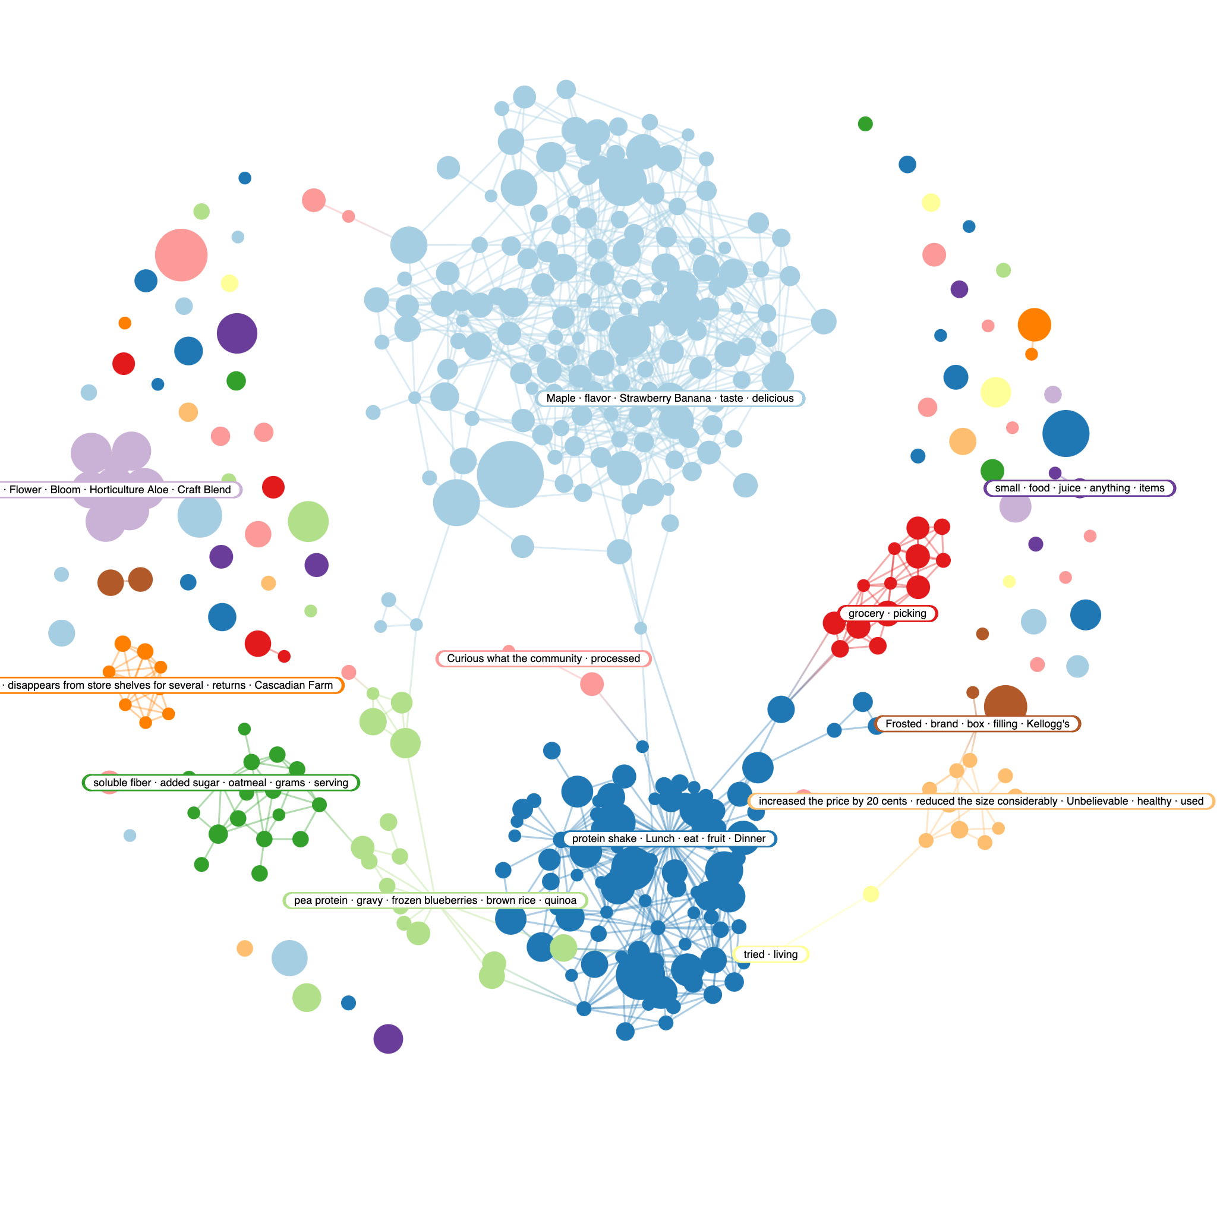

Slide 56
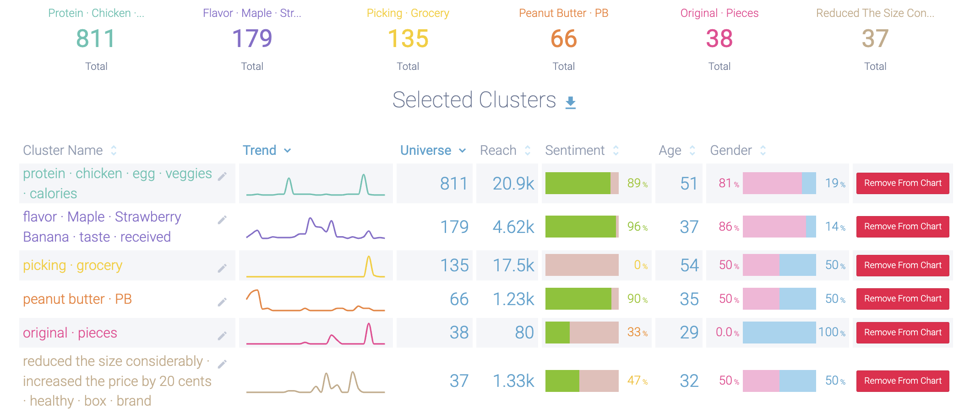
Topics/Narratives

Slide 57
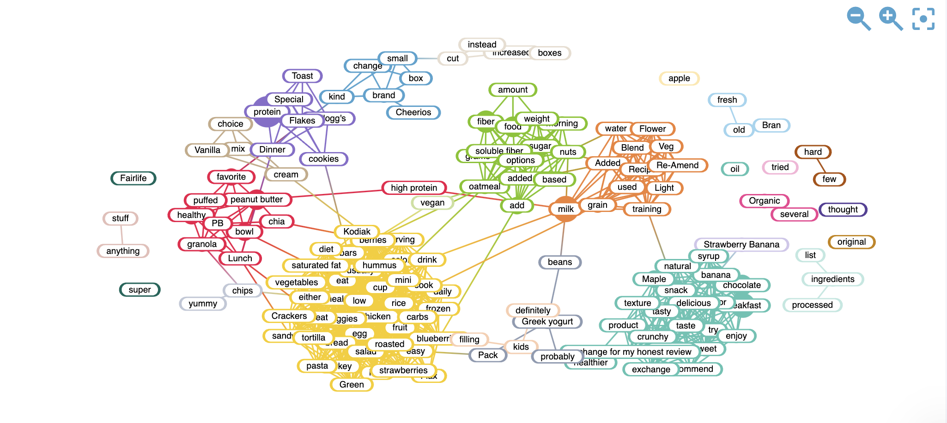
Positive Keywords

Slide 58
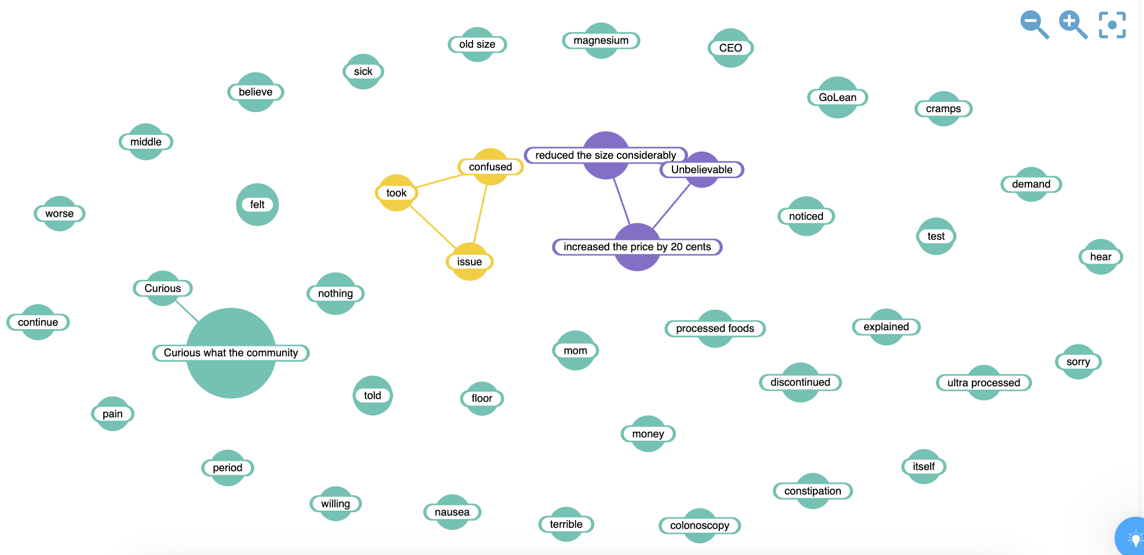
Negative Keywords

Slide 59
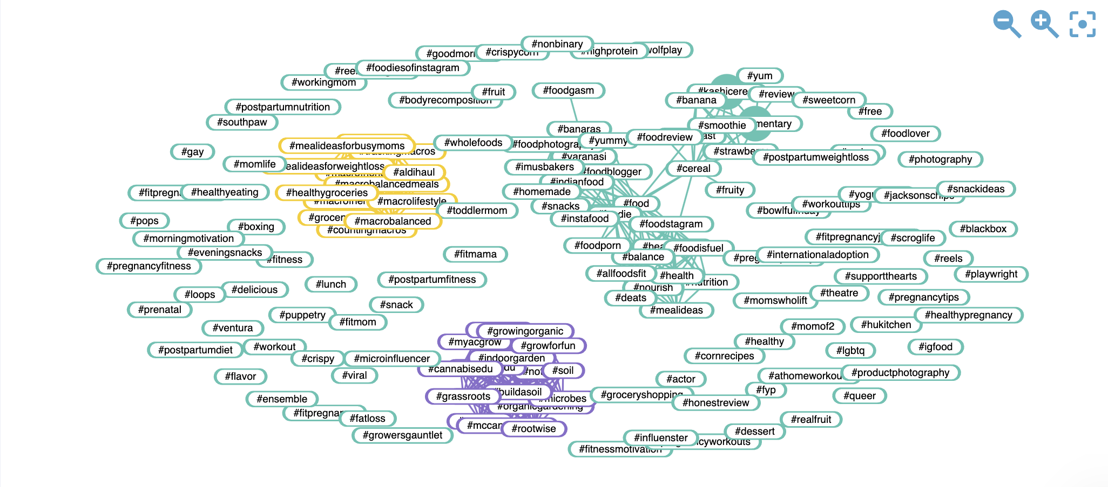
Hashtags

Slide 60
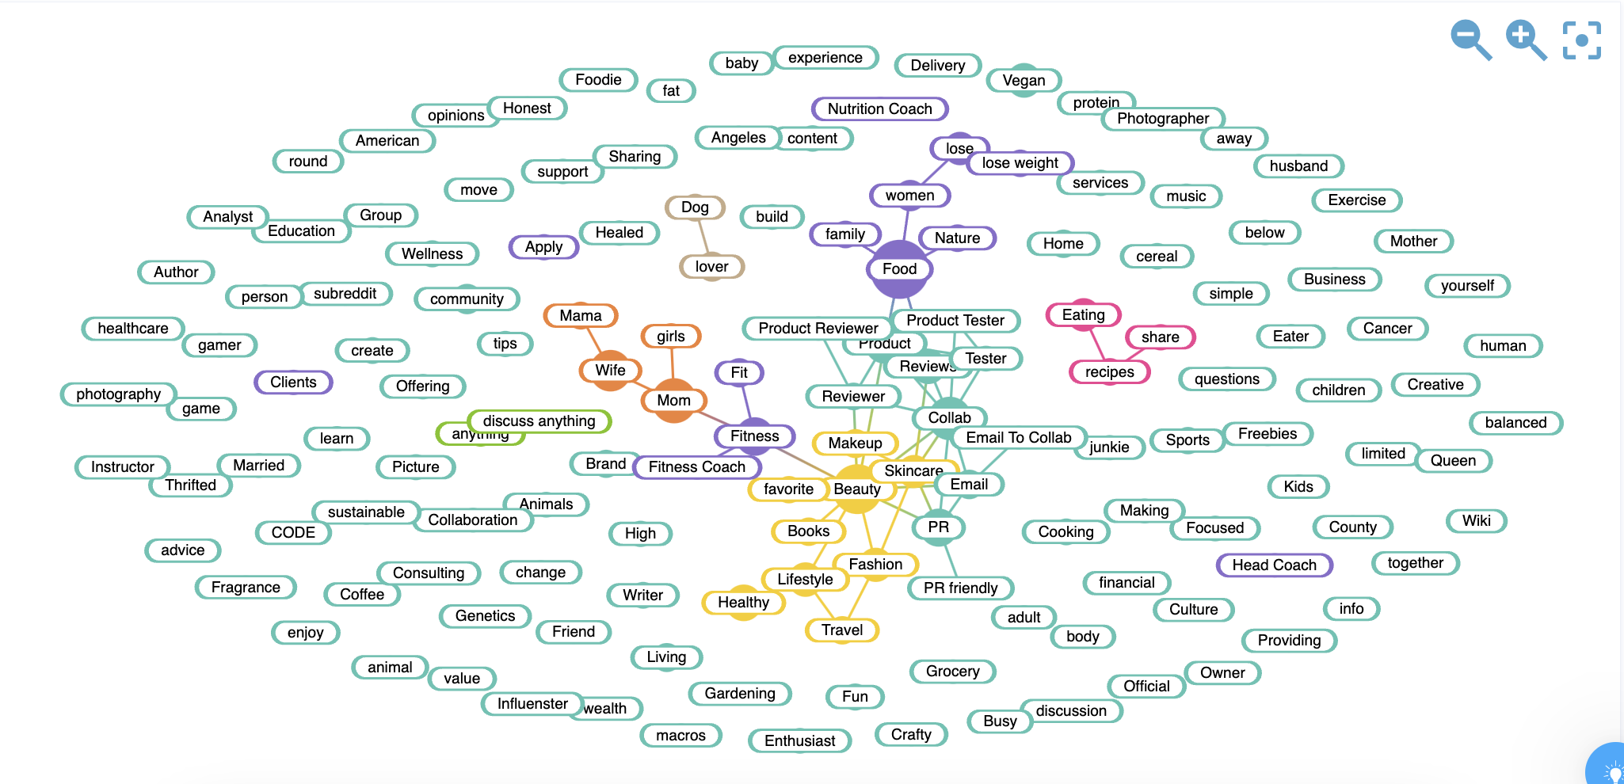
Bios/Target

Slide 61
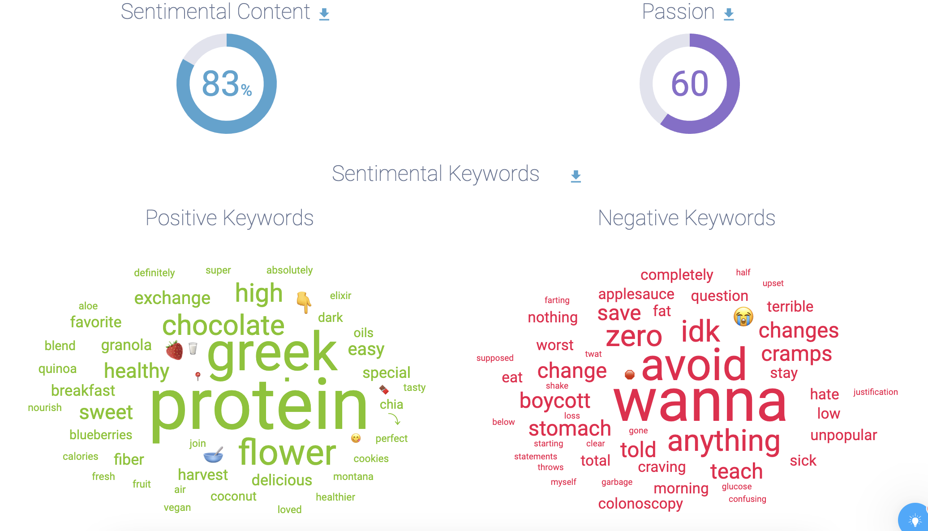
Sentiment

Slide 62
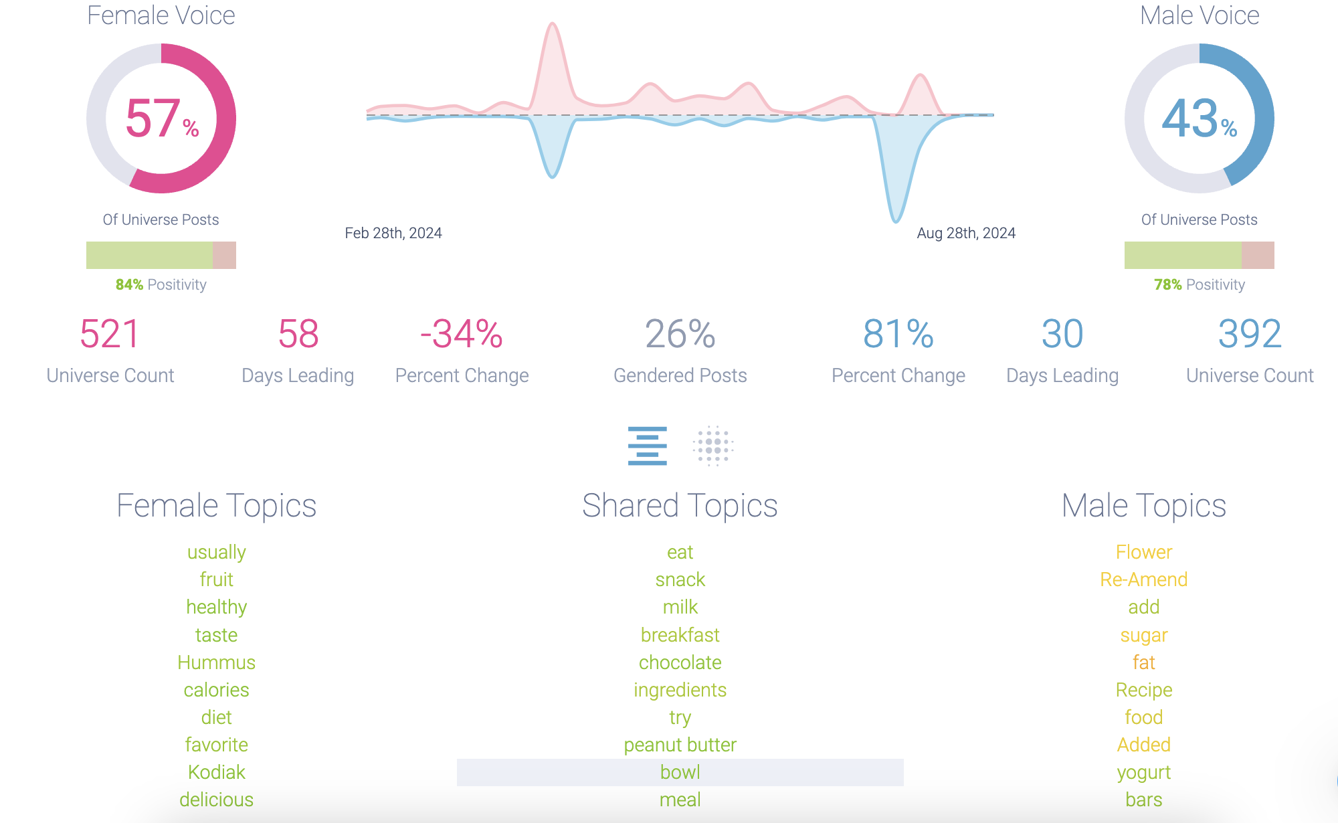
Gender Trend

Slide 63
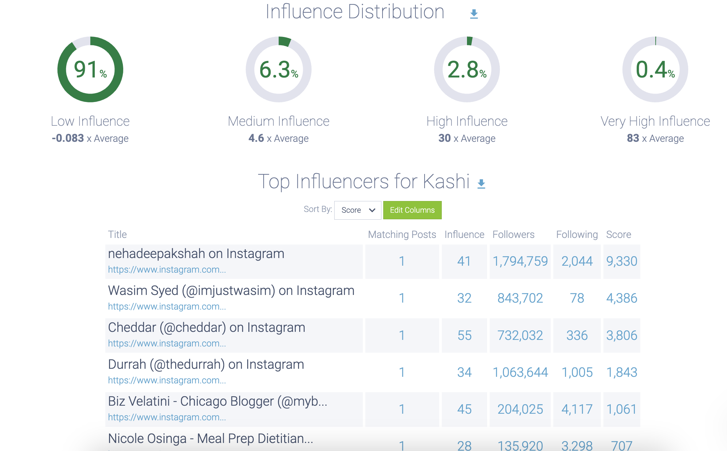
Influencer Distribution

