Slide 1
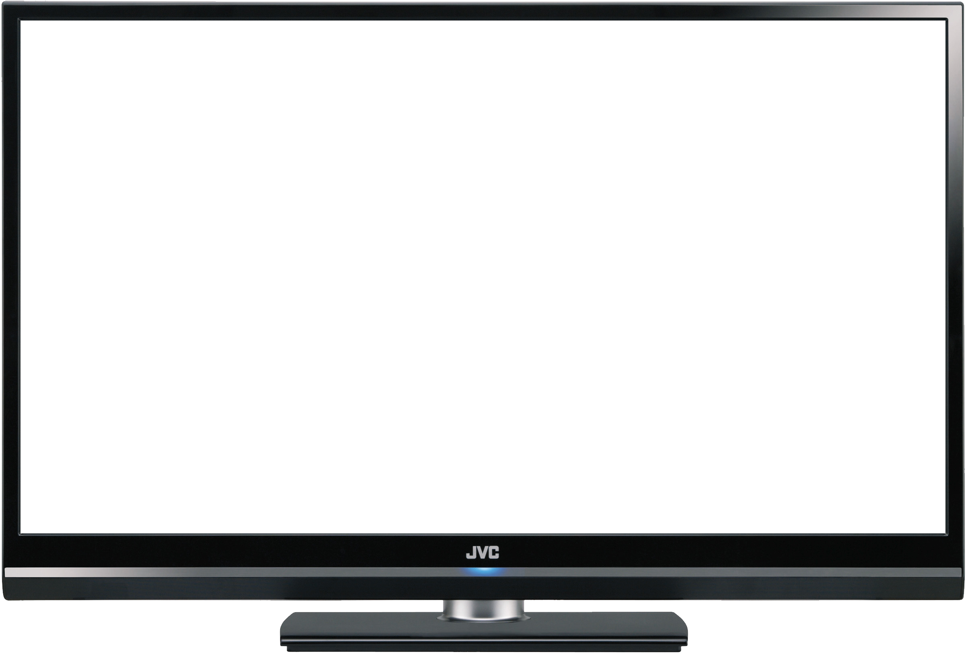

Trust in Media
Notes:
Presentation:
“Hi everyone, I’m Deirdre, I’m Emme, I’m Rachel, I’m Mitch, I’m Jady and we’re the trust in media group. We created a little clip to introduce our topic. Enjoy!”

Slide 2

Trust in Media
Question:
In general, how much trust and confidence do you have in the mass media -- such as newspapers, TV and radio -- when it comes to reporting the news fully, accurately and fairly?
Notes:
Presentation:
When we began our research we found this iPoll question which became the basis for our project. Then say question.

Slide 3
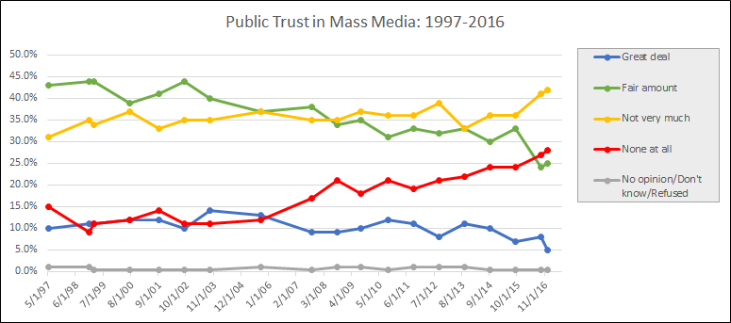
Public Opinion Trend
Trust in Media
Data Source: iPoll Databank, surveys conducted by Gallup
Notes:
Public’s trust in mass media has been decreasing since 1997
Trust drops dramatically after election years
Presentation:
Here is a graph representing the results from this research question. It shows that the public’s trust in mass media has been decreasing since 1997 and that trust in media drops dramatically after election years. Having a great deal of trust and a fair amount are decreasing as you can see and not very much trust and none at all are on the rise.

Slide 4
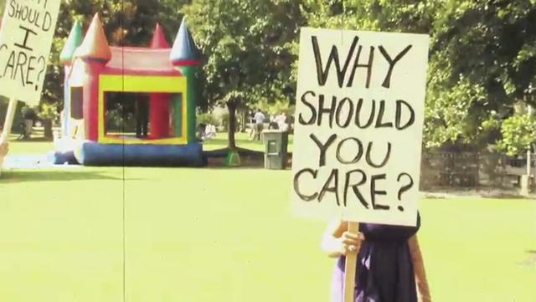
Trust in Media
Notes:
Emme is on this
Leads to substantial information loss among public
More likely to resist the information they receive from mainstream media and look out their own partisan news sources that confirm their own preexisting views

Slide 5
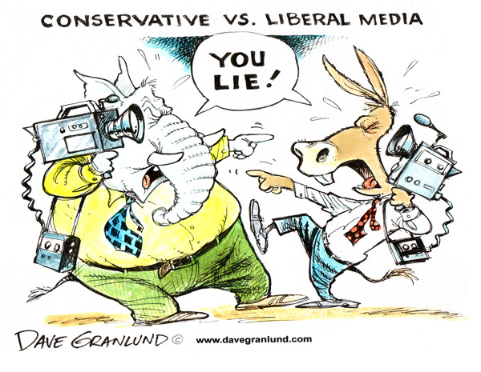
Trust in Media
Theoretical Foundations
Hostile Media Effect (HME): Partisan viewers of media content will perceive that content to be biased against their own positions, sometimes regardless of whether the content is neutral or biased.
Notes:
Emme
Deirdre add photos
Include past research?
Implications:
Impact on public opinion
News consumption patterns
Attitudes toward democracy
Political participation
First identified in 1985 by Robert Vallone, Lee Ross and Mark Lepper
Studies have explored the theory in terms of coverage of political conflicts, presidential elections, genetically modified food, union strikes and sports
Chose this theory because we found that a lot of the underlying causes of distrust in media had to do with the amount of media outlets available that confirm partisans beliefs. This relationship to partisanship is what lead us to form the following media predictions

Slide 6

Media Predictions
Trust in Media
Media Effects
Confirmation of own political views
Decrease in trust in media, increase in hostility towards media
Media Content
Due to hard news coverage of political campaigns
Increase in “fake news” → decrease in “biased news”
Notes:
Emme
People will believe the information they are consuming if it comes from a source that aligns with their own political views
People are less likely to trust the media and more likely to be hostile toward the media if it comes from a source that has opposing political views as them
We predict the corresponding shifts in public opinion were due to hard news coverage of political campaigns
We predict that as news media’s use of the term “fake news” increases, their use of the term “biased news” decreases, ultimately forming for hostile associations with “fake news”

Slide 7

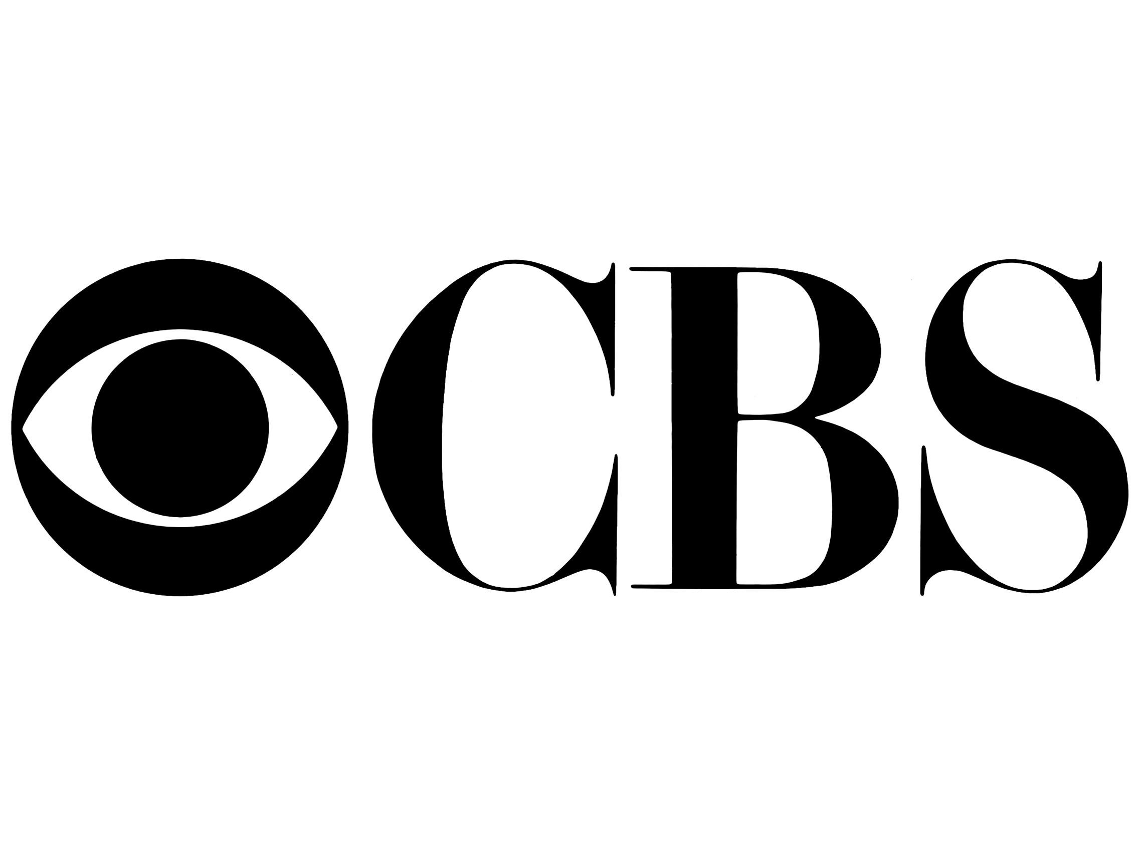
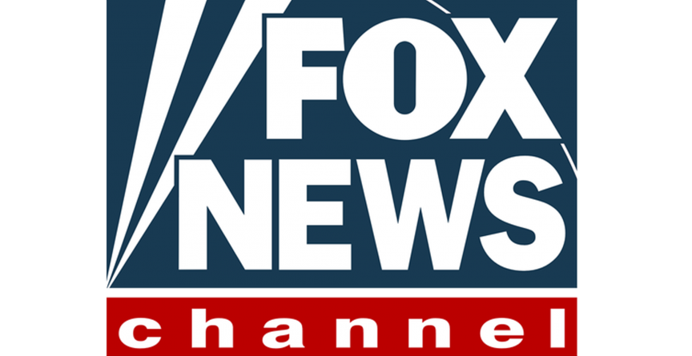
Research Methodology
Trust in Media
Notes:
Rachel
Stratified search from 1997-current
Factiva database
Only broadcast media, not print
Fox News (right)
MSNBC (left)
CBS (neutral)
Sample size: 24,815 occurrences
Created spreadsheet with 25 search strings
Selected strings w/ most relevant articles & least overlap
Grouped them into 4 categories

Slide 8
Trust in Media
Analyzed Search Strings
Chosen based on relevance of article results and to minimize overlap between strings
LIBERAL MEDIA BIAS
GENERAL MEDIA BIAS
CONSERVATIVE
MEDIA BIAS
FAKE NEWS
Notes:
RACHEL
Liberal Media Bias
media AND (liberal or Democrat* or progressive or “left-wing”) AND bias*
“liberal media”
“on the left” AND media
Conservative Media Bias
media AND (conservative or Republican* or “right-wing”) AND bias*
“conservative media”
“on the right” AND media
General Media Bias
bias* AND media AND president* AND election
media AND (political* or partisan*) AND bias
“media bias”
“Fake News”

Slide 9
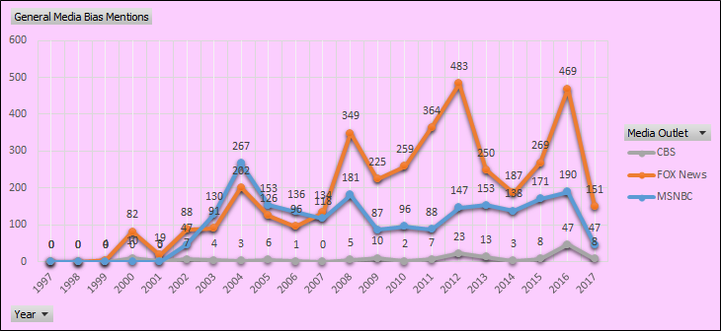
Trust in Media
Content Analysis Results
Notes:
Mentions of bias peaked during election years
CBS has the fewest hits with our search terms, possibly because it tries to appear impartial

Slide 10
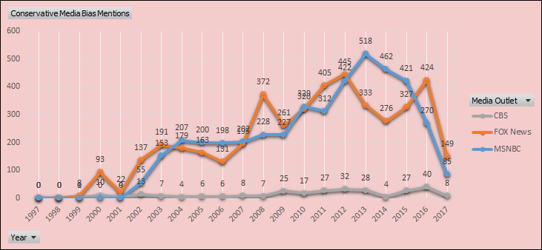
Trust in Media
Content Analysis Results
Notes:
Number of occurrences in which media bias is associated with a particular political slant has increased from 1997 until now
This shows that MSNBC and Fox News take stances and reaffirm their viewers’ beliefs

Slide 11
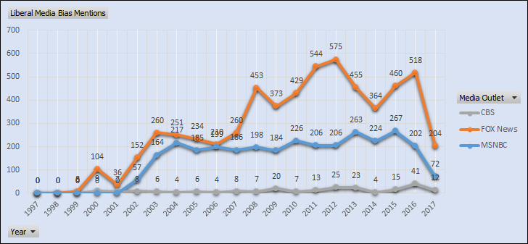
Trust in Media
Content Analysis Results
Notes:
As mentions of bias in news increases, the public’s trust of media decreases

Slide 12
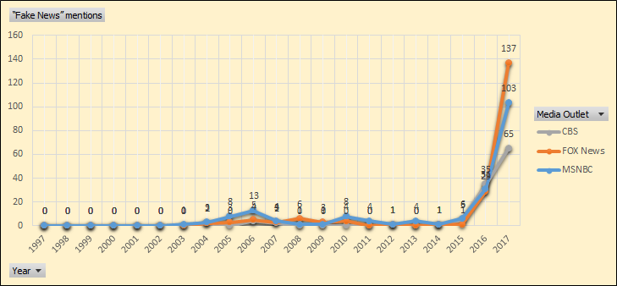
Content Analysis Results
Trust in Media
Notes:
Higher occurrences in strongly partisan outlets
Highest mentions in 2017, and we’re not even halfway through the year

Slide 13
Survey Results
Trust in Media
Trump hits media for ‘FAKE NEWS’ after tax return report
Hours after a much-touted “scoop” revealed part of President Trump’s 2005 tax returns – and in the process, undermined the speculation that he was a tax dodge – the commander-in-chief fired back Wednesday morning with another volley of barb-laden tweets. “Does anybody really believe that a FAKE reporter, who nobody ever heard of, ‘went to his mailbox’ and found my tax returns? FAKE NEWS!” Trump tweeted. The reporter’s story about finding the tax documents in the mail mirrors how a New York Times reporter was mailed Trump tax info from 1995 in October.
Source: FOX News
Notes:
Originally a Fox article

Slide 14
Survey Results
Trust in Media
Trump hits media for ‘FAKE NEWS’ after tax return report
Hours after a much-touted “scoop” revealed part of President Trump’s 2005 tax returns – and in the process, undermined the speculation that he was a tax dodge – the commander-in-chief fired back Wednesday morning with another volley of barb-laden tweets. “Does anybody really believe that a FAKE reporter, who nobody ever heard of, ‘went to his mailbox’ and found my tax returns? FAKE NEWS!” Trump tweeted. The reporter’s story about finding the tax documents in the mail mirrors how a New York Times reporter was mailed Trump tax info from 1995 in October.
Source: FOX News

Slide 15
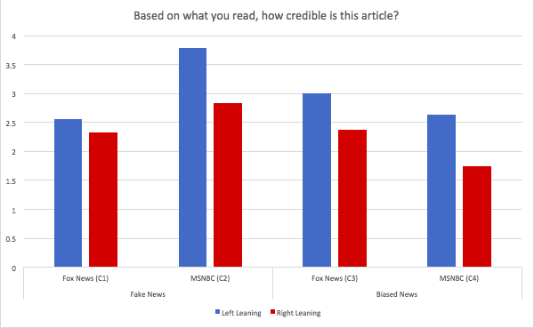
Survey Results
Trust in Media
Notes:
In general, left leaning respondents thought articles were more credible than right-leaning respondents
Left-leaning respondents thought the FOX news article was more credible when it mentioned biased news as opposed to fake news, confirming our hypothesis that fake news would trigger distrust in media
However, when attributed to MSNBC, left-leaning respondents thought the article mentioning fake news was much more trustworthy than the one mentioning biased news
Similarly, right-leaning respondents thought the article attributed to MSNBC mentioning fake news was much more trustworthy than the one mentioning biased news

Slide 16
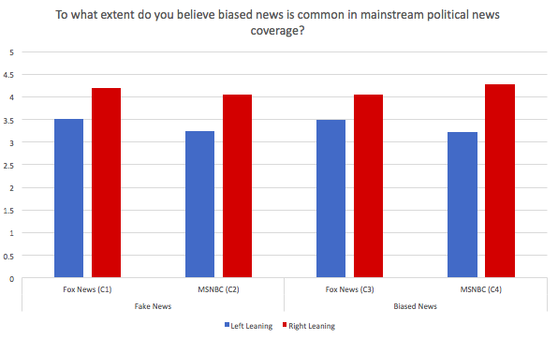
Survey Results
Trust in Media
Notes:
Right-leaning respondents believed biased news was more common than left-leaning respondents

Slide 17
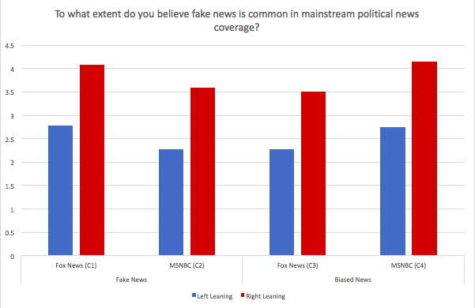
Survey Results
Trust in Media
Notes:
Right-leaning respondents believed fake news was more common than left-leaning respondents
When comparing these results to the previous slide, you can see that the partisan divide is much greater when prompted about “fake news” as opposed to “biased news”

Slide 18
Discussion
Trust in Media
Results confirm the relative Hostile Media Effect
Pre-existing biases in the content could have swayed the results
Key Insight: The public’s own political views significantly impacts:
the sources they seek to get their information from and
the levels of trust they have in certain media sources
Notes:
Confirms our overall hypothesis → general trend of people validating their own political beliefs and fake news has become more powerful than biased news
Using content that is inherently biased already, our results are relevant to studies about a relative hostile media effect, rather than an absolute hostile media effect
-Since the articles shown was originally from FOX News, pre-existing biases in the content could have swayed the results → taking content from another source and creating an entire survey of our own could have produced more results
-Ultimately, the public’s own political views significantly impacts the sources they seek to get their information and the levels of trust they have in those media sources

Slide 19
Sources
Trust in Media
http://101fundraising.org/wp-content/uploads/2014/08/Why-should-you-care-image.jpg
Video inspired by The New York Times most recent campaign
https://img.clipartfox.com/7af77301d4c90c03e46d913f93189ad4_monitor-transparent-lcd-png-blank-tv-screen-clipart_2400-1626.png
http://www.msnbc.com/sites/msnbc/themes/leanforward/images/site-header/msnbc-logo-card.png
http://victorygroup.com/wp-content/uploads/FOX-NEWS-864x445.png
http://logok.org/wp-content/uploads/2014/03/CBS-logo-old.png
https://68.media.tumblr.com/6ff30d219e67dfe04590892ce228e810/tumblr_o4ks3hLe0U1sin4f5o1_500.gif
http://www.davegranlund.com/cartoons/wp-content/uploads/cons-lib-media-web.jpg
http://maui.hawaii.edu/hooulu/wp-content/uploads/2017/01/image1-e1483830884386.png
http://faculty.georgetown.edu/jml89/MediaBook.pdf
http://www.oxfordbibliographies.com/view/document/obo-9780199756841/obo-9780199756841-0079.xml

