Slide 1

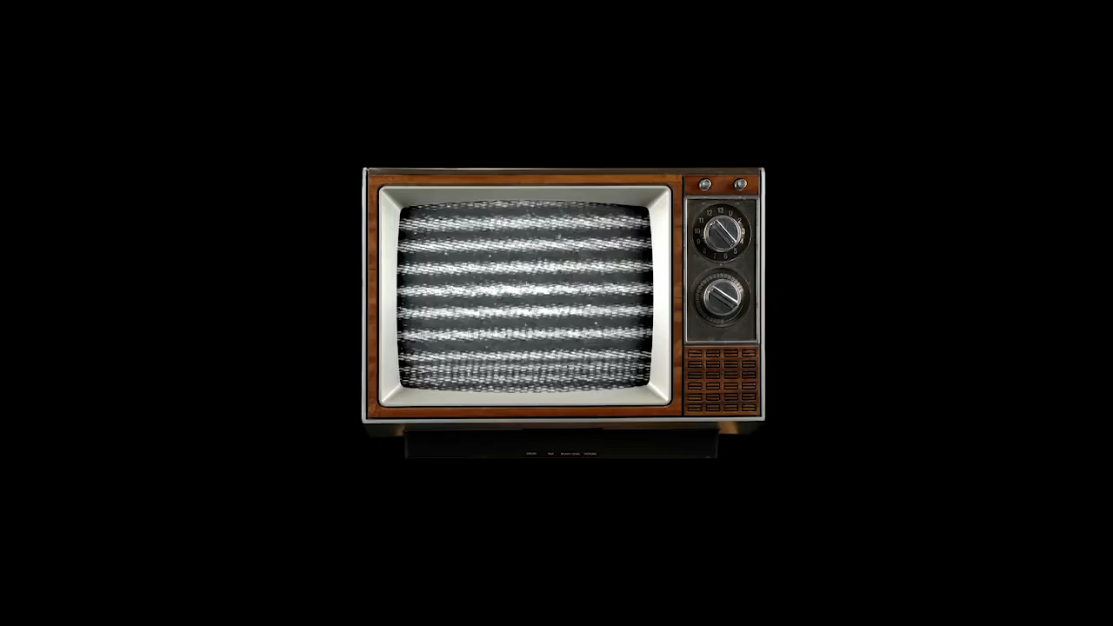

Slide 2
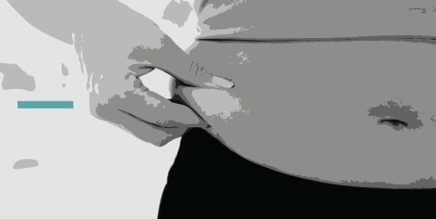
Body Image in the Media
Expressions
Casey Donart, Nicole Hurley, Olivia Jones, Jenna Mytton, Maddie Weston & Zach Wright

Slide 3
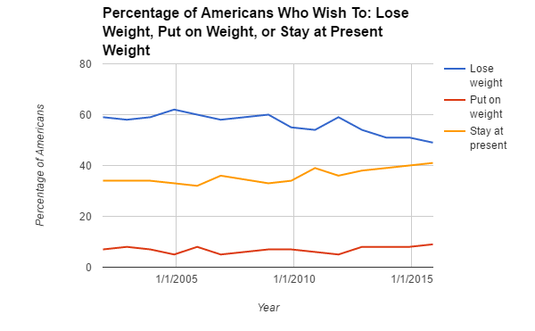
Now Trending.
Source: Gallup, 2001-2015
Notes:
And I’m Casey. As seen in the video, we’ve been researching the topic of body image. This is important because body image is a key part of self-esteem. We need to better understand how the media is portraying people's bodies and how this is impacting viewers. In order to explore this issue, we looked into a series of Gallup polls from 2001-2015 that showed that the percentage of Americans who wish to lose weight has notably decreased.

Slide 4
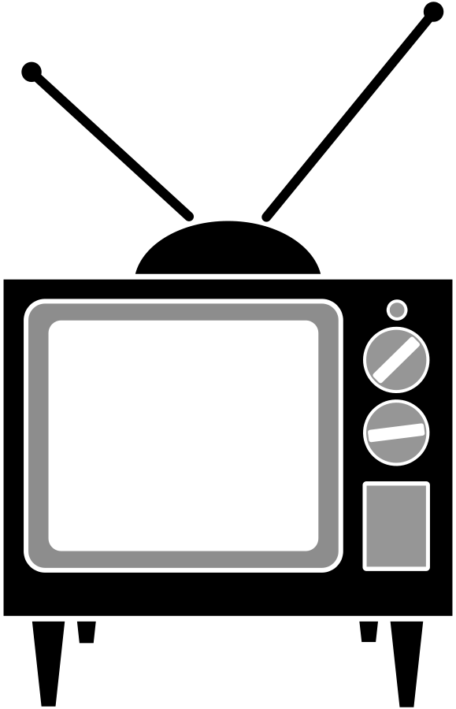
Cultivation.
An increase in body-positive advertising leads people to feel more comfortable with their own bodies
99% of U.S.
households have
at least one TV.
–Static Brain, 2016
Notes:
We first thought about the cultivation theory, which is defined as the more frequently people are exposed to television and choose to “live” in the television world, the more likely they are to believe that it is reflective of reality. So in connecting the cultivation theory with body image, we considered that body-positive advertising is contributing to the population becoming more comfortable with their own bodies.
Theory:
–Dhavan Shah, 2017

Slide 5
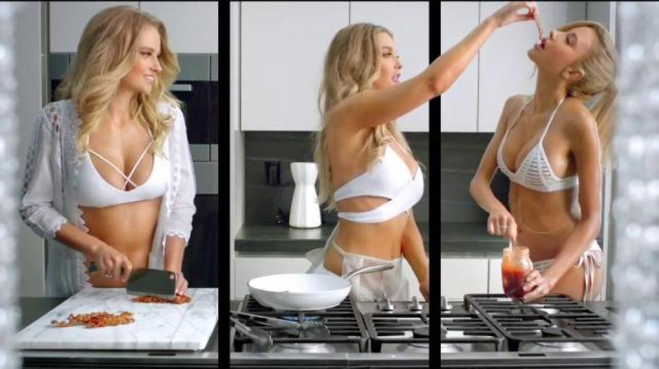
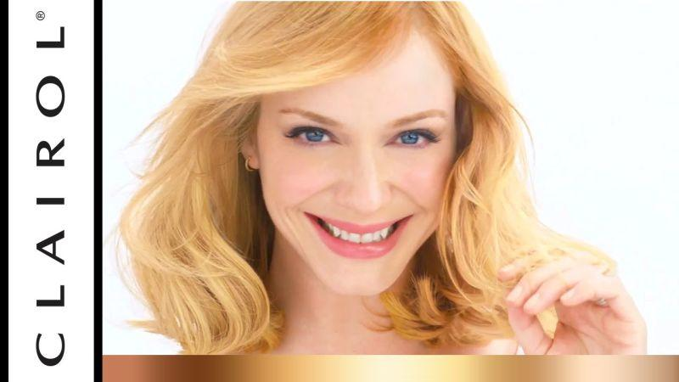
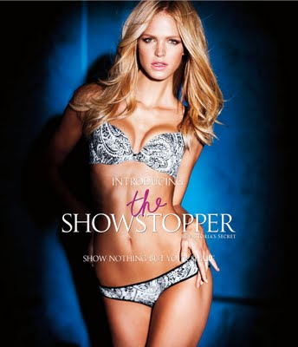
Media Predictions.
1. Advertising media has an extensive history of using white, thin female models in its content. There’s been a recent increase in amount of diverse body types represented in media.
2. The more body-positive campaigns that exist—such as Dove Real Beauty and Aerie “Real”—the more secure people will feel in regards to their own body images and weights.
Notes:
So after considering the cultivation theory, we thought about what this could mean in the future. One prediction we considered was how advertising has a history of using white, thin female models in the media they produce. With an increase in body-positive campaigns we predicted that people will become more comfortable with their own body images and weights

Slide 6
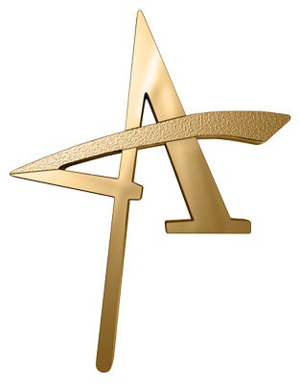
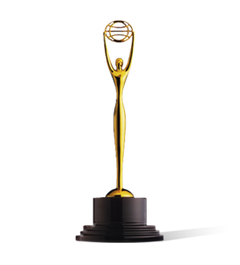
Content Analysis.
Television advertisements
  Lack of access to concise data
  Clio Awards & AAF Addy Awards
    2007-2016
    10 advertisements per award per year
      Grand, Gold, Silver category winners
      Sample: ~200 advertisements
  Missing data window
    AAF site crash, 2009-12
  Total = 156
Potential problems and biases
  Analyzing only award-winning ads may have excluded others
    We didn’t see any significant differences
  Not all of our advertisements were related to body image
Notes:
1.5 min (continue to next slide) JENNA

Slide 7
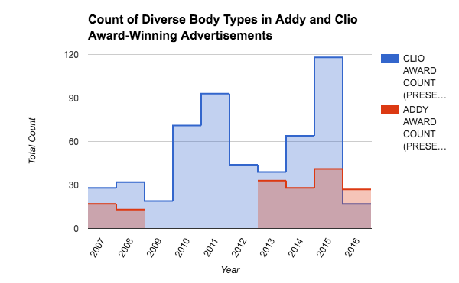
Content Analysis.
Method:
156 advertisements
  Presence
  Count
  Sentiment
  Relevance
Notes:
1.5 min (continue from last slide) JENNA

Slide 8
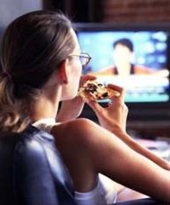

Survey.
Manipulated wording of survey question
When diverse body types are represented in television advertisements, I feel comfortable
with my own appearance.
When models and actors are represented in television advertisements, I feel comfortable
with my own appearance.
Notes:
While our content analysis of award winning ads did not show us a discernible difference, our survey was a different story. Two conditions, changed the wording of how we referred to the subjects of people in ads: “Models and actors” versus “diverse body types.” We felt that “diverse body types” more closely captured the images shown in body positive campaigns, therefore hypothesizing that respondents were more likely to “somewhat” or “strongly agree” with feeling comfortable about their appearances when asked about diverse body types, compared to when they were asked about models and actors.

Slide 9
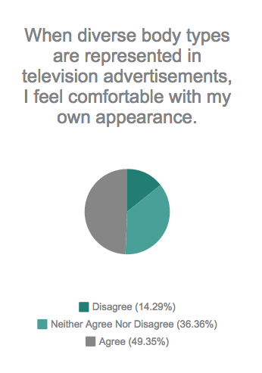
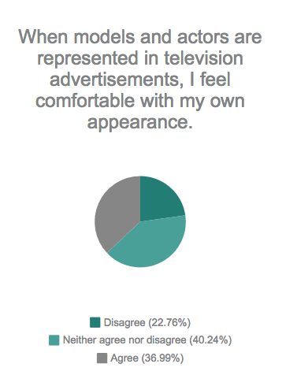
Survey Results.
1 2 3 4 5
Strongly disagree
Somewhat disagree
Neither agree nor disagree
Somewhat agree
Strongly agree
Mean:
3.54
(Closest to
‘Somewhat agree’)
Mean:
3.24
(Closest to
neutral)
Notes:
Combined “somewhat agree” and “strongly agree”; “somewhat disagree” and “strongly disagree”
Less people perceive a shared identity with “models and actors,” but identify significantly stronger with the phrase “diverse body types”

Slide 10
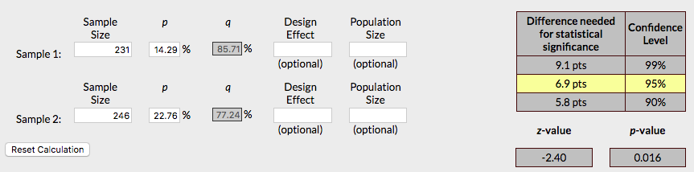
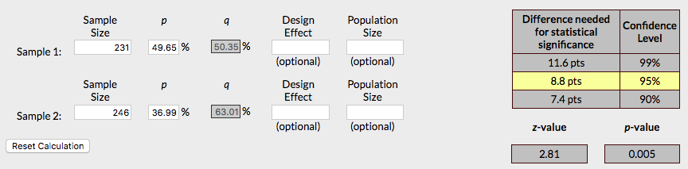
Survey Results.
Disagree with statement:
Agree with statement:
Notes:
231 = diverse body types
246 = models and actors

Slide 11
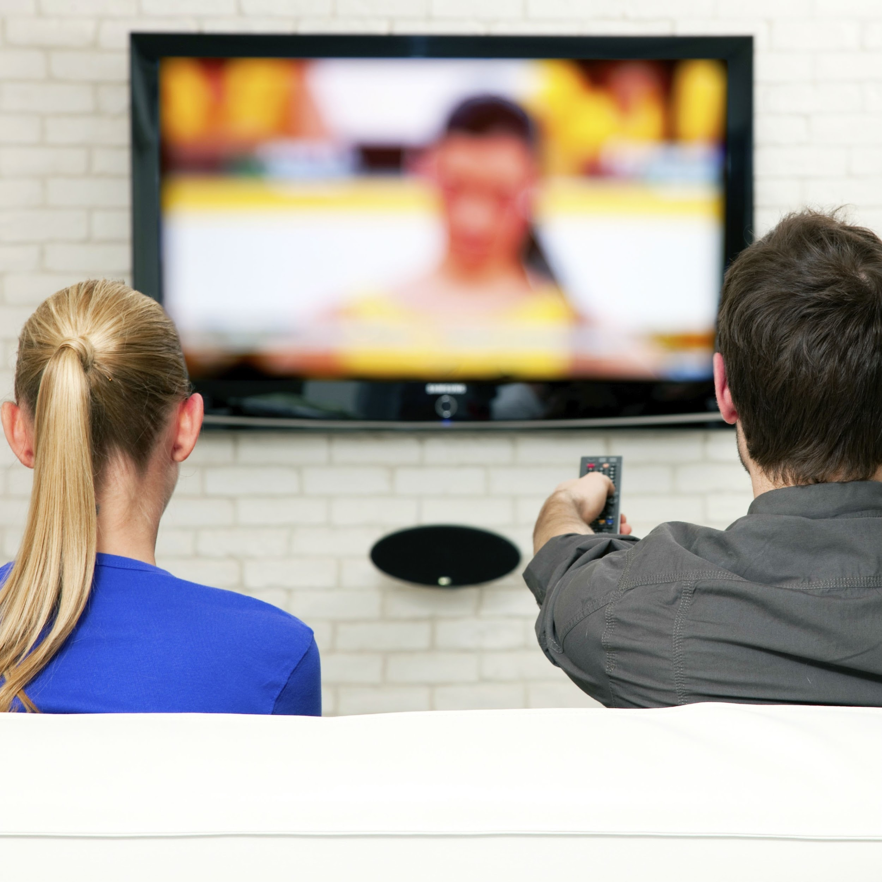
Going Further.
Model diversity has an effect experimentally
  Analysis implies our trend
cannot be explained with
cultivation theory alone
Identification is key¹
  identify less with prototypical models
  sociological trends
  identify with diverse models
¹ Belle & Dittmar, 2011
Notes:
Zach

Slide 12
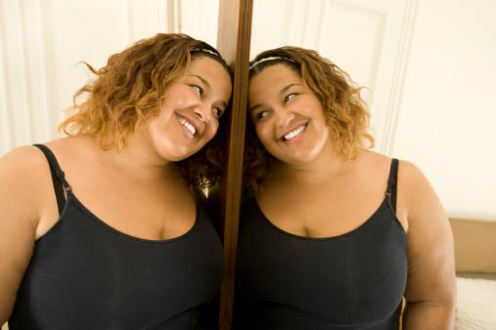
Going Further.
There is a shortage of
advertisements directly
related to body image
(content analysis)
  availability heuristic
fallacy
Increase in body positivity
might have happened
—just in a way that was too subtle to detect;
amplified by identification and the heuristic
Notes:
Zach

Slide 13
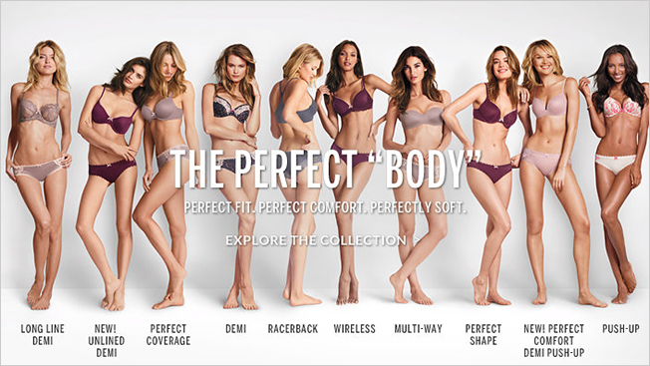
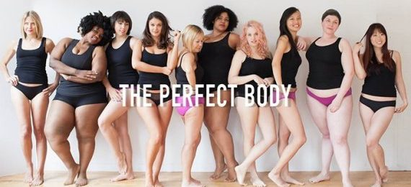
What does this mean?
What other data and studies are needed?
How many people do ads reach?
Overall, people do view themselves in light of the content that they take in.
Notes:
Knowing our study and the results: what are the implications on society? We are interested in looking at how the results vary based on age and gender. For example we believe that girls between the ages of 11-15 would have different responses compared to men ages 40-44. More studies also need to be done specifically related to medium in which advertisements are shown. Is there a difference between tv ad, internet ad, print ads. There are literally millions of advertisements that could be analyzed. In addition, does the media affect the health of society? The prevalence between eating disorders and media is well documented but we want to look into the effects of media on the growing obesity epidemic. Lastly, how many people do ads really reach today? With netflix, recorded TV, and ad blockers advertisements may not have the reach they normally do. Our data shows that body-positive campaigns do shape consumers’ views on body weight and body image. Moving forward, Expressions will continue to examine the reasons and circumstances behind this shift in body weight perceptions in the United States and believe that with more data and studies this could explain the changes in our mediated society as well as the body images of the American people.

