Slide 1
Your Future in Strategic Communication

Slide 2
Pitch Meeting
Our normal classroom, 2195 Vilas Hall
6:00 – 8:00 PM (301/303) on Dec 10th
8:00 – 10:00 PM (302/304) on Dec 10th
For the 8:00 start, please be quiet as you wait outside in the hallway, as the prior session finishes.
Will have Ian’s Pizza delivered to the room to provide some sustenance before we start at 5:55 and 7:55
Please bring your own drinks or change for the vending machine on the 1st or 5th floor

Slide 3
Final Exam
Emailed exam study guide; covers lectures 11 through 23
You can bring one 8½” by 11” sheet with notes, double-sided, in any font size
You will complete peer evaluations when you take the final – last sheet of the test

Slide 4
Final Exam
Exam times for the final in 2195, this classroom
Early Exam in 2195 Vilas – 2:45 PM - 4:45 PM, December 12th
Late Exam in 2195 Vilas – 2:45 PM - 4:45 PM, December 17th
Exam will be the same format as midterm exam
50 items, multiple-choice format
Please let us know if you need accommodations!!!!

Slide 5
Future Trends
Data Analytics
Need to measure, interpret and evaluate campaigns
Hybrid Integrated Marketing
Bridging traditional, digital, and alternative media
Digital Convergence
Digital appliances, interactive, and mobile
Co-creation of Brand Content
Consumer and marketer jointly create brand
Connections Planning
Deeper focus on insights for media plans

Slide 6
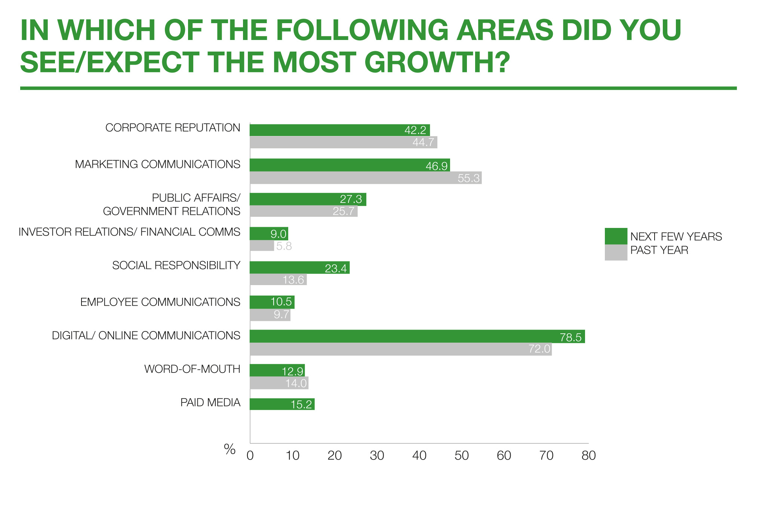
Biggest Growth Areas

Slide 7
Careers/Courses
Market Research and Account Planning
Entry level: Research Assistant or Jr. Planner
J566 – Communication and Public Opinion
J658 – Communication Research Methods
J677 – Data Analysis and Visualization
Account Management
Entry level: Assistant Account Executive/Planner
J449 Account Planning and Strategy
J470: Strategic Communication Campaigns
Creative and Design
Entry level: Junior Copywriter or Assistant Art Director
J445 - Creative Campaign Messages
J465: Social Media Marketing Communications
Media & Interactive
Entry level: Assistant Media Planner or Buyer
J447 - Strategic Media Planning
J463 – Digital Media Strategy
PR and Promotions
Entry level: PR/Promotions Account Executive
J464 – Public Relations Planning
J453 – Media Relations Planning
J566 – Communication and Public Opinion

Slide 8
Preparing for a Career
Self-education
Read ad trade journals: Ad Age - http://adage.com
Go to the big websites - http://adsoftheworld.com
Major ad bloggers and marketing consultants - https://www.inc.com/travis-wright/16-top-marketing-blogs-and-publications-you-need-to-be-following.html
Internships
Identifying job prospects
Create and update resume
Specialized cover letters
Assemble portfolio
Volunteer and be a self-starter

Slide 9
Getting a Job
Focus areas:
Cultivating leads
Honing your resume
Drafting cover letters
Successful interviewing

Slide 10
Cultivating Leads
Leads can:
Offer you a job
Refer to other contacts
Identify opportunities
Point you in the right direction
Build a list of contacts (Networking)
Professionals, friends and family, alumni, employers, professors, clubs and groups
Courtesy interviews

Slide 11
Honing Your Resume
1. Update regularly
Career goals
Work experience
Education
Personal
2.Concise: one page, statements in <10 words
3. Professional look
Won’t get you a job, but might lose it
4. Seek opportunities to flesh out resume

Slide 12
Honing Your Resume
5. Emphasize accomplishments not just jobs:
“Organized,” “created,” “established,” “revamped,” “developed,” “initiated,” “streamlined,”
6. XYZ format:
Achieved X through Y with Z impact
6. What image is conveyed?
Leader
Organized
Ambitious
Goal-directed
Smart and thoughtful

Slide 13
Drafting a Cover Letter
Be Direct; Get to the point
Stress accomplishments
Don’t over sell
Research the company and know the executive’s name, position, clients
Call company to double-check info
Be positive and show enthusiasm
DO NOT SAY “I know I don’t have…”

Slide 14
Drafting a Cover Letter
Format:
Purpose
What are you seeking?
Presentation:
Why is it worth the reader’s time to see you?
What’s next?:
Call to action
Leave yourself room to initiate contact

Slide 15
Successful Interviewing
Preparation:
Selling yourself
Five-minute resume in 90 seconds
Be different, but be yourself
Interviewing can be fun
Emphasize success/accomplishments
Practice, practice, practice
Mirror, voice recorder, video
Do your homework
Learn as much as you can about the organization
Clients, leaders, accomplishments, awards, and direction

Slide 16
Successful Interviewing
Concerns of the interviewer:
Can you do the job?
Skills and experiences
Will you do the job?
Motivation
Do you fit with the organization?
Personality

Slide 17
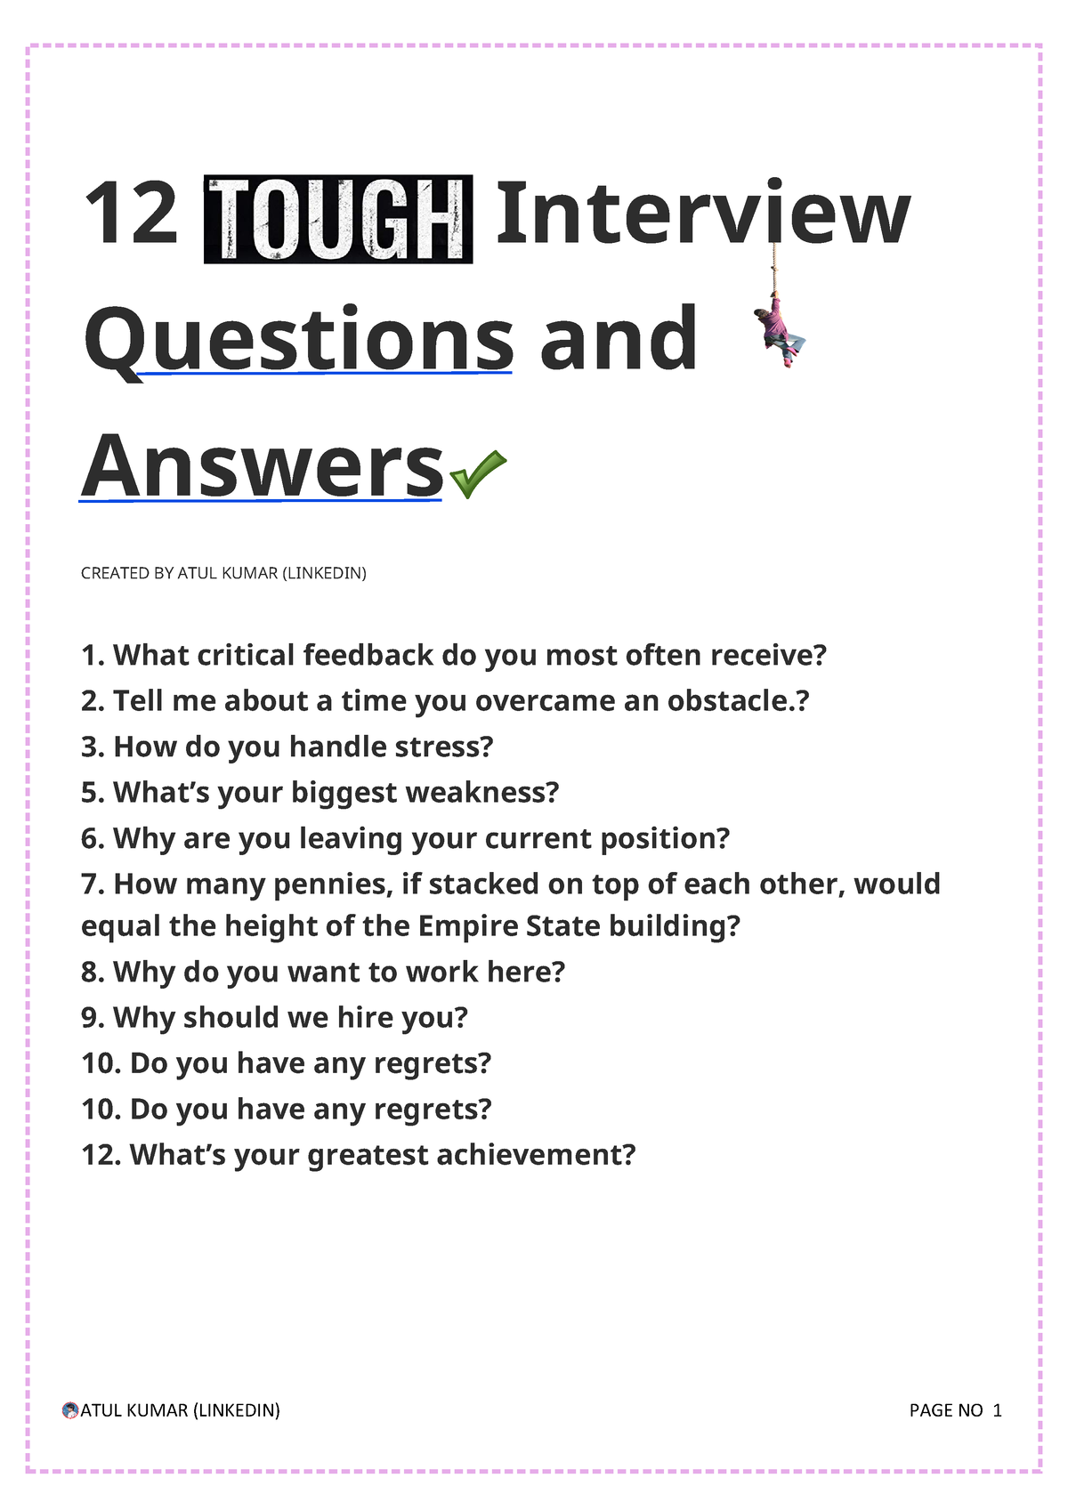
Interview Questions
Personality Questions
The "Weakness" Questions
Previous Work Questions
Tough "On the Job" Questions
Tricky Interview Questions
Rock or a Cloud?
Dinner Guests?
Favorite Book?
Favorite Movie?

Slide 18
Successful Interviewing
Reminders:
Look and feel your best
Be prompt
Be warm, enthusiastic, observant and polite
Have a brief list in mind of what to stress
Listen to questions and dialogue
Take notes
Evaluate your performance: strengths/weaknesses
Relax, be confident and have fun
The more you do the better you get

Slide 19
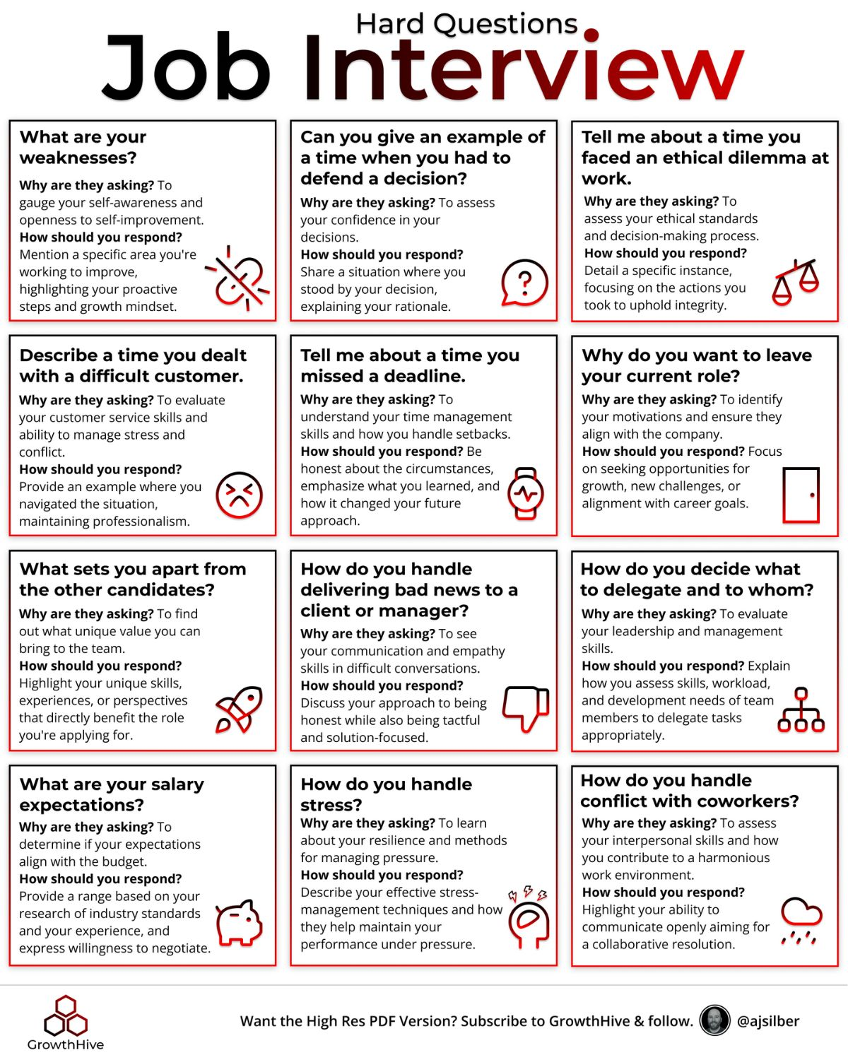

Slide 20
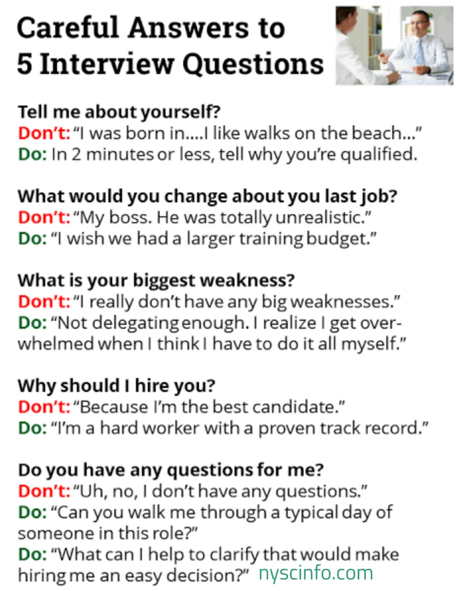
Unsuccessful Interviewing

Slide 21
What Makes a Successful...
Strategic communication professional?
Writing
Thinking
Speaking
Communication skills
Analytical skills
Computational skills
Creativity and problem solving
Dedication/effort
Persistence
First job vs career mobility

Slide 22
Building the UW Network
Alumni Association
Maintaining contact with the SJMC
Provide the school with career updates
Professors/TAs – stay in touch with us
Benefits
Networking
Jobs
Pipeline to new graduates

Slide 23
Course Evaluations
Course evaluation is online:
https://it.wisc.edu/services/heliocampusac/
Higher rate of completion if done during class, so we are hoping you can take a few minutes to do so now.

Slide 24
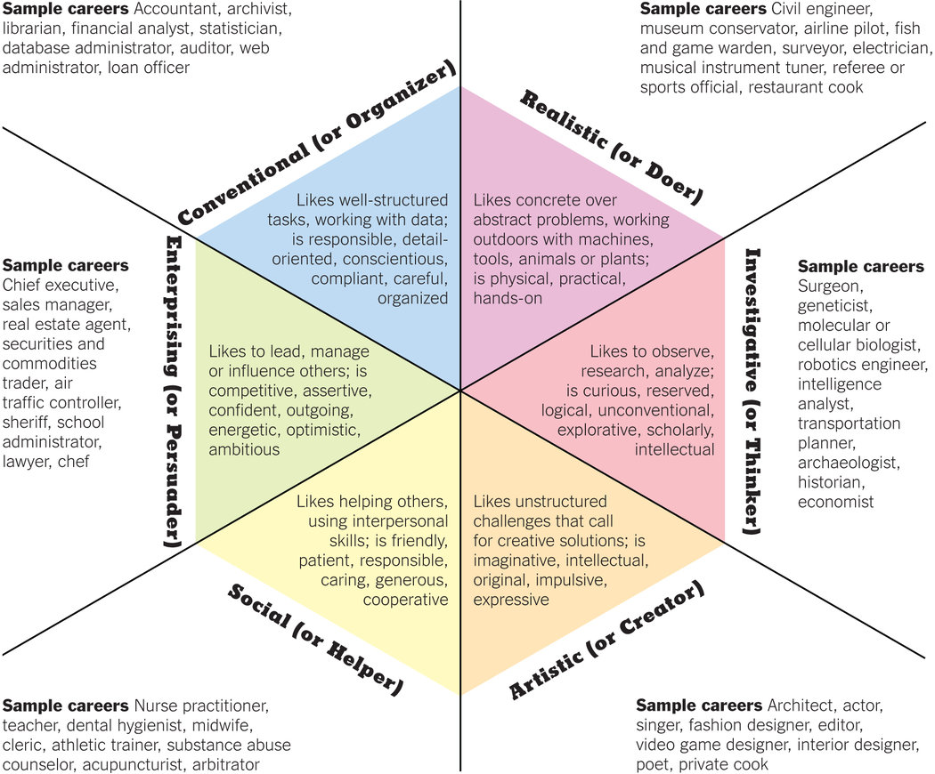
Find Your Fit

Slide 25
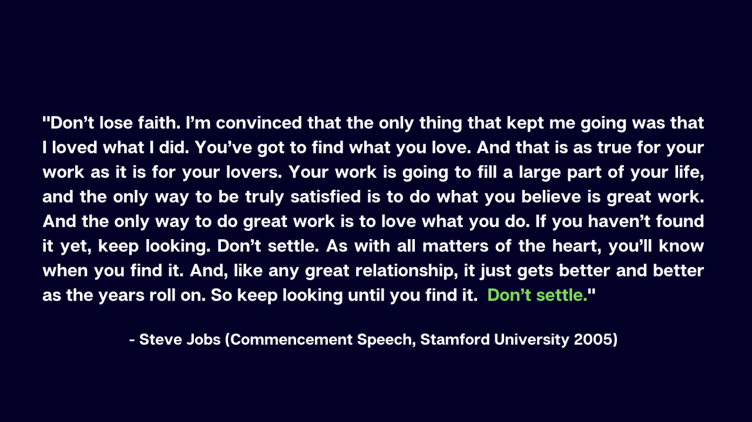

Find work you love

