Slide 1
Political Marketing and Campaigning

Slide 2
Beyond Marketing Communication
The principles and practices you have encountered in this class are flexible and can be applied across contexts.
Social Marketing
Health Campaign
Non-profit Communication
Political Campaign Management

Slide 3
Political Marketing
Candidate elections: President, Congress, governors, state legislatures, mayors, city councils.
Decline of strong party organizations: More independents; more split-ticket and drop-off voting in down-ballot races.
Issue referenda: Ballot measures on abortion, marijuana, minimum wage, voting rules, etc., now attract national-level money and messaging.
Media-based lobbying: Interest groups increasingly pressure elected officials via public campaigns, not just direct lobbying.
Costs have exploded: Total federal election spending reached $14.4B in 2020—double 2016—and remained extremely high in 2024.

Slide 4
Political Advertising
Key means of communication with the public
Though 2016 saw the rise of social media
Still the single biggest budget line in competitive campaigns, especially for the presidency.
Nearly $1 billion in presidential ads in 2012
$8.8 billion across all races in 2012; $10.2 billion in 2016
Over $14 billion for federal election spending in 2020 & 2024
Heavily focused spending in last week - ad blitz
Concentrated on 1/3 of the population
battleground states, media markets, including streaming and connected TV inventory as well as local TV.

Slide 5
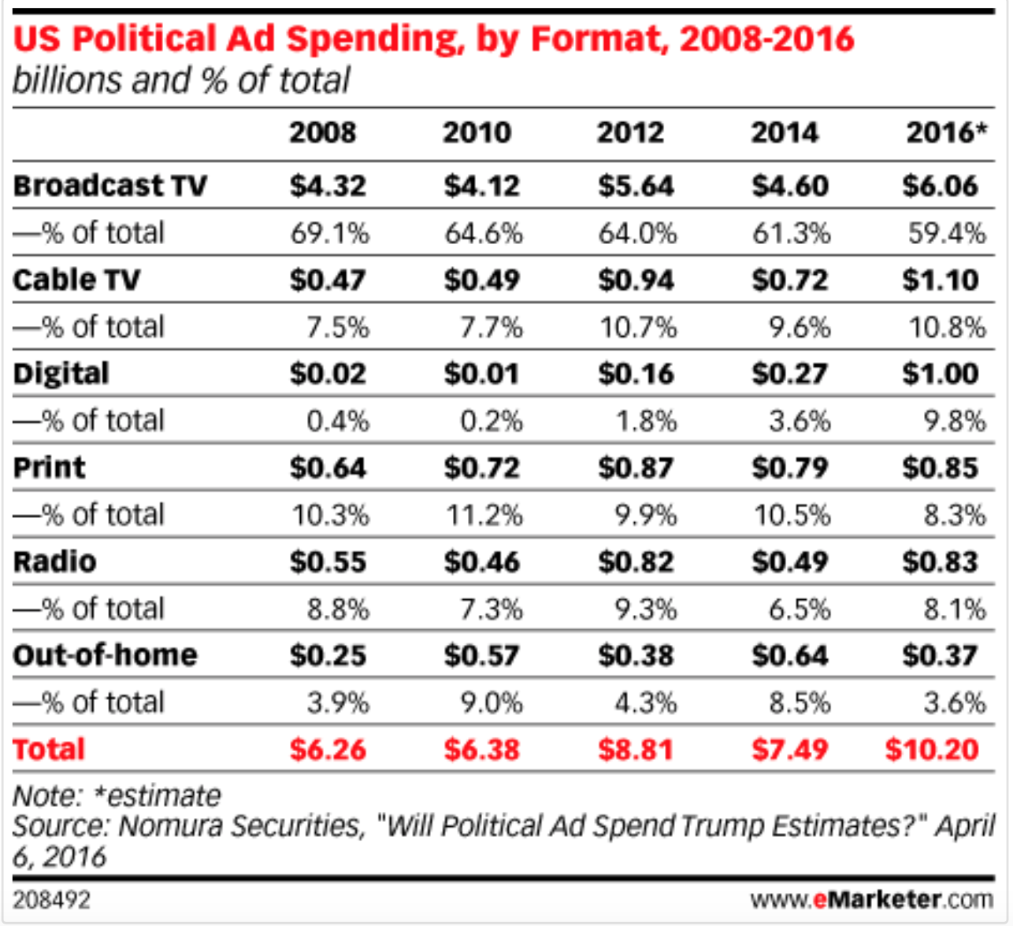
And Spending Explodes…

Slide 6
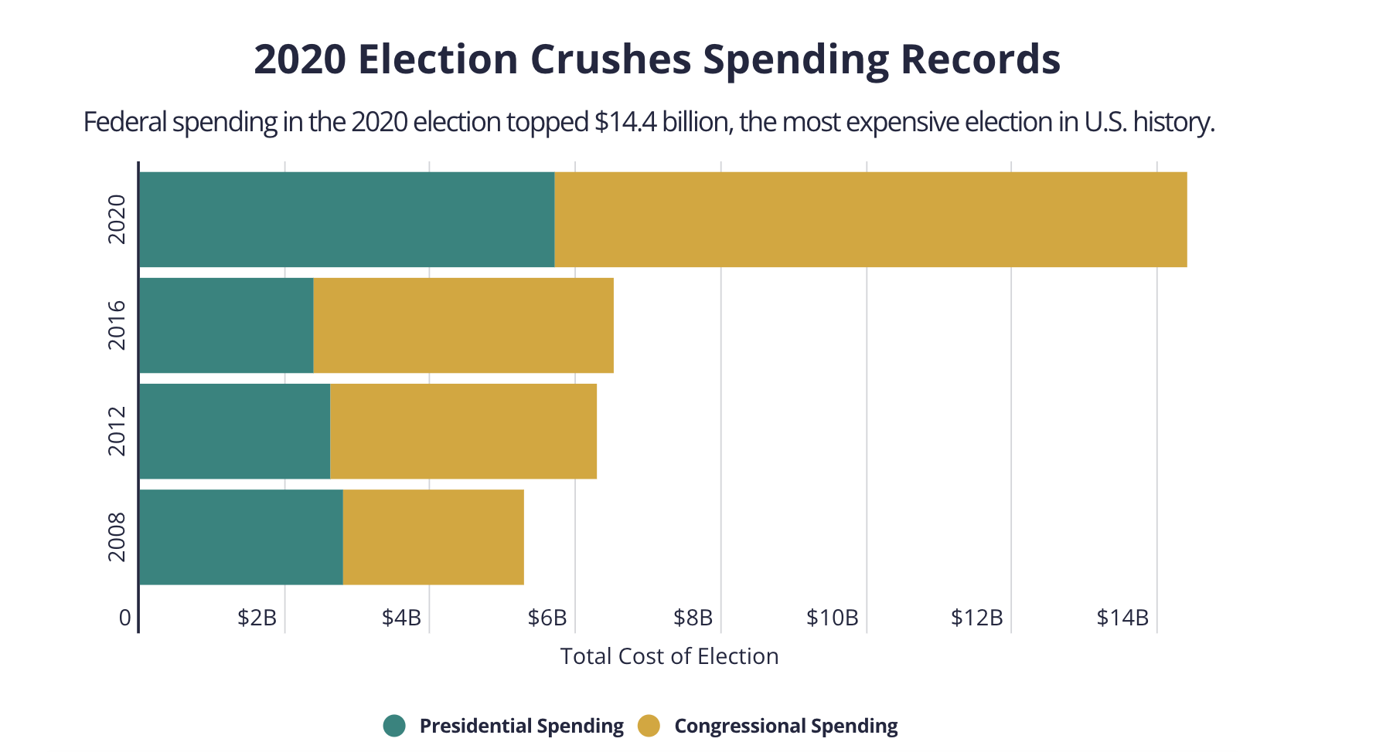
Total Election Spending for Federal Elections,
not counting State Races, has more than doubled

Slide 7
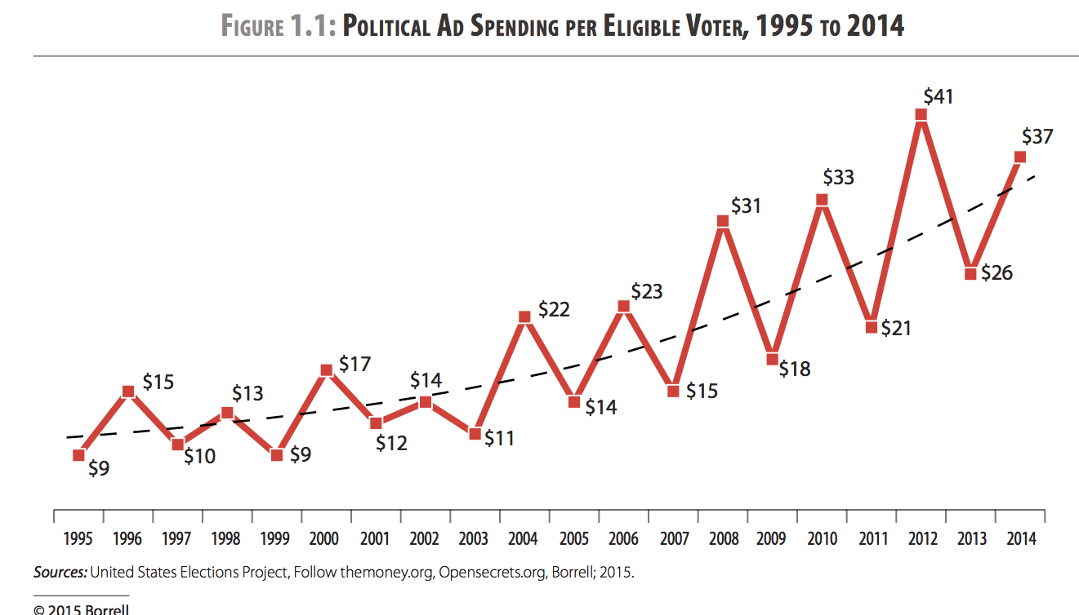
Cost Per Voter Rising
Now up to $90 of spending per eligible voter
Over $140 per net vote generated in 2020

Slide 8
2016 Marked a Shift
Actual was below projection: $10.2 billion.
Broadcast TV, the media mainstay of political advertising, is still dominant but down 20% - Shift to free and paid social media
From $5.45 billion to $4.4 billion in 2016
Lost $ share to Cable and Digital, both up
Digital up to $1.4 billion, growing 789% from $160 mil. in 2012.
Cable television, up 52% to $1.35 billion in 2016
Social media and online video go from experimental to essential.

Slide 9
Broadcast Still Dominant

Slide 10
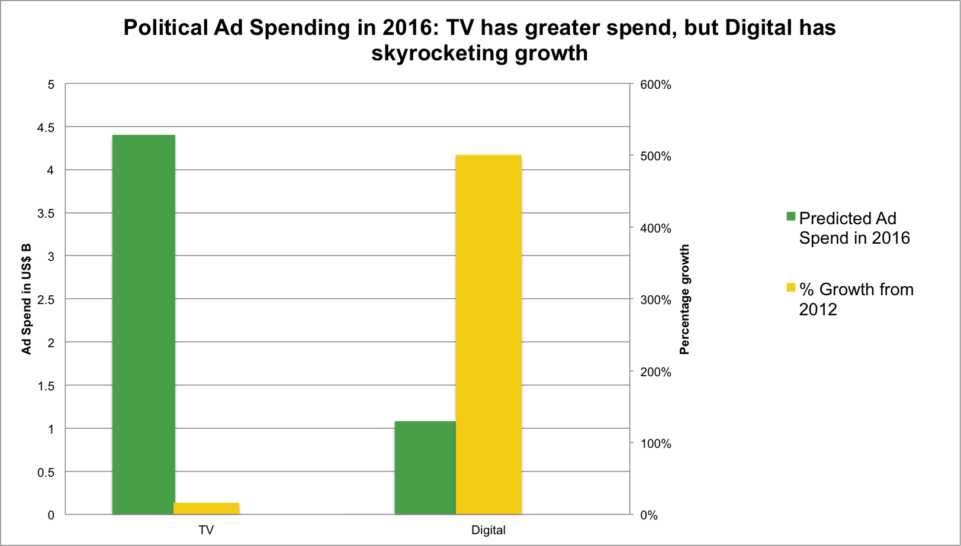
Digital Shift in 2016

Slide 11
Trump Outspent on TV
But got nearly $3 Billion in “Earned Media” Coverage.
Driven by coverage of his Tweetstorms, Staged Media Events, and Public Events
Social Media and Public Relations

Slide 12
Crowding out the News Cycle
Dominated the news agenda, with constant cycle of stories so that subsequent coverage includes his views
Trump got $2.8 billion in primary coverage; Clinton $1.1 billion; Cruz $770 million, making up for ad spending difference – “Trump sucked the oxygen out of the room”
Nearly $5 Billion in unpaid coverage for the full cycle
Differences set before Super Tuesday, with Trump way up; “click-bait” candidate, who drove up news consumption
Same pattern playing out in 2020. Biden dominating the ad war and Trump dominating the news cycle
On social platforms, news influencers talked about Trump more than Harris; Trump was named in about twice as many influencer posts (12% of posts vs. 6% for Harris).

Slide 13
Digital Shift: 2012-2024
Digital share of political ad spending:
2012: ≈ 2%
2016: ≈ 14%
2020: ≈ 14% (digital dollars surged, but total spending did too)
2024: ≈ 28% ($3.46B), with connected TV responsible for much of the jump.
Key digital shifts by 2024:
Massive growth in Streaming / YouTube on TV screens
Social platforms (Meta, Google properties) are capturing over $1.3B in political ad purchases, even before counting smaller platforms.

Slide 14
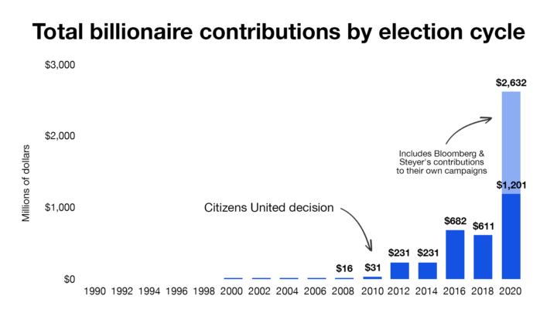
Citizens United decision brings dramatic changes

Slide 15
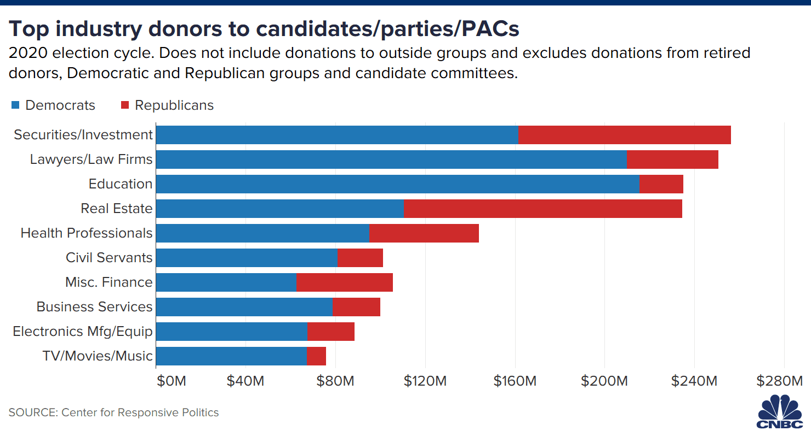
Lobbying, Fundraising, PACs, and Parties

Slide 16
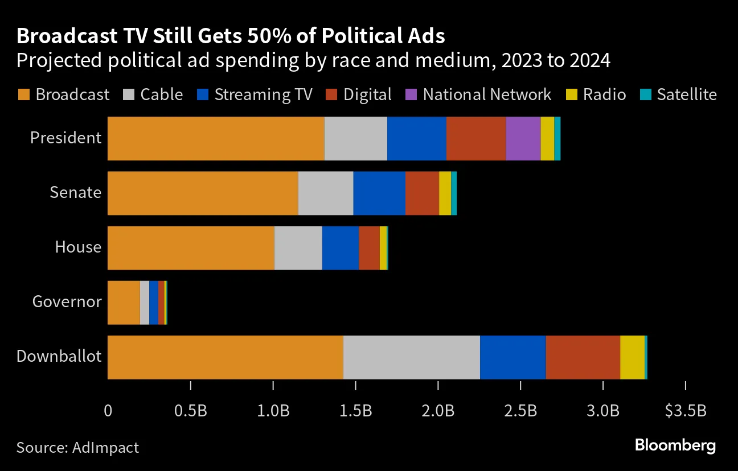
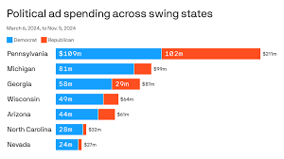

Slide 17
Branding of Politics and Product Politicization
Politicians are branded like products
And product use is politically skewed
Choose to feature certain imagery, brands, symbols, and products in ads as a way to brand the candidate

Slide 18
Republican consumers are different from Democratic consumers. Alcoholic beverage consumption by party

Slide 19
Media consumption: Cable viewers and newspaper readers by party

Slide 20
Ownership of car makes by party

Slide 21
Things to Watch in Ad Composition
Importance of non-verbal cues
Sounds and music sets tones
Graphics
Editing
Code words

Slide 22
Highly Controversial
Question the quality and accuracy of the info
Mudslinging and misrepresentations
Fear about the impact on citizens
Fosters cynicism and demobilization
Distort opinions and alter elections
Switching vote based on ad claims
New layer – generative AI & deepfakes:
AI‑generated images and audio now appear in political content
2024 saw use of deepfake audio
(e.g., fake Biden robocalls in New Hampshire)

Slide 23
Lessons from Modern Campaigs
Candidates don’t dictate the news discourse
Though gatekeepers sometimes let them
Campaigns do control websites, broadcast ads & direct media (mailers, telephone calls, social posts etc.)
Can amplify inaccuracies and distortions
Elections are won locally - ex. electoral college
Swing states, specific regions, local precincts
Play good cop, bad cop - makes attacks worse
PACs, 527s, and stealth campaigning

Slide 24
Negative Advertising
Not a new occurrence – since the 50s
Eisenhower attacks Democrats
Johnson’s “Daisy Girl” against Goldwater
Important part of recent election bids
Beginning in 1980, PACs used ads to support certain candidates as an “independent expenditure”
Willie Horton Ad – PAC against Dukakis

Slide 25
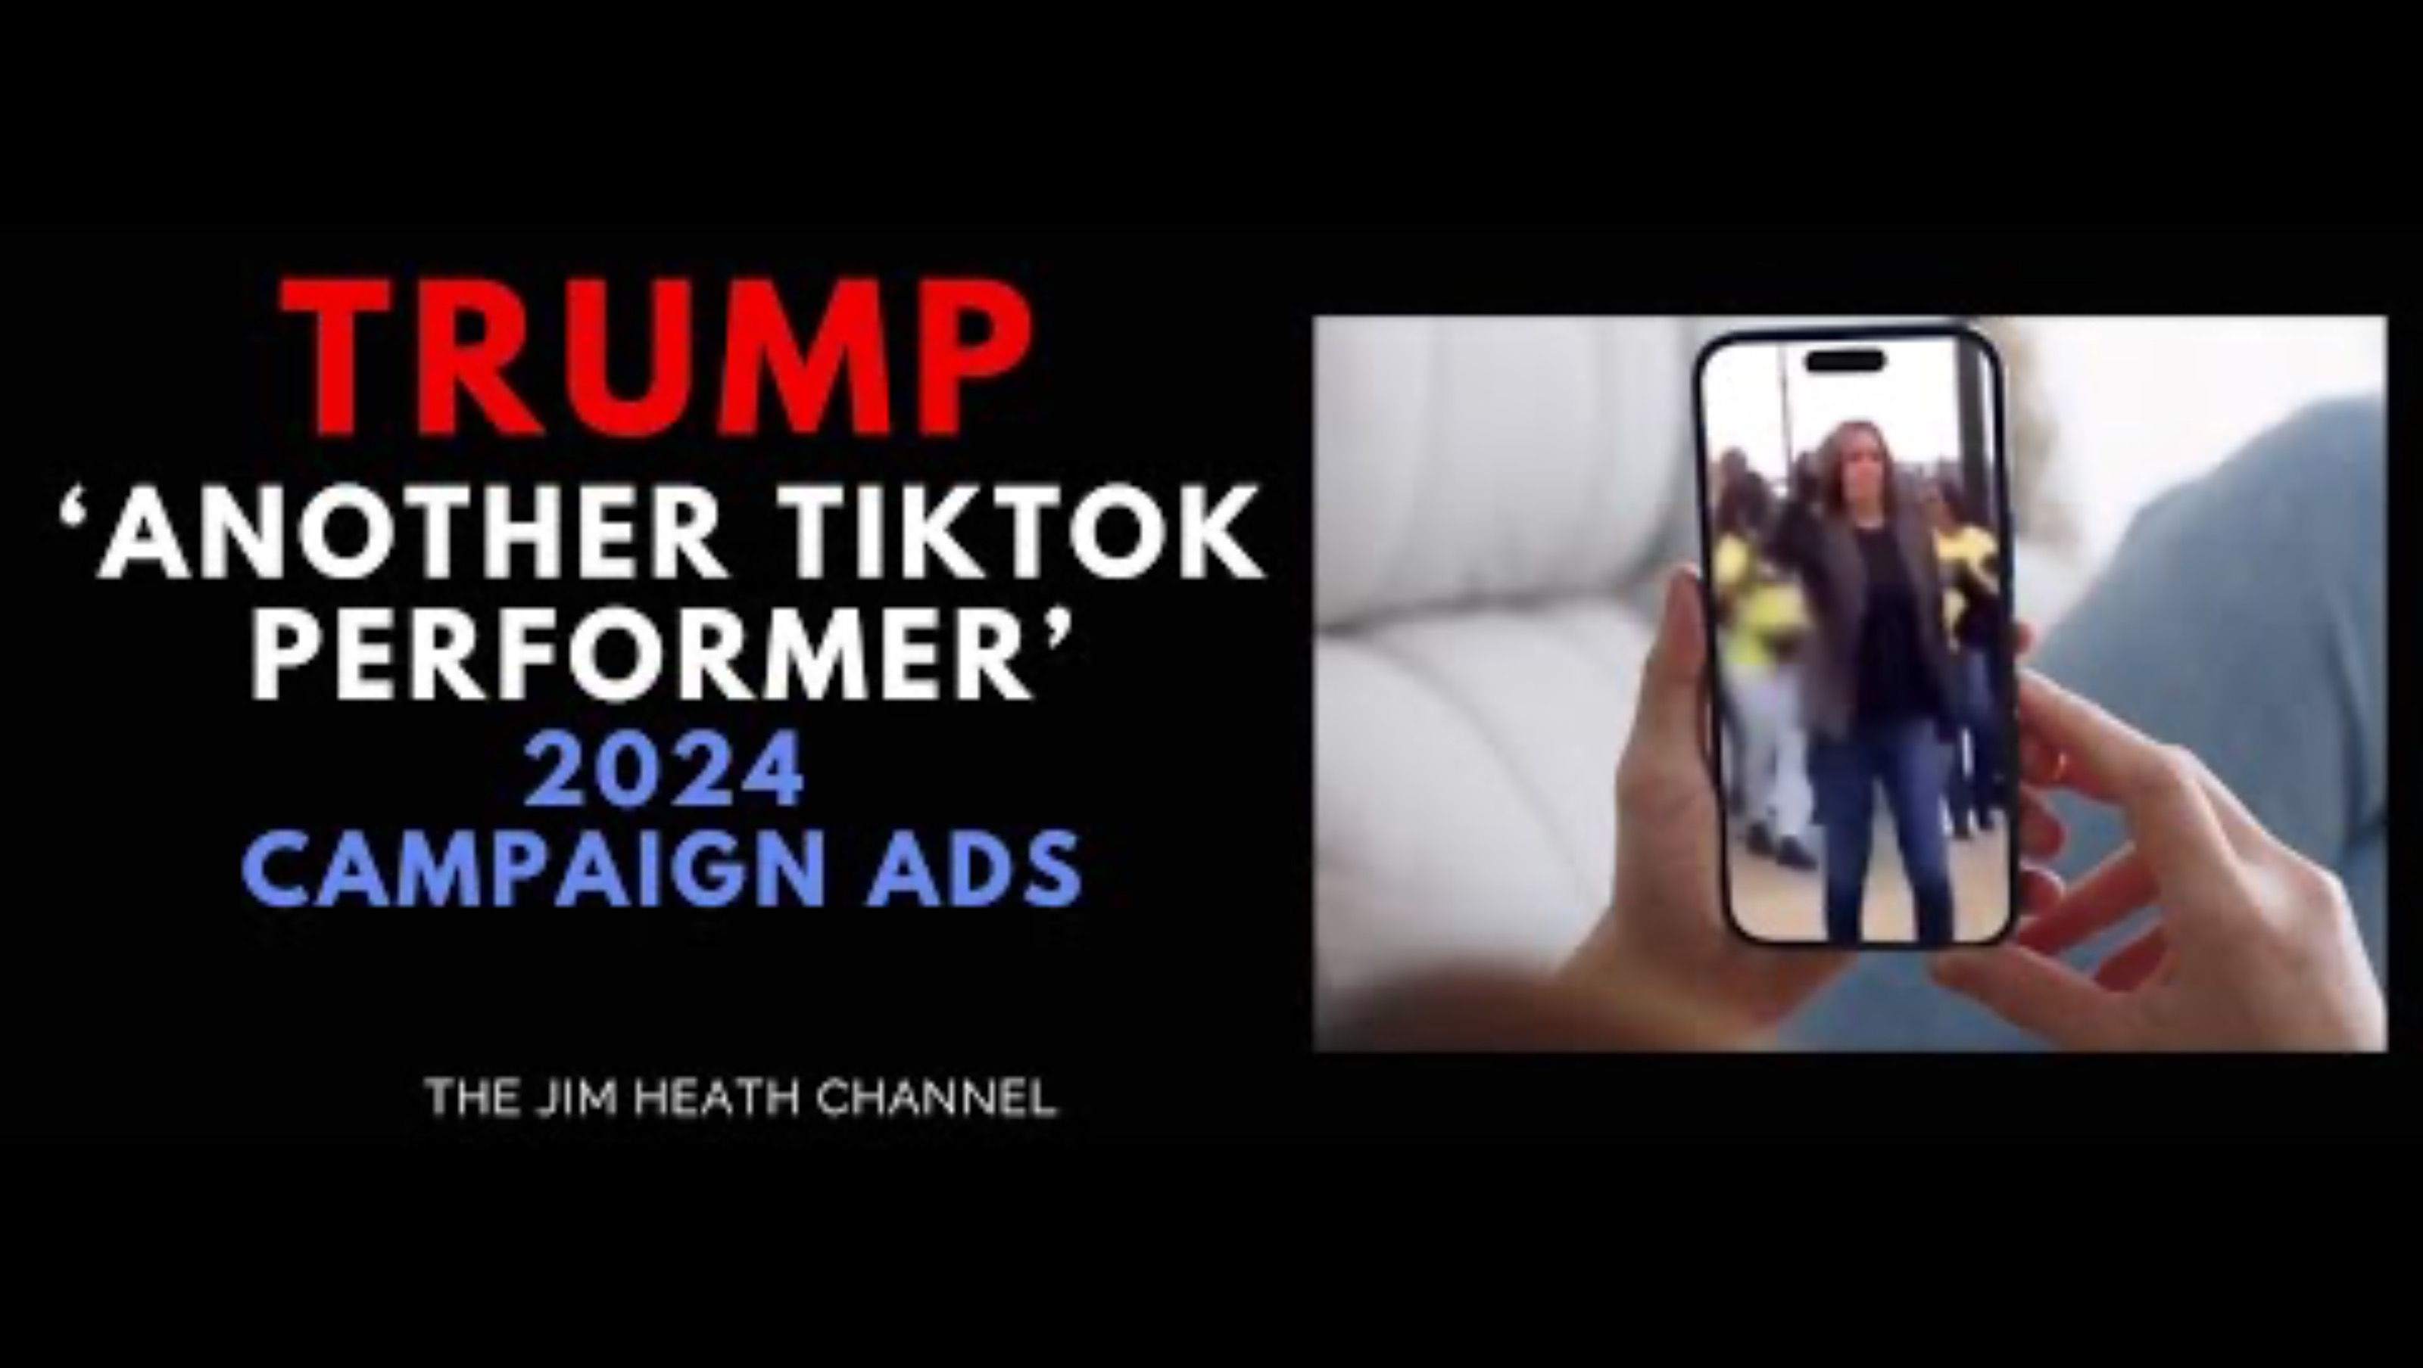
Negative Ads
Focus on criticisms of the opponent, fault character, accomplishments, or issue positions – “attack advertising”
Negative are growing in prominence and visibility

Slide 26


Used Across Campaigns

Slide 27


Comparative Ads
Contrast the sponsoring candidate with opponent on issue positions or character

Slide 28
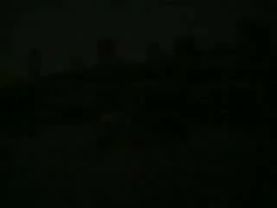
Types of Positive Ads
Positive Ads – focus on good characteristics, accomplishments, or issue positions of sponsor
Morning in American
Reagan
Boy from Hope
Clinton
Image Oriented – focus on character and personal traits
Issue Oriented – focus on the issue/policy positions

Slide 29
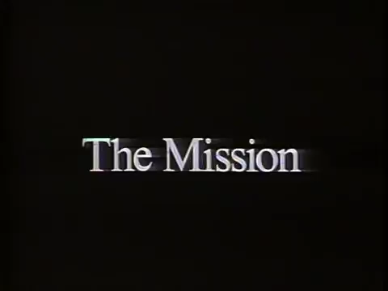

Image vs. Issue

Slide 30
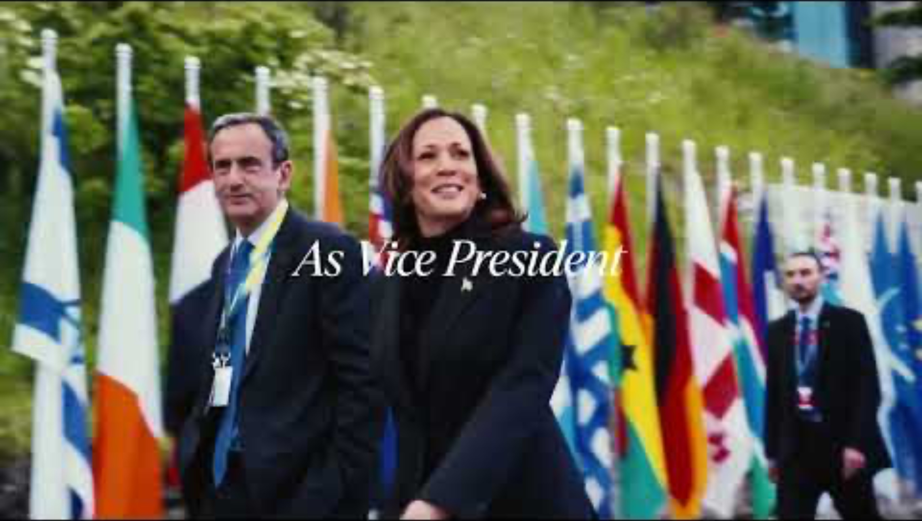

Slide 31


Rise of Viral Videos
Segmented targeting of groups
Appeals based on affinity and humor

Slide 32

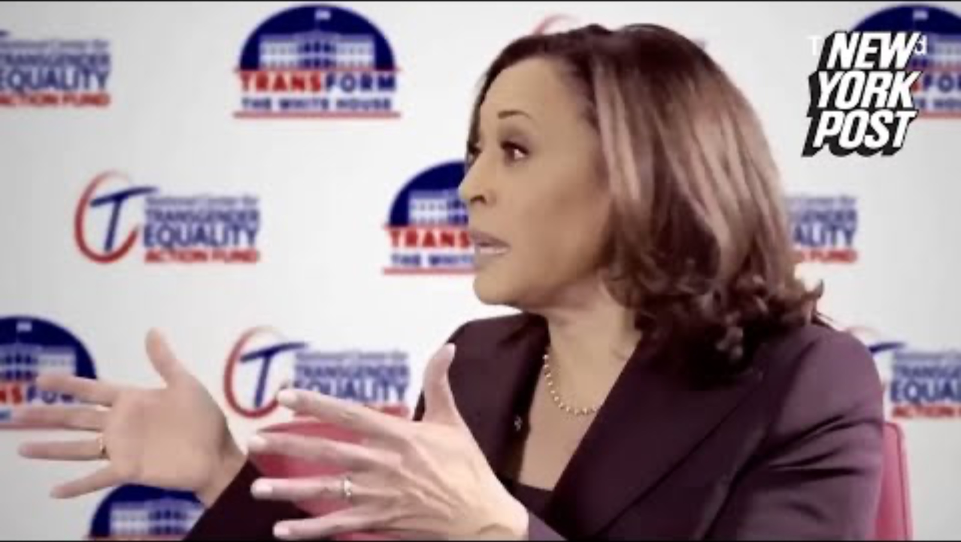
Increasingly Contentious Politics

Slide 33
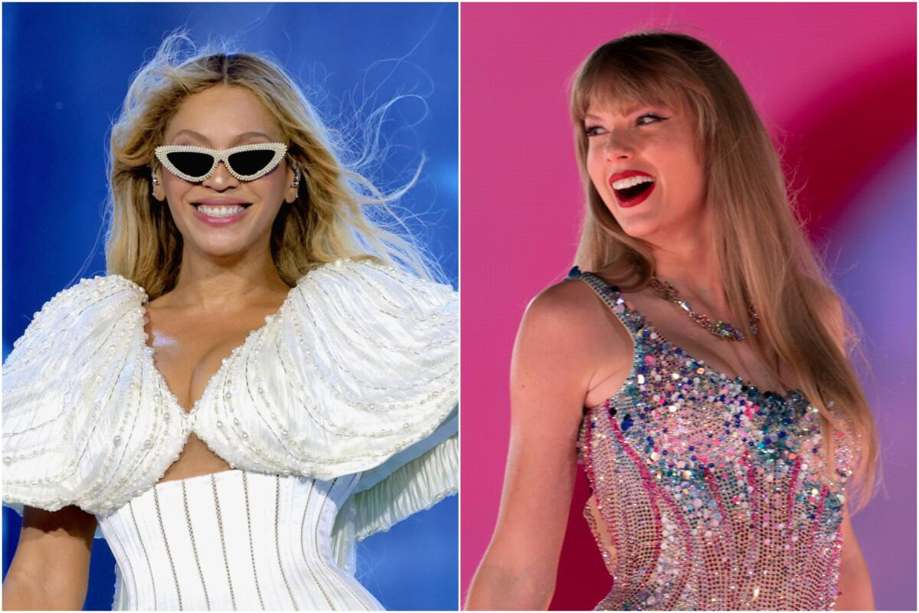
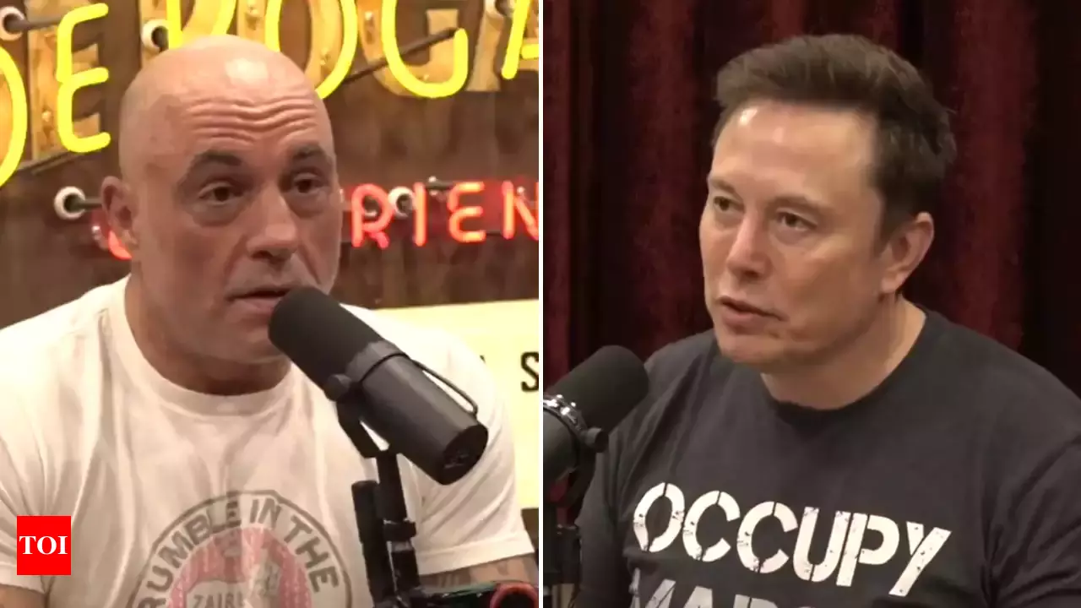
Celebrity Endorsements
Podcasts, Twitter/X, “Stan Communities, Rogan Bros

Slide 34
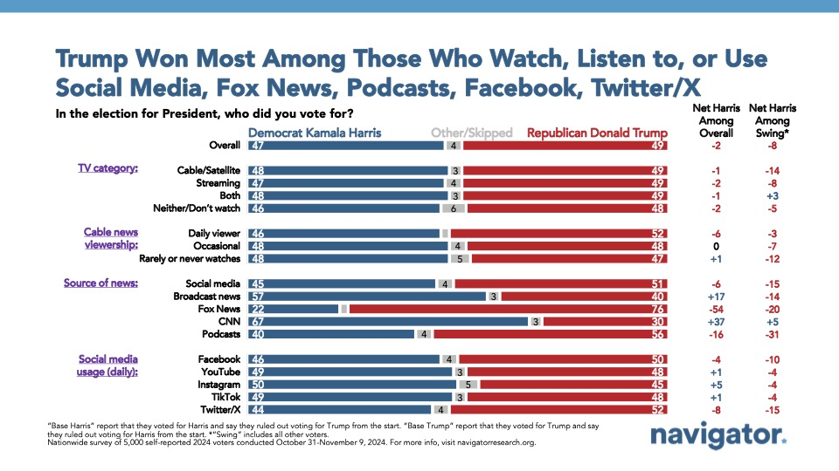
What Drove the Vote in 2024?

Slide 35
Political Ad Effects
The Negativity Effect
Yes, Negative Ads more easily recalled
The “Demobilizing” Effect
No, Negative ads are actually mobilizing
The Backlash Effect
Yes, Negative as can help the attacked

