Slide 1
Plan books and Presentations

Slide 2
Class Grade
Points:
Exams:
Exam 1 100
Exam 2 100
Group Project:
Draft of Situation Analysis 10
Draft of Campaign Strategy 10
Draft of Remaining Sections 30
Group Project Campaign Summary Report
Group Grade 40
Individual Grade 60
Group Project Pitch Meeting 25
Group Project Peer Evaluation 25
Participation and Attendance:
Participation Score 50
TOTAL 450

Slide 3
Group Project Activities
Draft of Situation Analysis 10
Draft of Campaign Strategy 10
Draft of Remaining Sections 30
Group Project:
Campaign Summary Report
Group Grade 40
Individual Grade 60
Group Project Pitch Meeting 25
Group Project Peer Evaluation 25

Slide 4
Project: Made up of group grade and an individual grade.
Recall that the overall grade is calculated as follows:
Two people in the same group could have this breakdown:
Draft of Situation Analysis 9.5/10
Draft of Campaign Strategy 9.5/10
Draft of Remaining Sections 26/30
Final Campaign Group Grade 36/40
Final Campaign Individual Grade 59/60
140/150 = 93.3% = A
Draft of Situation Analysis 9.5/10
Draft of Campaign Strategy 9.5/10
Draft of Remaining Sections 26/30
Final Campaign Group Grade 36/40
Final Campaign Individual Grade 42/60
123/150 = 82% = BC
Will also have peer evaluations to provide feedback – 25 pts

Slide 5
Campaign Plan Books
Campaign plan
5 Sections, 40-50 pages
Yes, you can go a bit longer, but not over 60 total
We need to read 50 pages x 20 teams = 1000 pages
Each person has primary responsibility for one section of the plan (individual grade), but must be integrated with the other sections (group grade)
The more integrated your structure, the more integrated the plan
Describes in detail the nature of the campaign proposed for the client while persuading them

Slide 6
Campaign Plan Books
Should be detailed and highly polished.
Graded on creativity, integration, critical thinking, strategic decision-making, problem solving, and the application of course concepts.
Choices should be clearly identified and backed by research, references, reasoning.
You will not be penalized for another team member’s weak section, though that may reduce your chances of “winning the business.”

Slide 7
Plan Example #1
Plan Example #2
Plan Example #3
Plan Example #4

Slide 8
Pitch Presentations
Pitch meeting
Oral summary and slide deck presentation of your campaign plan to “win the business.”
Covers all aspects; each team member presents
10 minutes max - Will stop you at 30 seconds over
5 x 10 minutes x 2 clients + transitions – very tight
Will have an order set in advance so we can move quickly. Report any issues to us today.
I will have Ian’s Pizza delivered to enjoy the while we listen to the pitch presentations.

Slide 9
Pitch Presentations
Grade based on the quality and skill with which the agency presents an oral summary of its campaign plan.
Be informative and persuasive - need both specific details and broad themes and the ideas that connect them.
Must articulate the goals/strategies of the campaign and the rationale behind creative, media, and pr/promotional strategies
Be sure to emphasize integration of campaign elements
Assemble with care as it plays an outsized role in the vote
Instructional team weighs the campaign book and pitch in the overall selection while students have less time with the campaign plan books
Prepare the deck and practice your presentation
”The book is the steak; the pitch is the sizzle”

Slide 10
Pitch Presentation #1
Pitch Presentation #2

Slide 11
…Group Project Activities
3. Peer Evaluations
Students will evaluate all other students in their group project agency besides themselves
Evaluations by other members are averaged to be worth 25 point toward the final grade
Submit these at the final exam.
IT’S A FORM ON FINAL PAGE OF EXAM SHEET

Slide 12
Outside Class Meetings
Pitch meeting
Two pitch sessions
6:00 PM – 8:00 PM, December 11th – Sections 301/303
8:00 PM – 10:00 PM, December 11th - Sections 302/304
Faculty and Students Vote on Winner
Student vote winner will receive 5 bonus pts.
The professor and TAs will award 10 bonus points
May split the business between two winning teams
Professor and TAs base their evaluations of the campaign plans books and pitch presentation
This determines the winning account(s)

Slide 13
Final Exam
Exam time for the final in 2195, this classroom
Listed time: 5:05 PM –7:05 PM, December 13th
Exam will be the same format as midterm exam
50 items, multiple-choice format
Please let us know today if you need accommodations

Slide 14
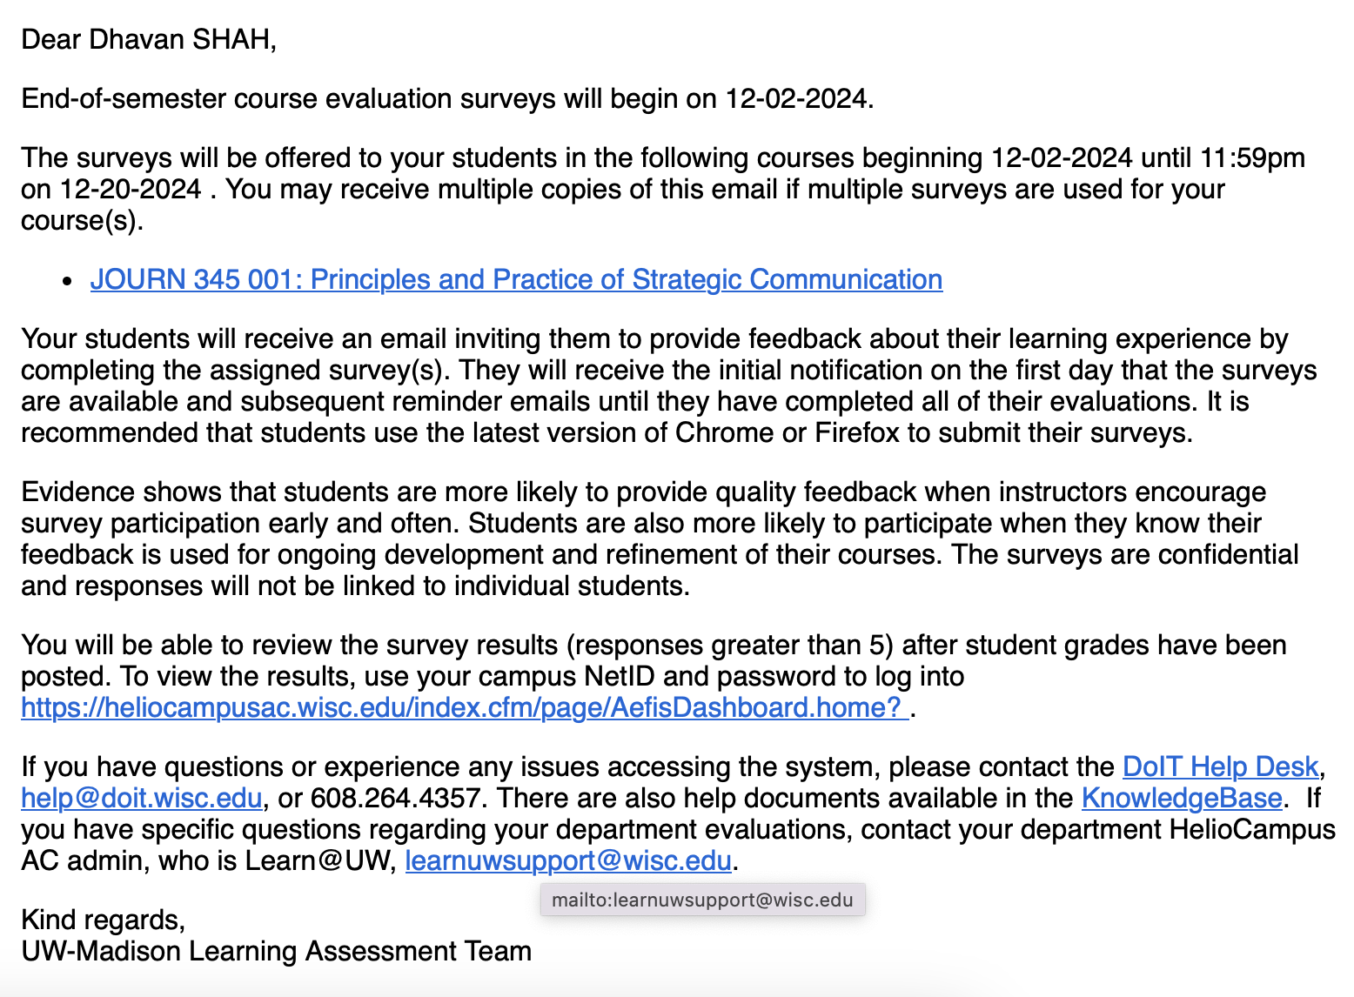
Your Evaluation of the Course

Slide 15

Course evaluation is online:
https://it.wisc.edu/services/heliocampusac/

