Slide 1
Research Inquiry

Slide 2
Basic Tools of Communication Science
Surveys
Experiments
Field (or “natural”) experiments
Social network analysis
Content analysis
Focused interviews
Qualitative Field Research

Slide 3
Types of Surveys
Polls (descriptive surveys)
Census (full population)
Sample surveys (specific group_
Probability sample survey
Each member of population has an equal chance of being selected in sample – representativeness
Permits generalizations about larger population

Slide 4

Survey Types
Cross-sectional
One time snapshot of the population
Panel surveys
People re-interviewed over time
Measures:
Change over time
Change in response to some event

Slide 5
Contact Methods in Survey Research
Face-to-face
Paper and pencil
Telephone
Direct mail
Mall intercept
Web-based

Slide 6
Advantages of Survey Research
Describing characteristics of a large population
Flexibility:
Permits measurement of many variables
Open and closed-ended questions
Capturing a large amount of information on:
Cognitions (thoughts), attitudes and behaviors
Possibility for anonymous response

Slide 7
Limitations of Survey Research
Structuring responses:
“round pegs into square holes”
“pseudo-opinions”
Often asks about opinions without context
General attitudes rather than more concretely applied to real situations
Artificiality of responding to survey
Demand characteristics, social desirability, conscious of observation

Slide 8
Experimental Methods
Tradition started by psychologists interested in media:
Adapted experimental methodology to communication
Many early researchers were psychologists
For example, Carl Hovland
“Why We Fight”
US Army commissions research during WWII
Effects of Frank Capra’s motivational film series
Experimental vs. control group
Exp group had more knowledge, but not more motivation

Slide 9
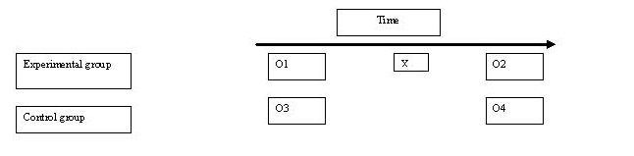
Experiments
Experiments provide control to:
Test hypotheses
Isolate cause and effect
Independent and dependent variables
Eliminate influence of third variables
Explanation over description
Simple models:
Pretest – Stimulus – Posttest
Experimental vs. control groups

Slide 10
Value of Experiments
Isolating cause and effect
Exp vs. Control group
All other factors are controlled
Facilitates causal inferences

Slide 11
Limitations of Experiments
Narrow focus
Limited number of variables at once
Artificial situation
Subjects are aware they are being observed
Limited external generalizability
Best at isolating short-term effects
Many media effects are long-term
How long do experimental effects last?

Slide 12
Field (Natural) Experiments
Experiments that take place in the real world
By design:
Public health campaign: intervention vs. control community
By coincidence:
Naturally occurring phenomenon
E.g., Comparing Northern Jersey to Southern Jersey in terms of voter turnout due to differing media conditions

Slide 13
Advantages of Field Experiments
Approximating control of experiment
Less artificial setting
Some control is sacrificed for greater generalizability

Slide 14
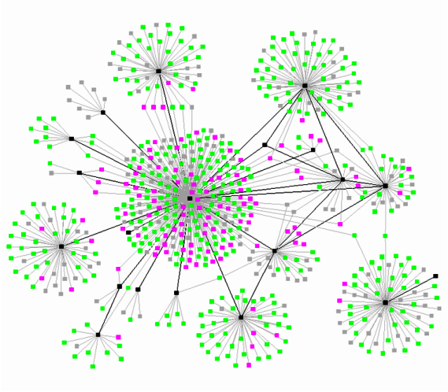
Social Network Analysis
Study of social networks
Understand social structure as made of nodes that are tied to one another in terms of strength, duration, frequency, quality, or some other feature.
Nodes are usually individuals or organizations
Ties can be any property of the relationships between nodes
Social networks operate on many levels
From families up to the level of nations

Slide 15
Social Network Metrics
Centrality: This measure gives a rough indication of the social power of a node based on how well they "connect" the network. Are they a hub or a spoke?
Closeness: This measures gives a sense of whether a node is near all other nodes in a network (directly or indirectly). How far along the "grapevine”?
Cohesion: This measures the degree to which nodes are connected directly - ‘cliques’ if every nodes is directly tied to every other one, ‘social circles’ if nodes are directly and indirectly tied to each other.
In-Degree and Out-Degree: The count of the number of ties to other nodes in the network – ties coming in vs. ties going out

Slide 16
Content Analysis
Systematic analysis of media texts, programs, etc.
Design coding instrument with content variables to be measured
More than one coder analyzes content
Codings compared to ensure reliability

Slide 17
Advantages of Content Analysis
Systematic analysis of content
Non-obtrusive
Reliability easy to assess
Do two observers reach the same conclusion?

Slide 18
Limitations of Content Analysis
Hard to get at deep meaning of content
Mundane questions emphasized for reliable measurement
More interesting concepts are hard to measure reliably
E.g., “media bias”

Slide 19
Focused Interviews
Trying to get a more in-depth look at opinion holding
More open-ended questions
Focus groups:
Planned discussions in an open-environment
Loosely-structured script with moderator
6 to 12 participants
Samples usually not randomly selected
1 to 2 hours
Qualitative and quantitative analysis of transcript
Often combined with surveys of participants

Slide 20
Functions of Focus Groups
Prior to survey research:
Identifying closed-ended survey items
Suggesting hypotheses
E.g., Media uses and gratifications-sought
Supplementing survey research
Going in-depth, “behind” the survey responses
E.g., Attitudes toward affirmative action
Getting at complex opinion/belief structures
More detailed responses
Subjects use their own language, terms, concepts

Slide 21
Limitations of Focus Groups
Influence of the facilitator
Influence of vocal participants
Small, non-representative groups
Biases in transcript interpretation
Artificial nature of focus group situations
Ditto for surveys and experiments

Slide 22
Qualitative Field Research
Naturalism – detailed and accurate description
Grounded Theory – patterns and themes from observational work
Case Study and Extended Case Method – focus on case and cases
Ethnography – participant and observer of the situation
Participatory Action Research – Serve as resource for studied group

Slide 23
Stages in the Research Process
Interest/initial exploration
Conceptualization
Choice of method
Operationalization
Population definition
Observation
Data processing and analysis
Application

Slide 24
Interest/Initial Exploration
Interest => preliminary exploration
What do we currently know?
Applicable research and theory
Define purpose/goals:
Exploration, description or explanation?

Slide 25
Conceptualization
What are the research questions?
Who or what do they apply to?
Identifying relevant concepts
What concepts/variables come into play?
Define all important concepts
E.g., Racial prejudice, political participation
How do we define them?

Slide 26
Choice of Method
Best method to answer research questions?
Content analysis?
Lab experiment?
Field experiment
Natural experiment?
Focus groups?
Survey?
Cross-sectional, trend, cohort, or panel?

Slide 27
Operationalization
How do we measure concepts?
E.g., Measuring attention to media
How has past research measured concepts?
What is best for our purposes?

Slide 28
Population Definition
To whom do we want to generalize results?
Define the population of units
Define sampling frame (population list)
Who are we going to study?
Define sampling strategy for selection
Should represent larger population

Slide 29
Observation
Making observations/collecting data
For example:
Survey interviewing
Content analysis coding
Taping focus group interactions
Experimental observations

Slide 30
Data Processing and Analysis
Data processing
Translating the observations into data
E.g., survey answers translated into numbers and entered into the computer
E.g., content coded into numbers
Data analysis
Synthesizing larges amounts of information
Data analysis examining relationships b/w concepts
Application of statistics and summary tables

Slide 31
Application
Packaging the results in usable form
Writing a research report:
Who is the audience?
Researchers, policymakers or public

Slide 32
Contexts of Communication Research
A. Advertising
B. Public Relations
C. Marketing
D. Public Opinion
E. Political Campaigns
F. Health Communication
G. Research Consulting
H. Interest Group Research
I. Academic Research

Slide 33
Becoming a competent researcher…
Mastering basic concepts and principles
Following systematic procedures
Striving for objectivity
Having good research questions
Using the right tool to answer the question
Testing underlying explanations
Learning by doing - Applied approach to learning research methods

Slide 34
2016 Rolling Cross Sectional Study
Collected from September 20 to November 7, 2016. The survey sample included about 100 respondents per day, using quota sampling from Qualtrics’ online panel to approximate U.S. Census data regarding age, race, education, and income. Each day consisted of a new sample, resulting in a final sample of 4,901 respondents over 49 days.
Candidate feeling thermometer ratings
Emotional reactions to candidates
Candidate and political party characteristics
Political knowledge (rolling current events)
Attention to campaign
News perceptions
Political attitudes
Vote certainty (before election)
Vote choice and experience (after election)
Liberal media
Conservative media
Social media use
Popular stories on social media (rolling current events)
Legacy news media
Local news media
Political conversation and social network
Social media and news attitudes
Political advertising exposure and reactions
Confidence in election/belief in election fraud
Partisanship, Ideology, and Issue Positions
Demographics

Slide 35
2018-2019 Swing State Panel
From October 26 to November 4, 2018, the first wave of a web-based, two-wave panel survey of registered voters in Wisconsin (N=2,058), Ohio (N=396), Michigan (N=391), North Carolina (N=369), and Pennsylvania (N=391), was collected. In wave two, launched in February of 2019, we were able to successfully recontact a subset of the same respondents in Wisconsin (N=1,058), Ohio (N=156), Michigan (N=121), North Carolina (N=133), and Pennsylvania (N=150). Respondents were recruited as part of an online panel by LHK Partners, a national survey research firm, using a nested quota sampling procedure stratified by age, gender, and race based on Census data from each state.
Group closeness and social trust
Institutional confidence
Political participation
Political talk and news networks
Political conversation and online network
Vote intention
News perceptions
Political attitudes
Political efficacy
Liberal media
Conservative media
New avoidance/fatigue
Social media use
Legacy news media
Local news media
News diet
Media trust
Candidate favorability and approval
Religious traditionalism/modernism
Racial resentment
Campaign enthusiasm
Partisanship, Ideology, and Issue Positions
Demographics
+ Experiments!!!

Slide 36
2020-2021 Wisconsin-Pennsylvania Panel
From October 21 to November 1, 2020, the first wave of a web-based, two-wave panel survey of registered voters in Wisconsin (N=3,076), Michigan (N=1,589), North Carolina (N=1,621), and Pennsylvania (N=1,751), was collected. In wave two, fielded from December 7, 2020 to December 15, 2020, we were able to successfully recontact a subset of the same respondents in Wisconsin and Pennsylvania (N= 1,849). Respondents were recruited as part of an online panel by LHK Partners, a national survey research firm, using a nested quota sampling procedure stratified by age, gender, and race based on Census data from each state.
Group closeness and social trust
Institutional confidence
Political participation
Political conversation and online network
Vote intention
News perceptions
Political attitudes
Liberal media
Conservative media
New avoidance/fatigue
Social media use
Legacy news media
Local news media
Media trust
Candidate favorability and approval
Health status, need for chaos, elitism
Hostile sexism, materialism \/post-materialsim
Racial resentment
Campaign enthusiasm
Partisanship, Ideology, and Issue Positions
Cultural taste/religious traditionalism/modernism
Occupation
Demographics
+ Experiments!!!

Slide 37
Getting into teams
Will be joining a team of 3-4 people to work on the group project
Exchange contact info (e.g., university email), discuss common workspaces (e.g. BOX, Google docs), and schedules.
Share your general interests and start discussion of project aims.
Do not need to land on a specific aim today. Will have class time.
Outside class meetings (online) in weeks 4 and 9. In class “workshop” sessions throughout the semester. Attendance noted.

