Slide 1
Univariate Statistics

Slide 2
Basic Statistical Principles
Central tendency
Dispersion
Standardization

Slide 3
Central tendency
Mode
Median
Mean
Skewed distributions

Slide 4
Frequency distributions
Show n of cases falling in each category of a variable
Starting point for analysis
Reveals out of range data
Signals missing data to be specified
Identifies values to be recoded

Slide 5
Frequency Distribution Example

Slide 6
Frequency Distribution Example

Slide 7
Mode
The most common score
E.g. (gender):
Frequency
Males 123
Females 148
-Female is the modal category

Slide 8
Median
Arrange individual scores from top to bottom and take the middle score
E.g. (Quiz scores):
Score Frequency
100 1
90 3
80 6 Median = 80
70 3
60 2
50 1

Slide 9
Mean
Statistical average (total scores/number of scores)
E.g. (Quiz scores):
Score Frequency
100 1
90 3
80 6 Median = 80
70 3 Mean = 76.88
60 2
50 1

Slide 10
Skewed distributions
Median may be a better indicator of central tendency
Example: Typical employee income
CEOs make 100 times average worker
Outlier distorts the average
Median works better
Income Frequency
$5,000,000 1 Mean= $99,500
$50,000 99 Median = $50,000

Slide 11


The Normal Curve
50% of cases are above the midpoint
50% of cases are below the midpoint

Slide 12
Importance of the Normal Curve
Many of the statistical analysis techniques that we’ll be talking about assume
Normally distributed variables
This assumption is:
Rarely checked
Often violated

Slide 13

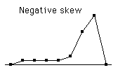
Positive and negative skews

Slide 14
Positive Skew Example

Slide 15
Negative Skew Example

Slide 16
Correcting for skewed distributions
Ways to correct for skewed variables:
Square root a positively skewed variable
Square a negatively skewed variable

Slide 17
Dispersion
How spread out are the scores from the mean?
Are they tightly packed around the mean
Or
Are they spread out?

Slide 18
Dispersion Measures
Range
Standard Deviation
Variance

Slide 19
Range
Distance between the top and bottom score
E.g., Hi Score = 96, Lo Score = 42, Range = 54
Only tells you about the extremity of the scores
These 3 distributions have the same range:
10, 11, 12, 13, 14, 15, 90
10, 85, 86,87,88,89,90
10,48,49,50,51,52,90

Slide 20
Standard Deviation and Variance
Both account for the position of all the scores
Both measure the spread of the scores

Slide 21
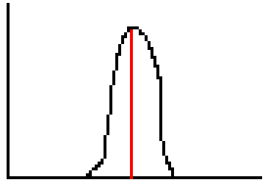
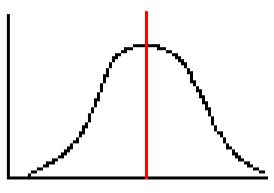
Standard Deviation
Small Variance
(small SD)
Large Variance
(large SD)

Slide 22
Standard Deviation and Variance: Measures of Dispersion
Standard deviation
measure of the width of the dispersion
or spread of the scores
or size of the average distance of scores from mean
The squared value of the standard deviation (sd²) is called the variance

Slide 23
Standardization
Converting variables to a uniform scale
Mean = 0
Standard deviation = 1
Formula:
z score = (score – mean)/standard deviation

Slide 24
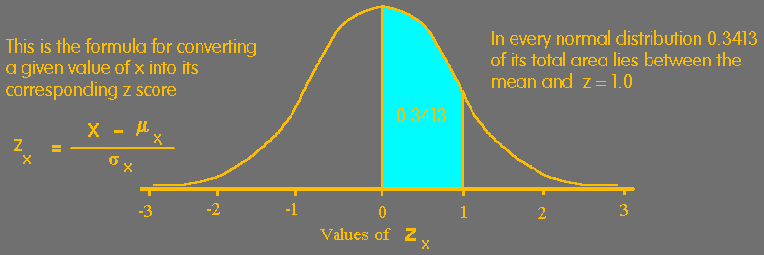
Standardization and Normal Curve
68% of cases fall within 1 standard deviation of the mean
95% of cases fall within 2 standard deviations of the mean
99% of cases fall within 3 standard deviations of the mean

Slide 25
Functions of Standardization
Makes two variables comparable
Allows us to compare within groups
Allows us to compare across collections
Stepping stone to other procedures (e.g., Pearson Correlation Coefficient)

Slide 26
Steps in Statistics
How to calculate
various statistics

Slide 27
Steps in Calculating Standard Deviation
Steps:
1. Calculate the mean
2. Subtract mean from each score (deviations)
3. Square all deviations
4. Add up squared deviations
5. Divide sum of squared deviations by N
6. Take the square root of the resulting value

Slide 28
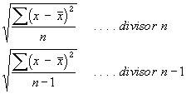
Formula for Standard Deviation
Formula averages distance of scores from mean:
For a population
For a sample used
to estimate
population sd

Slide 29
Example of Calculation (sd)
Scores x-M Square
16 16-10 = 6 36
12 12-10 = 2 4
10 10-10 = 0 0
6 6-10 = -4 16
6 6-10 = -4 16
Mean = 10 (50/5)
Sum of Squares = 72
72/5 = 14.4
Sq root = 3.79

Slide 30
Calculating Variance
Same as standard deviation without last step
Standard deviation’s descriptive utility
If standard deviation is 5, the average distance from the mean is 5
Variance is building block for other procedures

Slide 31
Standardizing and Variable Comparability Example
Students took two exams:
Exam 1 Exam 2
Student A 90 90
Student B 80 100
Student C 80 100
Student D 80 100
Student E 70 10
Mean = 80 80

Slide 32
Standardizing and Variable Comparability Example
Exam 1 Z1 Exam 2 Z2
A 90 1.58 90 .28
B 80 0 100 .57
C 80 0 100 .57
D 80 0 100 .57
E 70 -1.58 10 -1.99

Slide 33
Standardizing and Within Group Comparability
Person: Height: z-Height:
Amos 5’8” -.50
Burt 6’1” .75
Cedric 6’5” 1.75
Arlene 5’1” -1.33
Bertha 5’4” -.33
Carla 5’11” 2.00
Men Women
Population Mean 5’10” 5’5”
Population SD 4” 3”

