Slide 1
Interactive Media:
Social Media

Slide 2
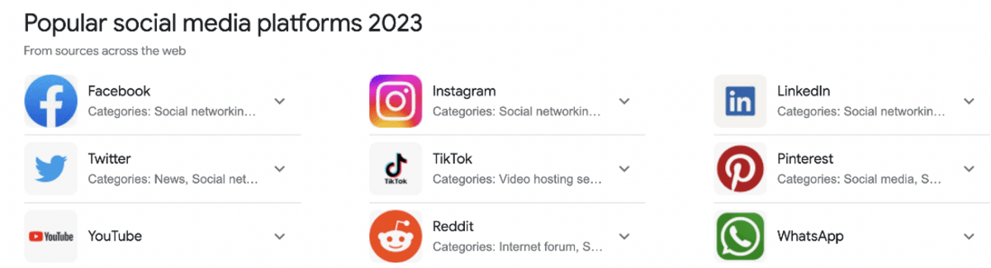

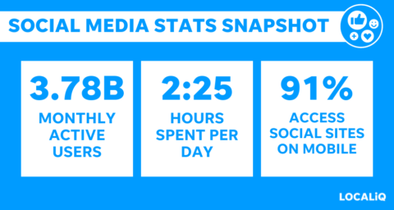
Social media has exploded
$173 billion in ad spending in 2022
$234 billion estimated spending in 2024
Over 90% of marketers use social media for marketing, paid and unpaid

Slide 3
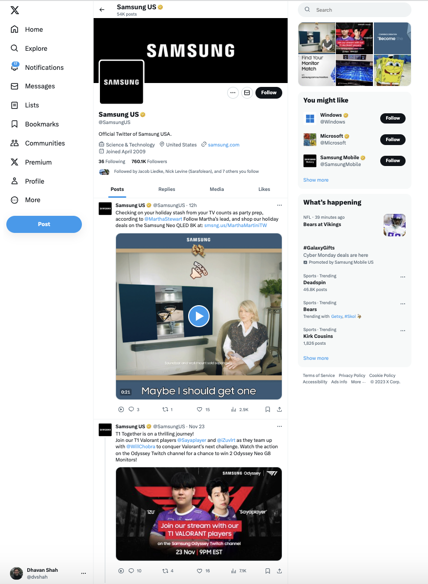
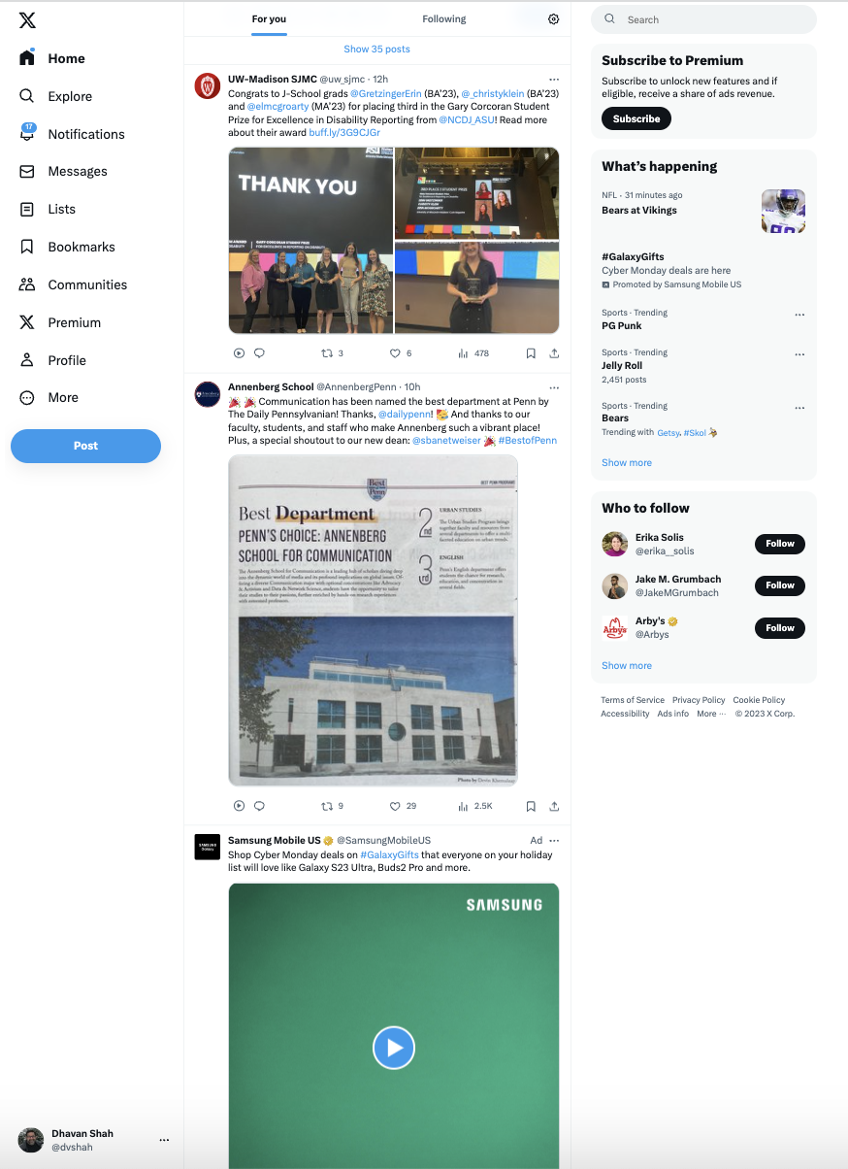
Social Media Tactics
2 main ways to use
social media in your
interactive media plan:
  Unpaid - manage ‘free’ content on your page
  Paid – buying ads on social media sites
Notes:
Online advertising
Hulu – streaming TV
Pandora – streaming audio
Search Engine marketing and Search Engine Optimization – SEM, SEO
Mobile
Social – Facebook, plus others

Slide 4
Social Media Marketing
Optimize your platform profile
  Accurate, complete, active, and interlinked
Post content to your profile page
  Useful and entertaining posts, videos, stories, live feeds
Engage with followers and audiences
  Like, share, comment & follow – customers/influencers
Advertise on platform using sponsored content
  Paid methods to target key audiences
Engage influencers to “tell-not-sell” to their followers
  Influencer marketing to bring authenticity & targeted reach
Measure your impact
  Use web analytics to see what is working

Slide 5
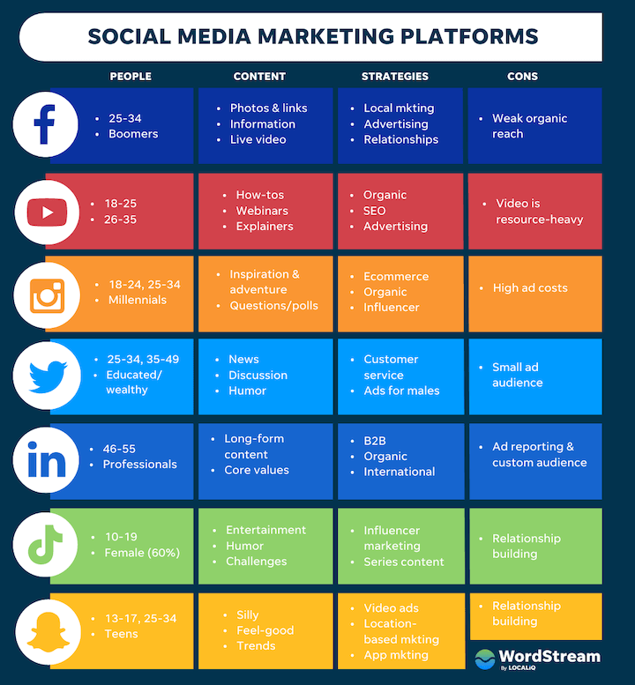

Slide 6
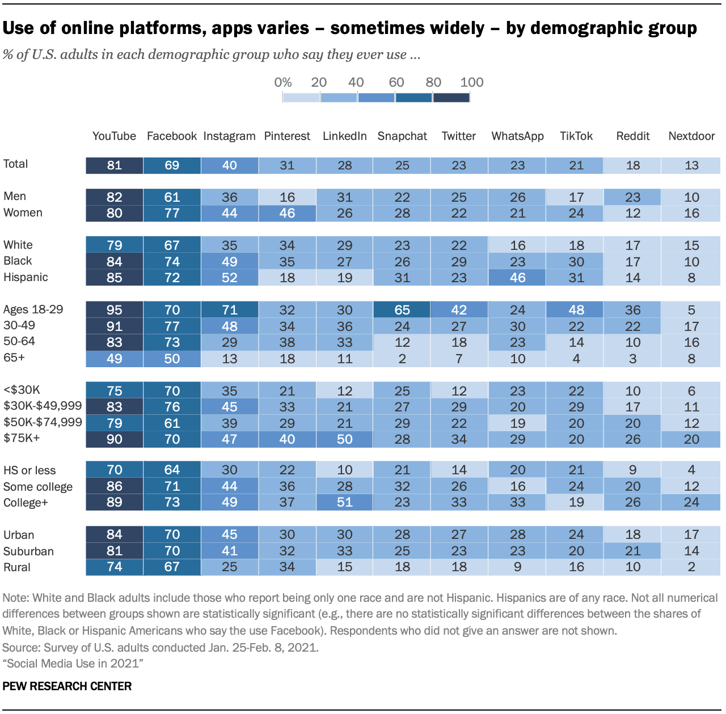
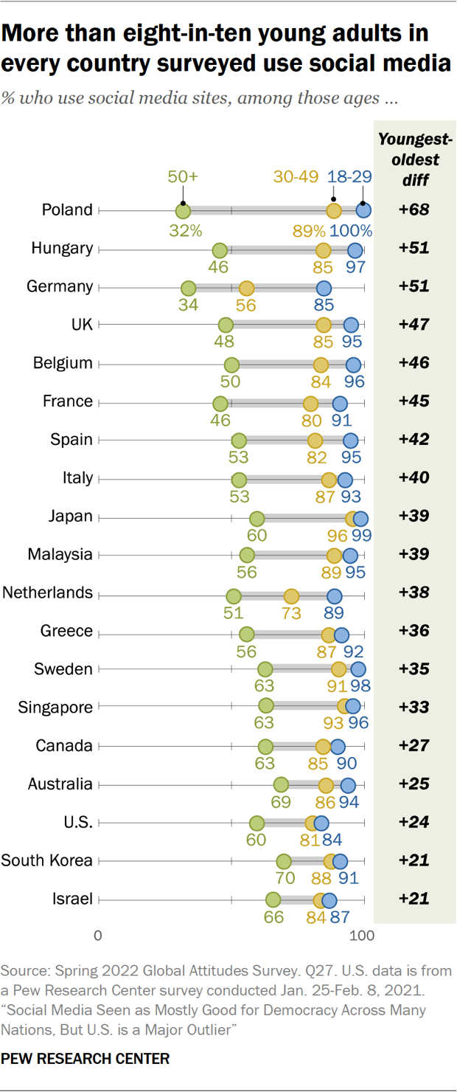

Slide 7
Success in Unpaid Social Media
Know when and how to find your audience
Engage in 2-way communications
  Not just talking to them, but listening as well
Integrate marketing messages from social media into all forms of your marketing mix
  Create Awesome Content!!!

Slide 8
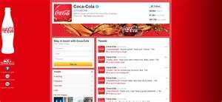
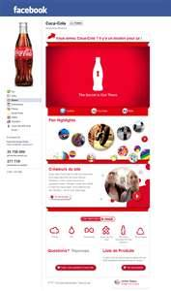
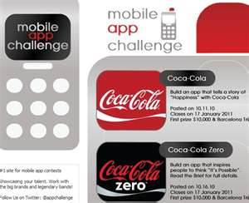

Content (and Branding) Drives All!
Lives across all points of consumer contact

Slide 9

Content Creation Skills
Wanted: We “need strong hybrids ….
understand technology, but also have a
sense of story and interconnectivity.”
Analytical skills
Communications
Writing
Creative

Slide 10
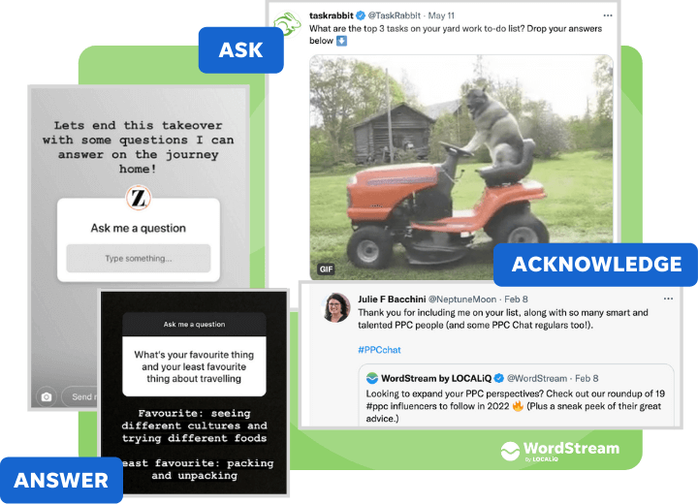
The Three ”A” of Social Media Engagement
Ask, Answer, and Acknowledge

Slide 11
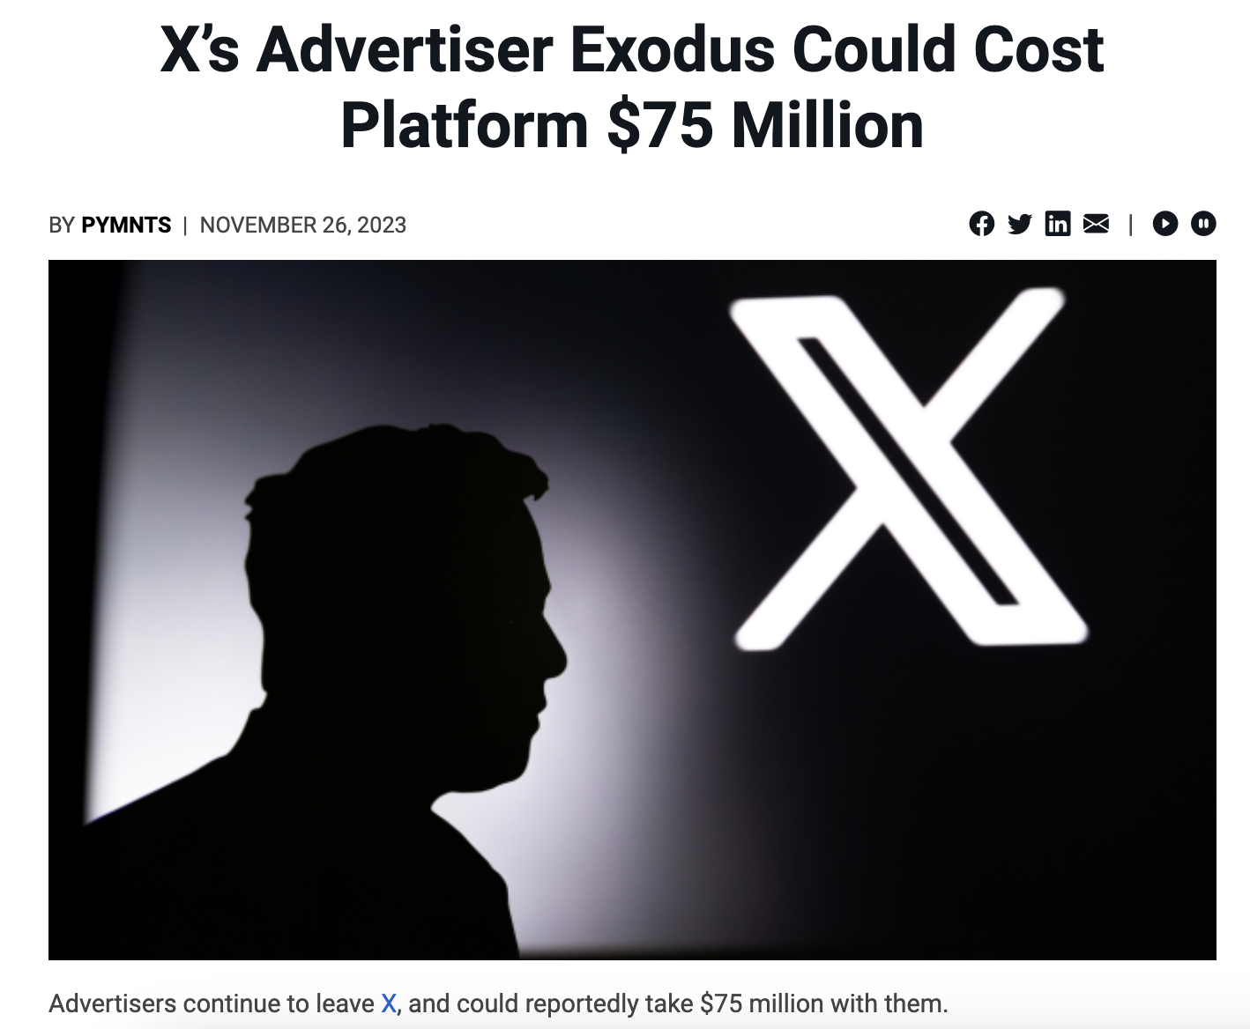
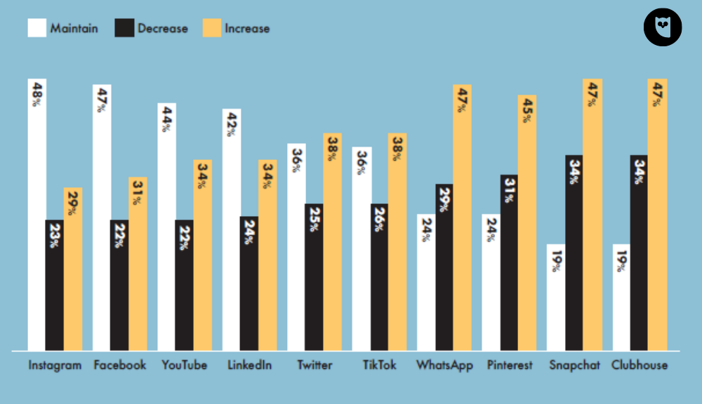
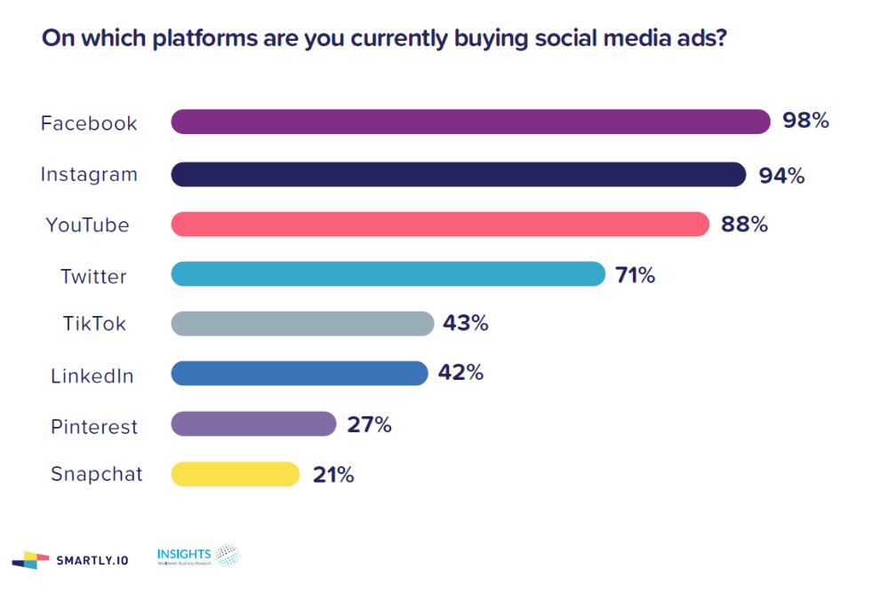
As Spending on Social Up over 50% from 2022… but can shift

Slide 12
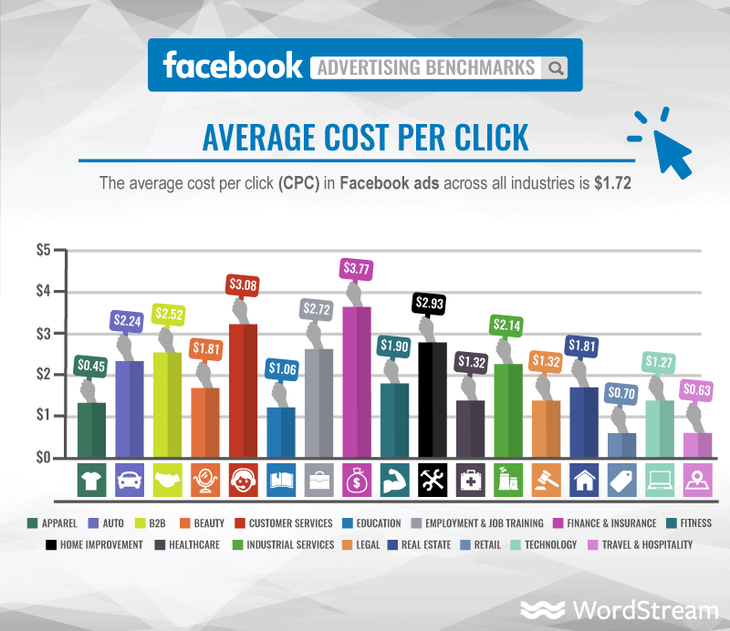
Some Social Media Ads Moving to Cost Per Click

Slide 13
Promoted Accounts
Promoted accounts are the “first results that come up in searches” and in the “Who to Follow section”
  For example: I follow Southwest airlines. United Airlines knows that. They pay X to promote the United account in the Who to follow” section.
On average, it costs $2.50 to $4.00 per follower
  Can ‘bid’ to the be promoted account – bigger bid wins
  Can set a budget, so don’t overspend

Slide 14
Promoted Posts
Marketers pay to have a greater ‘reach’ / distribution of a post, sent to more people
  More people than just your current followers
Can be used to generate new followers, drive behavior, or increase awareness

Slide 15
Visual Sharing Sites
Instagram/TikTok vs. Pinterest
  Instagram/TikTok is about sharing your own photos/clips, Pinterest is about curation.
  Instagram/TikTok is more about revealing, while Pinterest is more about discovering.
  Instagram/TikTok’s audience is more diverse, and larger than Pinterest’s. Pinterest’s audience skews female and more affluent
  Instagram/TikTok is mainly mobile, while Pinterest in for mobile and desktop use.
    Pinterest users buy more – share their experiences

Slide 16
For Your Project
For final project, work with the following assumptions for Social Media:
  Having a brand page on Facebook, Instagram, X, YouTube and/or Pinterest are free
  Facebook, Instagram, X, YouTube, other Social Advertising cost $ as noted in the project manual.
  Purchase space and allocate as explained

Slide 17
mobile

Slide 18
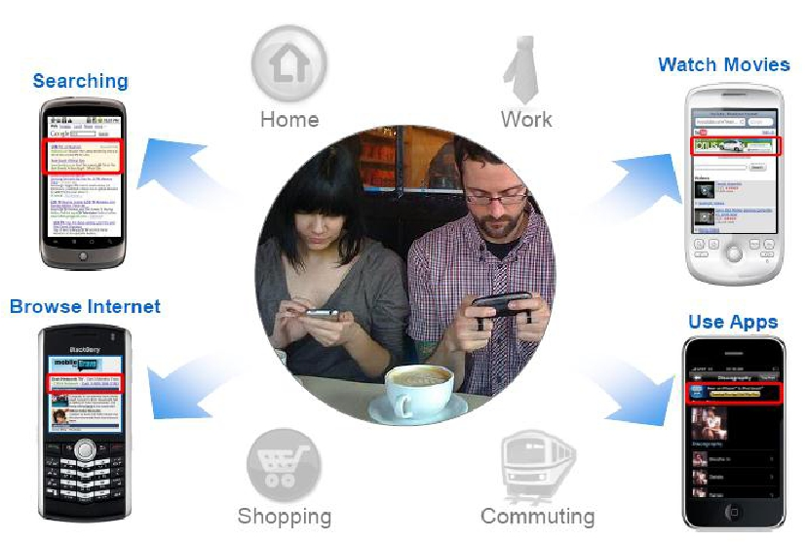
Core Benefits: Any Time, Any Where

Slide 19
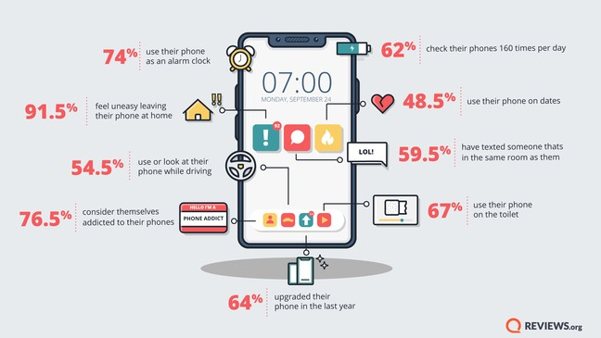
Smart Phone Usage is Exploding
2018 data

Slide 20
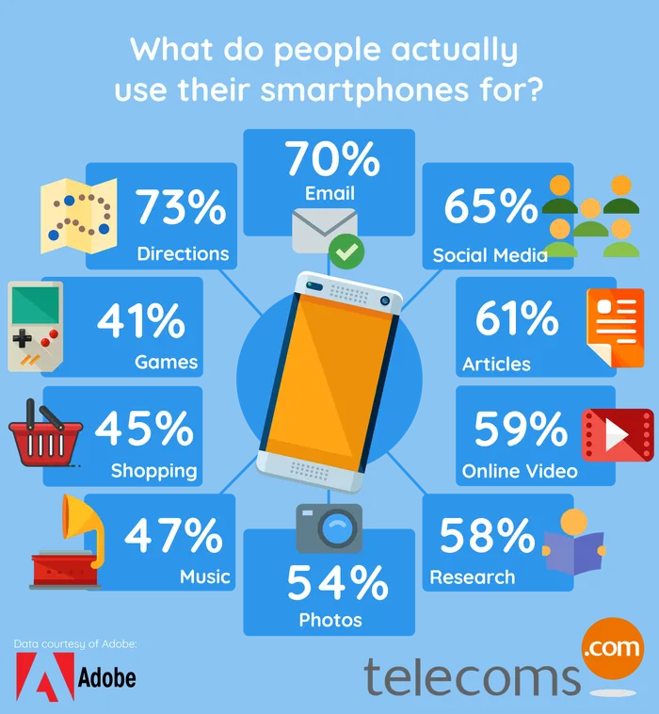
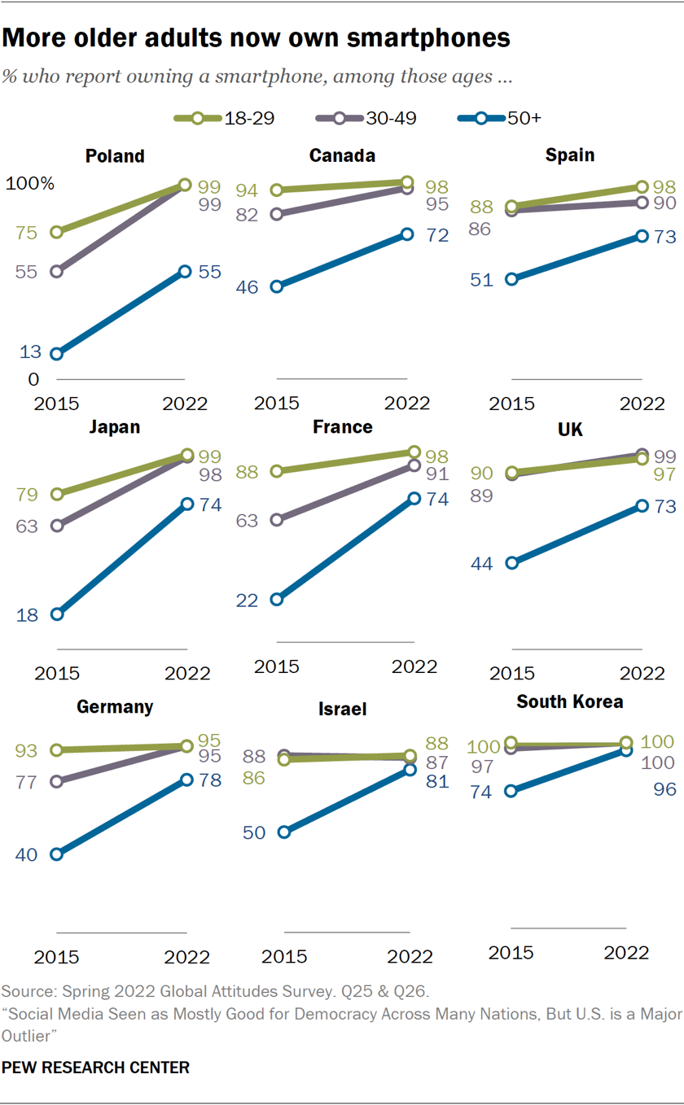
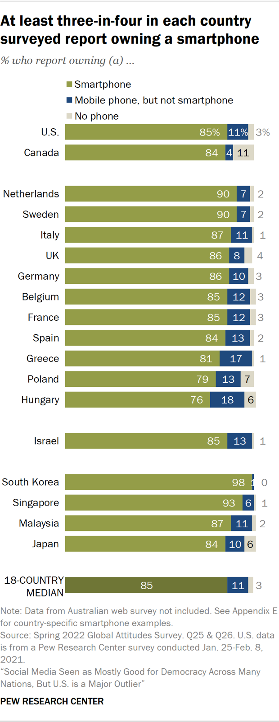
Global and cross-generational

Slide 21
Mobile “Advertising” Tactics
Text Messaging
Mobile Display Advertisements
Mobile Promotions
Mobile Search
Mobile Social

Slide 22
Streaming video and audio

Slide 23

Streaming Video/Connected TV
  Ads placed within streaming video content on the internet
    Free or lower cost online video content
    Video ads are placed generally within the content of the TV show or movie
  Growing opportunity as content consolidation grows
    About $1 billion was spent on streaming video ads in 2007
    Over $62 billion was spent on streaming video ads in 2024
      Of this $24 Billion on Connected TV like Hulu and Prime
Hulu
Peacock
Sling
Paramount+
Max
Pluto TV
Amazon Prime

Slide 24

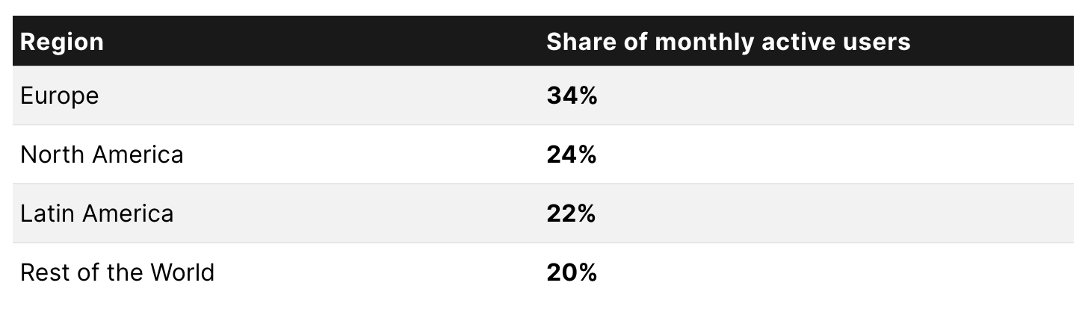
Music Streaming’s Mobile Explosion
More than half of all Spotify / Apple Music usage comes from mobile
Spotify among the most used apps, with 365 million active monthly users in 2023

Slide 25
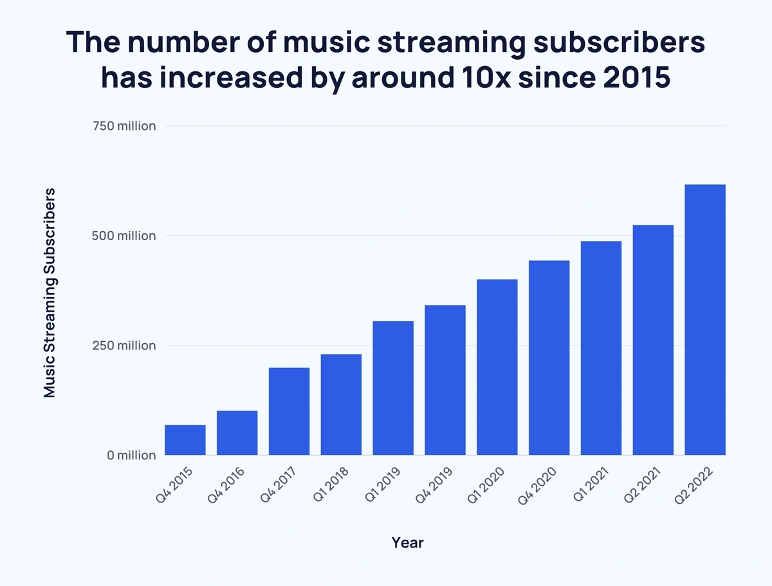

Slide 26
Highly Targetable
Via the user, through their sign-up profile
  Basic Demographic Characteristics
  Geographic: register via their zip code
  Genre: type of music
  By the type of device

