Slide 1
Sales Promotion and Viral Marketing

Slide 2
PR and Promotions Plan
Public Relations Strategy
Who are your key stakeholders and what are their concerns?
What issues are important to public and how will PR manage opinion?
Public Relations Tactics
Discussion of media relations strategy and targeted media
Attention to government, employee, and financial relations
Publicity Programs, Reputation Management, Crisis Planning
Discussion of Promotions Activities
Sweepstakes, contests, discounts, loyalty programs, trade promotion etc.
Should be supported by public relations and creative messaging
Discussion of Viral Marketing, Events Planning, and Brand Activations
Buzz marketing efforts must receive PR support (can connect with creative)
PR & Promotional Budget Estimates and Deliverables
Provide rough estimates of cost linked to PR efforts
Create multiple press releases and promotional concepts
Must be consistent with Campaign Strategy

Slide 3
What is Sales Promotion?
Various techniques to enhance brand value
Integrated activity: Ad/PR/Marketing
Increasing brand value for:
Consumers
Consumer sales promotion
Retailers
Trade-market sales promotion

Slide 4
Forms of Consumer Sales Promotion
Coupons
Price-off deals
Premiums
Contests/sweepstakes
Samples/trial offers
Product placement
Refunds
Rebates
Frequency programs

Slide 5
Forms of Trade-Market Sales Promotion
Point-of-purchase displays
Incentives
Allowances
Trade shows
Cooperative advertising

Slide 6
Reasons for Growth
Demand for greater accountability
Companies demand tangible results
Short-term orientation of corporations
Used to stimulate quarterly gains
Proliferation of products on the market
Differentiating brands to value-oriented consumers
Increased power of retailers
Trade-market efforts target Walmarts/Targets
Media clutter and advertising overload
Breaking through crowded media environment

Slide 7
Goals of Sales Promotion
Motivating trial use
Encouraging an increase in consumption
Inducing repeat purchases
Fostering long-term loyalty

Slide 8
Coupons
Advantages:
Some consumer respond to price incentives
Coupon users are likely brand switchers
Manufacturer controls timing/location of drop
Repeat—coupon chain build brand loyalty
Induce users to try upscale option or larger volume
Disadvantages:
Current users use coupons, reducing profits
High cost of administering coupon program
Reduced with digital delivery and redemption
Fraudulent use of coupons
False redemption by consumers and retailers

Slide 9
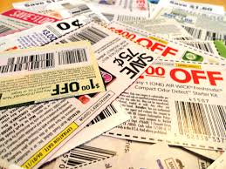
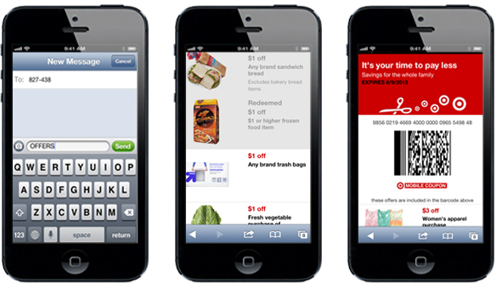
Digital/Mobile Coupons
Internet coupons: Online retailers and promotional and discount codes. Reduced cost or free shipping, price reduction, or percentage discount.
Mobile coupons: Requested or delivered to a mobile, sometimes through geo-fencing technology
Mobile app: Code sharing by users to recruit new users with referral benefits (e.g. Airbnb, Uber).

Slide 10
Price-Off & Premiums
10-25% price reduction incentive
Comes out of manufacturer’s pocket
Regular users often stock up on product
Products offered free as premium
Products inserted inside other products
Free Printer with laptop purchase
Products exchanged for proof of purchase
Might be an additional amount of same product

Slide 11
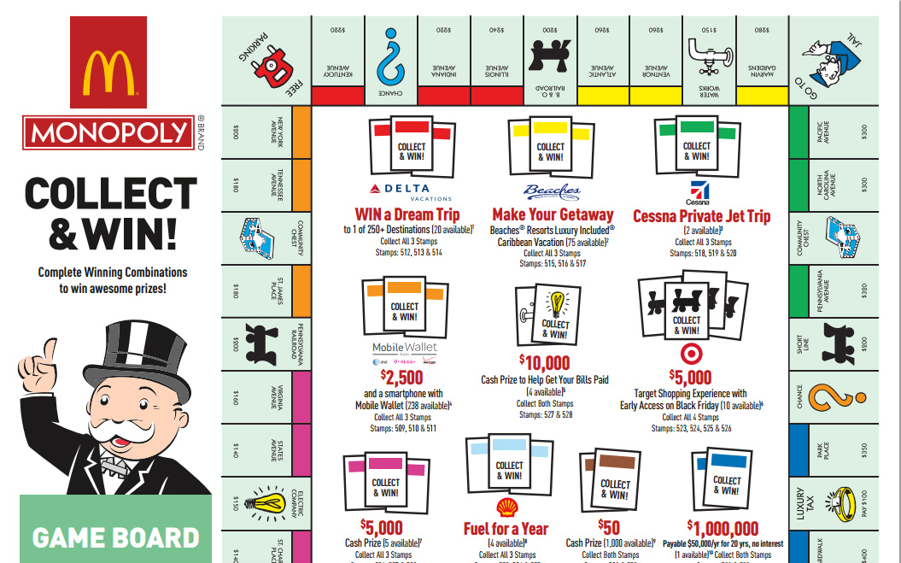
Contests and Sweepstakes
Contest: consumers compete based on skill
Sweepstakes: winner selected by chance
Scratch-off cards, McD’s Monopoly game
Problems:
High cost of admin/prizes
Regulations and restrictions
Consumer focus on the
game over the product

Slide 12
Sampling and Trial Offers
Useful for new products
Existing products with weak market shares in specific geographic areas
Types of Sampling:
In-store sampling
Door-to-door — newspaper insertion
Mail sampling — targeted zip codes
On-package sampling — shampoo to conditioner
Mobile sampling — Weinermobile
Trial offers — free for a limited time

Slide 13
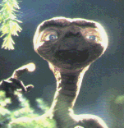
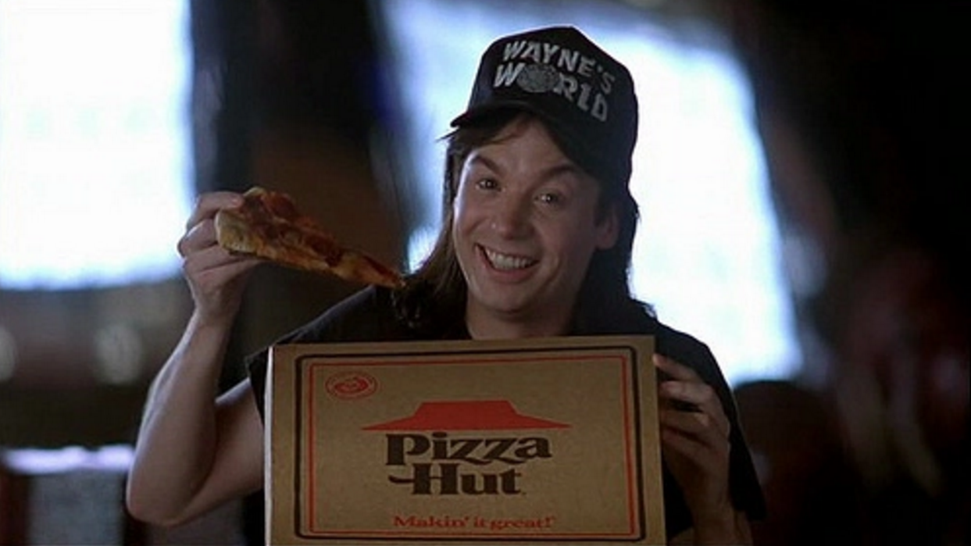
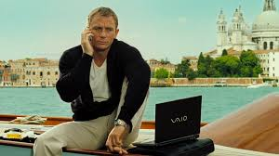
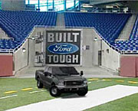
Product Placement
Products inserted into movies and TV
Started with Reese’s Pieces in ET
Firms specialize in product placements
Reality TV, Sitcoms, Film, Sports

Slide 14
Frequency/Loyalty Programs
Frequent flyer programs
Loyal customer rewards
To induce brand loyalty
To increase sales volume
Similar to rebates
Money returned after purchase
Can induce multiple purchases
Hotel chains and airlines among industry leaders
Can create extra opportunity for “members”

Slide 15
Objectives for Consumer Sales Promotion
Stimulating trial purchase
E.g., Free trial product / Coupons
Stimulating repeat purchases
E.g., Frequent flyer / Hotel rewards programs
Stimulating larger purchases
E.g., Two-for-one price reduction
Introducing a new brand
E.g., Trials inserted into newspapers
Combating competitor’s strategy
Discount response to competitor’s product launch

Slide 16
Trade-Market Sales Promotion
Targeting retailers/distributors
Breaking into to new retail outlets
Expanding retail presence

Slide 17
P.O.P. Displays and Incentives
Drawing attention to product on shelf
May also include:
coupons and sweepstakes forms
Increases sales for retailers
Increase sign-ups at locations
Awards of travel certificates, gifts, cash bonuses for reaching sales/enrollment targets
Motivating the sales force at P.O.P.

Slide 18
Allowances
Merchandise allowances
Free product
Can reward retailer for featuring display
Slotting fees: direct cash to stock item

Slide 19
Trade Shows
Related products from different manufacturers
Impressing retailers and consumers with the latest product developments
Tech - Consumer Electronics Show
Automobiles - NAIAS - Detroit

Slide 20
Sales-Training Programs
Manufacturer provides training
Helps retail sales force
Complex products like computers
Demonstrational videos and brochures

Slide 21
Cooperative Advertising
Manufacturer splits the cost of advertising with the retailer
Manufacturer gets local discount rate
Retailer gets support for ad budget

Slide 22
Objectives for Trade-Market Sales Promotion
Obtaining initial distribution
Getting ”on the shelf/getting retailer/location buy-in
Increasing order size
Retailers prefer small orders with low inventory
Outlet/locations prefer simple methods
Integrating with consumer sales promotion
Push/pull strategy, where one reinforces the other
Increase store/location traffic
Helping retailers/locations get customers

Slide 23
Risks of Sales Promotion
Creating a price orientation
Conditioning consumers to a lower price
Borrowing from future sales
Bought today at a lower price
Alienating customers
Changes to programs, Unavailable incentives
Time and expense
Taking dollars away from advertising
Emphasizing short-term payoffs, while sacrificing long-term campaign goals

Slide 24
Viral - Buzz - Word of Mouth
Valuable source credibility
People more inclined to believe Word of Mouth Marketing than more formal means
Receiver tends to believe that the communicator is speaking honestly (i.e. not receiving an incentive for their referrals).
Not always true - paid opinion leaders IDed

Slide 25
Not New, But Added Potency
Multi-level marketing in 60s & '70s - Amway and Mary Kay Cosmetics
The Blair Witch Project (1999) – used Internet campaign to suggest that the film was a real event – grossed nearly $250,000,000
AI (2001) – Trailers listed Jeanine Salla as Sentient Machine Therapist; Google search lead to matrix of 40 websites providing the back story
BMW Films (2002) – Shorts directed by eight famous directors attracted nearly 55 million viewers and launched Clive Owen’s career.
Burger King's Subservient Chicken campaign (2004 until 2007), unbranded until the reveal, named top viral effort by Wired magazine

Slide 26
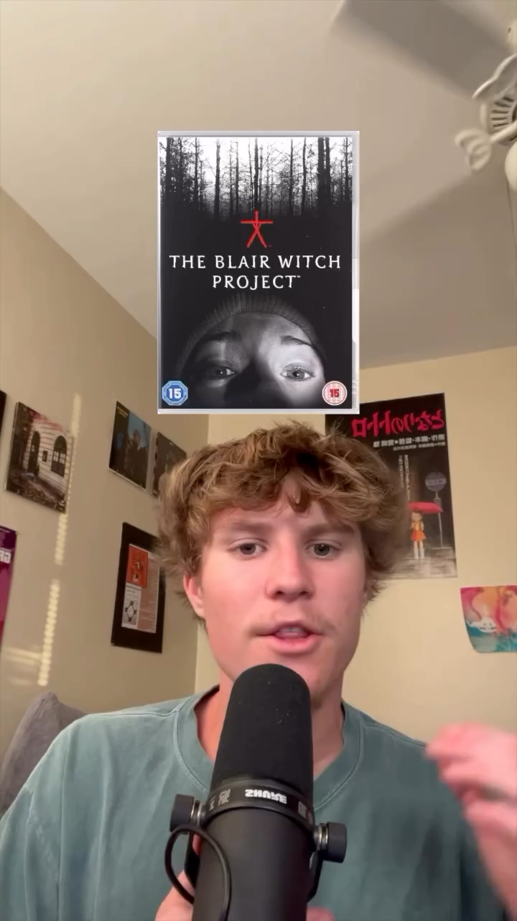

Slide 27
Buzz and Social Media
Use of social networking software as a platform for buzz marketing - Web 2.0
Social media has provided an ad model that allows targeting of users based on their profile information & contacts – identity categories
Facebook
Instagram
YouTube
Snapchat
Threads
X

Slide 28
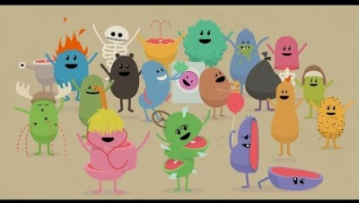
2012 “Dumb Ways to Die” for Rail Safety: +290 mil. views on YouTube
Catchy song turned into karaoke versions, posters, books, and more.
Post campaign: 21% decrease in railway accidents and near misses.

Slide 29
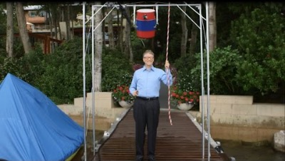
Ice Bucket Challenge to raise research funding for ALS in 2014/2015
Filmed being doused with bucket of ice water and then nominating others.
Posted to social media; raised over $115M worldwide

Slide 30
Buzz Marketing Case
Cross Campaign Creativity
Teasers to Build Interest
Buzz to Persuade without Mass Media
Advertising to Launch Relationships
Internet as a Return Destination
In Store Contact as Ultimate Goal
Buzz and Sale Promotion often tied together

Slide 31
Viral Magic - Old Spice
Named “Marketer of the Year” by Brandweek for this campaign
“The Man Your Man Could Smell Like”
More than double sales of Old Spice body wash from February to July
Old Spice deodorant sales grew by 30 percent during same period

Slide 32

Original Ad

Slide 33

Encore Campaign

Slide 34

Case Summary

Slide 35
Next Gen Social and Viral
Building Buzz through partnerships
Jumping on opportunities to generate “viral cascades”
Taking advantage of emergent moments
Stitching brand to event with merch and collab content
Organic virality, though smart timing/content
Take full advantage of trends/happenings/memes
Create content pillars for generating streams
Create opportunities for key moments to go vital

Slide 36
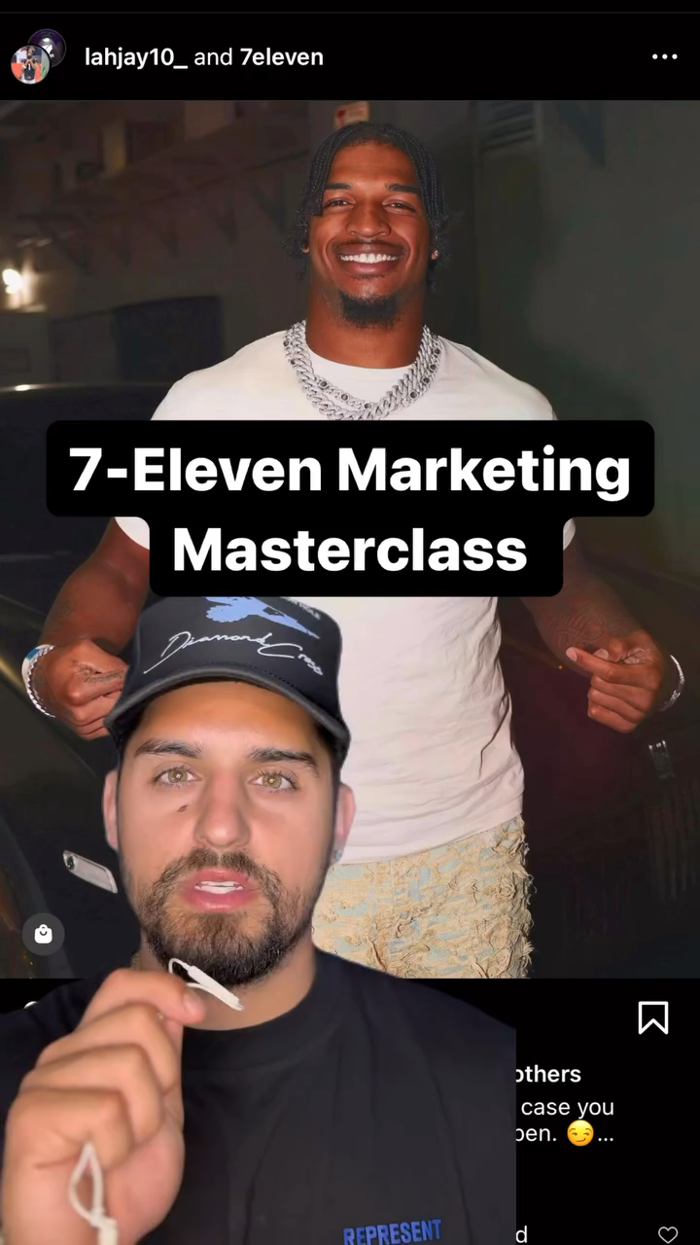
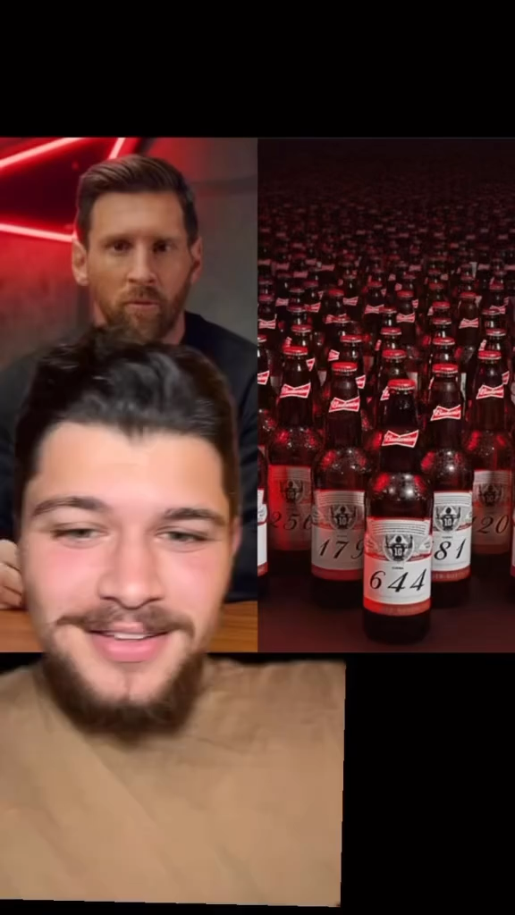

Slide 37
