Slide 1
Journalism 566:
Experimental Methods

Slide 2
Experimental Research
Take some action and observe its effects
  Extension of natural science to social science
  Best for limited and well-defined concepts
  Useful for hypothesis testing - need “theory”
  Focus on causation, not just description

Slide 3
Components of Experiment
Three components:
  Independent and dependent variables
    Effects of stimulus on some outcome variable
  Pretesting and post-testing
    Ability to assess change, ideally, before and after the stimulus is experienced
  Experimental and control groups
    Comparison group that does not get stimulus

Slide 4
Experimental and Control Groups
Must be as similar as possible
Control group represents what the experimental group would have been like had it not been exposed to the stimulus.
Often, true control is not possible, so you expose each group to contrasting experiences of the stimuli

Slide 5
Selecting Subjects
Probability sampling
  Ideally, we get a diverse, representative sample
  Often, it is college undergrads…
  For you, a random cross section of Americans
    Balanced on Gender, Age, and Education
Randomization
  Most statistics used to analyze results assume randomization of subjects into conditions
  Randomization only works if you have a reasonably large pool of subjects.

Slide 6
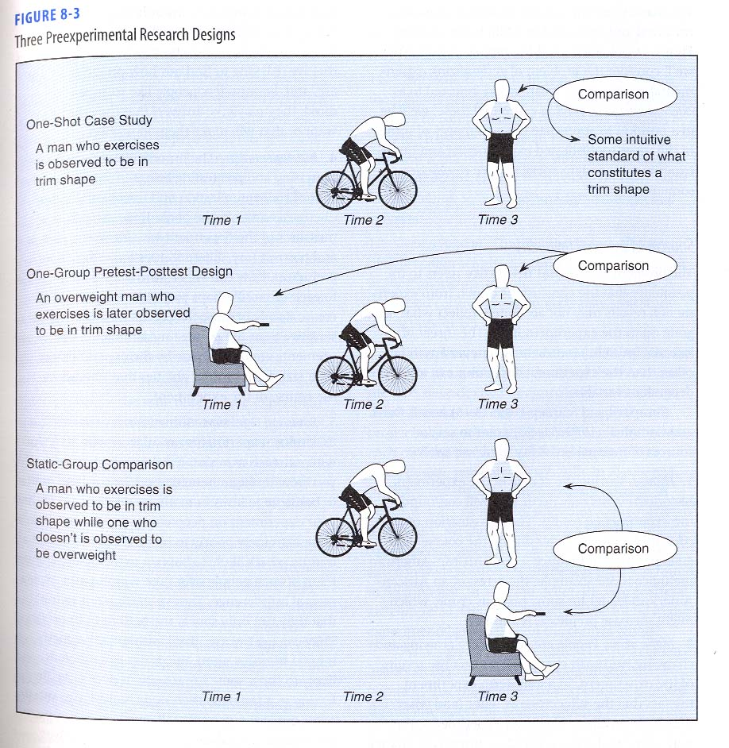
Pre-Experimental Designs
One-Shot Case Study
One Group Pretest-
Posttest Design
Static Group
Comparison

Slide 7
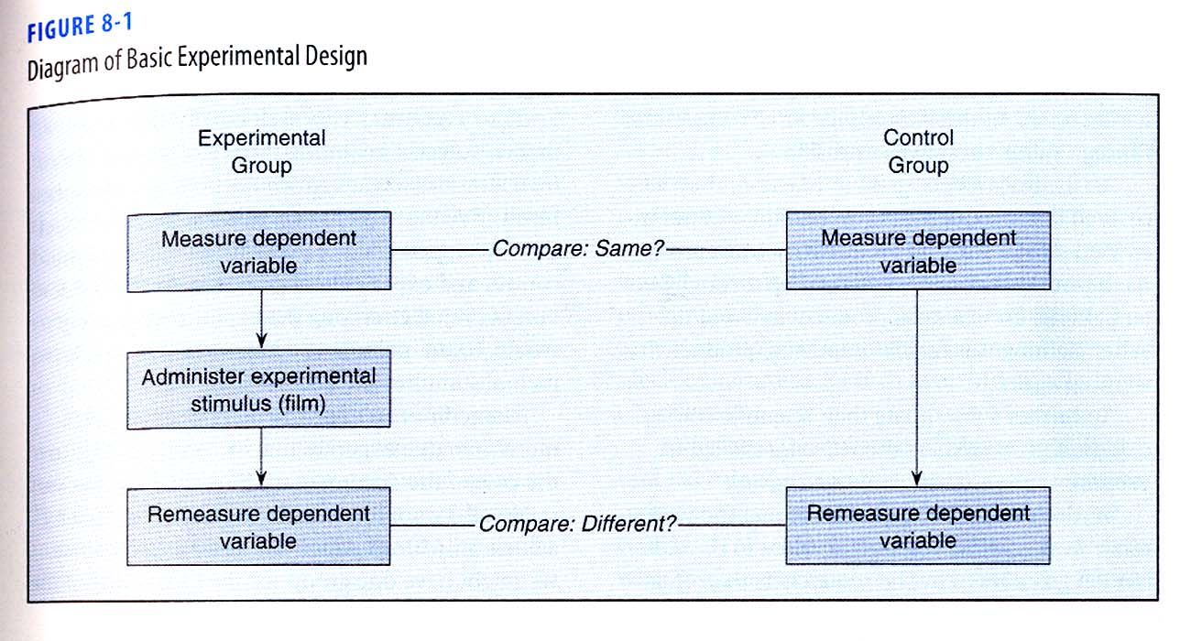
True Experimental Design

Slide 8
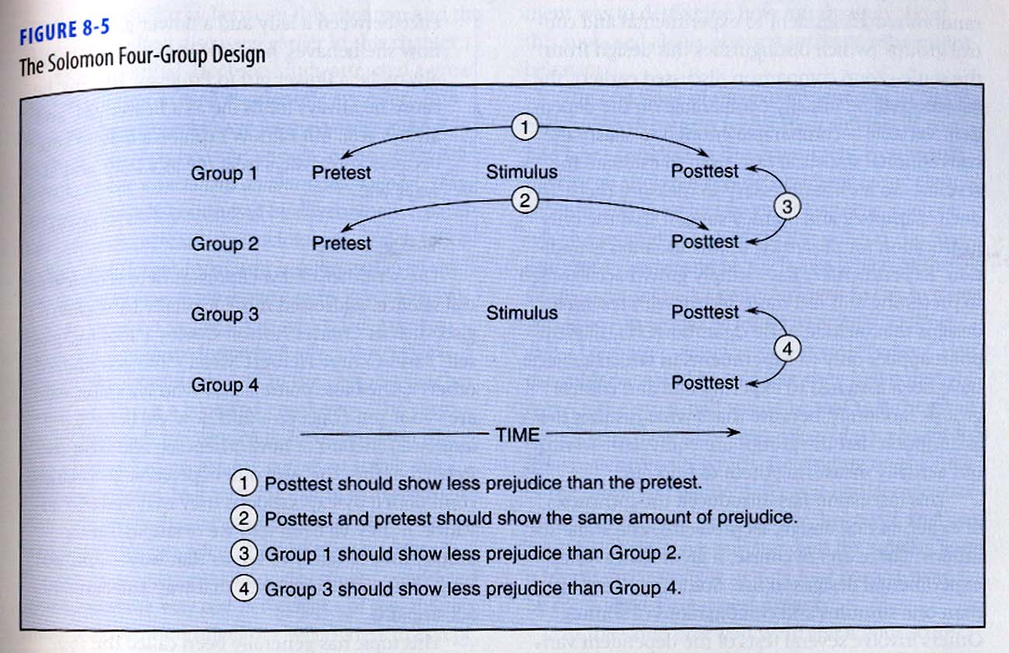
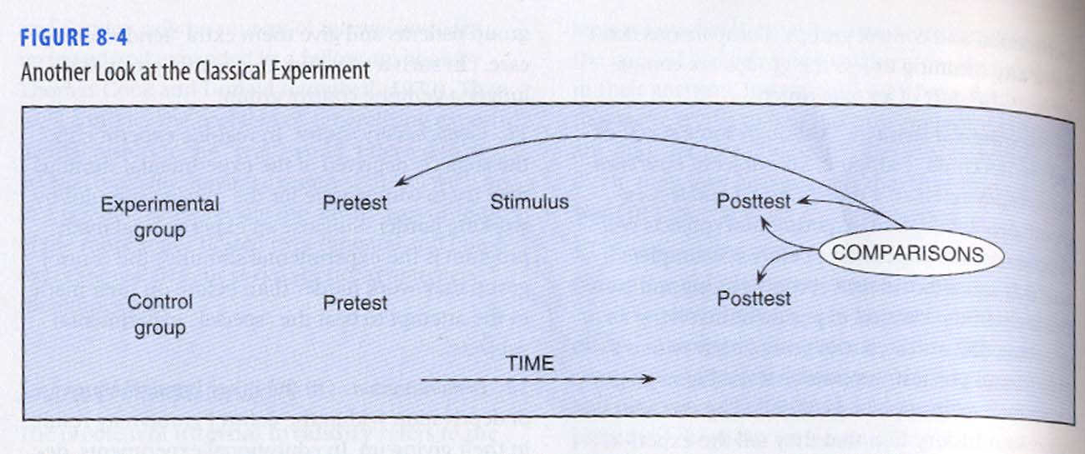
Solomon Four-Group Design
Classic Design may sensitize subjects
More complex experimental designs

Slide 9
Posttest-only Control Group Design
Includes Groups 3 and 4 of the Solomon design.
With proper randomization, only these groups are needed to control the problems of internal invalidity and the interaction between testing and stimulus.
  By manipulating the question wording, and seeing differences in responses to identical response categories, this is your study design

Slide 10
Other Design Considerations
Double blind - no experimenter bias
Subject selection - convenience or representative
  Generalizability vs. explanatory power
  Probability sampling for representativeness
  Randomization over matching for equivalence

Slide 11
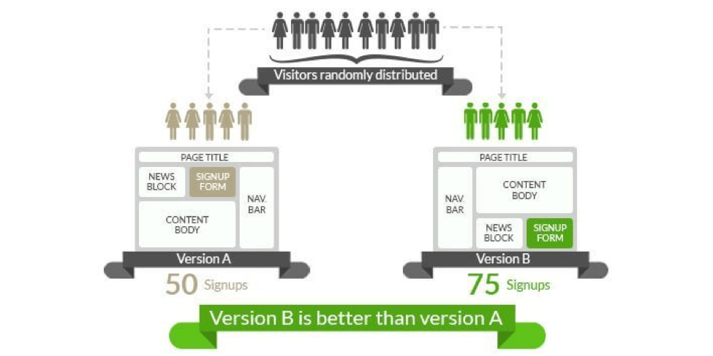
Digital Marketing – A/B Testing

Slide 12
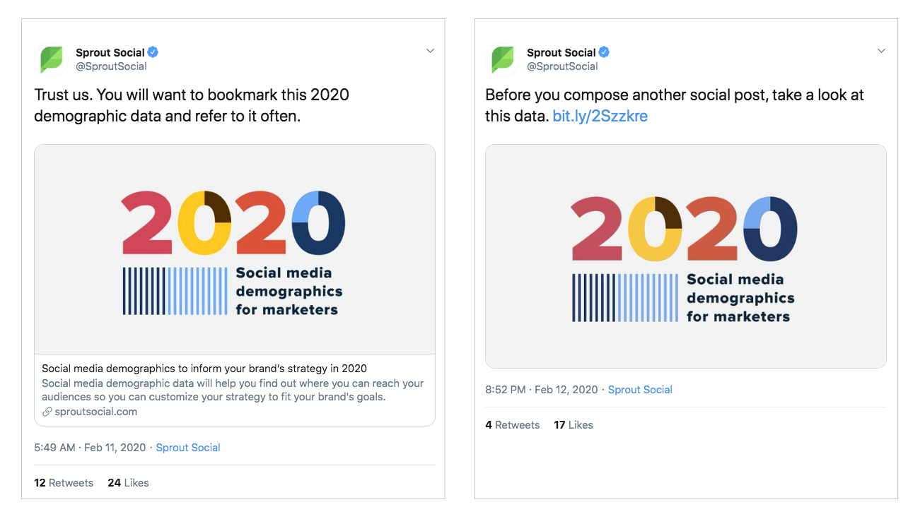

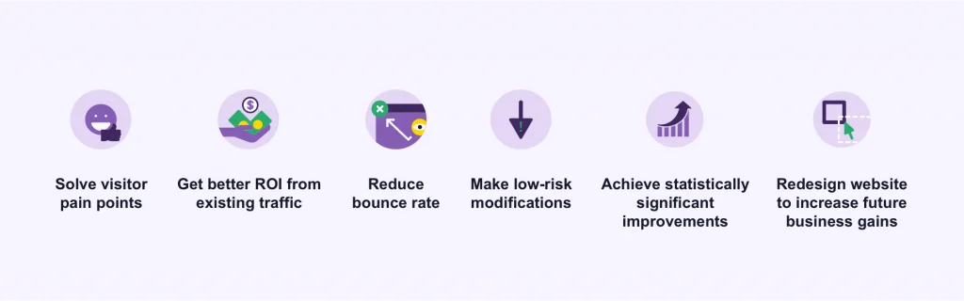
Many Possibilities via Platforms to Test Different Messages

Slide 13
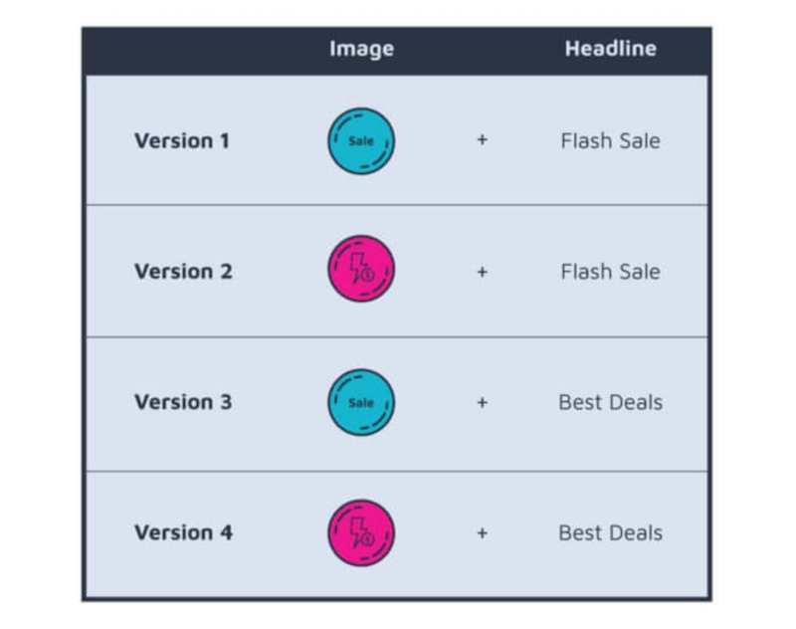
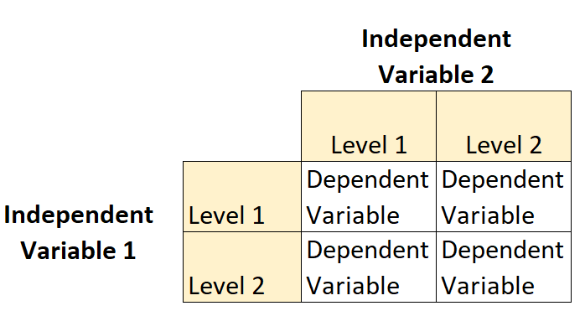
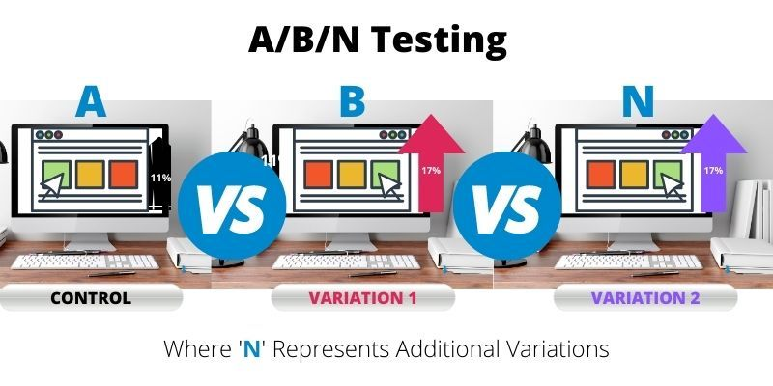
More Complex Designs

Slide 14
Threats to Validity in Experiments
History - intervening event can alter responses, not the manipulation
Maturation - people change over the course of the study
Testing - respond to measures (e.g., repeated knowledge scores)
Instrumentation - change measures (e.g., any change to instrument can have effect)
Regression - Regress to mean (e.g., when extreme cases are selected for inclusion)

Slide 15
Threats to Validity in Experiments
Experimental mortality - Drop out of study
Selection biases - incomparable groups
Diffusion of treatment - contamination of control (stimulus affects control group)
Compensatory rivalry - control group competes harder to overcome lack
Demoralization - control group may give up

Slide 16
"Natural" Experiments
Important social scientific experiments occur outside controlled settings in the course of normal social events.
  Ex. Two states that share a media market allow us to see effects of the “air war” vs the “ground war” on voter mobilization and turnout.
Raise validity issues because researcher must take things as they occur.

Slide 17
Experimental Method
Strengths:
Isolation of the experimental variable over time.
Experiments can be replicated several times using different groups of subjects.
Weaknesses:
Artificiality of laboratory setting (but not survey exp.)
Social processes that occur in a lab might not occur in a more natural social setting.

Slide 18
Time and Survey Design
Extending logic of Experiments to Surveys
  Longitudinal designs:
    Panel studies
  Survey experiment
    manipulated wording, order, or response categories

Slide 19
Pros and Cons of Survey Exp.
Strengths of survey experiments:
Logistically easier than “real” experiments
  Random assignment is quite easy
• Drawbacks of survey experiments:
  Does our “treatment” actually look like the concept we’re interested in?
  Do people respond to shifts in wording the way they respond to real events in news?

Slide 20
Mechanics of Survey Experiment
Sample
Survey Form A
Survey Form B
Sample from population of interest or draw a convenience sample
Randomly assign participants to experimental conditions
Administer dependent measures and calculate within-group average estimates on Y
Treatment influences independent variable of interest (X)
Form B induces X_{B}
Form A induces X_{A}
Measure Y, obtain Y_{B}
Measure Y, obtain Y_{A}
Analysis: Estimate average treatment effect
ATE = Y_{A} - Y_{B}
From Doug Ahler, UC Berkeley

Slide 21
“Classic” Survey Exp. Techniques
Often used for improving measurement:
  Question wording experiments
  Question order experiments
  List experiments for sensitive topics
But also well-suited to hypothesis tests
For any of these, the randomizer tool in Qualtrics survey flow works well

Slide 22
Impact Requires Clear Difference
Impact: The degree to which the treatment affects X as expected
Problems for impact
  “Low dose”
  Time and decay
  Participant attention
  Suspicion
From Doug Ahler, UC Berkeley

Slide 23
Example of Survey Experiment
Would you say we are spending too much, just about enough, or too little on assistance for the poor?
Would you say we are spending too much, just about enough, or too little on welfare programs?
  Produces about a 30% difference

Slide 24
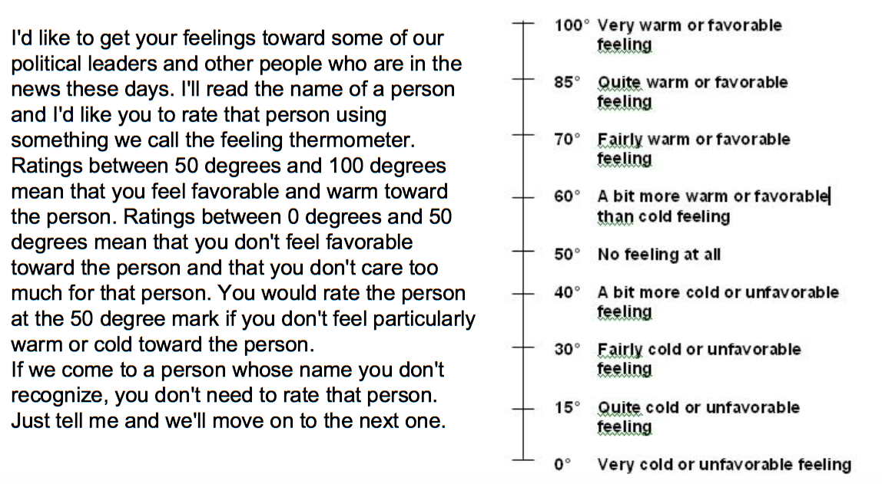
Example of Survey Experiment
Poor People - Average 73 degrees
People on Welfare – Average 53 degrees

Slide 25
GROUP BREAKOUT
Get in your lab teams and consider your question wording, question order, and response options in your experiment:
How many conditions do you want to consider differences?
Do you want to cross various factors in a 2 x 2 design?
Can you test your hypotheses with the question wording?
Do you need a second question to assess outcomes?

Slide 26
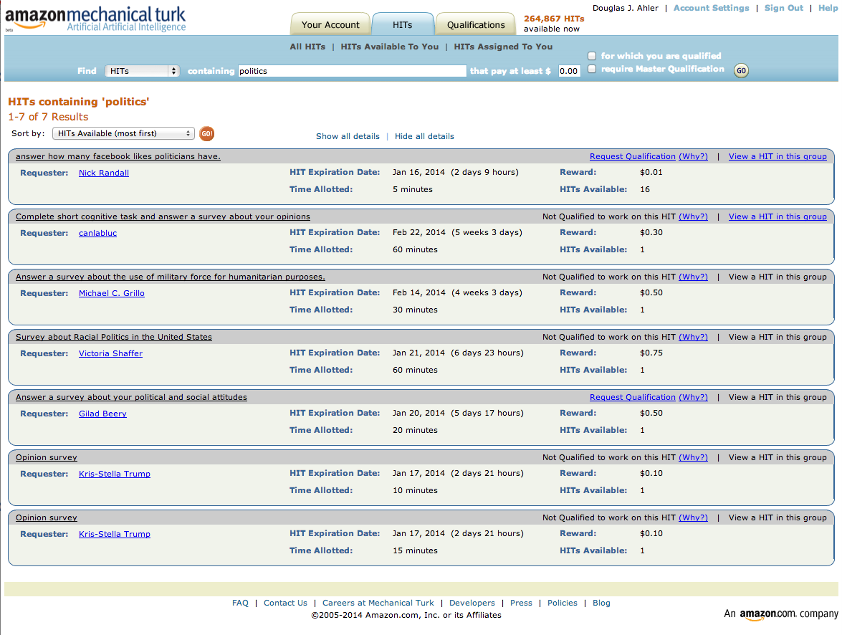

Using Mechanical Turk
Online web-based platform for recruiting and paying people to perform tasks
Human Intelligence Tasks (HITs) can be used to recruit survey respondents

Slide 27
MTurk Pros and Cons
Cheap!
Participants are attentive
More diverse than a many convenience sample (e.g., college sophomores)
Classic findings validated
Not population-representative
Degree of non-representativeness
Turkers becoming “professional subjects”
See Berinsky, Huber, & Lenz (2012, in Political Analysis) for more detail.

Slide 28
IRB for Human Subjects Research
Prior to fielding anything you might present or publish, you need approval from IRB (Institutional Review Board)
The UW-Madison is committed to protecting the rights and welfare of individuals participating as subjects in its research. The IRB is charged with reviewing human subjects research.

