Slide 1
Journalism 566: Public Opinion & Research Design

Slide 2
Public opinion and communication
Theory
Normative & philosophical roots; History; Connection to public policy & economy
Attitudinal and Cognitive Models - Psych; Social Influence and Social Conflict – Socio
Research
of Public opinion
of Media effects on public opinion
Models of Media Influence (ex Framing)
Models of Perceptional Influence (ex S.O.S)
Problems and challenges
Design and methods
Research procedures

Slide 3
What is research?
Scientific research?
Chemistry or Bacteriology?
Social research?
Quantitative or Qualitative?
Key feature: A systematic plan of inquiry

Slide 4
Outline
Nature of research
Functions of research: What to achieve?
Unit of observation: What to observe?
Design (time): How to observe?
Method (tool): How to observe?
Correlation vs Causality

Slide 5
Epistemology
“the theory of knowledge, especially with regard to its methods, validity, and scope. Epistemology is the investigation of what distinguishes justified belief from opinion.”
“the study of knowledge and justified belief”

Slide 6
Epistemology
Sources of knowledge:
Reason: a priori (or non-empirical)
Perception: a posteriori (or empirical)
Introspection
Memory
Testimony
Etc.

Slide 7
Epistemology
the study of knowledge and justified belief
Sources of knowledge:
Reason: a priori (or non-empirical)
Perception: a posteriori (or empirical)
Introspection
Memory
Testimony
Etc.

Slide 8
Scientific Empirical Investigation
Basic steps in most research:
Offering explanations
Making observations
Interpreting the results
Refining explanations

Slide 9
Scientific Empirical Investigation
Your project:
Starting with a public opinion phenomenon: describing an opinion trend
Offering explanations (standing on the shoulders of giants): making media predictions
Making observations (accumulating empirical evidence): content-analyzing media content & experimental testing of language shifts;
Interpreting the results: conducting data analysis
Refining explanations: confirming/disconfirming/making new media predictions

Slide 10
Outline
Nature of research
Functions of research: What to achieve?
Unit of observation: What to observe?
Design (time): How to observe?
Method (tool): How to observe?
Correlation vs Causality

Slide 11
Functions of Research
1. Exploration
2. Description
3. Explanation
Most research involves all three
Studies move from exploration toward explanation as knowledge accumulates

Slide 12
1. Exploration
“Learn about” or “familiarize”
Asking basic questions
How does the public feel about term limits?
Do people support the death penalty?
Purposes:
1. General understanding
2. Test feasibility of further research
3. Pretest methods of further research

Slide 13
1. Exploration
Characteristics:
• Usually done at the initial stage of research
• Less structured • Small sample sizes; not representative
• Focus groups and in-depth interviews
useful for exploration

Slide 14
2. Description
Describing situations and events
More deliberate than exploratory research
Precise, measured description
Orientation toward enumerating the details that lie behind a particular event or action
In which ways has the population of the U.S. changed? - US Census
In which ways has public support for the War in Iraq eroded? - Roper Poll Database
Notes:
Cross sectional studies – Describe population at one point in time
(snapshot) – Multiple snapshots from different samples
• Longitudinal studies –Same sample is measured repeatedly
–panel studies (continuous, discontinuous/omnibus)

Slide 15
3. Explanation
Getting at the question of “why”
More than describing events
Explain why they occur in a certain way
Orientation toward discovering key reasons
Laws that govern nature of relationships
E.g., Going beyond opinion polls:
Why are people voting for a certain candidate?
Why has the population changed in these ways?

Slide 16
Creating Explanations
Research often seeks explanations
Examine relationships between variables
Ex. Is gender related to voting behavior?
Unit of analysis: Voters
Could further explore gender/voting link
Why is there a gender gap in voting?
Explanation of why is a theory

Slide 17
Outline
Nature of research
Functions of research: What to achieve?
Unit of observation: What to observe?
Design (time): How to observe?
Method (tool): How to observe?
Correlation vs Causality

Slide 18
Unit of Observation
What we look at to make observation
E.g., respondents in a survey
Usually same as unit of analysis
Sometimes different:
E.g., predicting the winner of presidential election
Unit of observation: voters
Unit of analysis: states

Slide 19
Types of Units of Analysis
Individuals
Groups
Organizations
Social Artifacts

Slide 20
Units of Analysis: Individuals
Most common unit of analysis in:
social science/public opinion research
Studies explain differences between individuals
Variables:
Income, Age, Gender, Race, & Opinion

Slide 21
Units of Analysis: Groups
Examples:
Households, families
Studies explain differences between groups
Variables:
Households: income, media use (Nielsen)
Marriages: types, communication patterns

Slide 22
Units of Analysis: Organizations
Examples:
Corporations, Non-profits, Universities
Groups with formal organizational structures
Studies explain differences between orgs
Variables:
Corporations: # employees, profits
Universities: graduation rates, average GPA

Slide 23
Units of Analysis: Social Artifacts
Examples:
TV programs, newspaper articles, documents
Studies explain differences between:
different social artifacts
artifacts produced by different sources
Variables:
TV programs: Level of violence
Newspaper articles: number of sources used

Slide 24
Outline
Nature of research
Functions of research: What to achieve?
Unit of observation: What to observe?
Design (time): How to observe?
Method (tool): How to observe?
Correlation vs Causality

Slide 25
Time and Research Design
Static designs:
Cross-sectional study
Longitudinal designs:
Trend studies
Cohort studies
Panel studies

Slide 26
Cross-sectional Study
Static snapshot
Slice of population at one point in time
E.g., an opinion poll
Inherent limitation:
Inability to capture change over time
Usually giving correlations not causal inferences

Slide 27
Trend Studies
Measures changes over time
Sequential cross-sections of the population
E.g., Changes over time in:
Political knowledge levels
Concern about global warming
Presidential approval rating

Slide 28
Cohort Studies
Tracking changes in a group as they age
Baby boomers (born during the post–World War II baby boom, approximately between 1946 and 1964)
Generation X
Millennials
Measure change across the aging process
Do millenials become more conservative?
Why can’t you answer this question with a cross-sectional design?
Untangle lifecycle vs. cohort differences

Slide 29
Panel Studies
Goes a step further:
interviewing the same people more than once
Captures change in individuals over time
E.g., NES Election Study
Pre-election and post-election
Can begin to explain which individuals are changing and why they are changing
The respondent mortality problem:
Are those who drop out different?

Slide 30
Outline
Nature of research
Functions of research: What to achieve?
Unit of observation: What to observe?
Design (time): How to observe?
Method (tool): How to observe?
Correlation vs Causality

Slide 31
Research methods
Content Analysis
Survey Research
Experimental Methods
Trend Analyses
In-depth Interviews
Observation
Life Narratives

Slide 32
Outline
Nature of research
Functions of research: What to achieve?
Unit of observation: What to observe?
Design (time): How to observe?
Method (tool): How to observe?
Correlation vs Causality

Slide 33
Finding Causes in Social Science
Modeled after the natural sciences
Cause and effect - deterministic model
E.g., determining what causes prejudice
Focus on the factors that contribute to prejudice
Assumes that all explanatory factors can be traced back through a complex chain of reasons

Slide 34
Criteria for Causality
Simple relationship does not establish that the connection is causal
Observed associations ≠ Causal explanations
Must judge credibility, or believability
Must consider alternative explanations
Conditions of causality:
1) Cause must precede effect
2) Two variables must be empirically correlated
3) Effect cannot be explained by some third variable

Slide 35
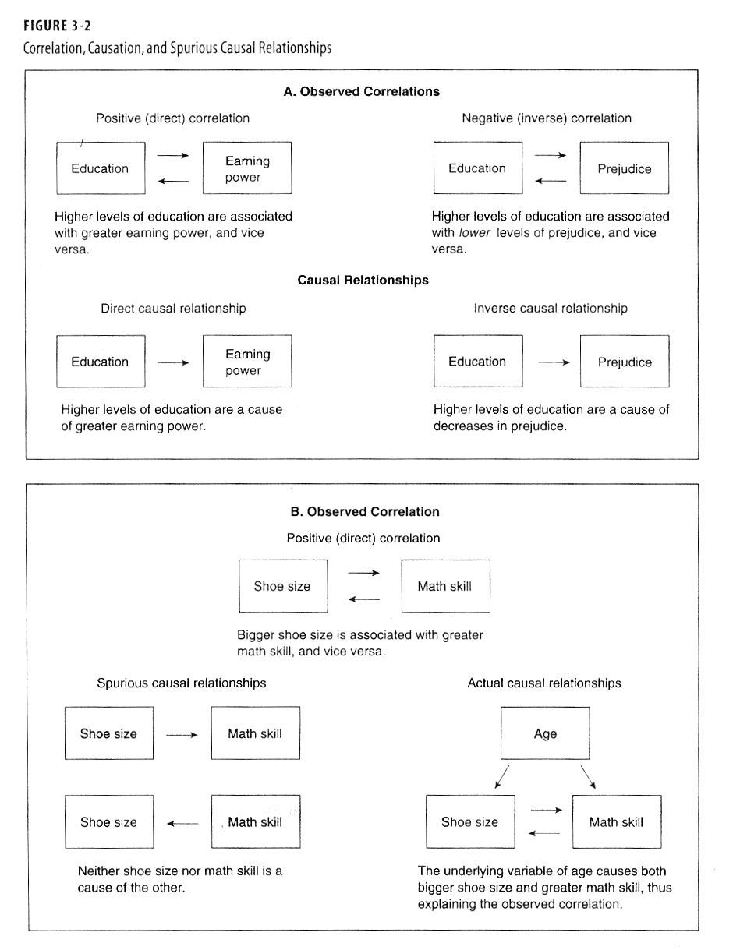

Slide 36
Necessary and Sufficient Conditions
Necessary Cause: A condition that must be present for the effect to follow
Necessary to be female to become pregnant
Sufficient Cause: A condition that, if it is present, guarantees the effect in question
Skipping exam is a sufficient cause for failing

Slide 37
