Slide 1
Public Relations Execution

Slide 2
Campaign Strategy
Objectives – What are your goals?
Targeting – Who are your best prospects?
Timing – When to market the product/service?
Geography – Where to concentrate your efforts?
Positioning – What’s your place relative to competition?
Brand personality – Human characteristics of your brand?
Competitive Advantage – What differentiate your brand?
Then do the Creative Brief

Slide 3
Public Relations Planning
A cohesive public relations strategy
  Who are your stakeholders and why do they care about your brand?
  What issues are important to your publics?
  How do you intend to influence or manage opinion around these issues?
Discussion of media relations strategy and target vehicle selection
  How will you encourage media to cover events and releases?
  Who are your contacts at various news outlets?
  Why will you direct attention toward these outlets?
  Will you engage in any product placement efforts?
Discussion of social media strategy
  How will you use social media to support your brand?
  What strategies will you use to engage with stakeholders?
  Will you run any social media promotions?
Discussion of public relations tactics (publicity generating events)
  What specific events, publicity programs, corporate ads are planned?
  How do these efforts reinforce the core message and brand position?
Discussion of promotional activities to be executed (sales incentives)
  What are the key promotional efforts?
  How does these efforts support the core message and brand position?
  How will Promotional and PR elements generate “buzz” or ‘go viral.”

Slide 4
Traditional PR Tools
House Ads
In-House Publications
Public Service Announcements (PSAs)
Corporate Advertising
Speakers, Photographs, Films
Displays, Exhibits, Staged Events

Slide 5
Online Communications
Allows direct, instantaneous connection between organization and audience
  Press Kits becoming digital
  On-line interviews
  On-line product launches
  Investor relations
  “Close friends” networks
No media gatekeepers
  Development of corporate web sites
  Extranets / closed networks
  Hate Sites, Chat room terrorists
  Email and Intranets - can be dangerous

Slide 6


Slide 7
Broadcasting and PR
Television Interviews
  CEO Media Training
Organizational Video
  Employees, Customers, Shareholders
  Other publics/stakeholders
Video News Releases (VNRs)
PSAs – Public Service Announcements
Satellite Media Tours (Back-to-back interviews)
Video Conferencing with Analysts

Slide 8
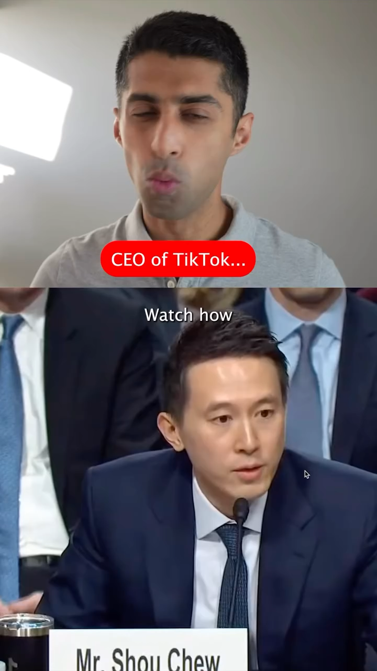
CEOs/spokespeople must be able to manage interviews, handle scrutiny under crisis, even Congressional testimony

Slide 9
Assessing Effectiveness
Hard to track the effects of PR
  Particularly for unpaid placements
  Takes effort to find output of campaign
    Process Evaluation - number of placements, number of articles, number of appearances
    Outcome Evaluation - measure change in audience knowledge, attitudes, and behaviors
    Becoming easier with news and social media monitoring tools, but also means more accountability
  Try to tie change to PR efforts

Slide 10
Content Analysis
Frequency of coverage
Placement within paper
People reached
Messages conveyed
Editing of releases
Attitude conveyed
  Computational Tracking Tools Allow More Flexibility and Depth of Analysis
    Tools like Synthesio and Infegy Atlas

Slide 11
The Press Release
Primary tool used to deliver messages to editors, producers, and reporters
Produced by company, used by press
Must be tailored to medium, written well, and, generally, tight and simple
Print news release, Video news release

Slide 12
Print Press Release
News Values
  Conflict
  Impact
  Novelty
  Distance
  Eminence
  Recency
CINDER - The spark but not the fire

Slide 13
Role of the Reporter
Reporter just needs to write the story
  Have to think about how they will see you press release - what is the peg and hook
  The Peg, this is what makes it news
  The Hook, this is what makes it interesting
  They may decide not to write about you, write something you don’t want, or write something tangential to your goals

Slide 14
Press Release Format
Double Spaced on 8.5” by 11”
Provide name, address, & phone number
Release date, typically no embargoes
Margins should be 1.5”
Length – short paragraphs
Slug lines – “more” / “###” at the bottom
Include a headline and cutlines
Timing – be sensitive to editorial deadlines

Slide 15
Press Release Style
Be fair and try to be objective
Use quotes
AP Style
Inverted pyramid
Do not misspell
Proofread

Slide 16


Slide 17
Media/Press Kits
Structures a successful press conference
Normally in folder form - easy access
Provides important background info
Given before or at press conference
  News release
  Backgrounder
  Biography
  Photographs
  Fact Sheets
  Q & A sheets

Slide 18
Media Kits
Make sure information is accurate and answers most fundamental questions
Sufficient background information to allow editor to select a story angle
Not too commercial. Balance and fair
Confine opinions to credible sources
Have visually arresting graphics

Slide 19
Backgrounder
Provide additional information to complement the shorter news release
Longer and more general
4-5 page backgrounder provides editors with more depth and details
Unlimited latitude for the writer
Subject matter dictates the form
  News Release Style
  Descriptive, narrative style

Slide 20
Biography
Biographical summary of key person/s
Can take many forms
  Straight Biography
  Narrative Biography

Slide 21
Fact Sheet or Q&A
Fact Sheet is a document that compactly profiles an organization
  Company, product lines, top managers, location, sales, leading product, history
Q & A either substitutes for or complements a fact sheet
  Lists the FAQs
  May substitute for a personal interview

Slide 22
Supporting Materials
Photographs
  In real environments, but eye-catching
  Focus on product/issue
  Have an underlying message

Slide 23
Press Conference
Convene media representatives to make a statement/answer questions
Risky PR activity - must be taken seriously
  Will the press show up?
  Will they ask the right questions?
  Do you want to answer them?
  Do you know how to answer?
  How will you react if you are cornered or unable to field the question?

