Slide 1
Public Relations Planning

Slide 2
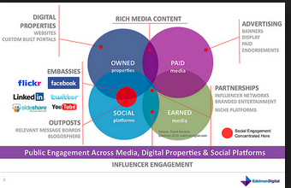
The rise of PR
Industry Forecast: PR and Word of Mouth Spending increasing 12% annually; employment 6% annually
PR can be more effective than advertising in the highly cluttered new media environment with skeptical audiences

Slide 3
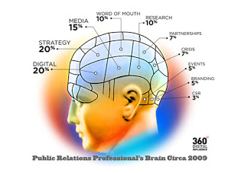
Definitions
PR helps an organization and its publics adapt to each other in mutually beneficial ways
PR seeks to win cooperation of stakeholders
More than “publicity”
Managing reputation as
an organization’s asset

Slide 4
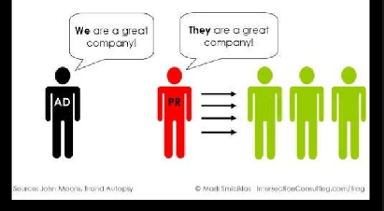
Different from Advertising
Media space not purchased
  Try to persuade gatekeepers to cover story
  Publicity (unpaid) vs. Institutional advertising (paid)
Less control over message content and audience
More credibility; audiences tend to think more objective and credible
Primary focus is to influence
attitudes and engage publics;
Differs from advertising where
attitude change strives to change behavior

Slide 5
Future trends in PR
Greater specialization among PR Pros
Globalization and internationalization
Social media listening and monitoring
Deeper interface with advertising/marketing
Internet/employee communication
Greater intelligence gathering / metrics – data-driven
More contributed content as newsrooms shrink
Relationship marketing with media vs mass pitching of stories
Expanding content creation in podcasts, newsletters, clips
Partnering with influencers for events and activations
Artificial intelligence, machine learning, and LLMs
Hottest areas
  High-tech, Finance, Health Care, Interactive

Slide 6
Online Communications
Allows direct, instantaneous connection between organization and audience
  Press Kits becoming digital
  On-line interviews
  On-line product launches/press conferences
No media gatekeepers
  Development of corporate web sites
  Email and Intranets - can be dangerous
  Owned media gaining importance

Slide 7
Public Relations Planning
Needs to link with Situation Analysis and overall Campaign & Creative Strategies. Based on this, what are your:
  PR objectives
  PR strategies
  PR tactics
  Method of PR Evaluation

Slide 8
PR & “The Big Idea”
In order for your PR messages to breakthrough, you need a “Big Idea”
  It may or may not link to your “Big Idea” in your Brand/Creative Strategy
  Ideally, it would ~ making your program more efficient, effective, and aligned
  Must be complementary, supporting and not contradicting the brand/creative strategy

Slide 9
PR and Publics
Internal and external publics
  Based on organizational boundaries
Primary, secondary and marginal
  Based on influence
Traditional and future
  Based on time
Proponents, opponents and uncommitted
  Based on relationship

Slide 10
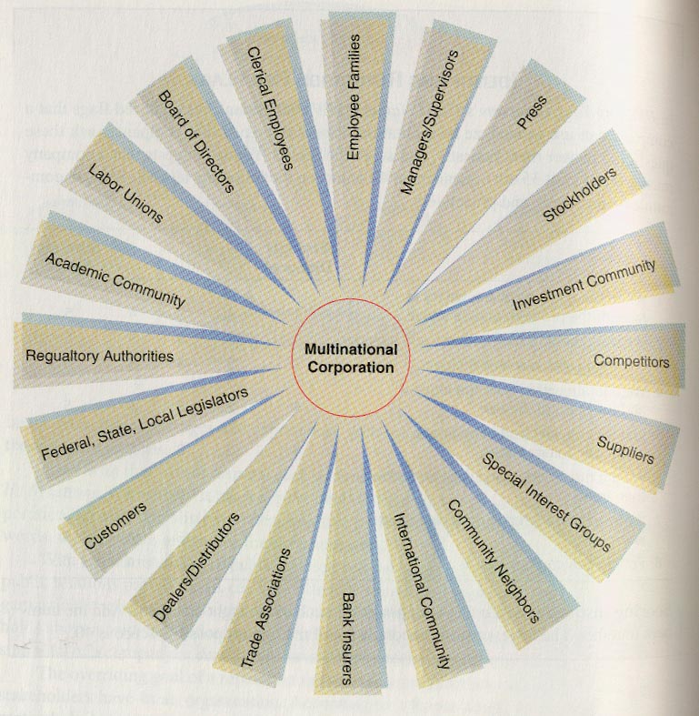
Key Stakeholders

Slide 11
Aspects of PR Planning
Issue Management
  Know opinion on key issues of interest
Image and Reputation Management
  Avoid, manage, and counter poor publicity
Relationship Management
  Communication with key stakeholders
Crisis Management
  Have a plan of action and lead communications
Marketing Public Relations
  Most of what you will propose and publicize

Slide 12
Public Opinion and
Issues Management
Monitor public opinion and news coverage about issues that are central to the organization’s interests
  What publics are important?
  What do these publics think?
  What media are important and how do they cover?
  What is the ongoing social media discourse about us?
Encompass the evolution of the issue in planning
  Potential, emerging issues?
  Obvious possible hurdles?
  Current stage challenges?

Slide 13
How to Do Issue Management
Develop programs to communicate to and with the public about the issues
  Identify issue trends
  Establish company’s (or industry’s) position
  Understand issue evolution and develop a strategy

Slide 14
Corporate Image and Reputation Management
Takes a long time to build; one slip can create a negative public impression
Corporate image is fragile; requires a reputation management program
It is the sum total of a company’s identity efforts and stakeholder images
  It is earned, not created

Slide 15
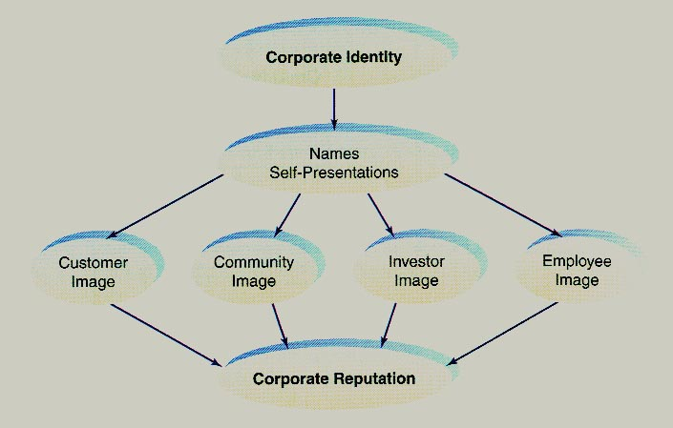
Identity to Reputation

Slide 16
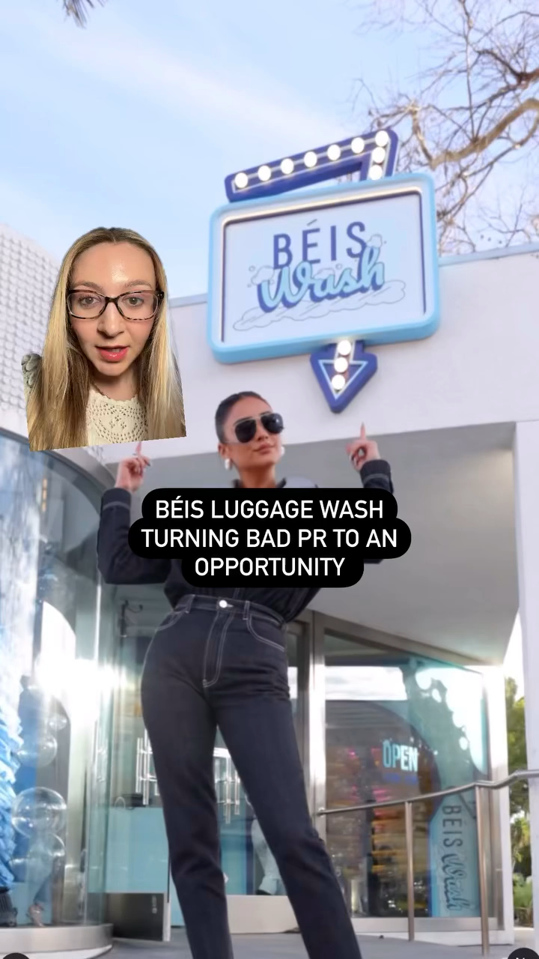
Reputation management requires constant media monitoring
Béis Travel tackles negative online comments with pop up “car wash” for bags
Opportunity to advance new partnerships, inform consumers, and go viral with consumers

Slide 17
Relationship Management
Managing relationship with stakeholders
  Government relations - regulators, legislators, and activists - lobbying
  Employee relations - human resources and employee unions - internal market
  Financial relations - financial markets, financial press, analysts, investors - annual reports
  Media relations - media contacts who cover stories on your category - publicity

Slide 18
Government Relations
Executive and legislature
  Federal Government
  State Government
  Local Government
Lobbying
  Legislative
  Grass-roots
Political Action Committees

Slide 19
Employee Relations
Online Communication
Print Newsletters
Management Publications
Employee Annual Reports
Bulletin Boards
Internal Video
Supervisory communication

Slide 20
Financial Relations
Shareholders
  Annual reports
  Company mailing
Analysts
  Annual reports
  Company visits
  Presentations
Financial Markets
  Business press
  Financial News channels

Slide 21
Crisis Management
Surprise
Insufficient information
Escalating events
Loss of control
Increased outside scrutiny
Siege mentality
Panic

Slide 22
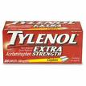
Crisis Management: Tylenol Case
7 people died—poisoned Tylenol in Chicago
Immediately alerted media, health pros, FDA, & public
Recalled Tylenol from entire US (cost $100 million)
Halted production and advertising immediately
Involved Chicago PD & FBI in the search for the killer
  Offered up a $100,000 reward
Reintroduced: triple-sealed tamper resistant package
  Introduced with $2.50-off coupons.

Slide 23
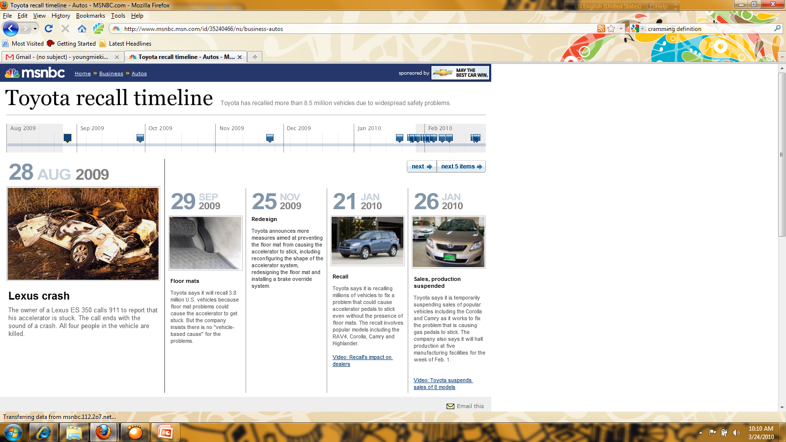
2009–11 Toyota Recall Timeline
http://www.msnbc.msn.com/id/35240466/ns/business-autos

Slide 24
Toyota’s Crisis Mismanagement
Too slow! Always behind
Invisible CEO until one-month after the accident
Pre-commitment to a narrow position, “No defect exists”
Upset important stakeholders—NHTSA, media, dealers
Evasive: withheld information
  Long term: Offered extended warranties and pumped up marketing, leveraging its long-term track record

Slide 25
Recent PR Disasters
Wells Fargo - After $3 billion fine for illegally targeting senior citizens, CEO blamed the bank’s lack of diversity on the “very limited pool of Black talent.”
Tyson Foods - Managers at an Iowa Tyson Foods plant ordered employees to work while they secretly wagered on the number who would contract COVID-19
CrossFit - The founder and CEO of CrossFit, Greg Glassman, resigned after making inflammatory comments online about the death of George Floyd.
Girl Scouts - The non-political, non-partisan organization tweeted about the confirmation of Amy Coney Barrett, a controversial Supreme Court nominee.
Subway - Ireland’s Supreme Court ruled that the rolls sold by the fast-food chain contain so much sugar that they do not legally qualify as bread.
Houston Astros - Following confirmation that the team cheated when winning the World Series, owner Jim Crane gave a press conference deflecting all blame.
Will Smith – And the Chris Rock slap heard around the world….
Kayne West – Antisemitic outburst at concerts and online….
Boeing's Continued 737 Max Issues…

Slide 26
Managing PR Controversies
American Eagle: The Sydney Sweeney "Great Jeans" ad - playful pun or eugenics undertones? Became cultural flashpoint
  Initial response defended campaign intent in the face of negative viral reaction.
  The controversy generated massive news and social media attention: 40 billion impressions.
  Brand highlighted that profits of "Sydney Jean” sales would go to a mental health nonprofit.
  Resulted in product sell-outs and a 20-year high in brand demand + a 26% surge in stock.
  Evolved crisis management? Suggests some brands may be willing to face controversy if they calculate that the publicity will be worth the risk.
Astronomer Inc.: CEO and head of HR involved in a scandal after a Coldplay concert's kiss-cam caught extramarital affair.
  Board of directors issued a public statement and launched a formal investigation; led to resignations of Astronomer's CEO, Andy Byron, and its chief people officer, Kristin Cabot.
  Debunking false information: The company worked to quickly correct misinformation circulating online, including false statements attributed to the former CEO.
  To control the narrative, Astronomer released a satirical video featuring Gwyneth Paltrow (ex of Coldplay frontman, Chris Martin) to build awareness of their product and events

Slide 27
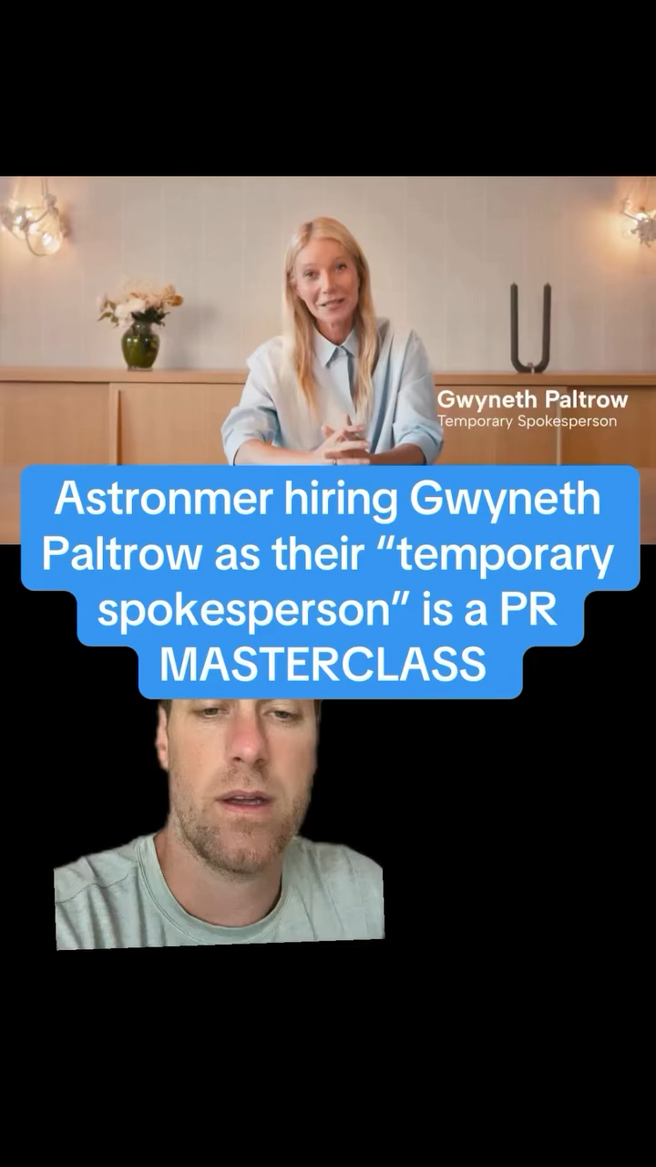

Slide 28
Communicating in a Crisis
Speak first and often
Don’t speculate
Go off the record at your own peril
Stay with the facts; no pre-committed views
Be open, concerned, not defensive
Make your point and repeat it
Don’t go to war with the media
Establish yourself as an authoritative source
Stay calm, be truthful and cooperative
Never lie

Slide 29
Recent PR Successes:
Airbnb: With the war in Ukraine, Airbnb offered temporary housing to 130,000 Ukrainian refugees through the non-profit Airbnb.org and waived guest and host fees to support people booking Airbnbs in Ukraine without traveling there.
CevaVe: "Michael CeraVe" campaign generated over 32 billion earned impressions and 2,000 articles with the bizarre claim that Michael Cera developed the skincare brand.
  Started with staged paparazzi photos of him carrying and sharing the product in NYC. Capped with Superbowl commercial. Born from Reddit threads joking about Cera. The campaign transformed CeraVe into a beauty brand.

Slide 30
Marketing through PR
Product publicity
Product placement
Third-party endorsement
Use of spokespersons
Trade show participation
Cause related marketing
PR advertising

Slide 31
Marketing Public Relations
More overlap with advertising
More consumer and sales focused
Increase brand credibility w/ consumers
  Can involve a combination of advertising, direct mail, merchandizing materials, as well as innovations in public relations
    Product publicity + product placement
    Endorsements + Spokespeople

Slide 32

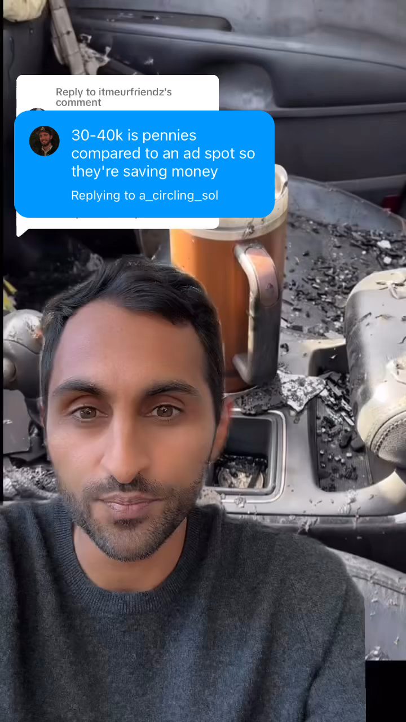

Slide 33
Cause and Mission Marketing
Cause marketing - adopting a cause and sponsoring its fundraising
  Target’s ‘Take Charge of Education”
  Yoplait Yogurt and Breast Cancer
Mission marketing – linking company’s philosophy and values to a cause
  Body Shop - Animals, Environment, Rights
  Ben & Jerry’s – Liberal Political Causes

Slide 34
Nonprofit PR
PR to affect attitudes and behaviors toward some idea or cause
  Political marketing
  Social Cause marketing
  Charitable marketing
  Government marketing
  Private Nonprofit marketing
  Association marketing

