Slide 1
Journalism 566: Opinion and Perception I: Third-person effects

Slide 2
Concerns about the Media
Various categories of media spark concern:
Political Advertising
Pornography
Misogynistic Music/Videos
Violent Television
What else?
What is the nature of the concern?
Notes:
Video games. Stock panic, COVID, Misinformation
Negative social desirability, negative impact on others

Slide 3
Basic Third Person Concepts
The Third Person Perceptions (TPP or 3PP)
“Others more affected by media messages than I am”
A gap in perceptions between self and others
Originally defined as Third person effect by Davison
The Third Person Effect (TPE or 3PE)
Cognitive and behavioral consequences of the TPP
E.g., willingness to accept media censorship
E.g., willingness to engage in “corrective action”
First observed by Gunther (1995) and Rojas et al. (1996)

Slide 4
Theoretical Underpinnings
Why do we see others as being more affected by media messages than ourselves? (McLeod et al., 2017)
Negative bias
Ego-enhancing motivational bias
“I am less affected by negative media messages”
“I am not as easy to manipulate as others”
Pluralistic ignorance
a general unawareness of what others really think and feel
Social identity approach
Us vs. them, the outgroup is more affected
Social distance corollary
The more dissimilar the others are, the more they are affected
Notes:
Inconsistent effect of 1pp
Pluralistic ignorance, fundamental attribution error, bias blind spot

Slide 5
Nature of Media Perceptions
Perceive others will be more affected by negative media content than will oneself:
Powerful Media: People tend to believe that media are persuasive and effects are common
“Hypodermic needle effect” for others
Persuasive press inference
Personal Immunity: People also tend to feel immune to these effects
“Limited effects” for self
Notes:
Media effects schema matters , that is
How we think about and perceive media matters
Overestimation of the media effect, and underestimation of effect on self.

Slide 6
Past Research on TPP
Perloff reports that 15/16 studies reviewed found support for TPP for range of negative content:
TV violence (Innes and Zeitz, 1988)
Pornography (Gunther, 1995)
Libelous news stories (Cohen et al., 1988; Gunther, 1991)
Product advertisements (Thorson & Coyle, 1994; Shah et al. 1999)
Negative political ads (Cohen & Davis, 1991)
Holocaust-denial advertisements (Price et al., 1998)
Media images of slimness (David & Johnson, 1998)
Several other forms of potentially harmful media content

Slide 7
Past Research on TPP and TPE
The Third Person Effect (TPE)
Most common effect: desire for censorship
Also on efforts to engage in “corrective action”
Posting comments online to respond
Results supporting the TPP:
Gunther (1995): greater TPP associated with greater support for restrictions on pornography
Rojas et al. (1996): TPE associated with desire to censor TV violence, pornography and general media content
Notes:
Fact checking

Slide 8
Antecedents and Consequences
Study 1: McLeod et al. (1997) “Support for censorship of violent and misogynic rap lyrics: An analysis of the third-person effect” Comm Research
Study 2: McLeod et al. (2001) “Behind the Third-person Effect: Differentiating Perceptual Processes for Self and Other” Journal of Comm.
Research Questions:
TPP occur for violent and misogynistic music?
Is there a connection between TPP and TPE?
Who is seen as most affected by negative influence?
What explains who perceives others as more affected?

Slide 9
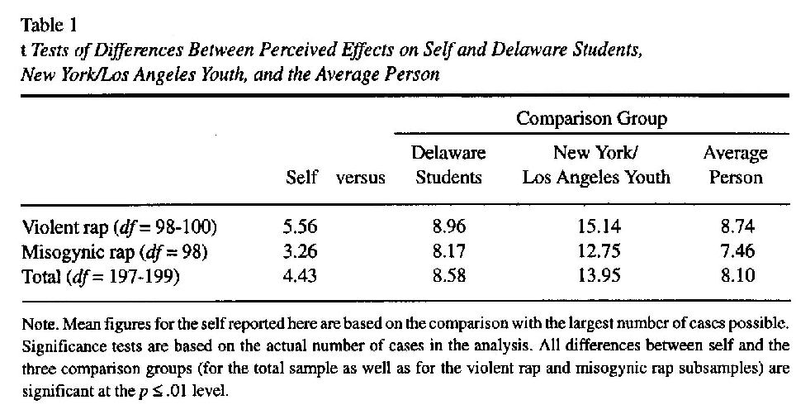
Study 1: Results for TPP
Notes:
202 Participants in 2 anti-social conditions
Measures:
Third-person differentials (self vs. others)
Three 3pp comparison groups (in order of increasing social distance):
Other Delaware students
People your age in cities like New York and Los Angeles
The average person
Support for censorship scale

Slide 10
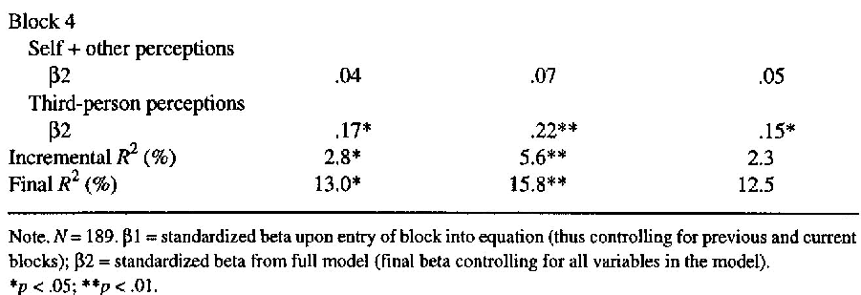
Study 1: Results for TPE
TPP predicts support for censorship (TPE)
TPP predicts support for censorship
TPP differential is the better predictor than the overall perceived negative effects
Notes:
Other explanations?
Exposure
Groups
Race
Age
The differential is calculated as Effects on others – effects on us

Slide 11
Antecedents of TPP
Past research suggest several potential predictors of perceived effects:
Perceived exposure to content
Perceived common sense of content target
Paternalism (“I know what’s best”)
Perceived anti-social nature of content
Notes:
Participants:
359 students (read sample lyrics and answer survey)
Content referents (combined for the analysis):
1. Violent anti-social rap
2. Misogynic anti-social rap
3. Violent anti-social death metal
4. Misogynic anti-social death metal
Data analysis:
Separate path analyses for self and other

Slide 12
Study 2: Self and Other Perceptions
Significant predictors for self:
Common sense (reduces perceived effects)
Anti-social lyrics (reduces perceived effects)
Conditional effects model for self
Internal factors mediate effects
Significant predictors for others:
Perceived exposure (increases perceived effects)
Paternalism (increases perceived effects)
Direct effects model for others
Internal factors do not mediated effects
Notes:
FAE

Slide 13
Consequences of TPE
Censorship and other content restrictions
Political behaviors
Willingness to speak out
Voting
Self-protective behaviors
Preventative behaviors against infectious diseases
Body image behaviors
Weight losing
Online cosmetic surgery ads
Notes:
Respondents who reported strong effects on self and others were more likely to engage in weight-loss efforts, while those who exhibited the largest 3PPs were less likely to do so.
Lim found that negative view of online cosmetic ads and TPP predicts support for regulation and corrective actions (ie. Filing a complaint, leave a comment warning others, share negative experience, sharing articles addressing the problem, talk to friends about this problem).

Slide 14
The state of TPP & TPE
New development:
Anti-smoking ads (David, Liu, & Myser, 2004)
Manipulative marketing techniques (Jung & Jo, 2013; Xie & Johnson, 2015)
Journalistic of ethics (Lee & Coleman, 2020)
Advertising’s negative effects on body image (Chia, 2007, 2009)
Infectious disease news and vaccination (Wei, Lo, and Lu, 2008)
Fake news and regulation (Jang & Kim, 2018; Yang & Tian, 2021)
Social media content moderation (Riedl, Whipple, and Wallace, 2021; Guo & Johnson, 2020)
Sharing fact-checking messages (Koo et al., 2021)
Climate change denial (Dalstrom & Rosenthal, 2018)
…
Notes:
By 2015 there are 200 papers on web of science
journalists believe that their colleagues in the same organization act unethically significantly less often and act ethically significantly more often than those at other organizations and in related industries.
Hypotheses supported in different topics and cultural context:
US, Korea, Germany, Taiwan, China, Spain and Singapore,
A robust and a fairly generalizable line of research.

Slide 15
Big Questions About TPP & TPE
Where do the perceptions come from?
Is the judgment of effect on self based on an assumption about “dosage” or “potency”?
Ex. I am not affected because I do not see it
Is the judgment of effect of other based on an estimate of a small effect on many people or a large effect on a few
Ex. Porn may make sociopaths dangerous

Slide 16
Big Questions About TPP & TPE
The nature of middle-range theory
Agnostic to structural changes in media ecology
From perceptions to behaviors
Measurement: beyond self-report data
The spin-off theory: Influence of the presumed influence
Presumed effect on others (not the gap) -> behaviors
Persuaded by our perceptions of others
Notes:
A middle-range theory (cf. grand theories: Marxism, Feminism)
Good for linking empirical observations with theory
Defined theoretical intention and extension
Testable claims
Largely agnostic about larger structure and the norms
What about social media, polarized political communication structure
Persuasive press inference in social media
A niche web-celebrities w/ 100K follower = TV program with 100K viewership?
Perceptions and our lived experiences
Presumed influence other drives behavior
Not the gap
Social perception in the digital environment
Causal relationships
Which is first: self exposure or other exposure
Does it matter?

Slide 17
Shift in Perspective
Agenda setting, Framing, Priming, Cultivation, and Ads all have direct effects.
Media content shapes opinion
Ex. Frame of message shapes issue interpretation
Third-person effects driven by perceptions of effects on self and others
Media content spurs perceptions
Ex. Perception of influences shapes censorship

Slide 18
Theories of Media Effects
What theory best explains the relationship between media content and your opinion trend?
What type of media content (ads, news, TV programs, popular music, etc.) affect your trend?
Are there competing frameworks that explain the link between media content and your trend?
Based on the framework(s), what predictions can you make about the relationship between specific media content and your opinion trend?

