Slide 1
Journalism 614:
Campaigning and
Political Advertising

Slide 2
Campaigning and Public Opinion
Communication campaigns
  Market products and services
  Shape image of brands and companies
  Shape culture and alter social landscape
  Promote positive health/social practices
  Promote political issues and candidates

Slide 3
Communication Campaigns
Campaigns try to…
…generate specific outcomes or effects
…in a relative large number of people
…usually within a specified time period
…through an organized/integrated set of communication activities and procedures

Slide 4

Great Ad Campaigns

Slide 5
Communication Strategies/Tactics
Identify potential audiences
Learn their attitudes, lifestyles, & behaviors
Target audiences through segmentation
Test potential themes and messages
Generate positioning and messaging scheme
  Careful process reflects high costs

Slide 6

Dove “Campaign for Real Beauty”

Slide 7
Campaign Planning
Applying models of persuasion and public opinion in the design of the campaign
Taking into account audiences existing cognitions, attitudes, motives, and behaviors
Understanding targets communication channels, usage patterns, and media reliance
Maintaining loyalty while broadening consumer base into new markets
Creating new social norms and habits

Slide 8
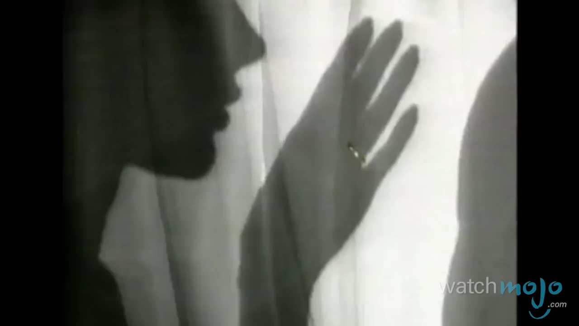
De Beer’s “A Diamond Is Forever”

Slide 9
Campaign Execution
Establishing clear and realistic campaign goals that direct and unify your efforts
Deliver high quality materials through a orchestrated dissemination strategy
Using mass media and interpersonal communication is a coordinated fashion
Employing social media as an amplifier or for buzz through networked connections

Slide 10

Word of Mouth and Buzz Building

Slide 11
Political Advertising
Key means of communication with public
Advertising spending accounts for majority of campaign budgets, especially for presidency
  Nearly $1 billion for presidency in 2012
    10 Billion across all political races for marketing
  10% spent in last week - ad blitz
  Concentrated on 1/3 of population
    battleground states, battleground markets

Slide 12
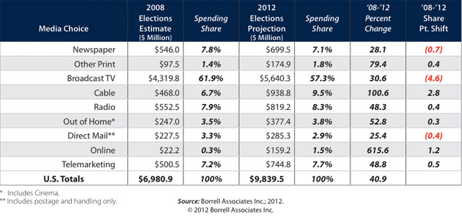
And Spending Explodes…

Slide 13
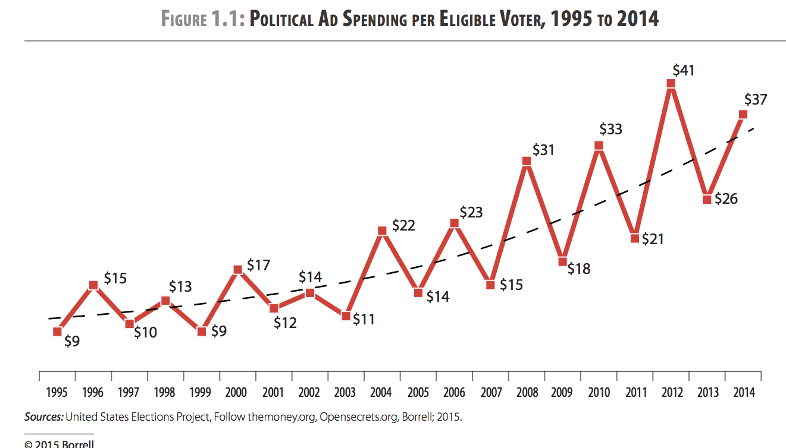
Cost Per Voter

Slide 14
Advertising Effects
Ads have effects
  Drive news reporting
    739 airings of Swift Boat Ads in three states drove coverage
    Ads also dictate the issue agenda
  Influence voters’ attitudes
    Shape perceptions of candidates
    Provide information about positions

Slide 15
Highly Controversial
Question quality and accuracy of info
  Mudslinging and misrepresentations
Fear about impact on citizens
  Fosters cynicism and demobilization
Distort opinions and alter elections
  Switching vote based on ad claims

Slide 16
Lessons from Modern Campaigning
Candidates don’t dictate the news discourse
  Though gatekeepers sometimes let them
Campaigns do control websites, broadcast ads, direct (mailers, telephone calls, etc.), and social media.
  Can amplify inaccuracies and distortions
Elections are won locally - electoral college
  Swing states, specific regions, local precincts
Play good cop, bad cop - makes attacks worse
  PACs, 527s, and stealth campaigning

Slide 17
Advice to Journalists
Follow the money to the source of ads
  What is the history and agenda of groups
Expose stealth campaigns
  Explore connections with candidates
Recognize Internet represents best and worst of modern campaigning
Do not allow candidates to dictate the terms or to dominate the coverage cycles
  As Trump did in 2016….

Slide 18
Dominate the News Cycle
Dominated the news agenda, with constant cycle of stories so that subsequent coverage includes his views
  Trump got $2.8 billion in primary coverage; Clinton $1.1 billion; Cruz $770 million, making up for ad spending difference – “Trump sucked the oxygen out of the room”
  Differences set before Super Tuesday, with Trump way up; click-bait candidate, who drove up news consumption

Slide 19
Trump dominated coverage all but one week of the primary
  Even when Democratic contest remained contested

Slide 20
And Trump’s coverage was less negative than key opponents
  Clinton’s coverage even more negative. Only Sanders is positive

Slide 21
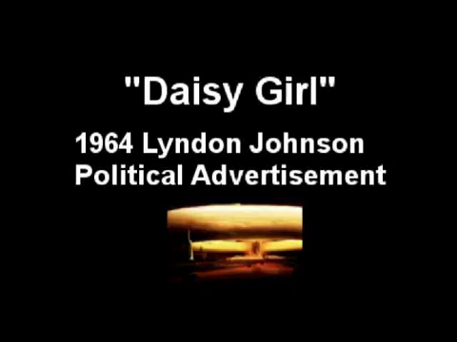

Negative Advertising
Not a new occurrence – since the 50s
  Eisenhower attacks Democrats
  Johnson’s “Daisy Girl” against Goldwater
Important part of recent election bids
  Beginning in 1980, PACs used ads to support certain candidates as an “independent expenditure”
  Willie Horton Ad – PAC against Dukakis

Slide 22

Negative Ads
Focus on criticisms of the opponent, fault character, accomplishments, or issue positions – AKA “attack advertising” – example, “LAZY”
Still, negative ads are a minority
  Most are contrast ads or positive ads

Slide 23


Types of Positive Ads
Positive Ads – focus on good characteristics, accomplishments, or issue positions of sponsor
  Morning in American
    Reagan
  Boy from Hope
    Clinton
Image Oriented – focus on character and personal traits
Issue Oriented – focus on the issue/policy positions

Slide 24
Political Ad Effects
The Negativity Effect
The Demobilizing Effect
The Backlash Effect

Slide 25
“Negativity Effect”
Voters learn issue information from ads
  Some find it rivals the effects of news, especially among light news viewers
Negative Ads are more easily recalled
  Greater effect on impression formation
  Greater effect on vote choice
Issue attacks do more than image attacks
  Responses to attacks have mixed effects – hurt both the sponsoring candidate and opponent
Use of news media reduces negativity effect

Slide 26
“Demobilizing Effect”
Initial findings argue that negative ads produced cynicism
  Reduces motivation to vote, lowers turnout 5%
Others find that demobilized independents balanced by increased voting among party loyalists - net positive
  Strengthen ties to political parties
Goldstein’s research finds negative ads are mobilizing
  Much better ad exposure measurement - WiscAds
Other scholars find difference between useful issue attacks vs. harsh mudslinging and other attacks
  Legitimate criticism actually increases turnout

Slide 27
“Backlash Effect”
Negative ads increase support for the attacked and decrease support for sponsor
Voters recoil against the negative tactics
  Particularly true of supporters of attacked candidate
May actually strengthen their resolve to vote
Overall effect of political advertising may be to increase turnout and participation

Slide 28
Normative Questions
Targeting of most likely voting segments leads to pandering by politicians?
Attention to “best prospects” for funds distorts democratic representation?
Excessive politicking leads to voter cynicism and withdrawal from public life?

