Slide 1
Journalism 614: Cultivation Theory

Slide 2

The ‘core’ of cultivation
Level of
television
viewing
Beliefs
about the
world

Slide 3

Cultivation in brief

Slide 4
The television world
A symbolic environment
TV is main storytelling system
Consistent system of messages
Or our consumption patterns are consistent
Presents a distorted vision of reality
Changes perceptions of the world we share
Socialization process
Happens gradually, growing slowly

Slide 5

Cultivation

Slide 6
Two parts
Message system analysis:
What is this TV world telling us?
Cultivation analysis:
Do those who watch more TV perceive reality to be like the TV world?
“Those who spend more time ‘living’ in the world of television are more likely to see the ‘real world’ in terms of the images, values, portrayals, and ideologies that merge through the lens of the television.” (Gerbner et al.)

Slide 7
Measuring concepts
Television viewing:
How many hours during the average week do you watch television?
The average American watches more than 4 hours of TV each day (or 28 hours/week, or 2 months of nonstop TV-watching per year). In a 65-year life, that person will have spent 9 years watching television content
“Light” viewers watch couple hours a day

Slide 8
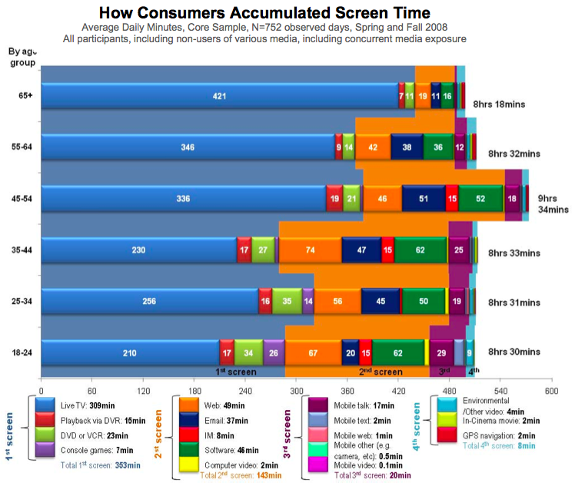

Slide 9
Measuring Outcomes
Beliefs about world:
Estimates of frequencies or distributions of events, occupations, other ‘hard facts’
Endorse certain social attitudes (i.e., social trust; dangerous world)

Slide 10
Does it happen?
Some studies find relationship between TV viewing and perceiving reality to be like the TV world is real but small
Strength of this relationship is claimed to be about 0.1 on a 0 to 1 scale.

Slide 11
Findings
Crime likelihood
‘Mean world’ perceptions
Occupation tendencies
Gender roles portrayals

Slide 12

Cultivating Racial Stereotypes?

Slide 13

Cultivating Gender Stereotypes?

Slide 14
Mainstreaming
Diverse groups become more similar at high levels of television use
Democrats
Liberalism
Republicans
Low TV
High TV

Slide 15

Violence in Video Games

Slide 16
Resonance
Cultivation effects greater for certain groups
Chicago
Fear of crime
Madison
Low TV
High TV

Slide 17
Flaws in cultivation theory
Is there really a link?
Does TV viewing really cause beliefs?
Effect sizes: big enough to matter?
A defense: Few people watch no TV, and even those few are indirectly influenced, so finding any effects at all is impressive

Slide 18
Flaws in cultivation theory
Shouldn’t we take content into account?
Are television messages uniform?
Cartoon violence not the same as realistic violence
Is TV viewing non-selective?
Different motivations lead to use of different genre
People construct meaning differently
Depends on their experiences and existing cognitions
Conceptual and operational flaws
Cultivation claim: The overall pattern of TV world is what’s important, not particular shows

Slide 19
How does it “work”?
Cultivation scholars slow to specify psychological mechanisms
Shrum (1995) found that heavy TV viewers give faster responses to cultivation-type questions
Heavy viewers had these answers “at the top of the head”
More accessible answers were available to heavy viewers as shortcuts to use in answering the question

Slide 20
Shrum’s Explanation
TV makes some ideas more accessible
Accessible ideas are given as survey responses
People don’t discount the ideas they got from TV
Cultivation is less likely to happen when people are motivated and able to process the information on TV

Slide 21
The bottom line
Despite Shrum’s work, cultivation still requires theoretical, methodological and conceptual refinement and empirical confirmation
How would you try to confirm or reject the Cultivation Hypothesis?
How might it explain changes in consumer sentiment? Perceptions of consumer norms? Trends in fashion and music?

